Slide 1
SQL III
The Query Language
R & G - Chapter 5
Based on Slides from UC Berkeley and
book.

Slide 2
NULL Values: Truth table
p | q | p OR q | p AND q | p = q
TRUE | TRUE | TRUE | TRUE | TRUE
TRUE | FALSE | TRUE | FALSE | FALSE
TRUE | Unknown | TRUE | Unknown | Unknown
FALSE | TRUE | TRUE | FALSE | FALSE
FALSE | FALSE | FALSE | FALSE | TRUE
FALSE | Unknown | Unknown | FALSE | Unknown
Unknown | TRUE | TRUE | Unknown | Unknown
Unknown | FALSE | Unknown | FALSE | Unknown
Unknown | Unknown | Unknown | Unknown | Unknown
Notes:
https://en.wikipedia.org/wiki/Null_(SQL)

Slide 3
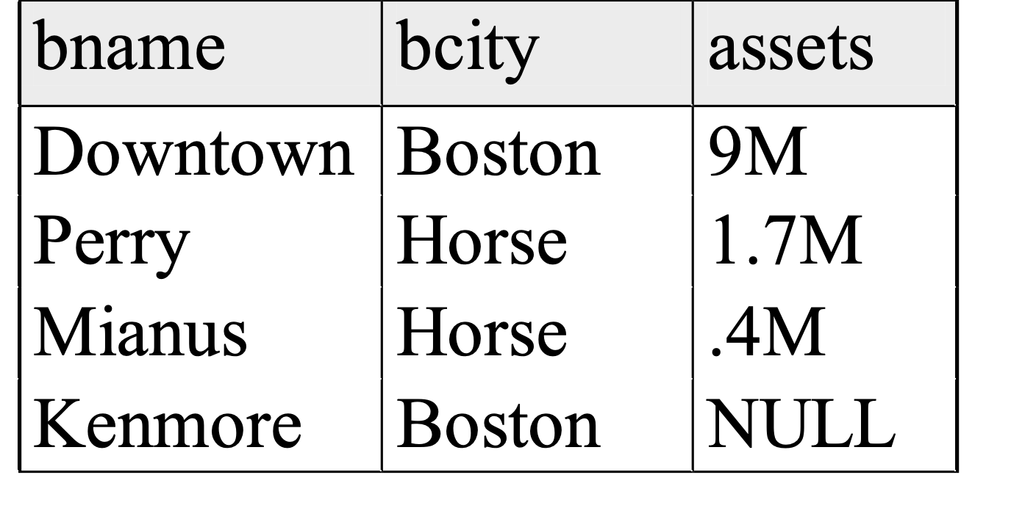
NULLs
Given:
branch2=
Aggregate operations:
SELECT SUM(assets)
FROM branch2
returns
SUM
--------
11.1M
NULL is ignored
Same for AVG, MIN, MAX
But.... COUNT(assets) retunrs 4! in some systems!!
MySQL IGNORES NULLS
Let branch3 an empty relation
Then: SELECT SUM(assets)
FROM branch3 returns NULL
but COUNT(<empty rel>) = 0

Slide 4
Joins
SELECT (column_list)
FROM table_name
[INNER | NATURAL | {LEFT | RIGHT | FULL} | {OUTER}] JOIN table_name
ON qualification_list
WHERE …
INNER is default
SELECT sname FROM sailors S JOIN reserves R ON S.sid=R.sid;
SELECT sname FROM sailors S NATURAL JOIN reserves R
WHERE R.bid = 102;

Slide 5
Inner Joins
SELECT s.sid, s.sname, r.bid
FROM Sailors s, Reserves r
WHERE s.sid = r.sid
SELECT s.sid, s.sname, r.bid
FROM Sailors s INNER JOIN Reserves r
ON s.sid = r.sid
Both are equivalent!

Slide 6
Left Outer Join
Returns all matched rows, plus all unmatched rows from the table on the left of the join clause
(use nulls in fields of non-matching tuples)
SELECT s.sid, s.sname, r.bid
FROM Sailors s LEFT OUTER JOIN
Reserves r
ON s.sid = r.sid;
Returns all sailors & bid for boat in any of their reservations
Note: no match for s.sid? r.sid is NULL!

Slide 7
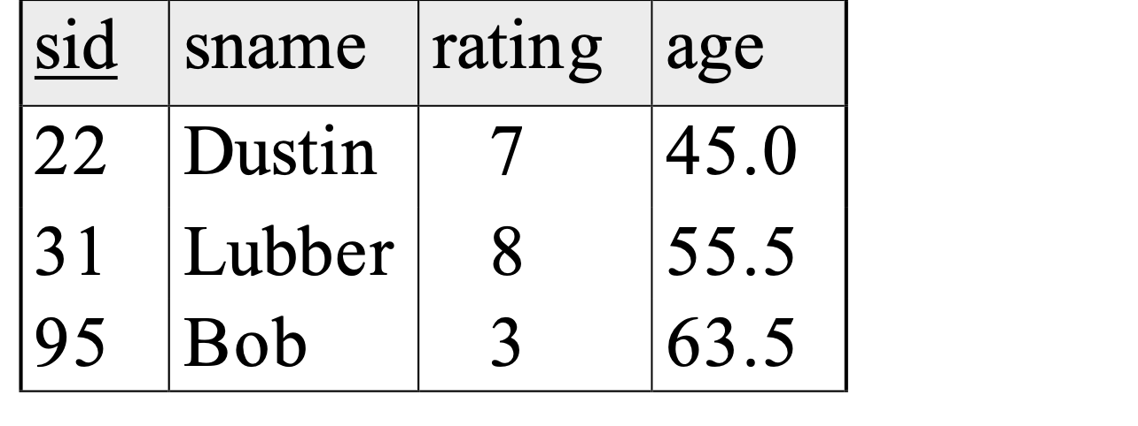
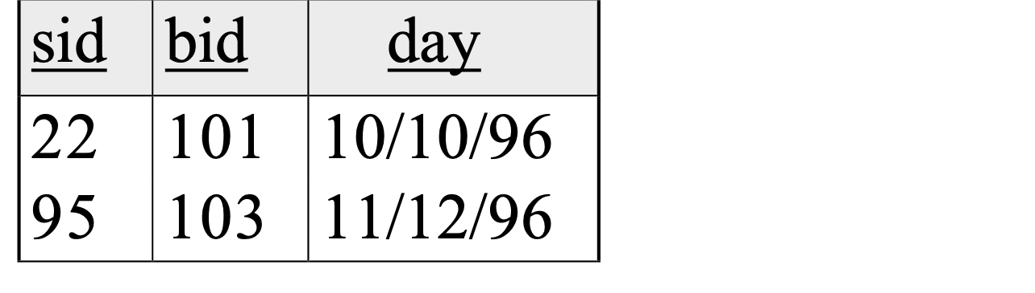
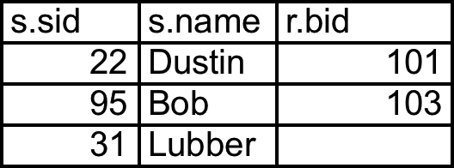
SELECT s.sid, s.sname, r.bid FROM Sailors s LEFT OUTER JOIN Reserves r ON s.sid = r.sid;
NULL

Slide 8
Right Outer Join
Returns all matched rows, plus all unmatched rows from the table on the right of the join clause
(use nulls in fields of non-matching tuples)
SELECT s.sid, b.bid, b.bname
FROM Reserves r RIGHT OUTER JOIN Boats b
ON r.bid = b.bid;
Returns all boats & information on which ones are reserved
Note: no match for b.bid? r.bid IS NULL!

Slide 9
Full Outer Join
Full Outer Join returns all (matched or unmatched) rows from the tables on both sides of the join clause
SELECT r.sid, b.bid, b.bname
FROM Reserves2 r FULL OUTER JOIN
Boats2 b
ON r.bid = b.bid;
Returns all boats & all information on reservations
No match for r.bid?
b.bid IS NULL AND b.bname is NULL
No match for b.bid?
r.sid is NULL

Slide 10
Constraints (revisited)

Slide 11
Constraints Over Multiple Relations
CREATE TABLE Sailors
( sid INTEGER,
sname CHAR(10),
rating INTEGER,
age REAL,
PRIMARY KEY (sid),
CHECK
( (SELECT COUNT (s.sid) FROM Sailors s)
+
(SELECT COUNT (b.bid) FROM Boats b)
< 100 ))
Number of boats
plus number of
sailors is < 100

Slide 12
Constraints Over Multiple Relations
Number of boats
plus number of
sailors is < 100
CREATE TABLE Sailors
( sid INTEGER,
sname CHAR(10),
rating INTEGER,
age REAL,
PRIMARY KEY (sid),
)
Awkward and wrong!
Only checks sailors!
ASSERTION is the right solution; not associated with either table.
Unfortunately, not supported in many DBMS.
Triggers are another solution.
CREATE ASSERTION smallClub
CHECK
( (SELECT COUNT (S.sid) FROM Sailors S)
+
(SELECT COUNT (B.bid) FROM Boats B)
< 100 )

Slide 13
Another simple constraint
Boat with bid 104 should be reserved by sailors with rating larger than 8.
CREATE ASSERTION HighRating
CHECK ( NOT EXISTS( SELECT *
FROM Sailors S NATURAL JOIN Reserve R
WHERE S.rating <= 8 AND R.bid = 104) )

Slide 14
Views
Views

Slide 15
Views: Named Queries
CREATE VIEW view_name AS select_statement
Makes development simpler
Often used for security
Not “materialized”
CREATE VIEW Redcount
AS SELECT b.bid, COUNT(*) AS scount FROM Boats b, Reserves2 r WHERE r.bid = b.bid AND b.color = 'red'
GROUP BY b.bid
Notes:
begin transaction;
create temp table TempTableFoo AS
SELECT b.bid, COUNT(*) AS scount FROM Boats2 b, Reserves2 r WHERE r.bid = b.bid AND b.color = 'red'
GROUP BY b.bid;
create table TempTableFoo as select * from Redcount;
delete from reserves2 where bid = 101;
select * from Redcount;
select * from TempTableFoo;
abort;

Slide 16
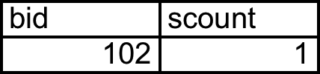
Views Instead of Relations in Queries
CREATE VIEW Redcount
AS SELECT b.bid, COUNT(*) AS scount FROM Boats b, Reserves2 r WHERE r.bid = b.bid AND b.color = 'red'
GROUP BY b.bid
Redcount
SELECT bname, scount
FROM Redcount r, Boats2 b WHERE r.bid = b.bid AND scount < 10

Slide 17
Views
create view vs INTO
(1) SELECT bname, bcity
FROM branch
INTO branch2
(2) CREATE VIEW branch2 AS
SELECT bname, bcity
FROM branch
vs
(1) creates new table that gets stored on disk
(2) creates “virtual table” (materialized when needed)
Therefore: changes in branch are seen in the view version of branch2 (2)
but not for the (1) case.

Slide 18
Subqueries in FROM
Like a “view create on the fly”
SELECT bname, scount
FROM Boats2 b,
(SELECT b.bid, COUNT(*)
FROM Boats b, Reserves2 r
WHERE r.bid=b.bid AND b.color='red'
GROUP BY b.bid) AS Reds(bid, scount)
WHERE Reds.bid=b.bid AND scount < 10

Slide 19
Common Table Expressions: WITH
Another “view creation on the fly” syntax
WITH Reds(bid, scount) AS
(SELECT b.bid, COUNT(*)
FROM Boats b, Reserves2 r
WHERE r.bid=b.bid AND b.color='red'
GROUP BY b.bid)
SELECT bname, scount
FROM Boads2 b, Reds
WHERE Reds.bid=b.bid AND scount < 10

Slide 20
Find the rating for which the average age of sailors
is the minimum over all ratings :
SELECT Temp.rating, Temp.avgage
FROM (SELECT S.rating, AVG(S.age) AS avgage,
FROM Sailors S
GROUP BY S.rating) AS Temp
WHERE Temp.avgage = (SELECT MIN(Temp.avgage)
FROM Temp)

Slide 21
SQL: Modification Commands
Deletion:
DELETE FROM <relation>
[WHERE <predicate>]
Example:
1. DELETE FROM account
-- deletes all tuples in account
2. DELETE FROM account
WHERE bname IN (SELECT bname
FROM branch
WHERE bcity = ‘Bkln’)
-- deletes all accounts from Brooklyn branch

Slide 22
SQL: Modification Commands
View Updates:
Suppose we have a view:
CREATE VIEW branch-loan AS
SELECT bname, lno
FROM loan
And we insert: INSERT INTO branch-loan VALUES( “Perry”, L-308)
Then, the system will insert a new tuple ( “Perry”, L-308, NULL) into loan

Slide 23
SQL: Modification Commands
What about...
CREATE VIEW depos-account AS
SELECT cname, bname, balance
FROM depositor as d, account as a
WHERE d.acct_no = a.acct_no
INSERT INTO depos-account VALUES( “Smith”, “Perry”, 500)
How many relations we need to update?
Many systems disallow

Slide 24
Discretionary Access Control
GRANT privileges ON object TO users
[WITH GRANT OPTION]
Object can be a Database, Table or a View
Privileges can be:
Select
Insert
Delete
References (cols) – allow to create a foreign key that references the specified column(s)
All
Can later be REVOKED
Users can be single users or groups
See R&G Chapter 17 for more details.

Slide 25
Embedded
SQL
Embedded SQL

Slide 26
Writing Applications with SQL
SQL is not a general purpose programming language.
+ Tailored for data retrieval and manipulation
+ Relatively easy to optimize and parallelize
Awkward to write entire apps in SQL
Options:
Make the query language “Turing complete”
Avoids the “impedance mismatch”
makes “simple” relational language complex
Allow SQL to be embedded in regular programming languages.

Slide 27
Cursors
Can declare a cursor on a relation or query
Can open a cursor
Can repeatedly fetch a tuple (moving the cursor)
Special return value when all tuples have been retrieved.
ORDER BY allows control over the order tuples are returned.
Fields in ORDER BY clause must also appear in SELECT clause.
LIMIT controls the number of rows returned (good fit w/ORDER BY)
Can also modify/delete tuple pointed to by a cursor
A “non-relational” way to get a handle to a particular tuple

Slide 28
Database APIs
A library with database calls (API)
special objects/methods
passes SQL strings from language, presents result sets in a language-friendly way
ODBC a C/C++ standard started on Windows
JDBC a Java equivalent
Most scripting languages have similar things
E.g. in Python there’s the “psycopg2” driver
ODBC/JDBC try to be DBMS-neutral
at least try to hide distinctions across different DBMSs

Slide 29
Summary
Relational model has well-defined query semantics
SQL provides functionality close to basic relational model
(some differences in duplicate handling, null values, set operators, …)
Typically, many ways to write a query
DBMS figures out a fast way to execute a query, regardless of how it is written.

Slide 30
Triggers (Active database)
Trigger: A procedure that starts automatically if specified changes occur to the DBMS
Analog to a "daemon" that monitors a database for certain events to occur
Three parts:
Event (activates the trigger)
Condition (tests whether the triggers should run) [Optional]
Action (what happens if the trigger runs)
Semantics:
When event occurs, and condition is satisfied, the action is performed.

Slide 31
Triggers – Event,Condition,Action
Events could be :
BEFORE|AFTER INSERT|UPDATE|DELETE ON <tableName>
e.g.: BEFORE INSERT ON Professor
Condition is SQL expression or even an SQL query (query with non-empty result means TRUE)
Action can be many different choices :
SQL statements , body of PSM, and even DDL and transaction-oriented statements like “commit”.

Slide 32
Example Trigger
Assume our DB has a relation schema :
Professor (pNum, pName, salary)
We want to write a trigger that :
Ensures that any new professor inserted has salary >= 60000

Slide 33
Example Trigger
CREATE TRIGGER minSalary BEFORE INSERT ON Professor
for what context ?
BEGIN
check for violation here ?
END;

Slide 34
Example Trigger
CREATE TRIGGER minSalary BEFORE INSERT ON Professor
FOR EACH ROW
BEGIN
Violation of Minimum Professor Salary?
END;

Slide 35
Example Trigger
CREATE TRIGGER minSalary BEFORE INSERT ON Professor
FOR EACH ROW
BEGIN
IF (:new.salary < 60000)
THEN RAISE_APPLICATION_ERROR (-20004, ‘Violation of Minimum Professor Salary’);
END IF;
END;

Slide 36
Example trigger
CREATE TRIGGER minSalary BEFORE INSERT ON Professor FOR EACH ROW
DECLARE temp int; -- dummy variable not needed
BEGIN
IF (:new.salary < 60000)
THEN RAISE_APPLICATION_ERROR (-20004, ‘Violation of Minimum Professor Salary’);
END IF;
temp := 10; -- to illustrate declared variables
END;
.
run;

Slide 37
Details of Trigger Example
BEFORE INSERT ON Professor
This trigger is checked before the tuple is inserted
FOR EACH ROW
specifies that trigger is performed for each row inserted
:new
refers to the new tuple inserted
If (:new.salary < 60000)
then an application error is raised and hence the row is not inserted; otherwise the row is inserted.
Use error code: -20004;
this is in the valid range

Slide 38
Example Trigger Using Condition
CREATE TRIGGER minSalary BEFORE INSERT ON Professor
FOR EACH ROW
WHEN (new.salary < 60000)
BEGIN
RAISE_APPLICATION_ERROR (-20004, ‘Violation of Minimum Professor Salary’);
END;
.
run;
Conditions can refer to old/new values of tuples modified by the statement activating the trigger.

Slide 39
Triggers: REFERENCING
CREATE TRIGGER minSalary BEFORE INSERT ON Professor
REFERENCING NEW as newTuple
FOR EACH ROW
WHEN (newTuple.salary < 60000)
BEGIN
RAISE_APPLICATION_ERROR (-20004, ‘Violation of Minimum Professor Salary’);
END;
.
run;

Slide 40
Example Trigger
CREATE TRIGGER minSalary
BEFORE UPDATE ON Professor
REFERENCING OLD AS oldTuple NEW as newTuple
FOR EACH ROW
WHEN (newTuple.salary < oldTuple.salary)
BEGIN
RAISE_APPLICATION_ERROR (-20004, ‘Salary Decreasing !!’);
END;
.
run;
Ensure that salary does not decrease

Slide 41
Another Trigger Example (SQL:99)
CREATE TRIGGER youngSailorUpdate
AFTER INSERT ON SAILORS
REFERENCING NEW TABLE AS NewSailors
FOR EACH STATEMENT
INSERT
INTO YoungSailors(sid, name, age, rating)
SELECT sid, name, age, rating
FROM NewSailors N
WHERE N.age <= 18

Slide 42
Row vs Statement Level Trigger
Row level: activated once per modified tuple
Statement level: activate once per SQL statement
Row level triggers can access new data, statement level triggers cannot always do that (depends on DBMS).
Statement level triggers will be more efficient if we do not need to make row-specific decisions

Slide 43
When to use BEFORE/AFTER
Based on efficiency considerations or semantics.
Suppose we perform statement-level after insert, then all the rows are inserted first, then if the condition fails, and all the inserted rows must be “rolled back”
Not very efficient !!

Slide 44
Combining multiple events into one trigger
CREATE TRIGGER salaryRestrictions
AFTER INSERT OR UPDATE ON Professor
FOR EACH ROW
BEGIN
IF (INSERTING AND :new.salary < 60000) THEN RAISE_APPLICATION_ERROR (-20004, 'below min salary'); END IF;
IF (UPDATING AND :new.salary < :old.salary) THEN RAISE_APPLICATION_ERROR (-20004, ‘Salary Decreasing !!'); END IF;
END;

Slide 45
Summary : Trigger Syntax
CREATE TRIGGER <triggerName>
BEFORE|AFTER INSERT|DELETE|UPDATE
[OF <columnList>] ON <tableName>|<viewName>
[REFERENCING [OLD AS <oldName>] [NEW AS <newName>]]
[FOR EACH ROW] (default is “FOR EACH STATEMENT”)
[WHEN (<condition>)]
<PSM body>;

Slide 46
MySQL Triggers
mysql> delimiter //
mysql> CREATE TRIGGER upd_check BEFORE UPDATE ON account
-> FOR EACH ROW
-> BEGIN
-> IF NEW.amount < 0 THEN
-> SET NEW.amount = 0;
-> ELSEIF NEW.amount > 100 THEN
-> SET NEW.amount = 100;
-> END IF;
-> END;//
mysql> delimiter ;

Slide 47
CREATE TABLE employees_audit (
id INT AUTO_INCREMENT PRIMARY KEY,
employeeNumber INT NOT NULL,
lastname VARCHAR(50) NOT NULL,
changedat DATETIME DEFAULT NULL,
action VARCHAR(50) DEFAULT NULL
);
DELIMITER $$
CREATE TRIGGER before_employee_update
BEFORE UPDATE ON employees
FOR EACH ROW
BEGIN
INSERT INTO employees_audit
SET action = 'update',
employeeNumber = OLD.employeeNumber,
lastname = OLD.lastname,
changedat = NOW();
END$$
DELIMITER ;

Slide 48
Constraints versus Triggers
Constraints are useful for database consistency
Use IC when sufficient
More opportunity for optimization
Not restricted into insert/delete/update
Triggers are flexible and powerful
Alerters
Event logging for auditing
Security enforcement
Analysis of table accesses (statistics)
Workflow and business intelligence …
But can be hard to understand ……
Several triggers (Arbitrary order → unpredictable !?)
Chain triggers (When to stop ?)
Recursive triggers (Termination?)

Slide 49
Database Application Development

Slide 50
Example Query
From within a host language, find the names and cities of customers with more than the variable amount dollars in some account.
Specify the query in SQL and declare a cursor for it
EXEC SQL
declare c cursor for select customer-name, customer-city from depositor, customer, account where depositor.customer-name = customer.customer-name and depositor account-number = account.account-number and account.balance > :amount
END-EXEC

Slide 51
Cursor
c
EXEC SQL open c END-EXEC
Every fetch call, will get the values
of the current tuple and will advance the pointer
A while loop to get all the tuples
Also, you can move up/down, go to the start, go to end, etc..
Finally, you can update/modify a tuple through a cursor

Slide 52
JDBC
Part of Java, very easy to use
Java comes with a JDBC-to-ODBC bridge
So JDBC code can talk to any ODBC data source
E.g. look in your Windows Control Panel for ODBC drivers!
JDBC tutorial online
http://developer.java.sun.com/developer/Books/JDBCTutorial/

Slide 53
JDBC Basics: Connections
A Connection is an object representing a login to a database
// GET CONNECTION
Connection con;
try {
con = DriverManager.getConnection(
"jdbc:odbc:bankDB",
userName,password);
} catch(Exception e){ System.out.println(e); }
Eventually you close the connection
// CLOSE CONNECTION
try { con.close(); }
catch (Exception e) { System.out.println(e); }

Slide 54
JDBC Basics: Statements
You need a Statement object for each SQL statement
// CREATE STATEMENT
Statement stmt;
try {
stmt = con.createStatement();
} catch (Exception e){
System.out.println(e);
}
Soon we’ll say stmt.executeQuery(“select …”);

Slide 55
JDBC Basics: ResultSet
A ResultSet object serves as a cursor for the statement’s results (stmt.executeQuery())
// EXECUTE QUERY
ResultSet results;
try {
results = stmt.executeQuery(
"select * from branch")
} catch (Exception e){
System.out.println(e); }
Obvious handy methods:
results.next() advances cursor to next tuple
Returns “false” when the cursor slides off the table (beginning or end)
“scrollable” cursors:
results.previous(), results.relative(int), results.absolute(int), results.first(), results.last(), results.beforeFirst(), results.afterLast()

Slide 56
CreateStatement cursor behavior
Two optional args to createStatement:
createStatement(ResultSet.<TYPE>, ResultSet.<CONCUR>)
Corresponds to SQL cursor features
<TYPE> is one of
TYPE_FORWARD_ONLY: can’t move cursor backward
TYPE_SCROLL_INSENSITIVE: can move backward, but doesn’t show results of any updates
TYPE_SCROLL_SENSITIVE: can move backward, will show updates from this statement
<CONCUR> is one of
CONCUR_READ_ONLY: this statement doesn’t allow updates
CONCUR_UPDATABLE: this statement allows updates
Defaults:
TYPE_FORWARD_ONLY and CONCUR_READ_ONLY

Slide 57
ResultSet Metadata
Can find out stuff about the ResultSet schema via ResultSetMetaData
ResultSetMetaData rsmd = results.getMetaData();
int numCols = rsmd.getColumnCount();
int i, rowcount = 0;
// get column header info
for (i=1; i <= numCols; i++){
if (i > 1) buf.append(",");
buf.append(rsmd.getColumnLabel(i));
}
buf.append("\n");
Other ResultSetMetaData methods:
getColumnType(i), isNullable(i), etc.

Slide 58
Getting Values in Current of Cursor
getStrin
// break it off at 100 rows ma
while (results.next() && rowcount < 100){
// Loop through each column, getting the
// column data and displaying
for (i=1; i <= numCols; i++) {
if (i > 1) buf.append(",");
buf.append(results.getString(i));
}
buf.append("\n");
System.out.println(buf);
rowcount++;
}
Similarly, getFloat, getInt, etc.
can also get the type of the columns from the metadata.

Slide 59
Updating Current of Cursor
Update fields in current of cursor:
result.next();
result.updateInt(“assets", 10M);
Also updateString, updateFloat, etc.
Or can always submit a full SQL UPDATE statement
Via executeQuery()
The original statement must have been CONCUR_UPDATABLE in either case!

Slide 60
Cleaning up Neatly
try {
// CLOSE RESULT SET
results.close();
// CLOSE STATEMENT
stmt.close();
// CLOSE CONNECTION
con.close();
} catch (Exception e) {
System.out.println(e);
}
need to close the connection, so the memory allocated will also be freed.

Slide 61
Putting it Together (w/o try/catch)
Connection con = DriverManager.getConnection("jdbc:odbc:weblog",userName,password);
Statement stmt = con.createStatement();
ResultSet results =
stmt.executeQuery("select * from Sailors")
ResultSetMetaData rsmd = results.getMetaData();
int numCols = rsmd.getColumnCount(), i;
StringBuffer buf = new StringBuffer();
while (results.next() && rowcount < 100){
for (i=1; i <= numCols; i++) {
if (i > 1) buf.append(",");
buf.append(results.getString(i));
}
buf.append("\n");
}
results.close(); stmt.close(); con.close();

Slide 62
Similar deal for web scripting langs
Common scenario today is to have a web client
A web form issues a query to the DB
Results formatted as HTML
Many web scripting languages used
jsp, asp, PHP, Python, etc.
most of these are similar, look a lot like jdbc with HTML mixed in

Slide 63
E.g. PHP/Postgres
<?php $conn = pg_pconnect("dbname=cowbook user=jmh\
password=secret");
if (!$conn) {
echo "An error occured.\n";
exit;
}
$result = pg_query ($conn, "SELECT * FROM Sailors");
if (!$result) {
echo "An error occured.\n"; exit;
}
$num = pg_num_rows($result);
for ($i=0; $i < $num; $i++) {
$r = pg_fetch_row($result, $i);
for ($j=0; $j < count($r); $j++) {
echo "$r[$j]&nbsp;";
}
echo "<BR>";
}
?>

