Slide 1
CAS CS 460
Introduction to Database Systems
Indexing: Hashing

Slide 2
Introduction
Hash-based indexes are best for equality selections. Cannot support range searches.
Static and dynamic hashing techniques exist; trade-offs similar to ISAM vs. B+ trees.
Recall, 3 alternatives for data entries k*:
Data record with key value k
<k, rid of data record with search key value k>
<k, list of rids of data records w/search key k>
Choice is orthogonal to the indexing technique

Slide 3
Static Hashing
# primary pages fixed, allocated sequentially, never de-allocated; overflow pages if needed.
A simple hash function (for N buckets):
h(k) = k MOD N
is bucket # where data entry with key k belongs.
h(key)
0
1
key
h
N-1
Primary bucket pages
Overflow pages

Slide 4
Static Hashing (Contd.)
Buckets contain data entries.
Hash fn works on search key field of record r. Use MOD N to distribute values over range 0 ... N-1.
h(key) = key MOD N works well for uniformly distributed data.
better: h(key) = ((A*key+ B) MOD P) mod N, where P is a prime number
various ways to tune h for non-uniform (checksums, crypto, etc.).
As with any static structure: Long overflow chains can develop and degrade performance.
Extendible and Linear Hashing: Dynamic techniques to fix this problem.

Slide 5
Extendible Hashing
Situation: Bucket (primary page) becomes full.
Want to avoid overflow pages
Add more buckets (i.e., increase “N”)?
Okay, but need a new hash function!
Doubling # of buckets makes this easier
Say N values are powers of 2: how to do “mod N”?
What happens to hash function when double “N”?
Problems with Doubling
Don’t want to have to double the size of the file.
Don’t want to have to move all the data.

Slide 6
Extendible Hashing (cont)
Idea: Add a level of indirection!
Use directory of pointers to buckets,
Double # of buckets by doubling the directory
Directory much smaller than file, so doubling it is much cheaper.
Split only the bucket that just overflowed!
No overflow pages!
Trick lies in how hash function is adjusted!

Slide 7
How it Works
Directory is array of size 4, so 2 bits needed.
Bucket for record r has entry with index = `global depth’ least significant bits of h(r);
If h(r) = 5 = binary 101, it is in bucket pointed to by 01.
If h(r) = 7 = binary 111, it is in bucket pointed to by 11.
LOCAL DEPTH
2
4*
12*
32*
16*
Bucket A
GLOBAL DEPTH
2
1
00
1*
5*
7*
13*
Bucket B
01
10
2
11
10*
Bucket C
DIRECTORY

Slide 8
Handling Inserts
Find bucket where record belongs.
If there’s room, put it there.
Else, if bucket is full, split it:
increment local depth of original page
allocate new page with new local depth
re-distribute records from original page.
add entry for the new page to the directory

Slide 9
Example: Insert 21,19, 15
21 = 10101
19 = 10011
15 = 01111
LOCAL DEPTH
2
4*
12*
32*
16*
Bucket A
GLOBAL DEPTH
2
2
1
00
1*
5*
7*
13*
Bucket B
21*
01
10
2
11
10*
Bucket C
DIRECTORY
2
7*
19*
15*
Bucket D
we denote key r by h(r).
DATA PAGES

Slide 10
Insert h(r)=20 (Causes Doubling)
LOCAL DEPTH
3
LOCAL DEPTH
3
2
Bucket A
GLOBAL DEPTH
32*
16*
32*
16*
Bucket A
4*
12*
32*
16*
GLOBAL DEPTH
2
2
3
2
00
1*
5*
21*
13*
Bucket B
1*
5*
21*
13*
000
Bucket B
01
001
10
2
010
2
11
10*
Bucket C
011
10*
Bucket C
2
100
Bucket D
101
2
15*
7*
19*
15*
7*
19*
Bucket D
110
3
111
Bucket A2
3
4*
12*
20*
(`split image'
4*
12*
20*
Bucket A2
of Bucket A)
(`split image'
of Bucket A)
Notes:
directory, global depth - binary representation of the size of the directory.
Increase the local depth by 1, then double the directory.

Slide 11
Points to Note
20 = binary 10100. Last 2 bits (00) tell us r in either A or A2. Last 3 bits needed to tell which.
Global depth of directory: Max # of bits needed to tell which bucket an entry belongs to.
Local depth of a bucket: # of bits used to determine if an entry belongs to this bucket.
When does split cause directory doubling?
Before insert, local depth of bucket = global depth. Insert causes local depth to become > global depth; directory is doubled by copying it over and `fixing’ pointer to split image page.

Slide 12
Directory Doubling
Why use least significant bits in directory
(instead of the most significant ones)?
Allows for doubling by copying the
directory and appending the new copy
to the original.
1
2
1
2
1
1
1
0, 2
00
0, 2
1
00
0, 1
0, 1
0
01
0
01
1
1
1
1
1
10
1
10
1, 3
1, 3
2, 3
2, 3
11
11
Least Significant
vs.
Most Significant

Slide 13
Comments on Extendible Hashing
If directory fits in memory, equality search answered with one disk access; else two.
100MB file, 100 bytes/rec, 4K pages contains 1,000,000 records (as data entries) and 25,000 directory elements; chances are high that directory will fit in memory.
Directory grows in spurts, and, if the distribution of hash values is skewed, directory can grow large.
Multiple entries with same hash value cause problems!

Slide 14
Comments on Extendible Hashing
Delete:
If removal of data entry makes bucket empty, can be merged with `split image’
If each directory element points to same bucket as its split image, can halve directory.

Slide 15
Linear Hashing
A dynamic hashing scheme that handles the problem of long overflow chains without using a directory.
Directory avoided in LH by using temporary overflow pages, and choosing the bucket to split in a round-robin fashion.
When any bucket overflows split the bucket that is currently pointed to by the “Next” pointer and then increment that pointer to the next bucket.
Notes:
Alloow overflow packets.
Unlike the other one, which addes new directory.
family of hash function, each time use two, one use initial packet, the second one is used for search and split.
After each iteration, the first one is removed and the second one becomes the first one.

Slide 16
Linear Hashing – The Main Idea
Use a family of hash functions h₀, h₁, h₂, ...
h_{i}(key) = h(key) mod(2^{i}N)
N = initial # buckets
h is some hash function
h_{i+1} doubles the range of h_{i} (similar to directory doubling)
Notes:
H_0 is from 0 to n-1
H1 is from 0 to 2n-1

Slide 17
Linear Hashing (Contd.)
Algorithm proceeds in `rounds’. Current round number is “Level”.
There are N_{Level} (= N * 2^{Level}) buckets at the beginning of a round
Buckets 0 to Next-1 have been split; Next to N_{Level} have not been split yet this round.
We use two hash functions at each round: hLevel and hLevel+1
Round ends when all initial buckets have been split (i.e. Next = N_{Level}).
To start next round:
Level++;
Next = 0;
Notes:
initially split packet 0
then split packet 1
to split the next packet, use the second hash function.

Slide 18
Linear Hashing - Insert
Find appropriate bucket using hLevel
If bucket to insert into is full:
Add overflow page and insert data entry.
Split Next bucket and increment Next.
Note: This is likely NOT the bucket being inserted to!!!
to split a bucket, create a new bucket and use h_{Level+1} to re-distribute entries.
Since buckets are split round-robin, long overflow chains don’t develop!

Slide 19
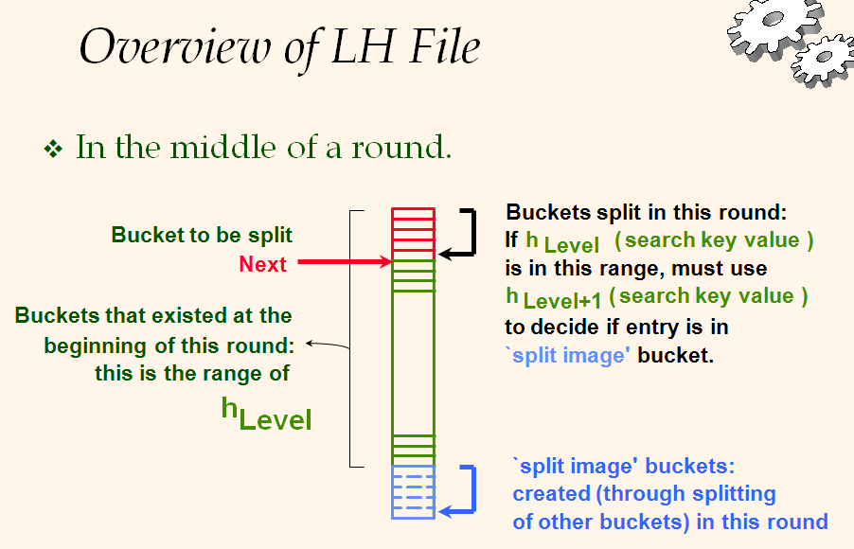
Overview of Linear Hashing - Insert

Slide 20
Example: Insert 43 (101011)
Level=0, N=4
Level=0
Next=0
PRIMARY
OVERFLOW
PAGES
PAGES
32*
Next=1
44*
36*
32*
9*
5*
25*
9*
25*
5*
30*
10*
14*
18*
14*
18*
10*
30*
31*
35*
7*
11*
31*
35*
7*
11*
43*
PRIMARY
44*
36*
PAGES
Notes:
43 mod 4 =3, insert to 3 but it is full, so split 0
apply value mod 8
only butcket 0 is modified, others staty the same
I is the level
n is the number of packets

Slide 21
Example: End of a Round
Insert 50 (110010)
Level=1, Next = 0
Level=0, Next = 3
PRIMARY
OVERFLOW
PAGES
PAGES
Next=0
PRIMARY
OVERFLOW
32*
PAGES
PAGES
9*
25*
32*
9*
25*
66*
18*
10*
34*
50*
18*
34*
43*
35*
11*
66*
Next=3
10*
7*
44*
36*
35*
31*
11*
43*
44*
36*
5*
37*
29*
5*
37*
14*
30*
22*
29*
14*
30*
31*
7*
22*
Notes:
number 2 is smaller than next 3, then apply mod 8, then 50 stays in 2
mod 16, N=4
i is the level

Slide 22
LH Search Algorithm
To find bucket for data entry r, find h_{Level}(r):
If h_{Level}(r) >= Next (i.e., h_{Level}(r) is a bucket that hasn’t been involved in a split this round) then r belongs in that bucket for sure.
Else, r could belong to bucket h_{Level}(r) or bucket h_{Level}(r) + N_{Level} must apply h_{Level+1}(r) to find out.

Slide 23
Example: Search 44 (11100), 9 (01001)
Level=0, Next=0, N=4
32*
44*
36*
9*
5*
25*
30*
10*
14*
18*
31*
35*
7*
11*
PRIMARY
PAGES
Notes:
44 mod 4
9 mod 4

Slide 24
Example: Search 44 (11100), 9 (01001)
Level=0, Next = 1, N=4
PRIMARY
OVERFLOW
PAGES
PAGES
32*
9*
25*
5*
14*
18*
10*
30*
31*
35*
7*
11*
43*
44*
36*
Notes:
0 smaller than next, apply the seond hash function
44 mod 8

Slide 25
Comments on Linear Hashing
If insertions are skewed by the hash function, leading to long overflow buckets
Worst case: one split will not fix the overflow bucket
Delete: The reverse of the insertion algorithm
Exercise: work out the details of the deletion algorithm for LH.
Notes:
the cost of search is 1.2 i/o.

Slide 26
Summary
Hash-based indexes: best for equality searches, cannot support range searches.
Static Hashing can have long overflow chains.
Extendible Hashing avoids overflow pages by splitting a full bucket when a new data entry is to be added to it. (Duplicates may require overflow pages.)
Directory to keep track of buckets, doubles periodically.
Can get large with skewed data; additional I/O if this does not fit in main memory.
Linear hashing does not use directory but a pair of hash functions and splits in order dependent of the bucket that overflows
Proceeds in rounds and at the end of each round the number of buckets has doubled

