Slide 1
FDF
(fils de fer)
3D Wireframe

Slide 2
Index
Project objective
Mandatory and bonus requirements
Key Learnings
Level of abstraction
Line drawing algorithms
Rotational matrices
Projections
Conclusion

Slide 3
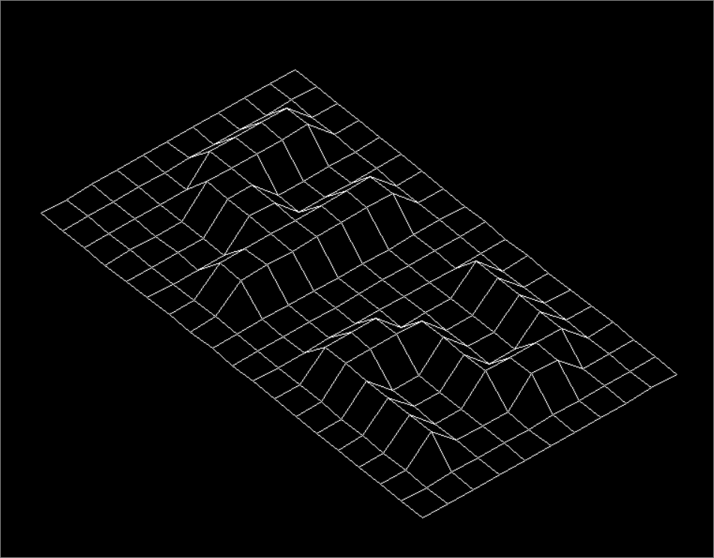
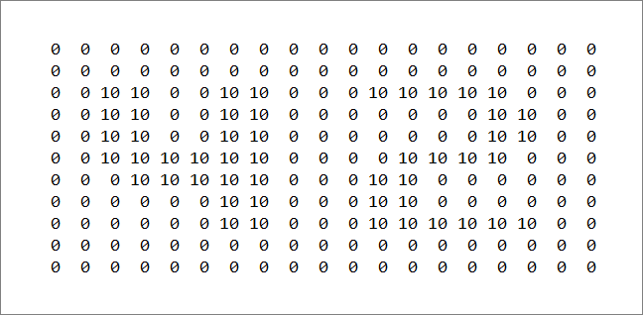
Objective
Display text with numbers
Separated by integers in wiregrid

Slide 4
Mandatory & Bonuses
Mandatory - translate user input to wire grid
Bonus -
(i) rotation
(ii) different projections
(iii) zooming
(iv) translation
(Highly suggest implementing bonuses if tackling this project!)

Slide 5
Key learnings

Slide 6

Level of Abstraction
Standard inputs when using minilibX
MiniLibX function/tools
- Only able to place pixel by pixel
x, y coordinates
Color in hexadecimal

Slide 7
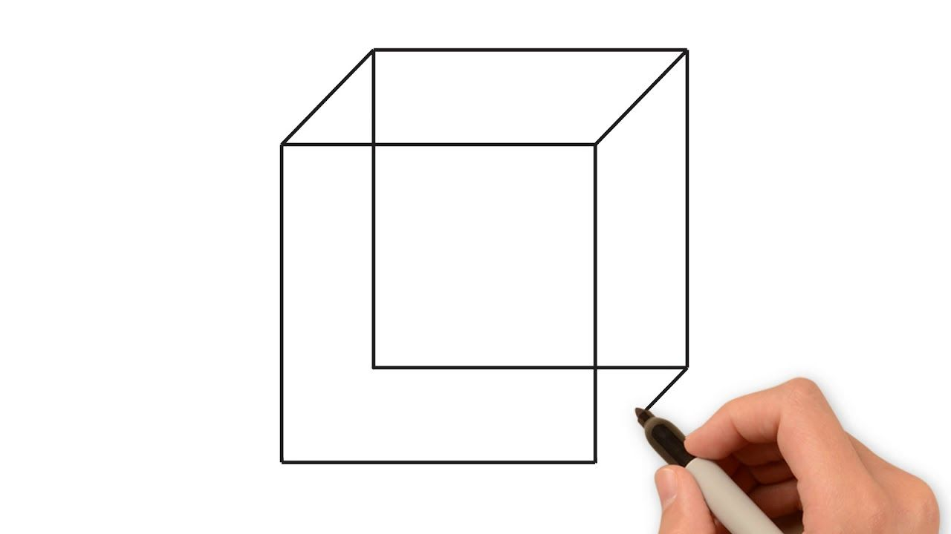
Level of Abstraction
Imagine drawing a cube on a piece of paper, but instead we’re ‘drawing’ pixel by pixel.

Slide 8
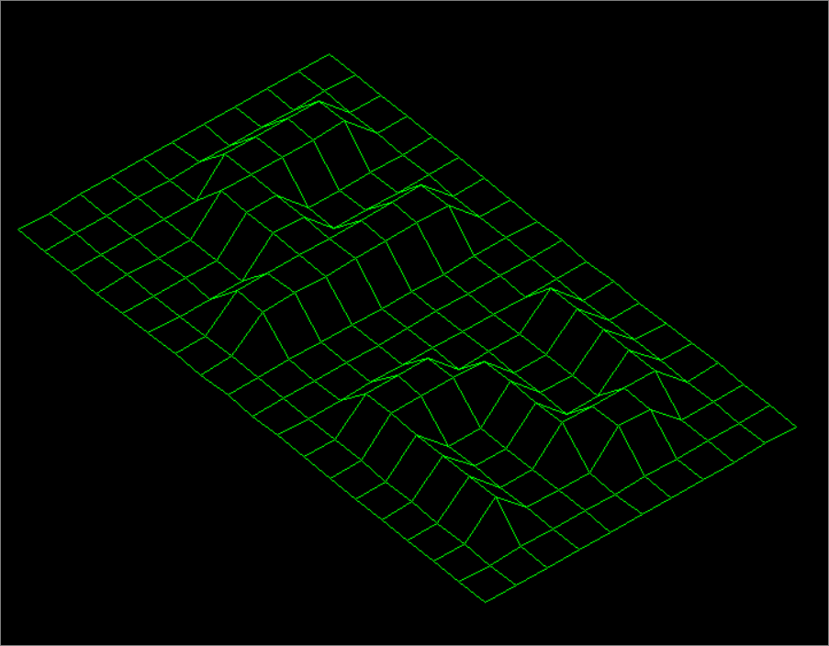
Level of Abstraction (cont’d)
?
MiniLibX function/tools
- Only able to place pixel by pixel

Slide 9
Level of Abstraction (cont’d)
(i) Line drawing algorithms
(ii) Rotational matrices
(iv) Projections
MiniLibX function/tools
- Only able to place pixel by pixel

Slide 10
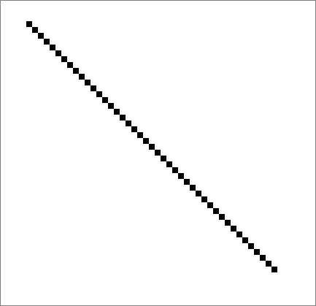
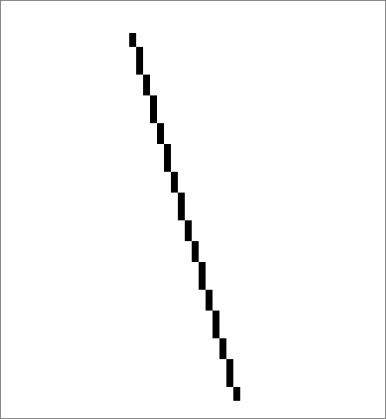
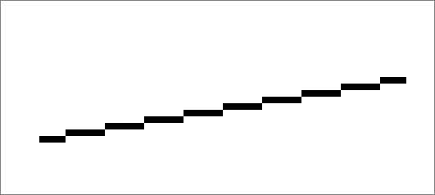
Line Drawing Algorithms
Since we are placing pixel by pixel, how do we write a function that can draw these lines?

Slide 11
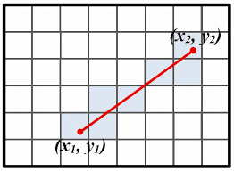
Line Drawing Algorithms (CONT’D)
Issue:
How to proportionately
draw pixels?

Slide 12
Line Drawing Algorithms (CONT’D)
Issue:
How to proportionately
draw pixels?

Slide 13



Line Drawing Algorithms (CONT’D)
Bresenham’s / Xiao Lin Wu’s line drawing algorithm

Slide 14
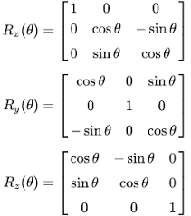
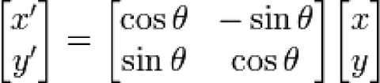
Rotational matrices
2D rotation 3D rotation
Uses:
Vectors
Minor trigonometry
Matrix multiplication

Slide 15
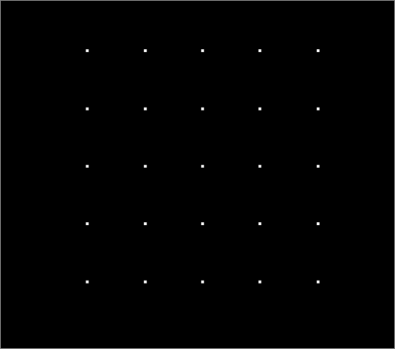
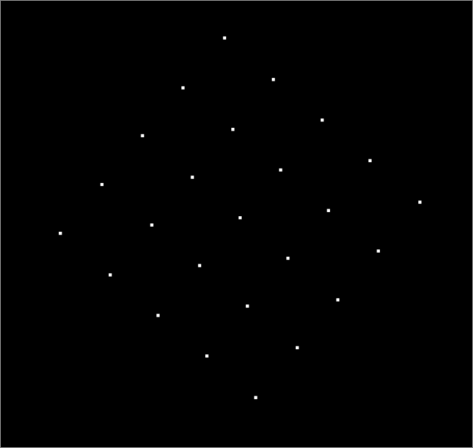
Rotational matrices
2D rotation

Slide 16
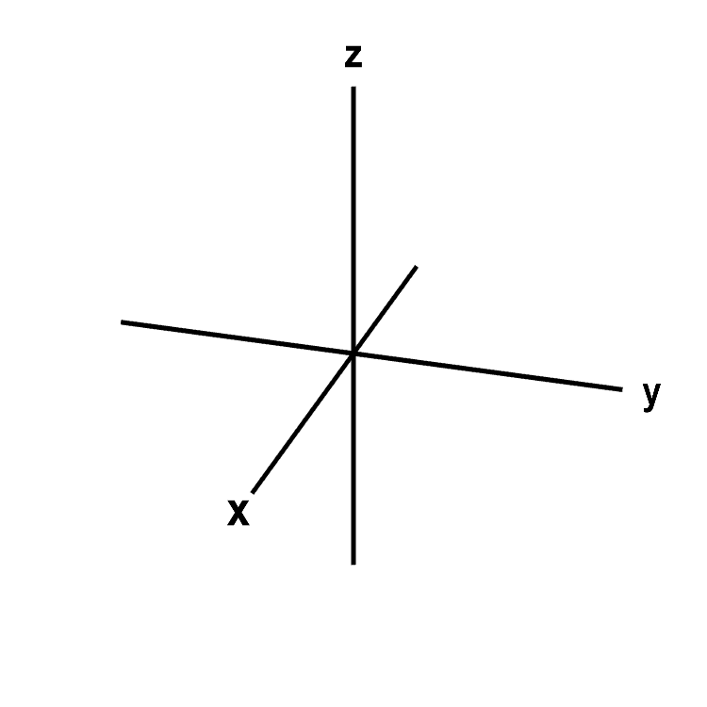
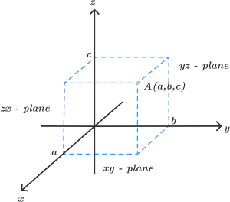
Rotational matrices (cont’D)
3D rotation

Slide 17
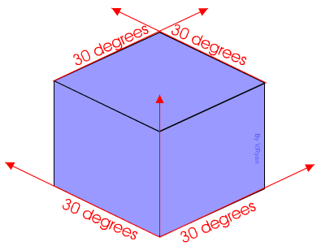
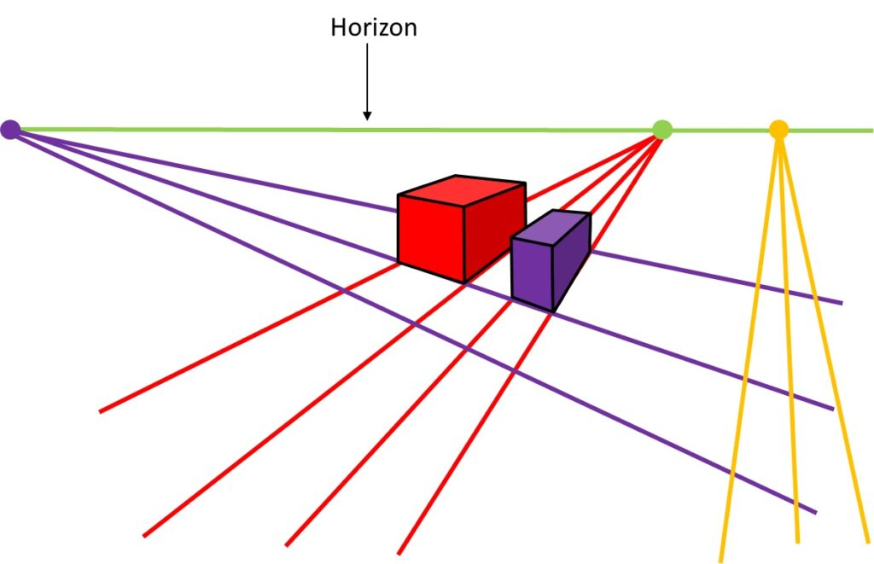
projection
Projecting 3D image in 2D screen
Isometric Perspective

Slide 18
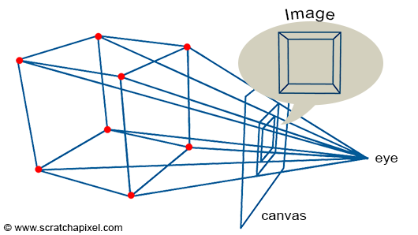
Projection (cont’D)
Projecting 3D image in 2D screen
(x, y, z)
coordinates
(x, y)
On screen

Slide 19
conclusion
Visualise objects in 3D environment
Appreciating abstraction of 3D graphic engines
Be comfortable with applying mathematical concepts and
Get used to understanding something ‘just enough’ for implementation.

