Slide 1
实验（二）状态机、LPM参数化模块库

Slide 2
实验内容1
实验内容：输入序列识别（状态机）
实验目的：状态机的设计，功能仿真

Slide 3
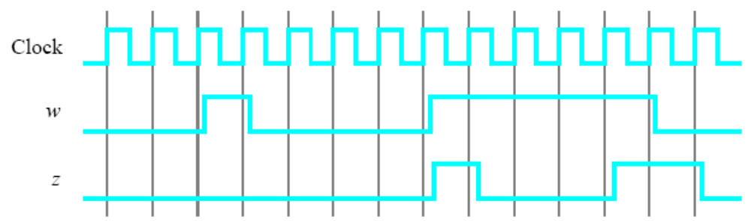
要求：
to implement a finite state machine (FSM) that recognizes two specific sequences of applied input symbols, namely four consecutive 1s or four consecutive 0s.
There is an input w and an output z. Whenever w = 1 or w = 0 for four consecutive clock pulses the value of z has to be 1; otherwise, z = 0. Overlapping sequences are allowed, so that if w = 1 for five consecutive clock pulses the output z will be equal to 1 after the fourth and fifth pulses. Figure 1 illustrates the required relationship between w and z.

Slide 4
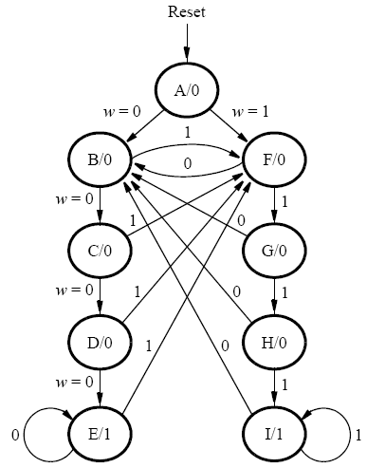

状态图：

Slide 5
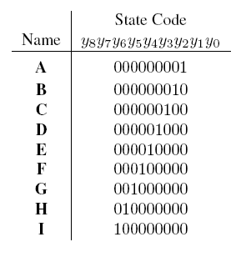
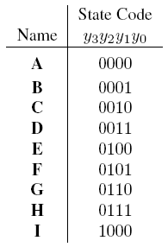

Slide 6
实验内容2
实验内容：片内RAM块
实验目的：使用LPM参数化模块库，片上RAM块显式例化与自动推导

Slide 7
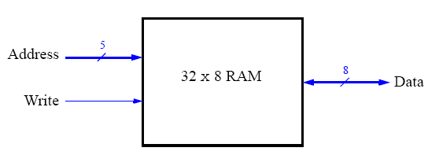
要求：
Use toggle switches SW7−0 to input a byte of data into the RAM location identified by a 5-bit address specified with toggle switches SW15−11. Use SW17 as the Write signal and use KEY0 as the Clock input. Display the value of the Write signal on LEDG0. Show the address value on the 7-segment displays HEX7 and HEX6, show the data being input to the memory on HEX5 and HEX4, and show the data read out of the memory on HEX1 and HEX0.
Test your circuit and make sure that all 32 locations can be loaded properly.

Slide 8
例化“Megafunctions”

Slide 9
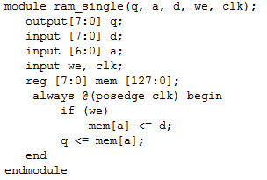
自动推导：

Slide 10
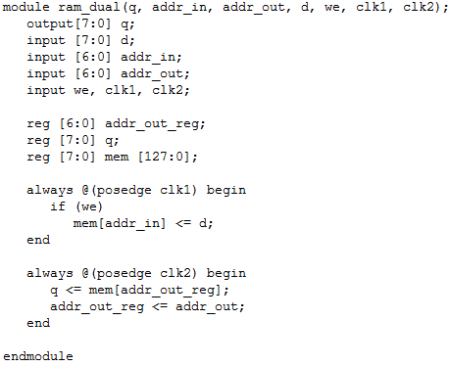
自动推导：

Slide 11
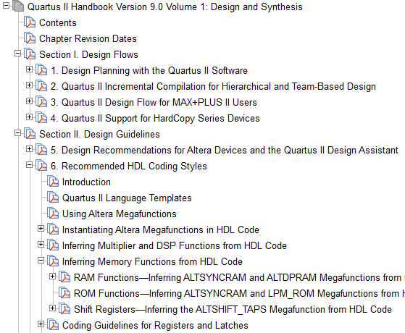
参考：
Quartus II Handbook
（Version 9.0）

