Slide 1
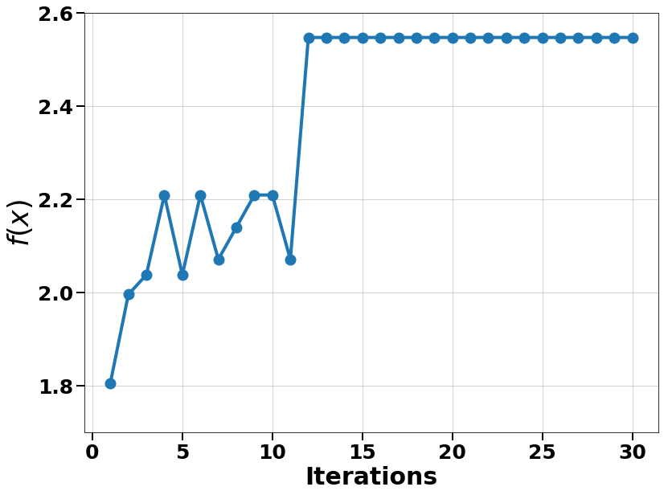
Bayesian optimization
Converge in 12 steps

