Slide 1
TAI2151 ARTIFICIAL INTELLIGENCE FUNDAMENTALS Knowledge-Based System for Nutrition and Diet
Rosalind Choo Lih Mei 1161102982
Siti Nursyuhada Binti Hamzah 1171101819
Tan Jia Chun 1171100329
Tan Yi Fan 1171100501

Slide 2
Introduction
A knowledge-based system on nutrition and diet
Recommend user nutrition based on the nutrition deficiency diseased that user are facing
Recommendation of food are based on the user’s BMI (Body Mass Index)

Slide 3
Objective
To create a proper nutrition and diet system that gives helpful recommendation to people for them to maintain a healthy lifestyle.
To help people solve nutrition deficiency diseases by recommending the food needed.
To lower down the rate of obesity of the people in Malaysia by recommending low calories food for people that are under overweight and obese category of BMI.

Slide 4
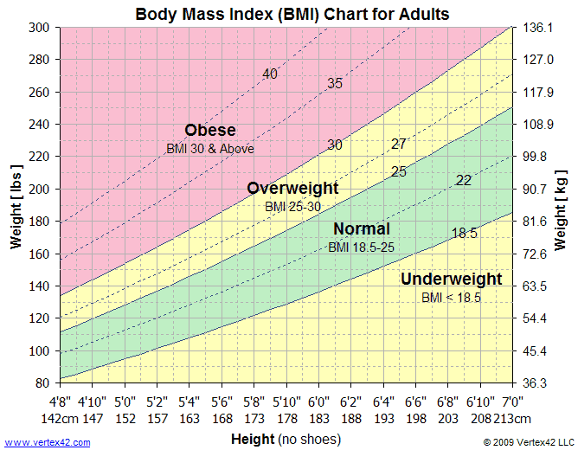
Body Mass Index Chart

Slide 5
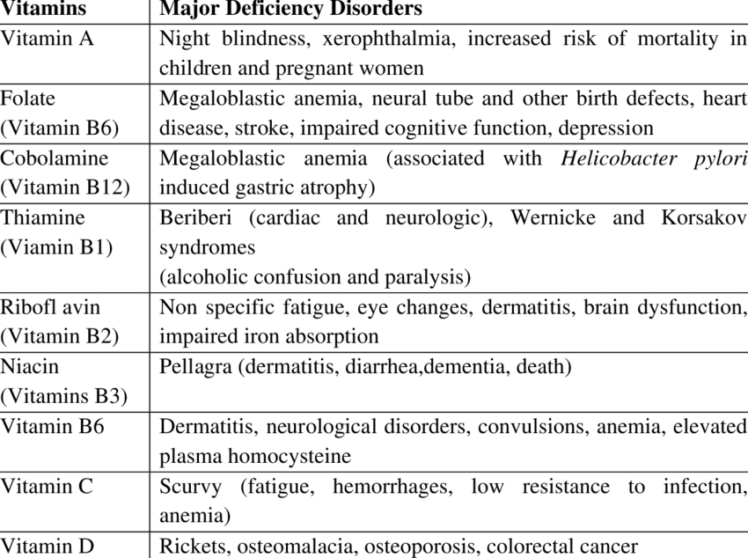
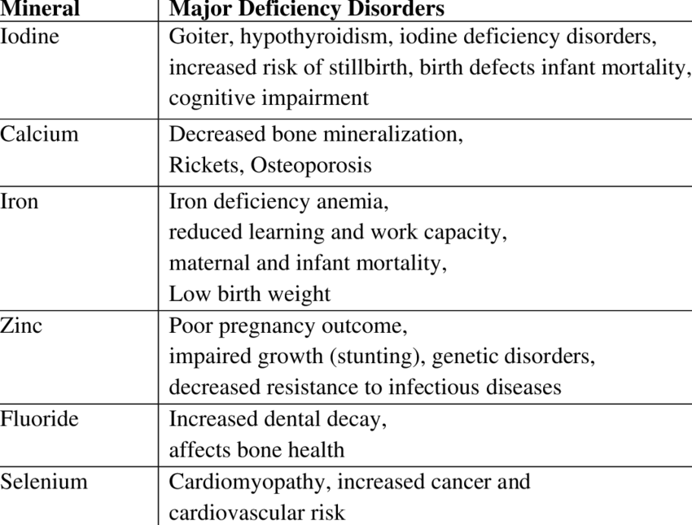
Food Nutrition Chart

Slide 6
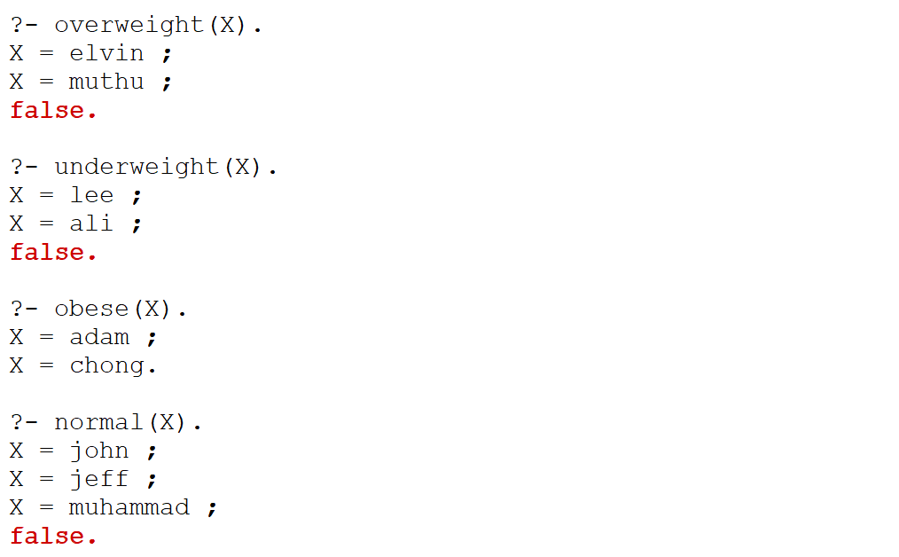
Sample Output
This picture shows the person’s data in the system

Slide 7
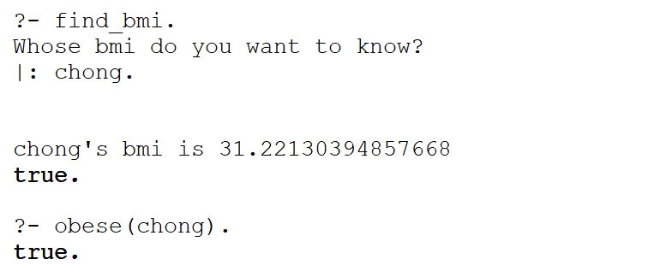
Sample Output
This picture show that the person found by the user (Chong) in the database is an obese

Slide 8
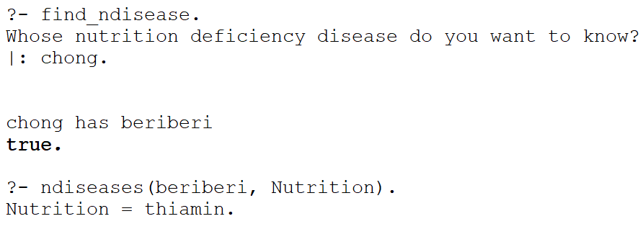
Sample Output
This picture that the nutrition deficiency issue is faced by the person (In this case, the user input Chong)

Slide 9
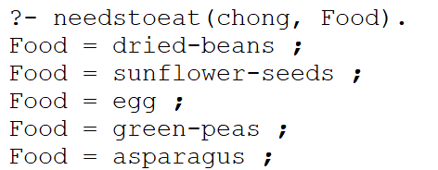
Sample Output
Now we know that Chong is an obese, and he needs thiamin (the nutrition) to solve problem he faces, beri-beri (nutrition deficiency issue)
The system would now recommend the food he needs to eat based on his bmi (31.22)

Slide 10
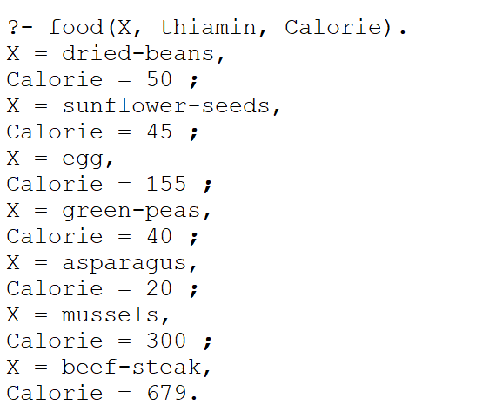
Sample Output
For Chong, the food less than 300 in calorie is recommended.
High calorie food (Calorie >=300) is not recommended for obese or overweight person

Slide 11
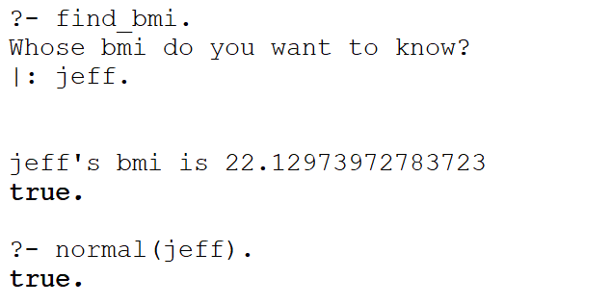
Sample Output
Now, the user would like to find another person’s information in the database (In this case, Jeff, and he is a normal weight person)

Slide 12
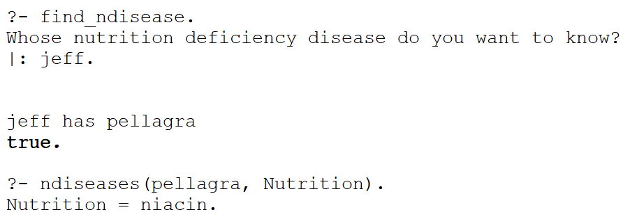
Sample Output
Now the user finds out the nutrition deficiency problem faced by the person (In this case, Jeff has pellagra issue)
The user also find out which nutrition is lacking to cause pellagra problem (Niacin)

Slide 13
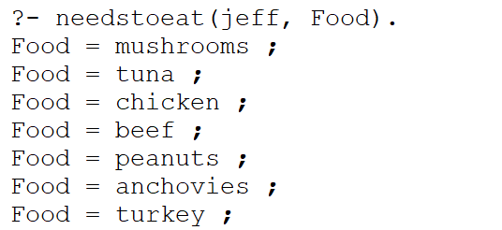
Sample Output
Now the user finds out what food does Jeff needs to eat

Slide 14
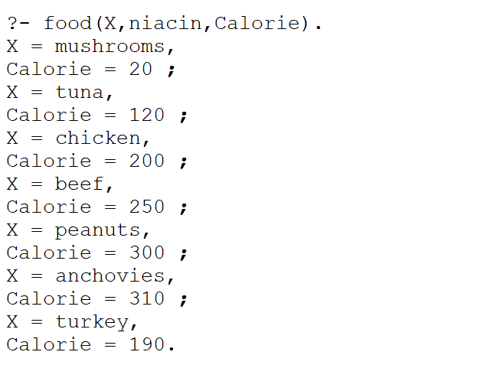
Sample Output
The system recommends all the food because the person is a normal weight person

Slide 15
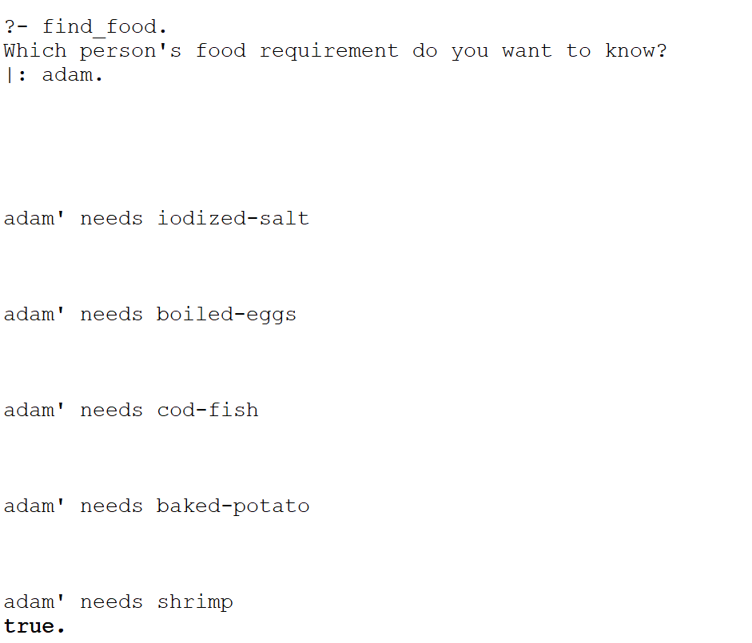
Sample Output
The other method:
The user can also use another function, find_food to find the food needs to eat by a person based on the nutrition deficiency disease by entering the person name
The recommended food is based on the nutrition deficiency disease and also the on the person’s BMI index

Slide 16
THANK YOU!

