Slide 1
Project Schedule
Task/Deliverable | Sub-task/Description | Month
 |  | 1 | 2 | 3 | 4 | 5 | 6 | 7 | 8 | 9 | 10 | 11 | 12
1. Investigating standard NL-MOR algorithms for HX application | 1.1: Reformulation of FVM-HX
 | 1.2: Investigation standard NL-MOR methods
2. Investigation of alternative NL-MOR method | 2.1: Feasibility test of the proposed algorithm
 | 2.2: Performance test of applying alternative NL-MOR to HX
3. Performance assessment | Performance assessment of integrated approach for VCC system
5. Final report

Slide 2
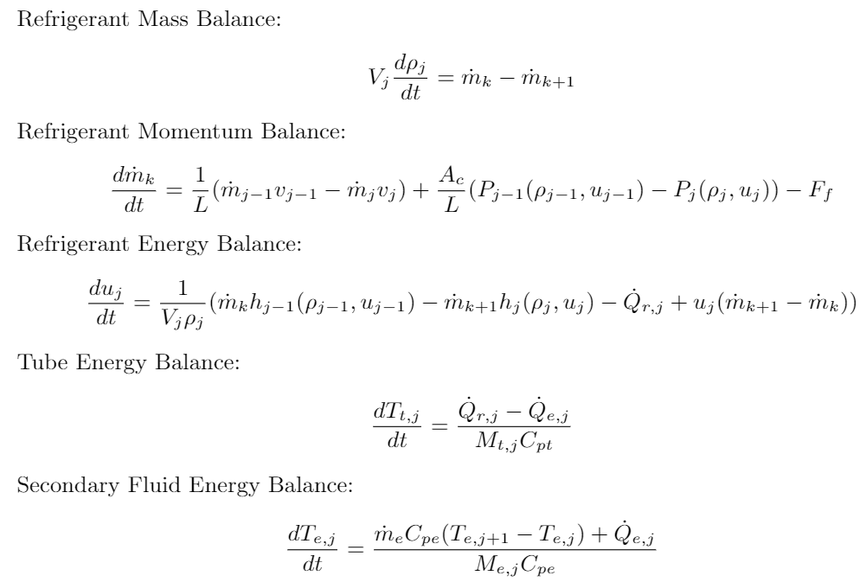
Reformulation of FVM-HX

Slide 3
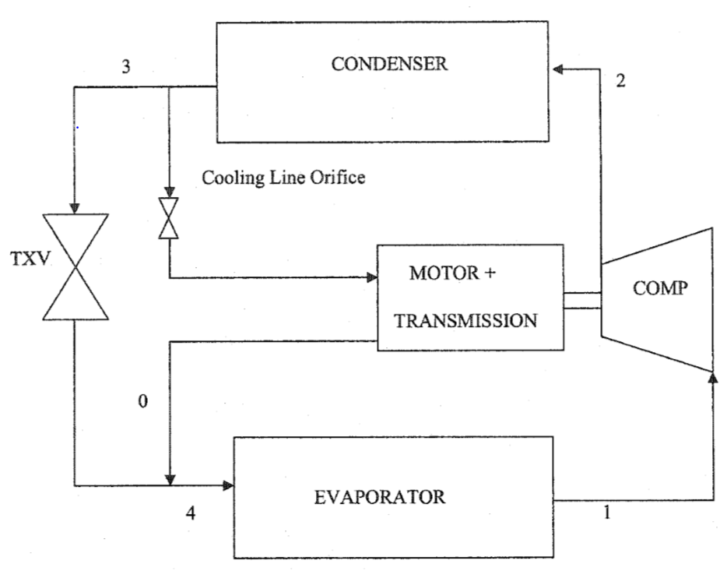
Case Study Chiller System
90-ton centrifugal chiller system tested under various operating conditions.
Refrigerant used is R134a and the secondary fluid is water.
Chiller components:
Shell-and-tube condenser
Shell-and-tube evaporator
Centrifugal compressor
Thermostatic expansion valve
controller

Slide 4
Simulation Environment: Dymola
A Modelica-based commercial platform with strong differential algebraic equations (DAE) solvers.
Modelica is an equation-based object-oriented modeling language that could accommodate acausality of system variables.

Slide 5
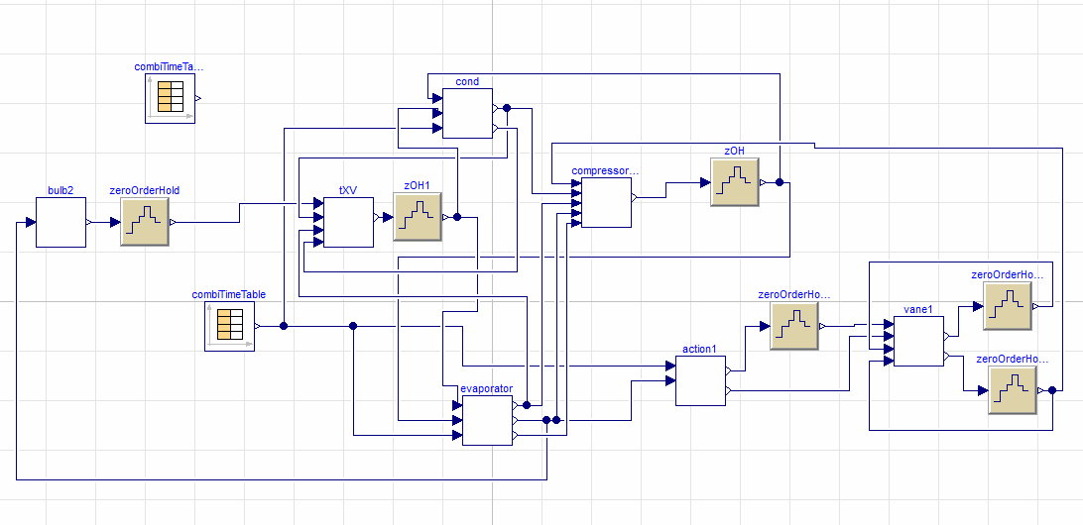
Chiller System Simulation
Condenser
Compressor
TXV
Controller
Evaporator

Slide 6
Simulation Results
Pressure Validation
Exit Enthalpy Validation
Exit Water Temperature Validation

Slide 7
Simulation Time
Simulation | Thermoproperties | Real time factor [-]
FVM_ρu (Dymola) | Neural Networks (NN) | 0.195
FVM_Ph (Dymola) | Media | 0.98
FVM_Ph (MATLAB) | CoolProp | 0.898
MB_Ph (MATLAB) | CoolProp | 0.128

