Slide 1
Summarization System – LING573
Group 10
Jiadong Li

Slide 2
System architecture
Preprocessing
Feature Extraction
Sentence Scoring
Sentence Selection
Information Ordering
Content Realization (not yet)

Slide 3
System architecture
Preprocessing Feature Sentence Sentence Selection &
Extraction Scoring Information Ordering
Documents
Sentences
Frequency
Scored
Sentences
Summary
Words
Position
Cue Words
Similarity

Slide 4
Preprocessing
Sentence segmentation (\n \t format stripping)
Word tokenization
Stop word removal
Ignored word selection ( “The” issue. ? tf•idf )
Stemming

Slide 5
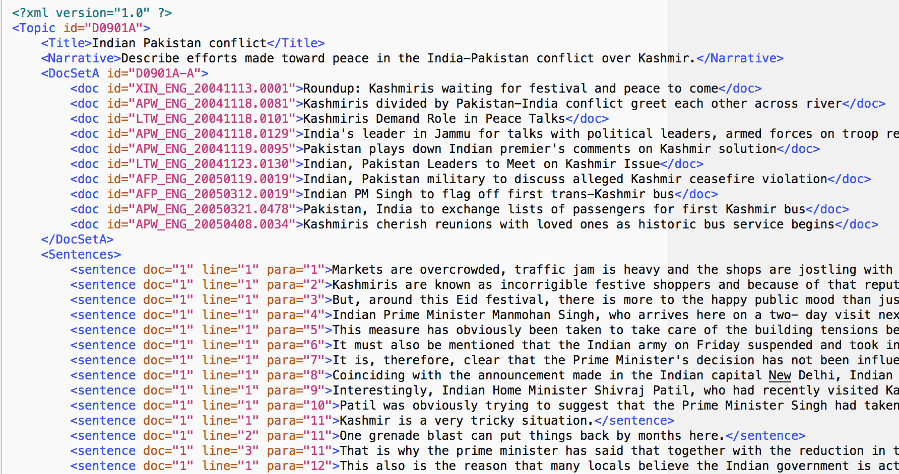
Preprocessing

Slide 6
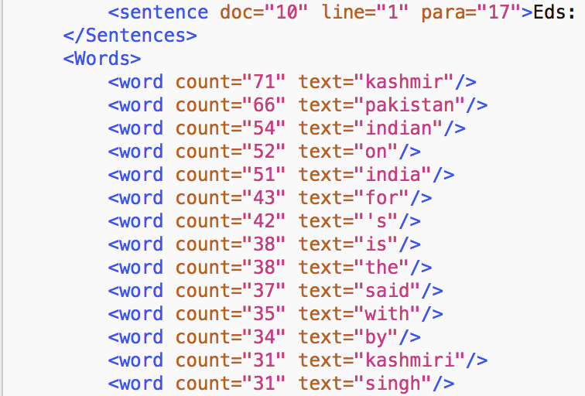
Preprocessing

Slide 7
Features
Frequency
long sentence vs. short sentences
THE sentences
Sentence position
Weight of the doc
Paragraph
Line
Cue words
Similarity with the title
Weight of the sentence

Slide 8
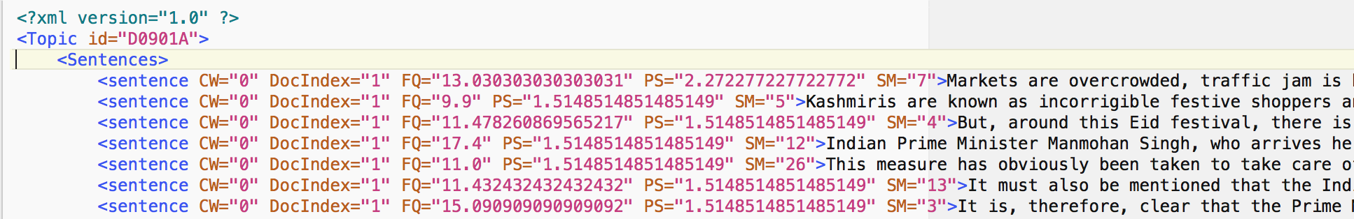
Features

Slide 9
Sentence Score
Give four score for the previous four features.
FrequencyScore(FS)
PositionScore(PS)
CueWordScore(CWS)
SimilarityScore(SS)
Final score = a*FS + b*PS + c*CWS + d*SS
Real implementation :
SentenceScore = (FrequencyScore + SimilarityScore) * PositionScore * (1 + (CueWordScore * 0.1))
Still need tuning

Slide 10
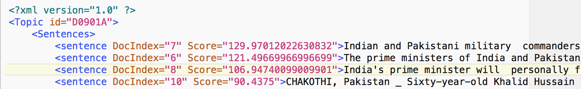
Sentence Score

Slide 11
Sentence Selection
Rank the sentence by score
Select top N sentences until the total words count reaches 100.

Slide 12
Information Ordering
Sentence score weights most.
Influence of the doc order.
Doesn't care about the sentence position inside of the doc.

Slide 13
Content Realization
Not implement yet

Slide 14
ROUGE result
 | P | R | F
ROUGE-1 | 0.31810 | 0.23876 | 0.27102
ROUGE-2 | 0.10376 | 0.07747 | 0.08814
ROUGE-3 | 0.03985 | 0.02973 | 0.03386
ROUGE-4 | 0.01939 | 0.01464 | 0.01660
Data used: ../training/2009/UpdateSumm09_test_topics.xml
ID from D0901A to D0944H

Slide 15
Issues and Successes
ROUGE score result
Score formula
Content realization

Slide 16
Related reading
P. Sarraf, Y. K. Meena, Summarization of Document using Java ,Vol. 3, Issue 2, February – 2014 International Journal of Engineering Research & Technology(IJERT)

Slide 17
Thank you

