Slide 1
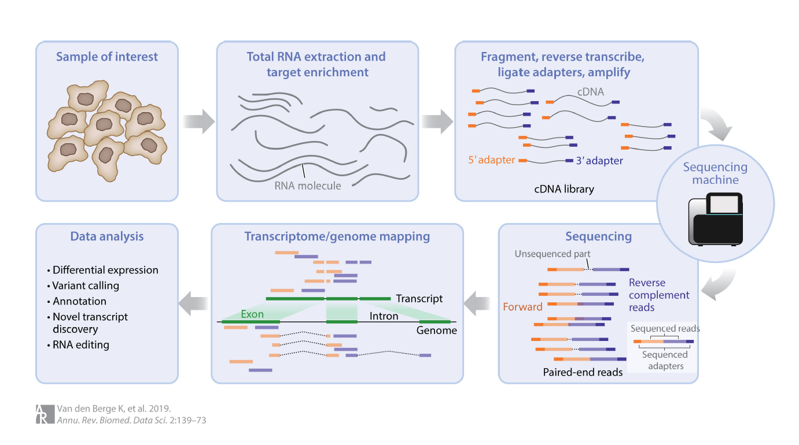

Slide 2
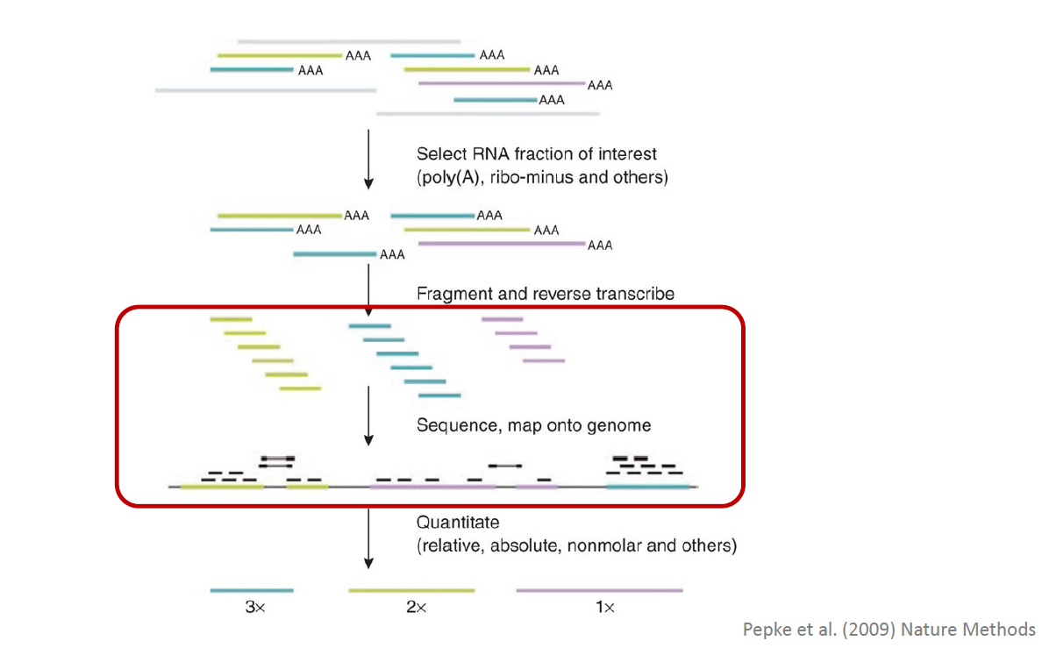

Slide 3
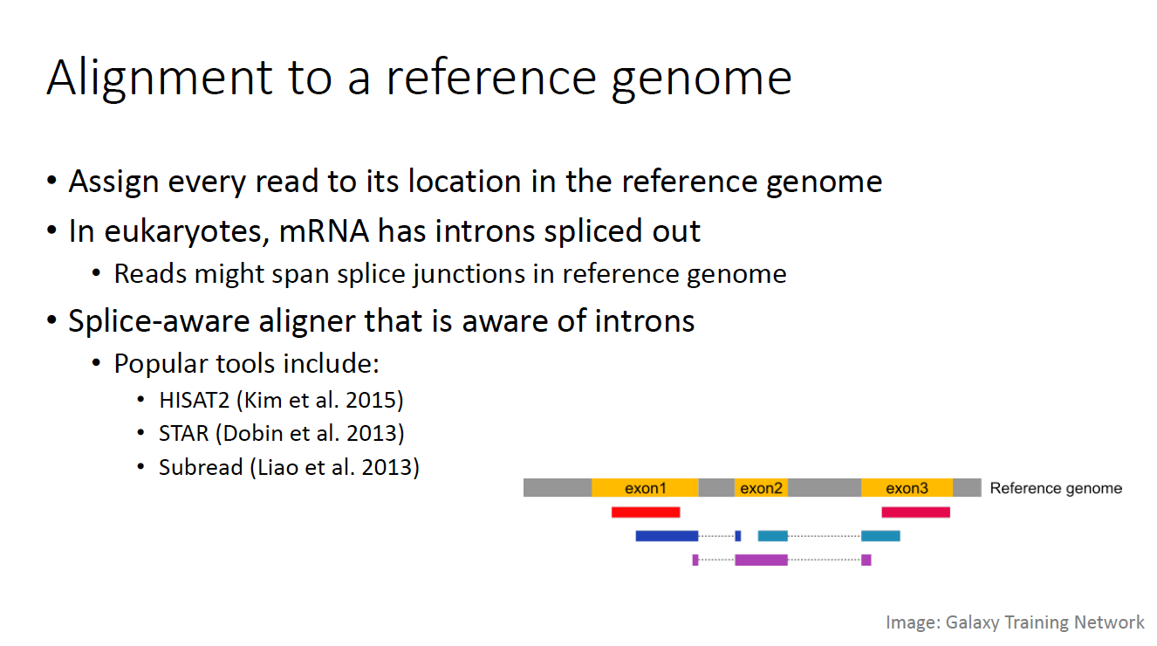

Slide 4
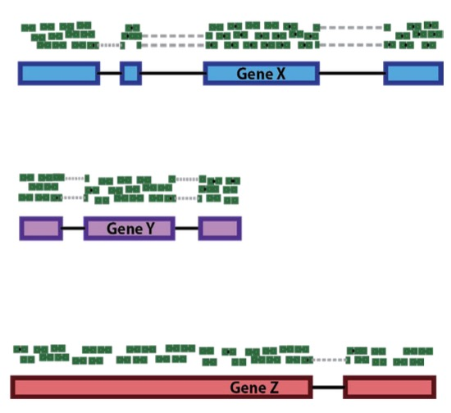
Raw data processing: from short reads to counts
Sequence all RNA in
this cell
Count the number of copies
Gene | Count
Gene X | 3
Gene Y | 3
Gene Z | 2
One cell
More information: https://github.com/hbctraining/DGE_workshop

Slide 5
Different sequences can give the same count
Two cells, one gene, different sequence composition
Reference fragment: ACGTTGCA
Alternative fragment: ACATTGCA
Cell | Reference | Alternative | Gene X total
C1 | 3 | 0 | 3
C2 | 1 | 2 | 3
C1 and C2 both report Gene X = 3
The matrix cannot recover the original 3:0 and 1:2 split.

Slide 6
What is lost in a gene-count matrix?
Gene totals hide which sequences contributed to the count
Sequence detail | Question hidden by gene totals
Base identity | Which reference or alternative allele?
Exons and junctions | Which splice form or circular junction?
Transcript ends | Which 3′ UTR or poly(A) site?
Sequences outside the feature set | Which virus, microbe, vector or novel RNA?
The matrix retains abundance per annotated gene and cell.
Retained reads or BAM files can still contain the missing evidence.

Slide 7
Malva changes the stored representation
The same sequencing data support different questions
Stage | Gene-count workflow | Malva sequence workflow
Input | RNA reads, barcode and UMI | The same sequencing data
Processing | Reference alignment Gene assignment and UMI collapsing | Sample k-mers Store their cell associations
Stored result | Cell × gene UMI counts | Sequence-to-cell index
Question | How much of gene X? | Which cells contain sequence Q?
For sequence queries, Malva bypasses reference-based gene quantification.
Gene counts remain useful. A Malva index is not a lossless FASTQ archive.

Slide 8
Building a sequence-to-cell index
A small worked example using k = 4
Distinct read types and their cells
Stored k-mer / cell associations
Cell | Read split into 4-mers
C1 | ACGT TGCA
C2 | ACGT TGCA
C2 | ACAT TGCA
4-mer | Cells containing it
ACGT | C1, C2
ACAT | C2
TGCA | C1, C2
The barcode preserves cell identity without a reference genome.
Repeated associations do not become molecule counts in this index.

Slide 9
Querying the sequence retrieves cell C2
The alternative fragment distinguishes cells with identical gene totals
QUERY
INDEX ENTRY
MATCHED CELL
ACAT
4-mer | Cells
ACAT | C2
C2
Alternative sequence
Plus sample and
cell metadata
Exact k-mer lookups identify matching cells.
Longer probes use sliding windows and match thresholds.
Queries read relevant index blocks instead of rescanning FASTQ.

Slide 10
Sequence queries produce task-specific outputs
Choose the feature after indexing the reads
Query or feature | Output | Typical use
Known gene sequence | Cell × gene pseudocounts | Expression exploration
Allele, junction or UTR | Matched cells and sequence signal | Sequence-specific questions
K-mer composition | Cell × bucket features | Cell neighbours and clusters
Pseudocounts summarize sequence matches, not UMI molecule counts.
Gene names and biological interpretation may still use references.
A missing hit can reflect limited RNA capture or coverage.

