Slide 1
Welcome to your
virtual lawn!
I would like to add some simple graphic here – maybe just grass blades – I would like the colors to be similar to the app – these are a little off

Slide 2
This web tool provides you with the ability to test different types of irrigation technologies in a virtual environment.
Skip intro

Slide 3
The different technologies are time-based, time-based with a rain sensor, time-based with a soil moisture sensor, and evapotranspiration controllers.
Clicking on each of the examples will take the user to a picture and description of each
Skip intro

Slide 4
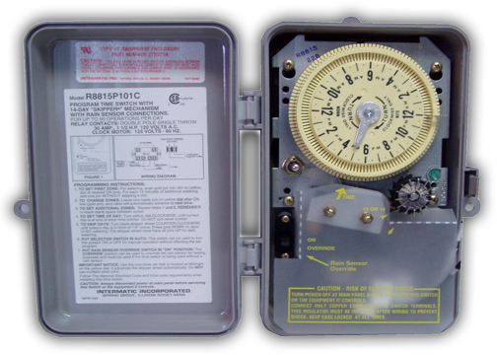
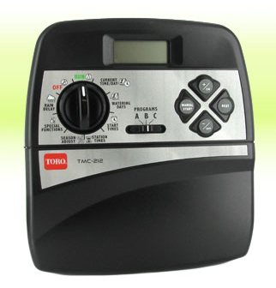
Time-based
Uses an automatic timer and schedules irrigation for specific times and days
Learn more
Go back

Slide 5
Time-based irrigation resources
Operation of residential irrigation controllers
http://edis.ifas.ufl.edu/ae220
Video
http://abe.ufl.edu/mdukes/controllers/video-irrigation-controllers.shtml
Go back

Slide 6
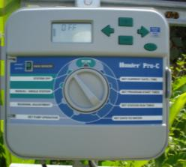
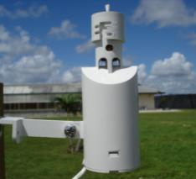
Time-based with a
rain sensor
Uses an automatic timer
with a rain sensor that will
disable irrigation if sufficient rainfall occurs.
+
Learn more
Go back

Slide 7
Time-based with rain sensor irrigation resources
Residential irrigation system rainfall shutoff devices
http://edis.ifas.ufl.edu/ae221
Video
http://abe.ufl.edu/mdukes/controllers/video-rain-sensors.shtml
Go back

Slide 8
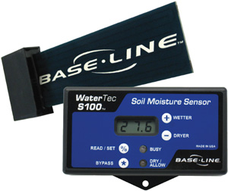
Time-based with
a soil moisture sensor
Uses an automatic timer with a soil moisture sensor. The sensor measures soil moisture and reports to the controller if too wet; if too wet, irrigation does not occur.
+
Learn more
Go back

Slide 9
Time-based with soil moisture sensor irrigation resources
Smart irrigation controllers: how do soil moisture sensor (SMS) irrigation controllers work?
http://edis.ifas.ufl.edu/ae437
Video
http://abe.ufl.edu/mdukes/controllers/video-soil-moisture-controllers.shtml
Go back

Slide 10
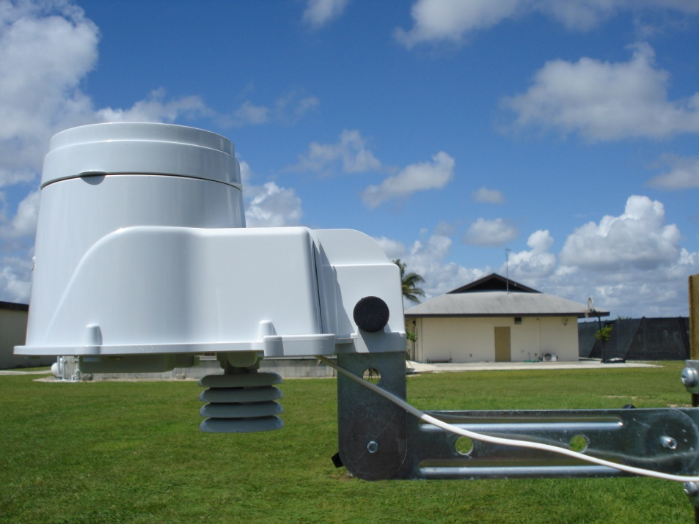
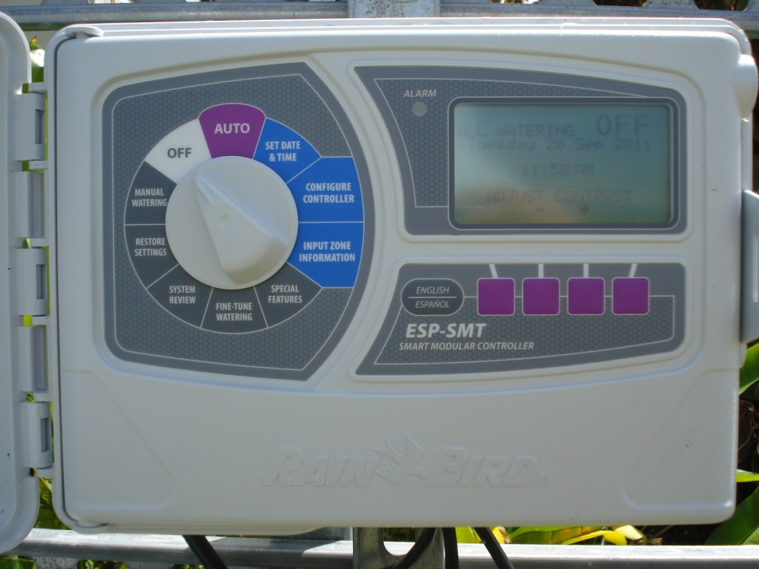
Evapotranspiration controllers
Uses weather measurements to estimate evapotranspiration. The estimated evapotranspiration losses are used to determine an irrigation schedule.
Learn more
Go back

Slide 11
Evapotranspiration controller irrigation resources
Smart irrigation controllers: operation of evapotranspiration-based controllers
http://edis.ifas.ufl.edu/ae446
Video http://abe.ufl.edu/mdukes/controllers/video-weather-based-controllers.shtml
Go back

Slide 12
Research and demonstrations
have shown that the rain sensor, soil moisture sensor, and evapotranspiration based irrigation technologies
save water.
Skip intro

Slide 13
This web tool uses weather data from the Florida Automated Weather Network (FAWN). The station closest to your location will be selected.
More information on FAWN can be found at http://fawn.ifas.ufl.edu
Skip intro

Slide 14
Shortly after you enter data,
you will receive an email with
your site results using last week’s weather data.
The results will include water volumes applied and not used, water stress days, and percent of water applied that was not used.
Skip intro

Slide 15
Currently, this tool is only for lawn turf and not for ornamental plants.
The tool allows you to select multiple irrigation technologies for comparison purposes.
Default values are available if you are unsure of a value.
All comments on the tool should be directed to Dr. Kati Migliaccio at klwhite@ufl.edu.
Enjoy!
Skip intro

Slide 16
Let’s get started!

Slide 17
I’m a new user:
Login:
Clicking on skip intro goes here

Slide 18
Enter your zip code
This information is used to determine values that describe evapotranspiration and to locate the nearest weather station.

Slide 19
Select a unit system
Metric
English
Values will be entered in the unit system selected

Slide 20
Soil characteristics
Root depth:
Soil type:
Irrigated area:
Root depth refers to the depth of soil in which roots are found. In some places this may be limited by the amount of soil and in other places this may be limited by other factors.
Depending on which word is scrolled over, a different text appears below.
For soil type: Select the dominant soil type for your lawn. If your soil type is not provided, pick the type that has soil water holding properties similar to your soil type.
For irrigated area: The irrigated area represents the area which receives irrigation.

Slide 21
Irrigation technology selected
Time-based
Time-based with rain sensor
Time-based with soil moisture sensor
Evapotranspiration controller
I see a check box being before each of these with the ability to select as many as they want

Slide 22
Rain sensor detail
Enter rain sensor setting:
Enter a rain sensor setting as this is usually an adjustable feature or use the default value.
If time-based with a rain sensor was selected – they will see this next, if not – this will be skipped

Slide 23
Soil moisture sensor detail
Enter sensor threshold:
Set a threshold below which irrigation is allowed to occur. The threshold generally corresponds to a portion of field capacity.
If time-based with a SMS was selected – they will see this next, if not – this will be skipped

Slide 24
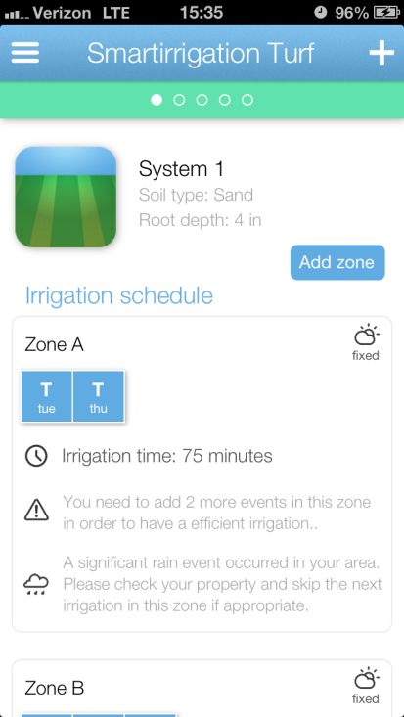
Irrigation schedule
SMWTFS
Select irrigation start time:
I would like this to look similar to the app – I will show you how it looks there
Start times should be on an hour timestep

Slide 25
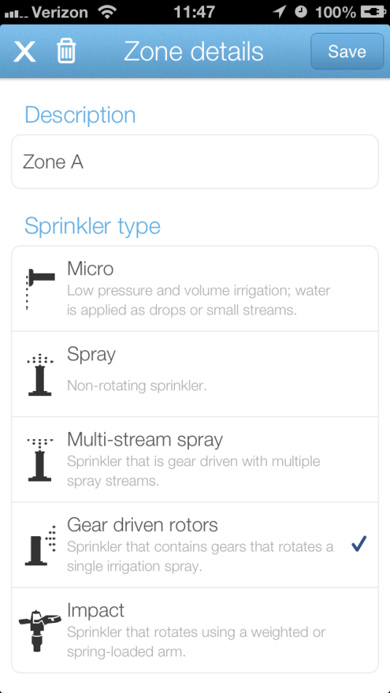
Irrigation system
Enter irrigation depth/amount
Select system
I would like this to look similar to the app – I will show you how it looks there – using same values and pics for systems

Slide 26
Correspondence
Would you like to receive weekly emails on how the system you designed applied irrigation?
Yes
No

Slide 27
Thank you!
This model is brought to you through funded provided by the University of Florida IFAS BMP program.
Questions?
Dr. Kati Migliaccio
klwhite@ufl.edu

