Slide 1
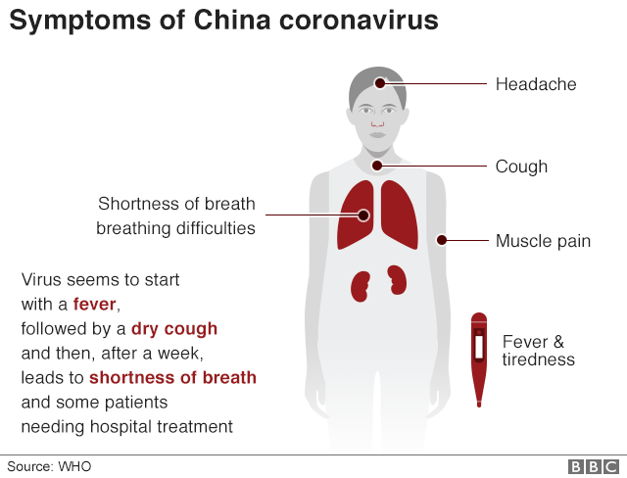
What is coronavirus?

Slide 2
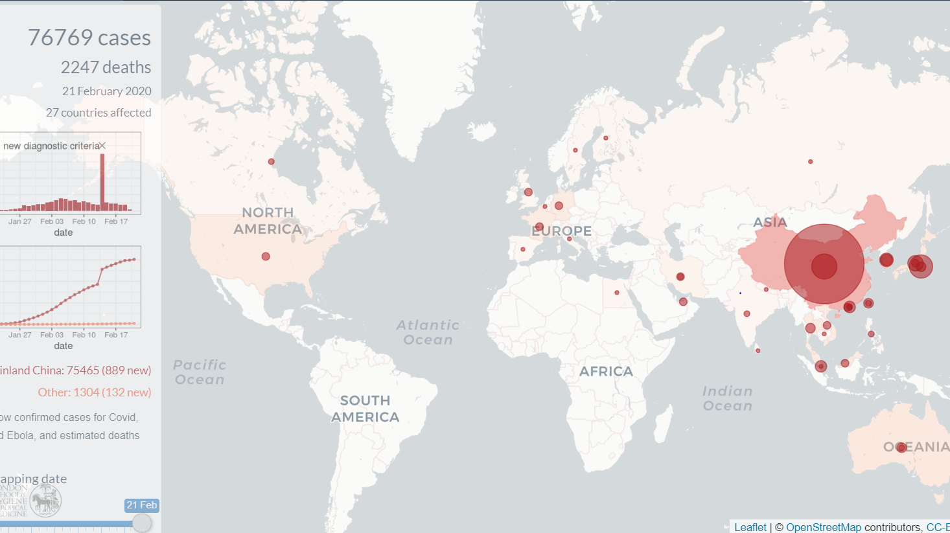
Impact of Coronavirus

Slide 3

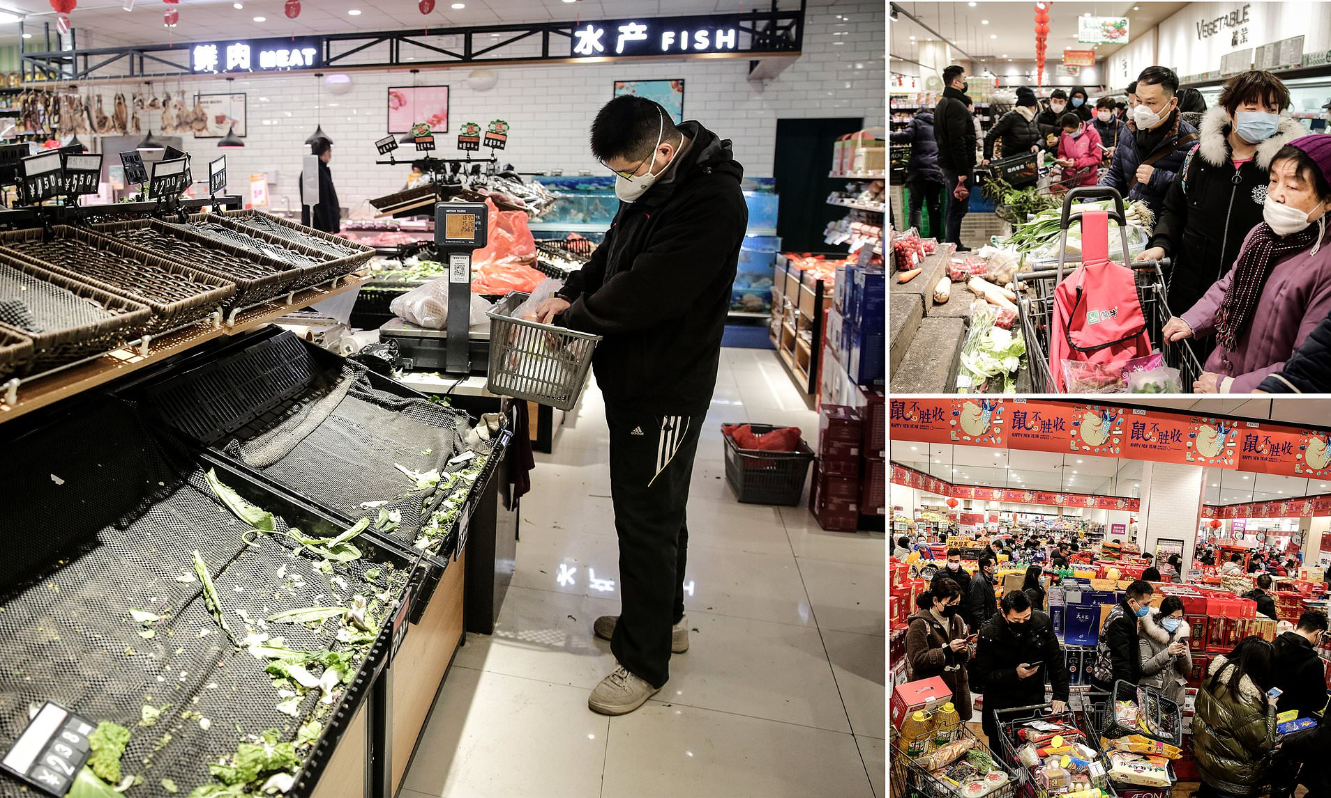
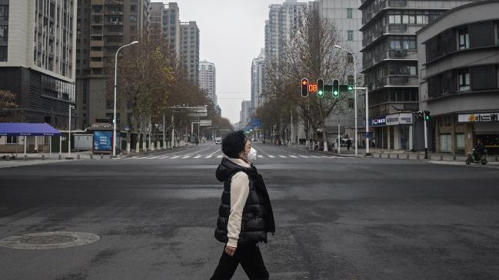
Social impact of Coronavirus

Slide 4
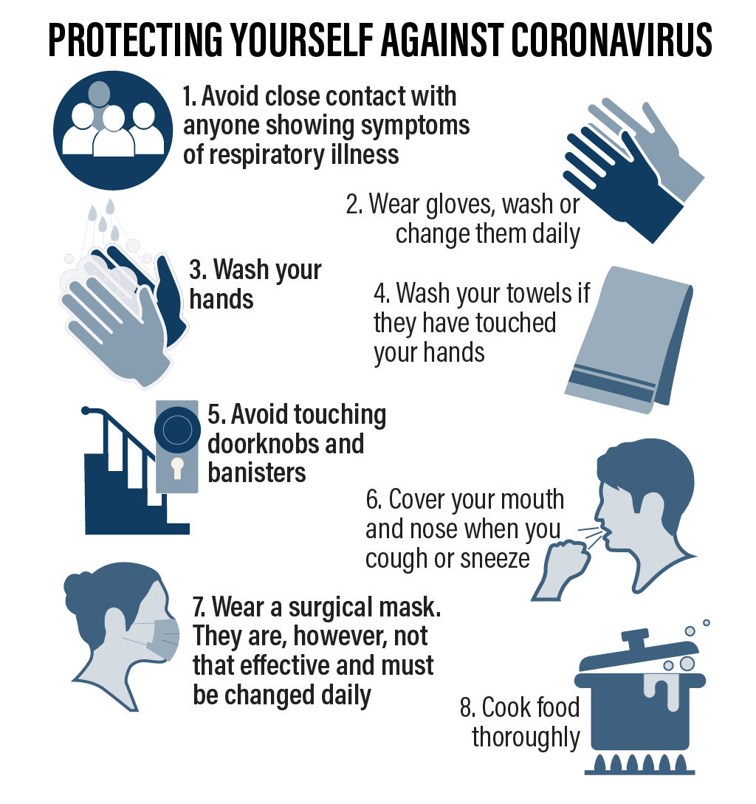
Protection against Coronavirus

Slide 5
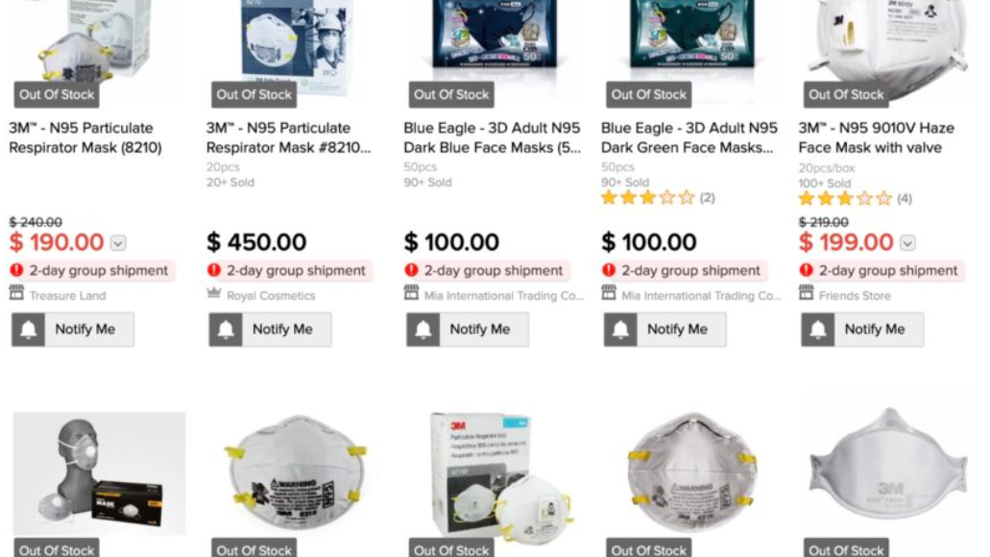
N95 Masks our strongest defense.

Slide 6

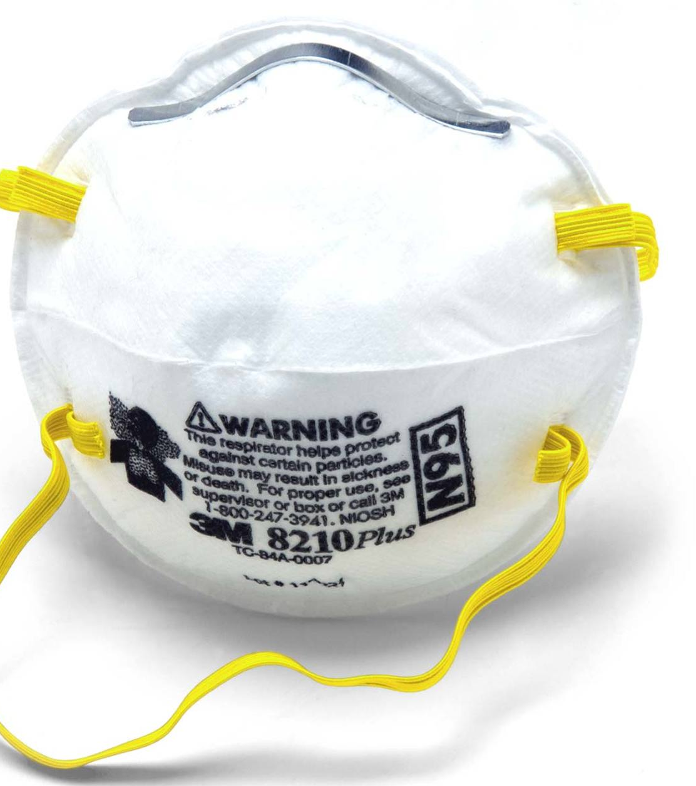
N95 Mask
8 Hours of usage

Slide 7
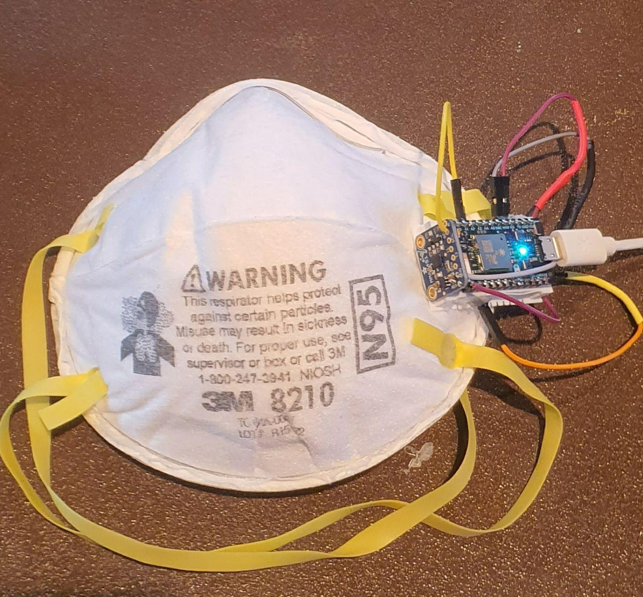
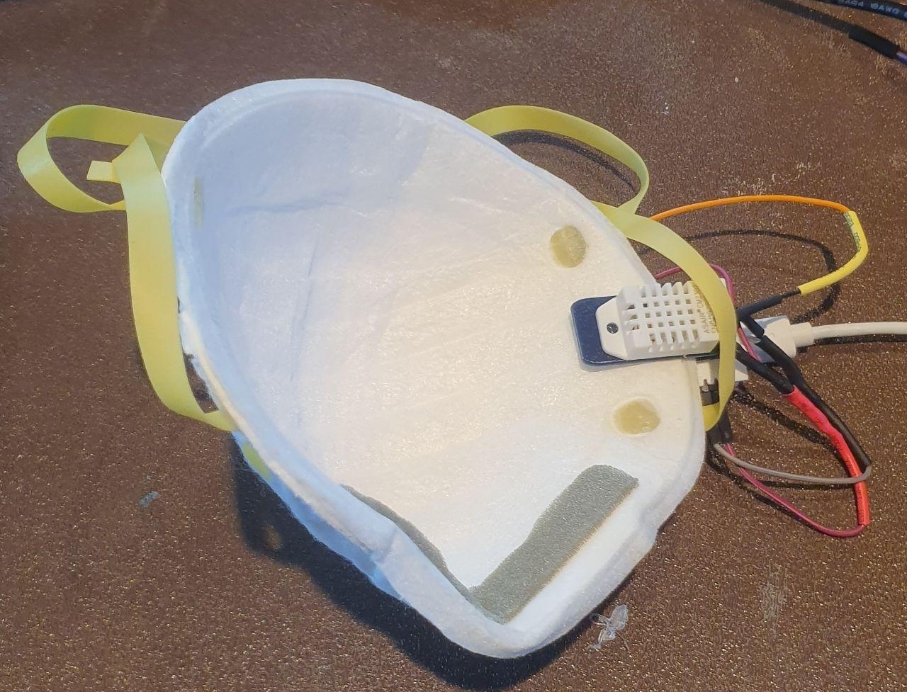
Masked Hero

Slide 8
Features
Real time feedback on the mask’s lifespan left
Alert user when it is dropping low.
Stop Mask wastage.

