Slide 1
Chatbot-Semantics: User Input Analysis
Kejni Dema, Eric Waldburger, Xu Jia Fug Liu | Project Advanced Web Technologies

Slide 2
Problem Statement
The websites for many of the German ministries are sometimes filled with too much information and the interested user must navigate through huge walls of text when he only requires a minimal amount of information that can be communicated very efficiently if there were a person to ask instead.
What is the next best thing?
An AI chatbot that can answer most FAQs and tailor the responses to what the user is requesting.

Slide 3
Scenarios
The bot should be able to answer users about required documents for a specific service, about available dates and appointments for the requested service.
It should also be able to guide the user through the appointment booking process by ways of asking the user for the necessary information and scheduling the appointment.

Slide 4
Technology Overview Pt.1
For the implementation of the AI chatbot we will be using Rasa Open Source and Rasa X.
The scenarios are created in terms of Rules (for when a fixed reply is always required such as greetings and form completion) and Stories (for when a back-and-forth conversation is required).
These are user defined at first but should be updated and iterated as the bot gathers more user requests and interactions.
A pipeline will be configured for training the bot on NLU (Natural Language Understanding).
In this pipeline there will be components to extract tokens, numbers and specific formats through the use of regular expressions and lookup tables, handling of typos etc.
For unexpected input there shall be a fallback behaviour.

Slide 5
Technology Overview Pt. 2
The way NLP works in rasa is that from a sentence of the type: "I am looking for a French restaurant in the centre of town“. The following NLP representation shall be extracted, which will then determine the bot’s response based on the defined rules and stories.
In the pipeline we would like to add the ability to detect user sentiment to offer other communication channels in case the bot cannot help and the user is getting frustrated.
{
"intent": "search_restaurant",
"entities": {
"cuisine": "French",
"location": "center"
}
}

Slide 6
Sentiment Analysis
For sentiment analysis we would like to use the approach mentioned in the paper “Social Preference Ontologies for Enriching User and Item Data in Recommendation Systems” by Christopher Krauss and Stefan Arbanowski. [1]
In this paper the algorithm assigns a value in the range (-1,1) to each word. The sentiment value represents the like relationship of the preference ontologies.
For assigning this value the TreeTagger [2] receives the word stems and SentiWS [3] and the Polarity database [4] are used. The algorithm consists of 4 different approaches whose values are then combined to produce the final result.

Slide 7
Planned Schedule
Milestones until 13.01.2022
Milestone 1
– Create stories for FAQs about the services offered at Bürgeramt.
– Select most important topics and use these for the bot
Milestone 2
– Implement bot with FAQ functionality
Milestone 3
– Create mock data and create rules for form completion for booking an appointment.

Slide 8
Planned Schedule
Milestones for 17.02.2022
Milestone 4
– Add sentiment analysis and modify rules and stories to account for user sentiment and provide the best possible user experience.
Milestone 5
– Optimize bot performance by experimenting with different pipelines, sets of rules, stories
– Perform mock interactions with bad input and edge cases to improve bot performance.
Optional Milestone 6:
– Implement real time data by connecting the bot the Bürgeramt website using scrapers
– Add more topics from the Bürgeramt to the bot

Slide 9
Planned Schedule
Completion on 28.02.2022
Final report
Source Code

Slide 10


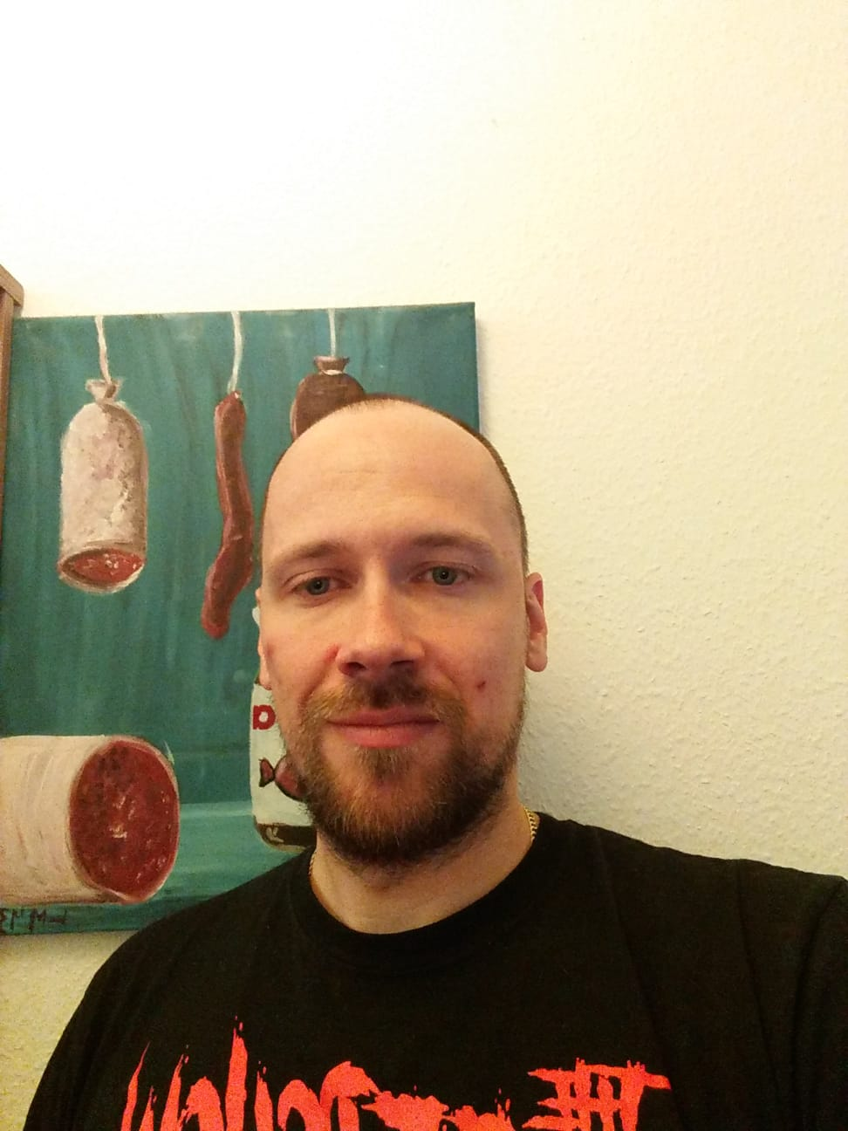
Thank you for your attention!

Slide 11
References
[1]Krauss, Christopher, and Stefan Arbanowski. "Social preference ontologies for enriching user and item data in recommendation systems." 2014 IEEE International Conference on Data Mining Workshop. IEEE, 2014.
[2] Schmid, Helmut. "TreeTagger-a language independent part-of-speech tagger." http://www.ims.uni-stuttgart.de/projekte/corplex/TreeTagger/ (1994).
[3] Remus, Robert, Uwe Quasthoff, and Gerhard Heyer. "SentiWS-A Publicly Available German-language Resource for Sentiment Analysis." LREC. 2010.
[4] Clematide, Simon, et al. "Evaluation and extension of a polarity lexicon for German." (2010): 7-13.

