Slide 1
Chatbot-Semantics: User Input Analysis
Kejni Dema, Eric Waldburger, Xu Jia Fug Liu | Project Advanced Web Technologies

Slide 2
Content
Rasa Pipeline
Language Detection
Sentiment Analysis
Stories & Rules
Live Data
What’s Next

Slide 3
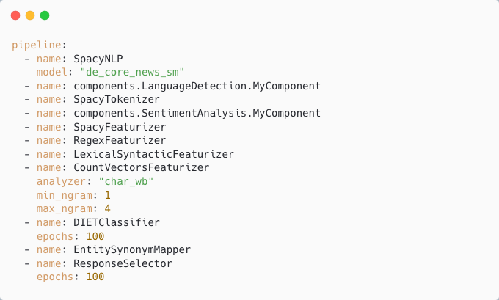
1. Rasa Pipeline

Slide 4
1. Rasa Pipeline cont.
Tokenizers:
Split an utterance into smaller chunks of text, known as tokens
Featurizers:
Generate numeric features for machine learning models
Two types of features:
Sparse Features: vector/matrix contains mostly zeros and few non-zero entries (i.e., generated by count-vectorizer)
Dense Features: contains mostly non-zeros (consist of pre-trained embeddings)
Intent Classifiers:
Classification of text based on sparse and/or dense features
Entity Extractors:
Detection of entities

Slide 5
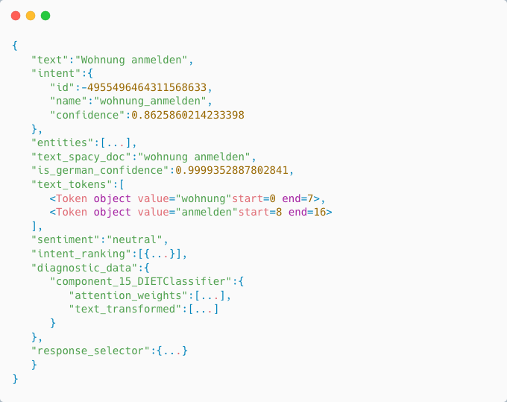
1. Rasa Pipeline cont.

Slide 6
2. Language Detection
Problem statement:
Detect language of input text
Supervised learning problem
Our approach:
Simple naive Bayes classifier
Based on character n-grams (Vatanen et al. (2010))
Data:
WiLI benchmark (Thoma, 2018): 1000 sentences from Wikipedia for 235 languages each (80/20 train test split)

Slide 7
2. Language Detection cont.
Model pipeline:
Count-vectorizer of character tri-grams (counts the number of occurrences of tri-grams for each language)
Naive Bayes classifier for multinomial models
Results:
German language statistics:
Precision: 96%
Recall: 97%
f1-score: 97%
Trained on 22 Indo-European languages:
Overall accuracy: 97%

Slide 8
3. Sentiment Analysis
Problem statement:
Identifying an expressed attitude in text
Supervised learning problem
Text classification problem
Three classes: negative, positive, neutral
Our approach:
Based on the paper: Bag of Tricks for Efficient Text Classification by Joulin et al. (2016)
Also known as fastText
“Simple”, yet powerful linear classifier for word embeddings

Slide 9
3. Sentiment Analysis cont.
fastText architecture:
Represent each sentence as “bag-of-words” (BoW)
e.g.: John likes to watch movies => "John","likes","to","watch","movies”
BoW is invariant to word order
But word order is often important
Word n-grams (bi-grams) as additional features to capture information about the word order
e.g.: "John","likes","to","watch","movies” => "John likes","likes to“, "to watch","watch movies"
Build vocab over training data and map words to pretrained word vectors (i.e., based on GloVe (Pennington et al., 2014))

Slide 10
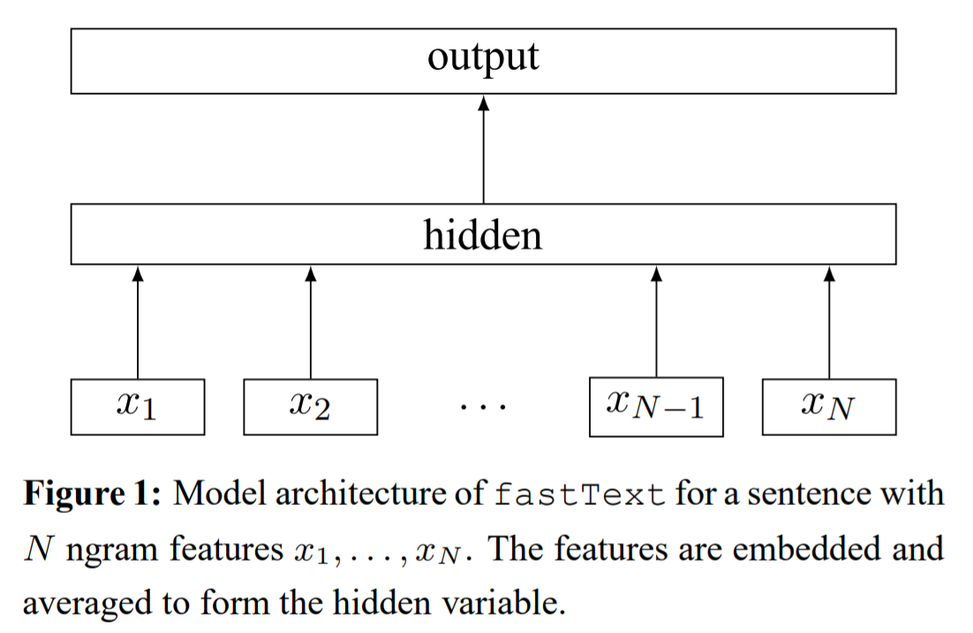
3. Sentiment Analysis cont.

Slide 11
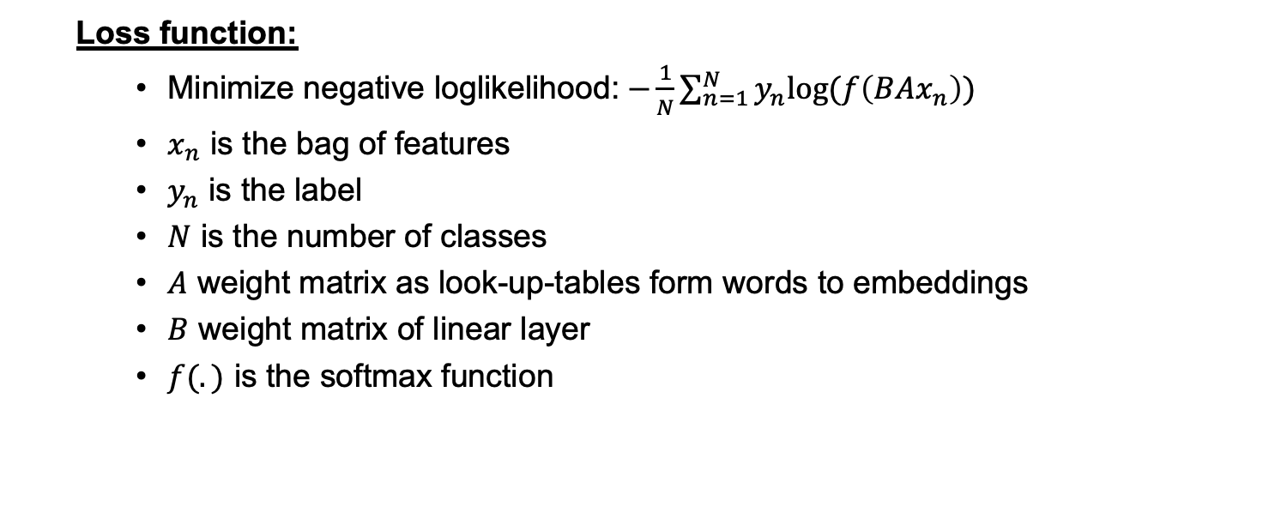
3. Sentiment Analysis cont.

Slide 12
3. Sentiment Analysis cont.
Data:
Holidaycheck (Guhr et al., 2020):
Holiday reviews (positive: 835,905, negative: 835,905, total: 1,671,810)
Filmstarts (Guhr et al., 2020):
Movie reviews (positive: 40,011, negative: 15,608, total: 55,619)
GermEval-2017 (Wojatzki et al., 2017):
customer reviews about “Deutsche Bahn” on Twitter (positive: 1,371, negative: 5,845, total: 7,216)
PotTS (Sidarenka, 2016):
Twitter (positive: 3,445, negative: 1,569, total: 5,014)
SB10k (Cieliebak et al., 2017):
Twitter (positive: 1,713 negative: 1,125 total: 2,838)
Leipzig mixed-typical corpus (Leipzig Corpora Collection, 2011)
Wikipedia sentences (neutral: 813,669)
Total: positive: 882,433, negative: 860,048, neutral: 813,669

Slide 13
3. Sentiment Analysis cont.
Data preprocessing:
Tokenization
Creation of word bi-grams
Lemmatization
Stop word removal
Implementation & results:
80/10/10 train, validation, test split
Vocab size: 100,000 features obtained from train set
Word embeddings: German GloVe (obtained from: deepset.ai/german-word-embeddings) with 300 dimensions
Linear layer with 10 hidden units
Adam optimization (Kingma et al., 2017) to train 30,003,033 parameters
Best found model: 88.13% test accuracy (90.05% validation accuracy) with learning rate: 0.001 (with 0.1 decay after each epoch), epochs: 5, batch size: 64

Slide 14
4. Stories & Rules
Recap:
Rules: describe short pieces of conversations that always should be followed
Stories: can generalize to unseen conversation paths
Rules implemented so far:
…
Stories implemented so far:
…

Slide 15


5. Live Data
Crawler:
Analyze requests for finding available dates
https://service.berlin.de/terminvereinbarung/termin/tag.php?termin=1&dienstleister=327346&anliegen[]=120703&herkunft=1
Find sources for topic/location to internal id mapping
Create mock requests to find all available days
Trying to access the available times is blocked by a Captcha

Slide 16
6. What’s Next
Integrate Crawler results into bot interaction

Slide 17
Thank you for your attention!

Slide 18
Appendix (some remarks)
Language Detection:
Naive Bayes classifier was trained on the following 22 languages:
Bosnian, Bulgarian, Czech, Danish, German, Modern Greek, English, French, Croatian, Italian, Latvian, Dutch, Polish, Portuguese, Romanian, Russian, Slovak, Slovene, Spanish, Serbian, Swedish, Turkish
is_german_confidence is the reported posterior probability over 22 classes that the input text is German
Weakness: relative high rate of misclassification for short text input (i.e., only one word consisting of 3-5 characters)
Sentiment Analysis:
Weakness: training data do not fit application domain; limited vocab size due to hardware restraints resulting in missing embeddings for “unseen” words
Instead of words one could use character n-grams to circumvent the missing embeddings problem of unseen words (as proposed by Bojanowski et al. (2017)), but that is probably not possible due to hardware restraints

Slide 19
References
Bojanowski, P., Grave, E., Joulin, A., & Mikolov, T. (2017). Enriching word vectors with subword information. Transactions of the Association for Computational Linguistics, 5, 135-146.
Cieliebak, M., Deriu, J. M., Egger, D., & Uzdilli, F. (2017, April). A twitter corpus and benchmark resources for german sentiment analysis. In Proceedings of the Fifth International Workshop on Natural Language Processing for Social Media (pp. 45-51).
Kingma, D. P., & Ba, J. (2014). Adam: A method for stochastic optimization. arXiv preprint arXiv:1412.6980.
Guhr, O., Schumann, A. K., Bahrmann, F., & Böhme, H. J. (2020, May). Training a Broad-Coverage German Sentiment Classification Model for Dialog Systems. In Proceedings of the 12th Language Resources and Evaluation Conference (pp. 1627-1632).
Joulin, A., Grave, E., Bojanowski, P., & Mikolov, T. (2016). Bag of tricks for efficient text classification. arXiv preprint arXiv:1607.01759.
Leipzig Corpora Collection (2011): German mixed-typical corpus based on material crawled in 2011. Leipzig Corpora Collection. Dataset. https://wortschatz.uni-leipzig.de/de/download/German
Pennington, J., Socher, R., & Manning, C. D. (2014, October). Glove: Global vectors for word representation. In Proceedings of the 2014 conference on empirical methods in natural language processing (EMNLP) (pp. 1532-1543).
Sidarenka, U. (2016, May). PotTS: the potsdam twitter sentiment corpus. In Proceedings of the Tenth International Conference on Language Resources and Evaluation (LREC'16) (pp. 1133-1141).
Thoma, M. (2018). The WiLI benchmark dataset for written language identification. arXiv preprint arXiv:1801.07779.
Vatanen, T., Väyrynen, J. J., & Virpioja, S. (2010, May). Language Identification of Short Text Segments with N-gram Models. In LREC.
Wojatzki, M., Ruppert, E., Holschneider, S., Zesch, T., & Biemann, C. (2017). Germeval 2017: Shared task on aspect-based sentiment in social media customer feedback. Proceedings of the GermEval, 1-12.

