Slide 1
Chatbot-Semantics: User Input Analysis
Kejni Dema, Eric Waldburger, Xu Jia Fug Liu | Project Advanced Web Technologies

Slide 2
Content

Slide 3
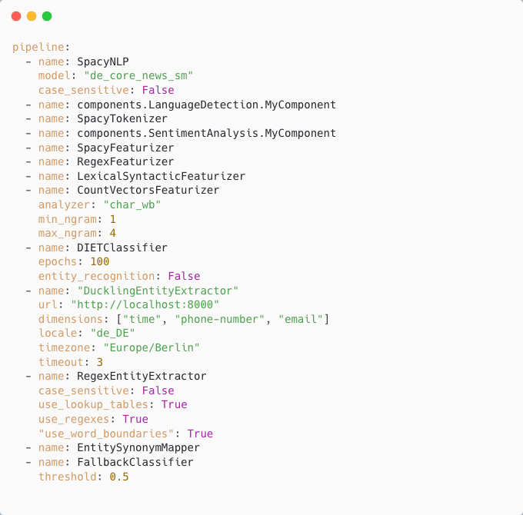
Updated Rasa NLU Pipeline

Slide 4
Integration of Sentiment Analysis & Language Detection
Sentiment Analysis:
To reduce amount of misclassification -> two stage fallback for bad sentiment
After bad sentiment is detected twice in a row, according actions will be triggered
Language Detection:
- Same two stage fallback approach as sentiment analysis
Implementation In Rasa:
Language and sentiment classes are saved as entities at first and than mapped to categorical slots with two categories (e.g., is German or not, is negative sentiment or not)
Since there is no wildcard intent -> [FallbackClassifier]
[FallbackClassifier] classifies all intents as nlu_fallback if intent confidence is below certain threshold

Slide 5
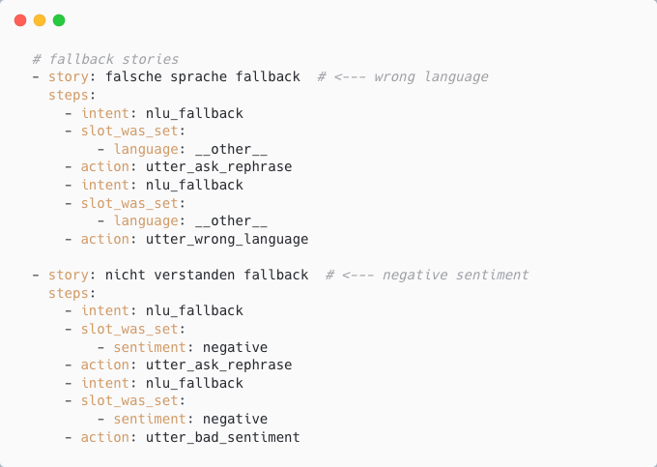
Integration of Sentiment Analysis & Language Detection cont.

Slide 6
Booking Process
Forms In Rasa
One of the most common conversation activities is to collect user provided information
Rasa built in concept: forms
Goal is it to fill slots
Slots can be filled by direct user answers or through entity recognition and extraction
direct user answer: requested slot: city; question: “Where do you live?”; answer: “Berlin”; set city slot to: Berlin
Entity recognition: answer: “I live in Berlin.”
Rasa also enables to use already extracted entities to be used later to fill slots
E.g.: user: “I want to book an appointment for next week.”; bot: activates form which requires time and name slot -> time slot will be filled by present time entity -> bot does not need to ask user about time anymore

Slide 7
Booking Process cont.
Required Slots For Our Booking Process
Service topic
District
Time
Name
Phone number
E-Mail address
Entity Recognition & Slot Filling
Time, phone number, e-mail: Duckling, rule-based (regex) text parser [DucklingEntityExtractor]
District: lookup tables with regex [RegexFeaturizer, RegexEntityExtractor]
Service topic: derived form story / intents
Name: direct user input

Slide 8
Booking Process cont.
Booking
Available appointments are can be saved in a relational database (i.e., SQLite)
When all required slots of the booking form are filled:
0. (optional) Rasa provides the option to perform validation of slots through custom actions; this is not need in our case
1.) trigger custom action which inserts booking into a database
2.) (not yet implemented) send confirmation e-mail to user
How To Get The Data About Available Appointments?
…

Slide 9
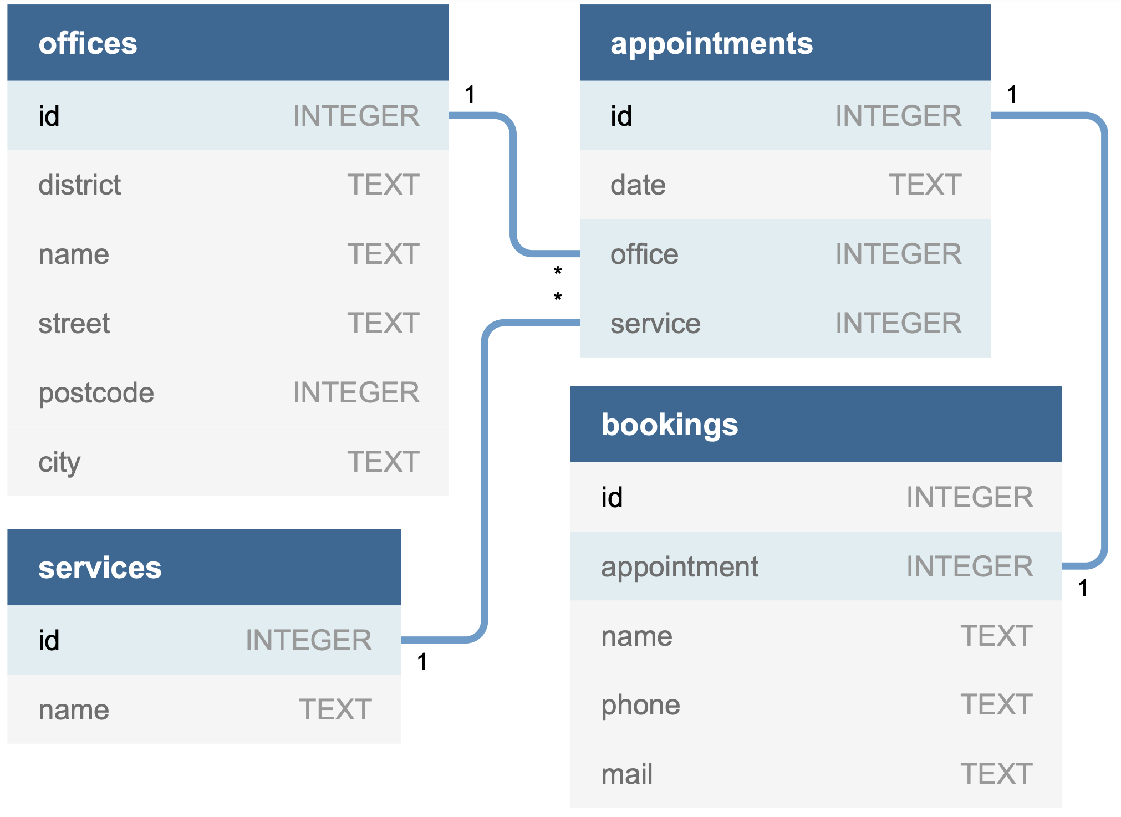
Booking Process cont.

Slide 10
Q&A Answering
Simple Approach
Each question is a different intent
Create create multiple stories or rules for multiple intents
(Optional: create one rule / story by using retrieval intents (categorical intents))
Create answers for all kind of intents / questions
Our Approach
Transformer neural network based approach
Introduction of transformer architecture by Vaswani et al. (2017)
Attention mechanism: compute similarity scores between words in a sentence
Non sequential input processing (not word by word) but use positional encoding
Superior to RNNs -> faster train time (no recursion) & no exponential forgetting
Used in NLP for language understanding & generation tasks

Slide 11
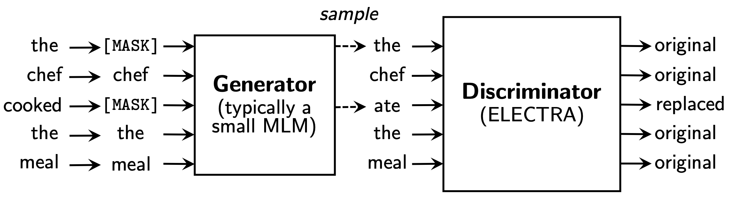
Q&A Answering cont.
Transformers & ELECTRA
We are using ELECTRA (Clark et al., 2020) for Q&A (trained by deepset.ai)
Two step training process:
1. Pre-Training: general language understanding
2. Fine-tuning: task-specific adaptation (downstream task)
ELECTRA pre-Training:
Different approaches for different transformer networks
Masked Language Modeling (MLM): random % of text is masked, goal is to recover masked text
Replaced Token Detection (RTD): find out whether a token is original or is made up by the generator

Slide 12
Q&A Answering cont.
Transformers & ELECTRA
ELECTRA fine-tuning:
GermanQuAD dataset (12MB train / 5MB test) which is the human translated SQuAD v1.1 dataset (Rajpurkar et al., 2016)
SQuAD is a reading comprehension dataset, a set of Wikipedia articles, where the answer to every question is a segment of text
Integration Into Rasa
Implementation of a custom NLG server
NLG server: response generation
Rasa still learns to predict actions and to react to user input based on past dialogues
If user asks a question -> NLG server forwards question to ELECTRA

Slide 13
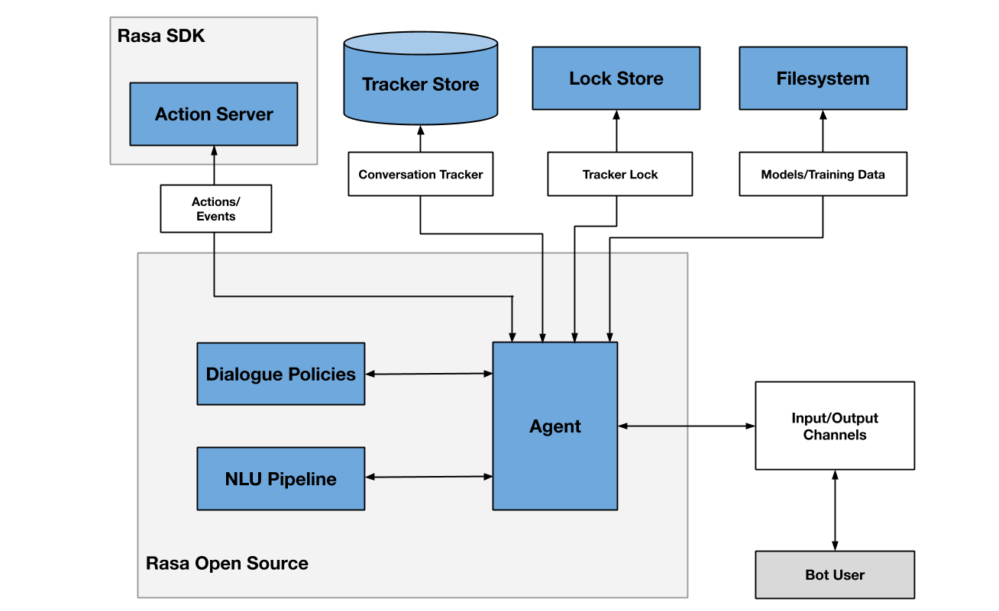
Q&A Answering cont.
Service Documents
Document Store
(ELECTRA)
NLG Server

Slide 14
Stories & Rules Summary
General Dialog Flow
User must pick a service topic first
Before a topic is set, user must confirm choice
When Topic picked, bot can answer FAQ regarding service
User can book an appointment for a service
What Is The Bot Also Capable Of?
Remembering already extracted entities which can be used to fill form slots later on
Jump between topics
Multiple questions in a row, because question are handled as rules
…

Slide 15
User Interface
Rasa Supported Input/Output Channels:
REST channel: post messages and either receive response messages directly, or asynchronously via a webhook
Websocket channel: provides bidirectional communication in real time
Our Simple Web UI:
JavaScript Socket.IO framework for websocket communication
JavaScript Botui (botui.org) framework to create a conversational UI
HTML + CSS to change the default appearance of Botui
Support of HTML and CSS markup of messages

Slide 16
Bot Demo

Slide 17
References
Clark, K., Luong, M. T., Le, Q. V., & Manning, C. D. (2020). Electra: Pre-training text encoders as discriminators rather than generators. arXiv preprint arXiv:2003.10555.
Rajpurkar, P., Zhang, J., Lopyrev, K., & Liang, P. (2016). Squad: 100,000+ questions for machine comprehension of text. arXiv preprint arXiv:1606.05250.
Vaswani, A., Shazeer, N., Parmar, N., Uszkoreit, J., Jones, L., Gomez, A. N., ... & Polosukhin, I. (2017). Attention is all you need. Advances in neural information processing systems, 30.

