Slide 1
PROJECTS (CHC 6096)
LECTURE - WEEK 6
Source Management and Version Control
2022/2023 - Semester 1

Slide 2
Lecture outline
Review of Lecture 5
Version Control
Git
Concluding Remarks

Slide 3
RECAP OF LECTURE 5: CONSOLIDATION OF CONTENT
Paying attention to formatting requirement and the content of previous Lectures is critical
Check at the Progress Report Requirements
Start Focusing on your Project Implementation

Slide 4

Why version control?

Slide 5
Version Control System
A tool that manages multiple versions of plain text files
Usually these files are program source code, but they can be any plain text file
Some VCSs can manage non-text files also, but in a less sophisticated way
Originally intended to help people work together on projects, but valuable for other purposes too

Slide 6
How version control helps
Much reduced risk of accidentally uploading a wrong version – only one version is visible at a time and you can find out if it’s the latest
Makes it much easier to archive working or milestone versions to retrieve later
Makes it easier to create a new copy to experiment on and then, if the experiment goes well, integrate the changes back to the original

Slide 7
Git
Git is a snapshot-based version control system used widely on the internet
It was created for tracking the source code of Linux and evolved from there
It includes aspects of both version control and the more sophisticated software configuration management (SCM)

Slide 8
Setting up
You can access Git in several ways
Through the command line and standard GUI interface available at https://git-scm.com/download/win
Using a third party tool like TortoiseGit or Tower
Using software provided by a hosting provider such as GitHub
Many IDEs such as Eclipse, NetBeans, etc include support for Git.
This lecture focuses on the standard GUI. The terminology and commands are the same in almost all interfaces.

Slide 9
Hosted Git
Services like GitHub offer to hold your work in the cloud
GitHub normally charges a fee for private storage, but for students a plan is available for free
Do not upload your project to public storage!
You do not have to use hosted Git. You can store your work on the Hard drive or a USB stick and still manage it with Git

Slide 10
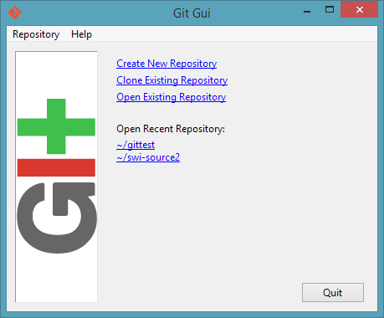
Starting Git
Choose “Create New Repository”
Give the name of an empty directory (you can move existing work in later)

Slide 11
Git Terminology
Git uses a special area called the repository to store data about your files
This stores your actual files, their previous versions, and information used by Git to synchronize them
It is placed in a hidden directory called .git
Do not alter anything in the .git directory directly

Slide 12
Git Terminology
The directory you specify to Git when you create a repository becomes the working directory
This holds the version you are currently working on, and is where you make changes
Changes you make in the working directory are copied to the repository by Git

Slide 13
Git Terminology
Files in Git are in one of three states
A file is Committed if the repository has a copy of the current version
A file is Modified if it has been changed since it was sent to the repository
A file is Staged if it is has been changed, and the changed version is ready to be sent to the repository, but has not actually been sent yet

Slide 14
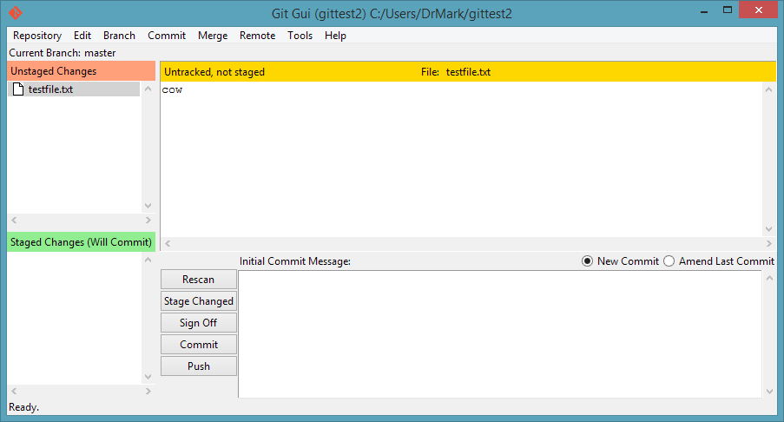
Status
If you copy or create files in your working directory, they will appear as “unstaged, uncommitted changes”

Slide 15
Staging and adding files
Clicking “stage changed” copies your changed files to the staging area.

Slide 16
Modifying further
When the file is staged a copy is taken.
Modifying a file that has been staged will not modify the staged version.
When you commit your work to the repository, the staged file will be committed, not the modified one.
Pressing the Rescan button checks the directory for new changes.
Pressing Stage Changed again will update the staged files.

Slide 17
Saving to the repository
To save files to the repository, type a Commit Message into the box on the right, then click Commit.
The Commit Message can be anything you like. It is saved to the repository with the files as a note to yourself to remember what changes you made.

Slide 18
Variant terms
Some IDEs and interfaces hide the staging step and just let you commit changes directly.
Some interfaces, including the command line, refer to staging a file as adding it.

Slide 19
Saving to the repository
Your file does not disappear once it is saved to the repository.
You can continue working on the file, then Rescan, stage and commit again when you have made useful changes.
Git will keep a record of every version you commit.

Slide 20
Undoing changes
If you realize your changes were a mistake, you can get back the last committed version.
To get back the last committed or staged version: Commit > Revert Changes
To undo staging, if you staged a file wrongly by mistake: Commit > Unstage from Commit

Slide 21
Beware
If you revert your file back to an older version in this way, you can’t get the newer file back.
Always be sure you want to do this before entering the command.
Remember you can always Rescan to see all files that have been changed since your last staging or commit.

Slide 22
Version History
Every time you store a commit, Git adds it to the history in your repository.
A series of commits form a chain.
You can view the current commit chain via Repository > Visualize All Branch History.
A
B
C
D

Slide 23
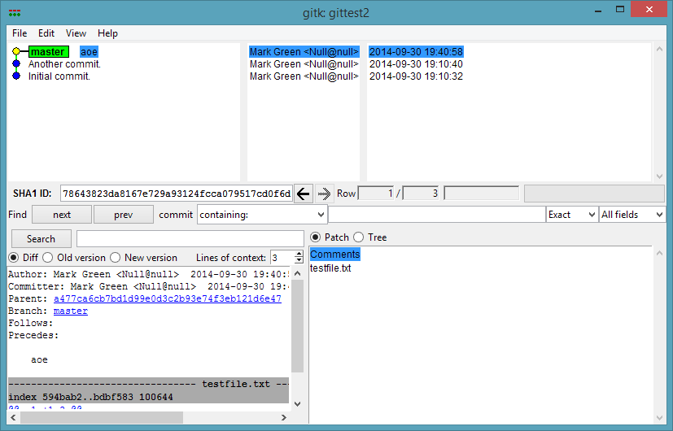
Showing Version History
List of commits and dates and times.
“Master” indicates most recent commit.

Slide 24
Using History
Whenever you test a version of your program and it works, commit.
If you make changes that break your program, restore the last committed version.

Slide 25
.gitignore
If your working directory contains a text file named .gitignore, any file named in it or matching a name in it will not be staged or committed.
This is usually used for files (eg Java .class files) which will be in your project directories but not useful to version control.
Most IDEs that support Git will automatically add a .gitignore file for you.

Slide 26
Going further back
We have seen how to get back your last commit.
What happens if you want to restore a commit that’s further back?
A
B
C
D

Slide 27
Going further back
What happens to the work done in commits C and D? Should it just be thrown away?
Git allows you to restore to point B, and work on from there, while retaining the work in C and D if you decide you need it.
A
B
C
D

Slide 28
Branches and heads
A project can have several commit chains at once by creating a branch.
Each branch has a “head”, which is the most recent commit on the branch.
By default, when you first create a project, you are creating the master branch.

Slide 29
Version History
Master Head
A
B
C
D

Slide 30
Creating a branch
Master Head
A
B
C
D
Experimental Head

Slide 31
Extending a branch
Master Head
A
B
C
D
E
Experimental Head

Slide 32
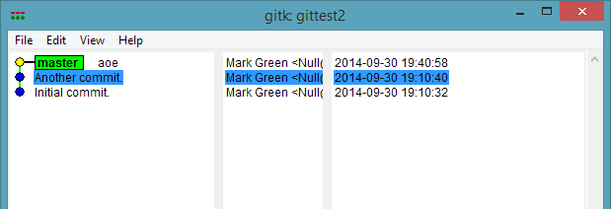
Creating a branch
Enter Repository > Visualize All Branch History.
Right click the commit you want to start from.
Choose “create new branch”.
Right Click

Slide 33
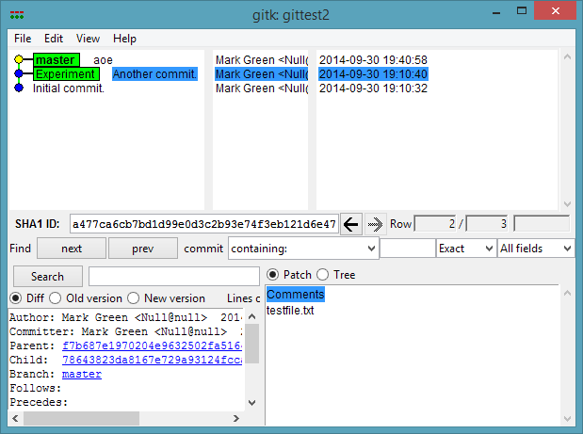
Created branch
Green text shows head of the new branch

Slide 34
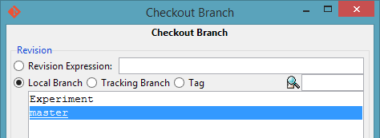
Activating a branch
Once you have created a branch, you must switch your work directory to that branch before you start making changes.
Close the visualization window and choose Branch > Checkout.
Choose your new branch.

Slide 35
Checking out a branch
At this point all files in your working directory will revert to their versions at the time of your past commit, B.
Also, note that the “current branch” has changed in the Git GUI.
You can then make changes and stage and commit them in the normal way, and the alternative branched version will be updated instead of the master version.

Slide 36
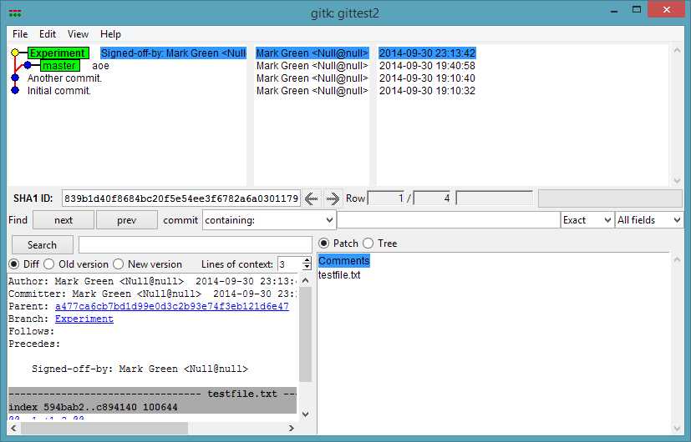
Displaying a branch
Branch head has moved on to recent commit
Point where branches diverge

Slide 37
Using a branch
You can now use Branch > Checkout to check the master branch back out and restore your older version.
You can return to the experimental branch whenever you like by using Branch > Checkout again.
In NetBeans, etc, there is often a “branch” selector in the corner of the editor that you can click on to instantly change the opened branch.

Slide 38
Using branches
If you have made changes that break your program, but think you might fix them in the future, commit them then create a branch at the last working version.
Check out this branch and you have your program working again and your changes still available on the original branch.

Slide 39
Using branches
If you have two ideas for how to solve a problem, commit your program before you start, then create a new branch.
Try the first idea and see how it goes. Commit it, then restore the original branch.
Create another branch, try the second idea and see how it goes. You can now switch between them any time.

Slide 40
Merging Branches
Tag: First Release
Master Head
A
B
C
D
E
Experimental Head
What happens if two branches both contain parts of valuable work?
Git will allow branches to be recombined. This process is called merging.

Slide 41
Merging Branches
Tag: First Release
Master Head
A
B
C
D
F
E
Experimental Head
You can merge a branch into an existing branch by initiating a merge straight away..

Slide 42
Merging Branches
Tag: First Release
Master Head
A
B
C
D
F
Combined Head
E
Experimental Head
Or you can create a new branch, check that out, then merge another branch into it; this gives you a new branch for the merged version.

Slide 43
Performing a Merge
Check out the first branch you want to merge.
Choose Merge > Local Merge and choose the other branch.

Slide 44
How Merging Works
Merging is based on comparing the two versions, which we shall call A and B.
The base version is also considered.
Since A and B are branches, at some point they must have branched off from a common point.
That version is the base version.

Slide 45
Merging
Tag: First Release
Master Head
A
B
C
D
F
Combined Head
E
Experimental Head
B is the base version.

Slide 46
How Merging Works
If a file is unchanged from the base version in both A and B, it stays unchanged.
If a file is changed from the base in A but not B, the changed version is kept.
If a file is changed from the base in both versions, and the changes are different, a conflict occurs and the merge must be resolved manually.

Slide 47
Manual Merging
When a file is changed in two branches, usually human intervention is required to work out how to combine the changes.
In written text, it may be OK to just apply all changes compared to the base.
In a program, it may be necessary to analyze how the changes might interact.
IDEs at this point can be very helpful. They can identify the changes between merges and let you choose which to keep.

Slide 48
Fear, Uncertainty and Doubt
Many users – even experienced users – fear using version control because they are afraid of losing work
Git tries its best to avoid ever losing work in either the working directory or committed files and ultimately is much less likely to lose work than other methods
However, the fear is understandable, but can be dealt with properly

Slide 49
Assuaging Fears
You can make your own backups of versions as long as
They are outside of the Git working directory
They do not include the hidden .git directory
If you bring these backups back into Git, they will appear as “new versions” but this may be OK

Slide 50
Assuaging Fears
If you start a merge that you can’t complete, some interfaces get “stuck” and will not let you proceed with anything
If this happens, you can always use the command line Git to recover. Start Git Bash, cd to your working directory:
Git merge ––abort will undo the merge, roll all files back to how they were before you started merging, and close the merge so you can do other things again
Git checkout ––conflict will roll all files back to the start of the merge, letting you start the merging process again and correct any mistakes you made

Slide 51
Assuaging fears
Another common way to get “stuck” is to be unable to change branches because an irrelevant file in the working directory has changed
Git will never change branches while there are changed files in the work directory to prevent losing work.
But if an IDE or compiler or other program has updated an irrelevant file (such as a preference configuration) this may stop you changing branches even though the file is nothing to do with you and you don’t care about it

Slide 52
Assuaging fears
Remove the irrelevant file from tracking: git rm --cached <filename>
After doing this, add it to .gitignore to prevent it happening again.
If you need to get unstuck quickly and you are absolutely positive that none of the changed files matter: git reset --hard HEAD This can lose work (since it is explicitly telling Git to bypass its safety mechanism)

Slide 53
Assuaging fears
When you check out an old version, you may get an ominous message about being “in detached head state”
Don’t panic! This just means “there’s no branch here so if you commit changes now, I won’t know what branch they should be on”. If you don’t intend to make changes it can be ignored
If you do make changes you can create a branch from the version you checked out

Slide 54
Remote access
If you use a remote hosting service such as GitHub, you will also be offered options to Push and Pull your repository
Push means Upload and merge; Pull means Download and merge
If you use remote sync, always pull before you start working and push when you finish. If you forget, your local and remote versions may go out of sync and you will have to merge them

Slide 55
QUESTIONS Time
Any questions regarding today’s content is highly welcomed…

Slide 56
CONCLUDING REMARKS
Getting Help: send your questions to your supervisors or the module leader.
Start working on your project. The report writing and project coding can be done simultaneously. It saves you time.
Enjoy your project!

