Slide 1
PROJECTS (CHC 6096)
LECTURE - WEEK 7
Testing & Evaluation
2022/2023 - Semester 1

Slide 2
Lecture outline
Review of Lecture 6
Testing and Evaluation of Sotware Development Projects
Testing and Evaluation of Machine Learning Projects
Concluding Remarks

Slide 3
RECAP OF LECTURE 6: SOURCE MANAGEMENT & VERSION CONTROL
Git makes it much easier to archive working or milestone versions to retrieve later
With Git there is much reduced risk of accidentally uploading a wrong version – only one version is visible at a time and you can find out if it’s the latest
Git makes it easier to create a new copy to experiment on and then, if the experiment goes well, integrate the changes back to the original

Slide 4
Testing and Evaluation of Sotware Development Projects

Slide 5
DEFINITION OF SOFTWARE TESTING
Software testing is the process of evaluating and verifying that a software product or application does what it is supposed to do.
The benefits of testing include preventing bugs, reducing development costs and improving performance.

Slide 6
software testing approaches
Afterwards: Only test the functionality and efficacy after implementation or design. Can be appropriate when others are not suitable.
Continuous: This approach ensures that test results are included in the project cycle, but may interrupt process.
Before (Test-Driven Development): Design testing together with specification, ensures correct results during implementation

Slide 7
Test-driven development (TDD)
TDD is based on practical experience of low-level software development
Agile can be seen as an extension of this concept, also known as the test-first approach
It relies on creating test conditions for each part of your system, and then completing the system, ensuring that all tests pass at all times.

Slide 8
WHAT IS TDD?
The motto of test-driven development is
Red, Green, Refactor.
Red: Create a test and make it fail.
Green: Make the test pass by any means necessary.
Refactor: Change the code to remove duplication in your project and to improve the design while ensuring that all tests still pass.

Slide 9
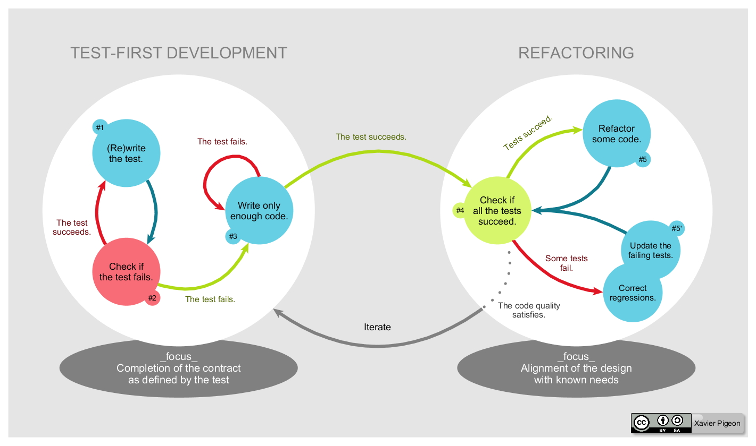
TDD Development Cycle

Slide 10
Types of software testing
Acceptance testing: Verifying whether the whole system works as intended.
Integration testing: Ensuring that software components or functions operate together.
Unit testing: Validating that each software unit performs as expected. A unit is the smallest testable component of an application.
Functional testing: Checking functions by emulating business scenarios, based on functional requirements. Black-box testing is a common way to verify functions.

Slide 11
Types of software testing
Performance testing: Testing how the software performs under different workloads. Load testing, for example, is used to evaluate performance under real-life load conditions.
Regression testing: Checking whether new features break or degrade functionality. Sanity testing can be used to verify menus, functions and commands at the surface level, when there is no time for a full regression test.
Stress testing: Testing how much strain the system can take before it fails. Considered to be a type of non-functional testing.
Usability testing: Validating how well a customer can use a system or web application to complete a task.

Slide 12
Why is software testing important?
Avoid financial loss
Nissan had to recall over 1 million cars due to a software defect in the airbag sensor detectors
Software failures in the US cost the economy USD 1.1 trillion in assets in 2016.
Avoid Architectural flaws
Prevent poor design decisions
Correct invalid or incorrect functionality
Alleviate security vulnerabilities
Manage scalability issues

Slide 13
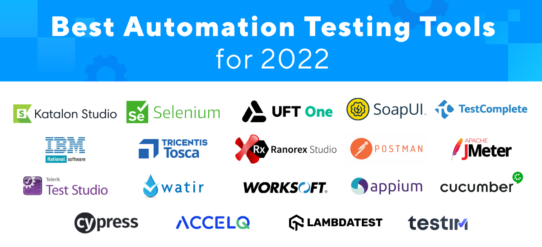
TOOLS FOR SOFTWARE TESTING

Slide 14
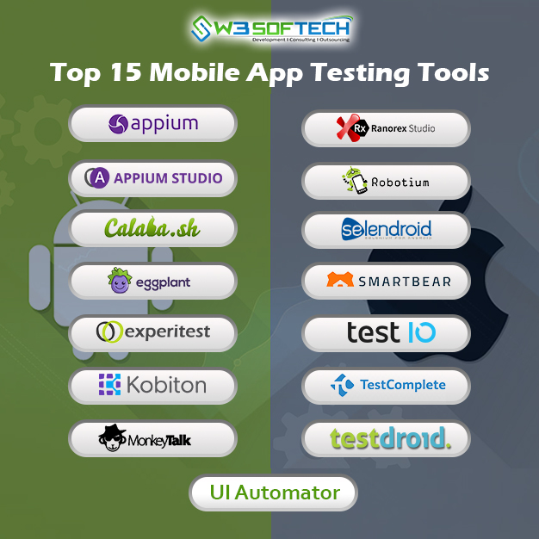
TOOLS FOR SOFTWARE TESTING

Slide 15
Limitations OF SOFTWARE TESTING
A test is only as good as the developer says it is.
Sometimes testing is too trivial, or too complex.
There are certainly always scaling issues.
Demonstrate suitability of testing by the incorrect result only.
You will need to use your best judgement, this will come with experience and practice.

Slide 16
EVALUATION OF SOFTWARE PROJECTS
Critical examination of the project.
Usually not Assessment (ranking or value).
Not about proving success, but accurately recording achievements and lessons learned from the process.
Evaluation can be done internally, e.g. yourself.
It can be done by an external evaluator, somebody not involved in the project.
Take care when you are internal evaluator, you do not presume the outcome of the evaluation, it should be evidence based.

Slide 17
Testing and Evaluation of MACHINE LEARNING Projects

Slide 18
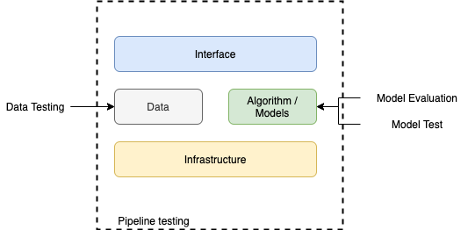
THE SCOPE OF MACHINE LEARNING PROJECTS TESTING

Slide 19
DATA TESTING
Data testing is the process of ensuring new data satisfies your assumptions. This testing is needed before we train a model and make predictions.
Example: ensuring that the different classes of the dataset are balanced.

Slide 20
MODEL EVALUATION & TESTING
This process is all about evaluating how good your ML pipeline is. Depends on the metrics and dataset set you’re using.
Types of Model Evaluation & Testing
Pre-train Testing- allows you to catch the bugs before even running the model
Post-train Testing - is used to check whether a model performs all the validations correctly or not. The post-train testing deals with the job behaviour. There are basically of three types.
Invariant tests - check how the input data is changing without affecting the entire performance of the Machine Learning model.
Directional tests - is a type of hypothesis testing where a direction of testing is specified earlier to the testing.
Minimum functional tests -is used to check whether the software or model is working according to the pre-requisite dataset or not.

Slide 21
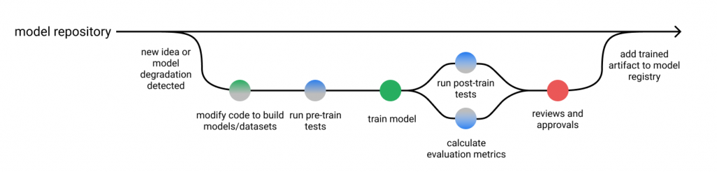
How to Test Machine Learning Models?

Slide 22
Pipeline testing
Pipeline testing is about ensuring your pipeline is set up correctly.
It’s like the integration tests in SWE.
For the ML system, it may measure consistency (reproducibility) as well.

Slide 23
IMPORTANT POINTS ABOUT ML PROJECTS TESTING
Machine learning systems are not straightforward to test, not only because it includes more components (code + data) to verify, but also it has a dynamic nature.
Models can be stale because of the data change (data drift) or the nature of things change (concept drift) over time.
Automated testing is an essential component in CI / CD to verify the correctness of pipelines with a low footprint.
While manual tests and human-in-the-loop verification are still crucial steps before we say a new ML pipeline is production-ready.
After a pipeline has been released to production, continuous monitoring and evaluation can ensure we’re not flying blind.
Customer feedback-based tests (.i.e A/B tests) are able to tell us if the problem we are trying to solve is actually getting better.

Slide 24
QUESTIONS Time
Any questions regarding today’s content is highly welcomed…

Slide 25
CONCLUDING REMARKS
Getting Help: send your questions to your supervisors or the module leader.
Continue working on your project. The report writing and project coding can be done simultaneously. It saves you time.
Enjoy your project!

