Slide 1

Projects: Testing and Evaluation
Tjeerd olde Scheper - 2021

Slide 2
Testing

Slide 3
Testing approaches
Afterwards: Only test functionality end efficacy after implementation or design. Can be appropriate when others are not suitable.
Continuous: This approach ensures that test results are included in the project cycle, but may interrupt process.
Test-Driven Development (Before): Design testing together with specification, ensures correct results during implementation.

Slide 4
Characteristics of a Good Unit Test - 1
A good unit test has the following characteristics.
Runs fast, runs fast, runs fast. If the tests are slow, they will not be run often.
Separates or simulates environmental dependencies such as databases, file systems, networks, queues, and so on. Tests that exercise these will not run fast, and a failure does not give meaningful feedback about what the problem actually is.
Is very limited in scope. If the test fails, it's obvious where to look for the problem. Use few Assert calls so that the offending code is obvious. It's important to only test one thing in a single test.

Slide 5
Characteristics of a Good Unit Test - 2
A good unit test has the following characteristics.
Runs and passes in isolation. If the tests require special environmental setup or fail unexpectedly, then they are not good unit tests. Change them for simplicity and reliability. Tests should run and pass on any machine. The "works on my box" excuse doesn't work.
Often uses stubs and mock objects. If the code being tested typically calls out to a database or file system, these dependencies must be simulated, or mocked. These dependencies will ordinarily be abstracted away by using interfaces.
Clearly reveals its intention. Another developer can look at the test and understand what is expected of the production code.

Slide 6
Test-driven development (TDD)
TDD is based on practical experience of low-level software development
Agile can be seen as an extension of this concept, also known as the test-first approach
It relies on creating test conditions for each part of your system, and then completing the system, ensuring that all tests pass at all times.

Slide 7
What is TDD?
The motto of test-driven development is
Red, Green, Refactor.
Red: Create a test and make it fail.
Green: Make the test pass by any means necessary.
Refactor: Change the code to remove duplication in your project and to improve the design while ensuring that all tests still pass.
Guidelines for Test-Driven Development
https://msdn.microsoft.com/en-us/library/aa730844(v=vs.80).aspx

Slide 8
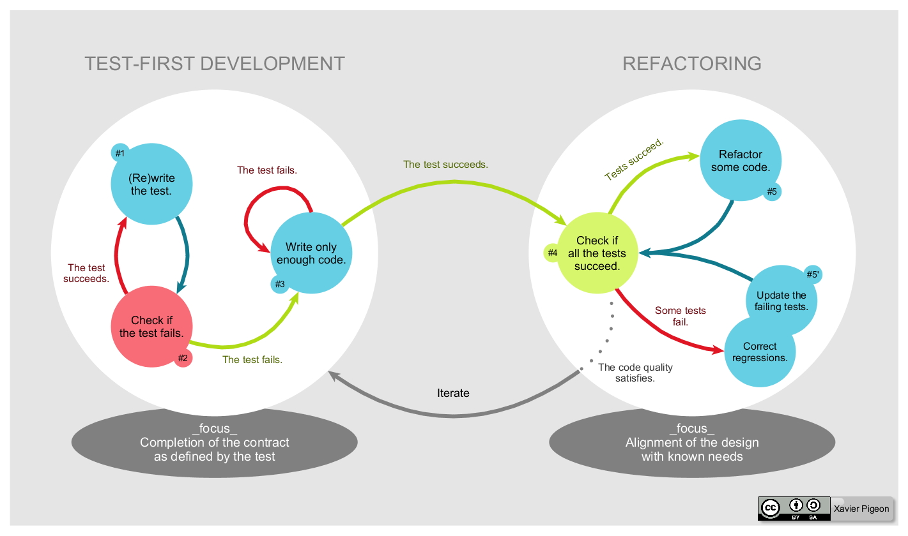
TDD Development Cycle
By Xarawn - Own work, CC BY-SA 4.0
https://commons.wikimedia.org/w/index.php?curid=44782343

Slide 9
TDD Steps - 1
Understand the requirements of the story, work item, or feature that you are working on.
Red: Create a test and make it fail.
Imagine how the new code should be called and write the test as if the code already existed.
Create the new production code stub. Write just enough code so that it compiles.
Run the test. It should fail. This is a calibration measure to ensure that your test is calling the correct code and that the code is not working by accident. This is a meaningful failure, and you expect it to fail.

Slide 10
TDD Steps - 2
Green: Make the test pass by any means necessary.
Write the production code to make the test pass. Keep it simple.
Some advocate the hard-coding of the expected return value first to verify that the test correctly detects success. This varies from practitioner to practitioner.
If you've written the code so that the test passes as intended, you are finished. You do not have to write more code speculatively. The test is the objective definition of "done." The phrase "You Ain't Gonna Need It" (YAGNI) is often used to veto unnecessary work. If new functionality is still needed, then another test is needed. Make this one test pass and continue.
When the test passes, you might want to run all tests up to this point to build confidence that everything else is still working.

Slide 11
TDD Steps - 3
Refactor: Change the code to remove duplication in your project and to improve the design while ensuring that all tests still pass.
Remove duplication caused by the addition of the new functionality.
Make design changes to improve the overall solution.
After each refactoring, rerun all the tests to ensure that they all still pass.
Repeat the cycle. Each cycle should be very short, and a typical hour should contain many Red/Green/Refactor cycles.

Slide 12
TDD Benefits - 1
The suite of unit tests provides constant feedback that each component is still working.
The unit tests act as documentation that cannot go out-of-date, unlike separate documentation, which can and frequently does.
When the test passes and the production code is refactored to remove duplication, it is clear that the code is finished, and the developer can move on to a new test.
Test-driven development forces critical analysis and design because the developer cannot create the production code without truly understanding what the desired result should be and how to test it.

Slide 13
TDD Benefits - 2
The software tends to be better designed, that is, loosely coupled and easily maintainable, because the developer is free to make design decisions and refactor at any time with confidence that the software is still working. This confidence is gained by running the tests. The need for a design pattern may emerge, and the code can be changed at that time.
The test suite acts as a regression safety net on bugs: If a bug is found, the developer should create a test to reveal the bug and then modify the production code so that the bug goes away and all other tests still pass. On each successive test run, all previous bug fixes are verified.
Reduced debugging time!

Slide 14
Limitations
A test is only as good as the developer says it is.
Sometimes testing is too trivial, or too complex.
There are certainly always scaling issues.
Demonstrate suitability of testing by the incorrect result only.
You will need to use your best judgement, this will come with experience and practice.

Slide 15
Evaluation
Based on Royal Society of Engineering Guidelines

Slide 16
Evaluation
Critical examination of the project.
Usually not Assessment (ranking or value).
Not about proving success, but accurately recording achievements and lessons learned from the process.

Slide 17
Internal versus External
Evaluation can be done internally, e.g. yourself.
It can be done by an external evaluator, somebody not involved in the project.
Take care when you are internal evaluator, you do not presume the outcome of the evaluation, it should be evidence based.

Slide 18
Planning Evaluation
What do you want to find out?
How will this help you?
How much time, (money), and effort do you need to commit?
What type of audience do you need to sample? What challenges will they present?
What are the most effective methods for achieving your evaluation aims?
How will you disseminate the results of your evaluation to your stakeholders?

Slide 19
Do not start with choosing your methods
Clearly define the aims of your evaluation before beginning to think about evaluation methods. Once you have defined your aims, you should choose the methods that best deliver your aims within the resources available to you.

Slide 20
Do not collect data simply because it is easy to collect.
Often the most useful data is the most difficult to collect. Ask ‘how will this help you?’ to help you filter out evaluation objectives that may yield data that is easy to collect but of little value in terms of evaluation and learning.

Slide 21
Do not only collect evidence of success.
This is likely to give you a distorted picture of what actually happened with your project. You may also lose the opportunity to learn useful lessons for future projects.

Slide 22
Do not become over-ambitious in data evaluation
This could include aiming for too large a sample or the choosing to use overly complex methods for your evaluation. Be mindful of the resources available for carrying out your evaluation – and don’t let the perfect become the enemy of the good.

Slide 23
Key Outcomes
Metrics: You will need to report metrics in terms of the number and type of activities completed, the number and type of participating engineers involved and the number and type of public audiences reached.
Experiences: Was the use of your system enjoyable, well-organised, thought-provoking, and worthwhile?
Impacts: These are relate to the benefits gained in terms of increased knowledge, deeper understanding, skills that are developed and attitudes changed.

Slide 24
Different Evaluation Approaches
Before-and-after evaluation: used to compare audience members' knowledge and attitudes before and then after an activity. Asking the same questions at each stage gives a measure of any changes. However, this type of design can be labour-intensive.
After-only evaluation: where opinions are gathered after the event. For example, your evaluation could ask respondents to reflect on their knowledge and attitudes prior to the activity and how they feel it has change as a result of the activity. Although this is easier to do than before- and-after evaluation it is important to remember you are relying upon respondents to honestly and accurately assess any changes in knowledge and attitudes. (Student feedback!)
Quantitative or Qualitative or Mixed: collect data from resources or users using mixed methods.

Slide 25
Data collection methods
Observation: suitable for data related to behaviour, may be biased or incomplete
Interview: allows collection of wider in-depth data, may be biased, requires skill, and is expensive
Focus group: very mixed source of data, requires skill, is expensive, and needs to be representative
Questionnaire: cheap, appropriate questions are crucial to the result, low response is a problem
Data mining: extract information from system output, or objective system generation, can be time consuming, and not always informative

Slide 26

Data Evaluation
A common problem in computing is the issue of evaluating data used to build a model.
A basic approach is to divide the data into two sets, training (or development), and testing data:
You should never evaluate your system or model on the same data used for training!

Slide 27
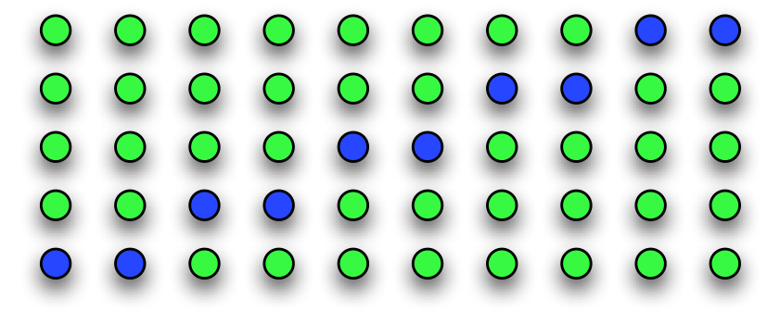
Cross-validation
A better approach is to split the data into H segments and then iteratively training on H − 1 segments and testing on the remaining one, repeating this procedure so each segment is used for testing once:
This approach reduces the likelihood of selecting a biased training/test split at the cost of having to train and test multiple models.

Slide 28
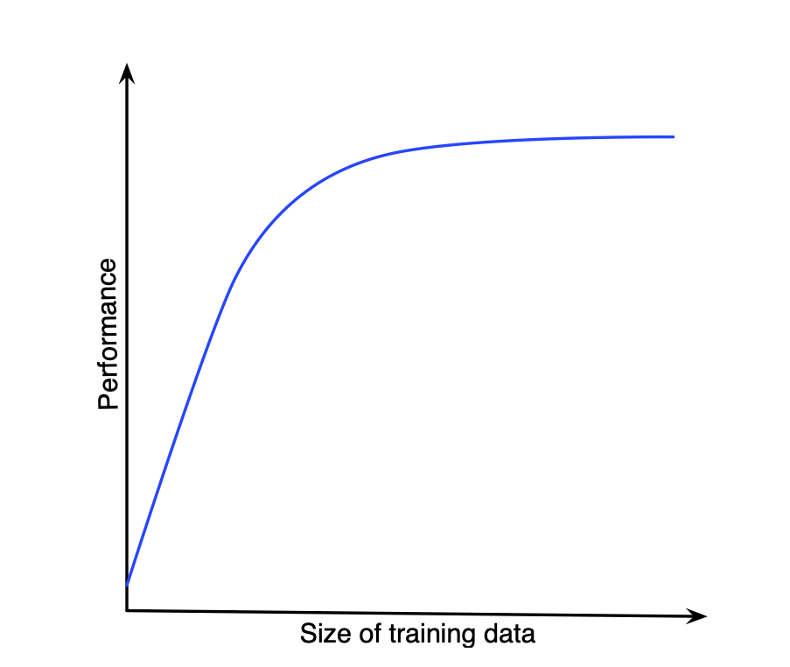
Cross validation limitations
If the amount of training data is in the steep part of the learning curve, the results from cross-validation will not be representative.

Slide 29
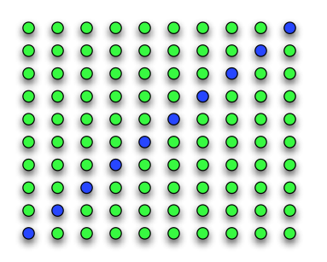
Leave-one-out
Leave-one-out evaluation takes cross-validation to the extreme by training on all but one of the data points, and testing on the one point left out:
This approach has less bias from the change in the training data size, though requires training many models and thus may be impractical for some algorithms.
However, it is a suitable approach for most computing data.

Slide 30
Reporting on Evaluation
In your discussion, you should include the outcomes of your evaluation.
Focus on the Key Outcomes (impact, experience, metrics).
Comment on the difference with the outcomes with your design.
Show what you have learned based on the evaluation (provide proof).
Show how the work can be sustained, continued, or improved.

Slide 31
Conclusion
Testing is a good idea…
Use appropriate testing approaches whenever possible.
Testing should help your evaluation.
Evaluation should be evidence driven on produced results.
The key element of testing and evaluation is your ability to critically reflect on your work based on objective measures (where possible).

