Slide 1

Hotel BOOKING CANCELLATION PREDICTION APP
“Plan for what it is difficult while it is easy, do what is great while it is small.”
― Sun Tzu, The Art of War

Slide 2




Motivation
35.9% average booking cancellation rate in 2020 and 31.9% average booking cancellation rate in 2021 hurt hotels’ revenue by a lot, lowering their revenue and profits.
By carrying out booking cancellation predictions, the hotels can refine their pricing strategy and resources allocation.
Free Booking
Travel Disruption
Source: http://blog.netaffinity.com/cancellation-trends-where-do-they-stand-and-how-can-you-overcome-them

Slide 3



LINK TO APP
http://msia423-361876428.us-east-1.elb.amazonaws.com/

Slide 4



DATA & RDS
The data is extracted from Hotel Booking Demand Datasets written by Nuno Antonio, Ana de Almeida and Luis Nunes. The dataset comprises of bookings for a resort hotel and a city hotel, including the bookings that effectively arrived and were cancelled.
Booking Details
Saving Bookings
Prediction
+ Past Bookings
Query Past Bookings
User
Application
RDS
Source: Nuno Antonio, Ana de Almeida, Luis Nunes, Hotel booking demand datasets, Data in Brief, Volume 22, 2019, Pages 41-49, ISSN 2352-3409, https://doi.org/10.1016/j.dib.2018.11.126. (https://www.sciencedirect.com/science/article/pii/S2352340918315191)

Slide 5
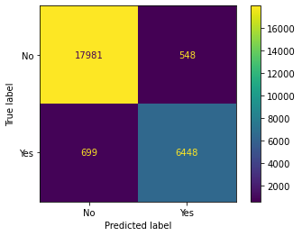
MODEL & SUCCESS CRITERIA
Label | Precision | Recall | F1-score | Support
0 | 0.96 | 0.97 | 0.97 | 18529
1 | 0.92 | 0.90 | 0.91 | 7147
Accuracy |  |  | 0.95 | 25676
Macro Avg | 0.94 | 0.94 | 0.94 | 25676
Weighed Avg | 0.95 | 0.95 | 0.95 | 25676
The decision tree model achieved macro average F1-score of 0.94 and weighted average F1-score of 0.95, which fulfils the predefined success criteria of F1-score greater than 0.9. The model is deployed online, and can make prediction on the fly based on user’s input.
Metric Term | Definition
Precision | : Percentage of correct prediction
Recall | : Fraction of positive that were correctly identified
F1 Score | : Weightage average between Precision and Recall
Support | : Number of occurrences

Slide 6
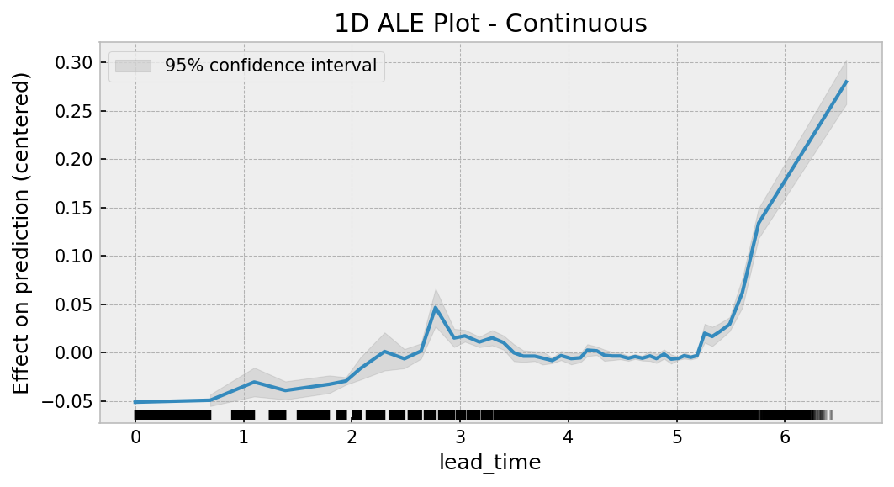
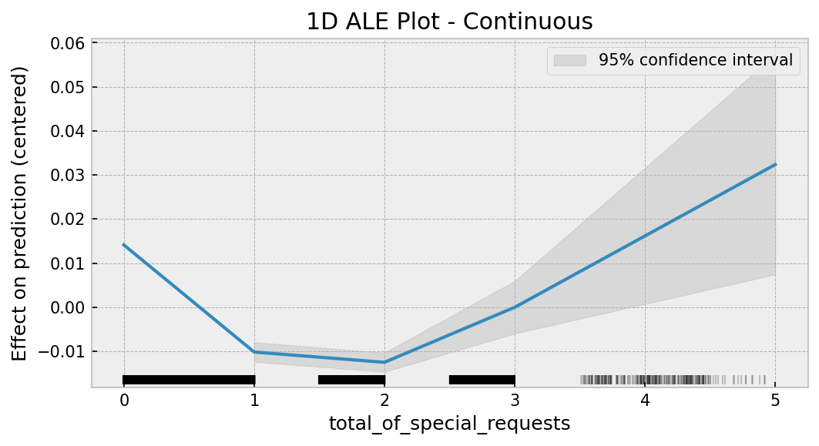
INSIGHTS
Higher lead time will lead to higher predicted probability of cancellation.
Bookings without special request or with a high number of special requests will lead to higher predicted probability of cancellation.

Slide 7

Thank you
Jia Hao Lo
jialo2022@u.northwestern.edu
https://www.linkedin.com/in/jiahaolo/

