Slide 1

Project: Collective Optimization for Cross Region AI Acceleration (COCA) Updates on PoliMi’s Activities (Dec.18.2024-Feb.4.2025)
Qiaolun Zhang, Jiaheng Xiong, Xiaomin Liu, Hessam Hashemizadeh, Nicola Di Cicco,
Mëmëdhe Ibrahimi, Francesco Musumeci , Massimo Tornatore
February 4th, 2024

Slide 2
Outline
Local-Topology-Aware CCL (LTCCL)
Motivation
Problem Statement
Heuristic Algorithm
Results (Comparison with TECCL)

Slide 3
Motivation: Limitation of Previous Approaches
Previous approach: transmit multiple chunks together to reduce propagation delay
“𝛼 − 𝛽” cost model
𝛼: fixed delay over a link (propagation, processing)
𝛽: transmission delay associated with sending 1 bit of data over a link (1/capacity)
Existing works do not investigate choice of chunk size

Slide 4
Motivation: Dividing Chunks to Sub-Chunks
GPU 1
GPU 2
GPU 3
GPU 1
GPU 2
GPU 3
Node 1
Node 2
Node 3
𝛼
𝛼
𝛽
𝛽/2
2𝛼 + 2𝛽 vs. 2𝛼 + 2/3𝛽
𝛼
𝛼
𝛽
𝛽
Transmit chunk divided to 2 sub-chunks
Transmit entire chunk
Transmit chunk divided to 2 sub-chunks
2 hops: Dividing a chunk into k sub-chunks ➔ reduces delay by $\frac{k−1}{k}$ 𝛽
TECCL is too slow to solve multi sub_chunks problem
TECCL cannot accurately model propagation delay

Slide 5
Problem Statement
Given
Network topology of multiple data centers
Collective operation
Chunk size
Number of subchunks
Problem statement
Decide
Routing of chunks
Scheduling of forwarding chunks in one node
Objective
Minimize the required to finish the collective
Constraints
Link latency
Node can only send a packet after receiving it
Each chunk can be split into multiple sub-chunks
Notes:
multicast in a big topic

Slide 6
Issue of Epoch Duration in TECCL
Epoch
Fast link case: epoch is defined as the delay of one chunk over the fastest link
Slow link case: epoch is defined as the delay of one chunk over the slowest link
Fast link case: finer-grained schedules
When propagation delay + transmission delay > one epoch duration:
E.g., 1 second + 0.1 second > 1 second ➔ 2 epochs used, 0.9 second wasted
GPU 1
GPU 2
GPU 3
𝛼 = 0.1 s
𝛽 = 1 s
2 epochs = 2s
𝛼 = 0.1 s
𝛽 = 1 s

Slide 7
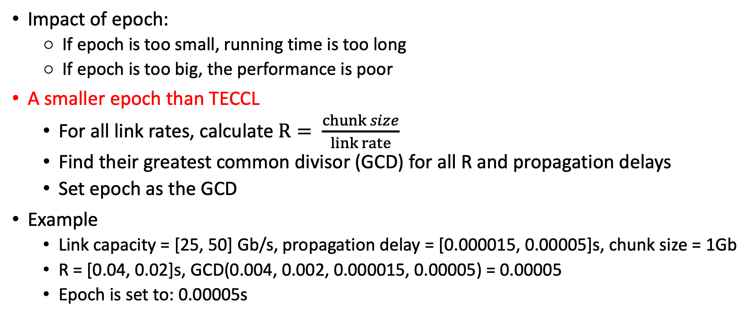
Choice of Epoch/Timestep
Impact of epoch:
If epoch is too small, running time is too long
If epoch is too big, the performance is poor
A smaller epoch than TECCL
For all link rates, calculate $R= \frac{chunk size}{link rate}$
Find their greatest common divisor (GCD) for all R and propagation delays
Set epoch as the GCD
Example
Link capacity = [25, 50] Gb/s, propagation delay = [0.000015, 0.00005]s, chunk size = 1Gb
R = [0.04, 0.02]s, GCD(0.004, 0.002, 0.000015, 0.00005) = 0.00005
Epoch is set to: 0.00005s

Slide 8
Flow Chart of the Proposed Algorithm
Divide chunks into sub-chunks
Start Time
GPU0
GPU1
GPU2
GPU0
GPU1
GPU2
Decide nodes that not need broadcast
Finish Time with sub-chunks
Packet sorting
Next Event
Finish Time
without sub-chunks
Collective finished
Each chunk will be divided into multiple sub-chunks, and independent decisions will be made for each sub-chunk
No
Yes

Slide 9
Flow Chart: Prevent Redundant Transmission
Divide chunks into sub-chunks
GPU2
GPU2
Decide nodes that not need broadcast
GPU3
0
0
0
0
0
0
0
0
0
0
GPU1
GPU3
0
GPU1
GPU0
GPU0
Packet sorting
Next Event
GPU4
GPU4
Each node broadcasts the chunks it already possesses to the neighboring nodes
Prevent redundant transmission to nodes already having the chunk
Collective finished
No

Slide 10
Flow Chart: Packet Sorting
Divide chunks into sub-chunks
GPU2
GPU2
0
0
Decide nodes that not need broadcast
1
GPU3
0
0
2
0
GPU1
GPU3
0
0
0
GPU1
3
GPU0
GPU0
Packet sorting
0
The packet plan to send
Low speed link
0
The packet is sending in the link
0
Hight speed link
0
GPU4
GPU4
Next Event
If multiple nodes plan to send the same chunk to one node:
Select the node that can send this chunk fastest considering
Sending queue
Link rate
Collective finished
No

Slide 11
Detailed issues
For the links between different chassis, we prefer to select different chunks transmit in these links at the same time
The transmission within the chassis is fast, and the performance bottleneck lies in the link between chassis connections.
This design will usage the transmission time in links between chassis to finish broadcast inner chassis
3
3
3
2
2
2
Chassis 1
1
1
1
1
2
3
Chassis 0

Slide 12
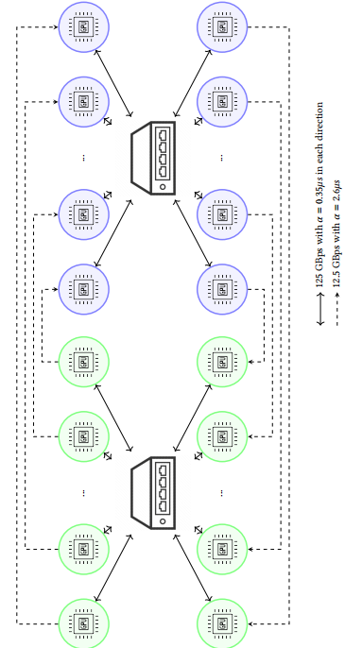
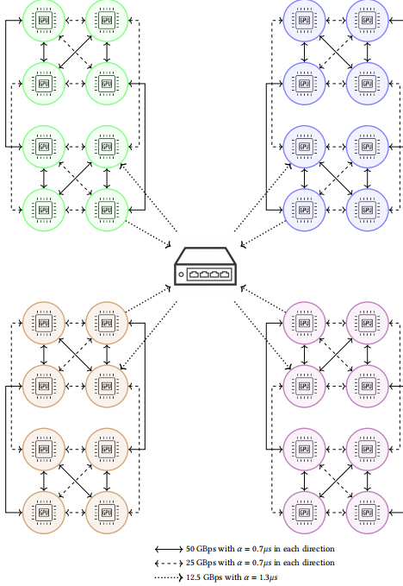
Initial Result: Topology
DGX topology with 1 chassis
NDv topology with 4 chassis

Slide 13
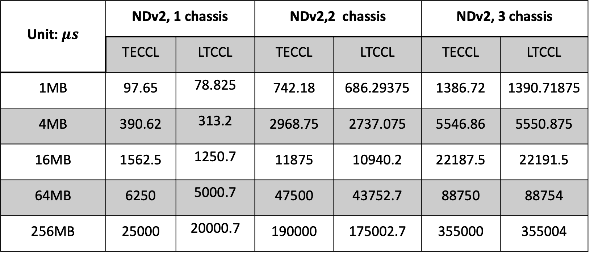
Collective time(Allgather, one datacenter)
Unit: $μs$ | NDv2, 1 chassis |  | NDv2,2 chassis |  | NDv2, 3 chassis
 | TECCL | LTCCL | TECCL | LTCCL | TECCL | LTCCL
1MB | 97.65 | 78.825 | 742.18 | 686.29375 | 1386.72 | 1390.71875
4MB | 390.62 | 313.2 | 2968.75 | 2737.075 | 5546.86 | 5550.875
16MB | 1562.5 | 1250.7 | 11875 | 10940.2 | 22187.5 | 22191.5
64MB | 6250 | 5000.7 | 47500 | 43752.7 | 88750 | 88754
256MB | 25000 | 20000.7 | 190000 | 175002.7 | 355000 | 355004
LTCCL is better than TECCL when topology is small (num_chunk is 1)

Slide 14
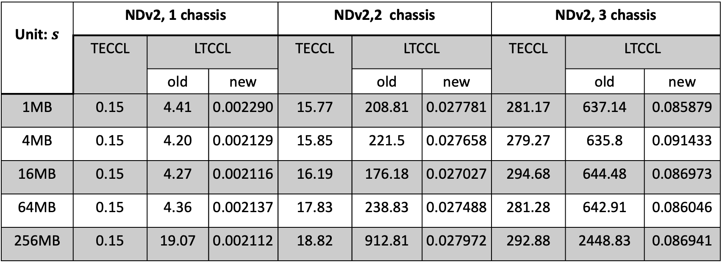
Execution time(Allgather, one datacenter)
Unit: $s$ | NDv2, 1 chassis |  |  | NDv2,2 chassis |  |  | NDv2, 3 chassis
 | TECCL | LTCCL |  | TECCL | LTCCL |  | TECCL | LTCCL
 |  | old | new |  | old | new |  | old | new
1MB | 0.15 | 4.41 | 0.002290 | 15.77 | 208.81 | 0.027781 | 281.17 | 637.14 | 0.085879
4MB | 0.15 | 4.20 | 0.002129 | 15.85 | 221.5 | 0.027658 | 279.27 | 635.8 | 0.091433
16MB | 0.15 | 4.27 | 0.002116 | 16.19 | 176.18 | 0.027027 | 294.68 | 644.48 | 0.086973
64MB | 0.15 | 4.36 | 0.002137 | 17.83 | 238.83 | 0.027488 | 281.28 | 642.91 | 0.086046
256MB | 0.15 | 19.07 | 0.002112 | 18.82 | 912.81 | 0.027972 | 292.88 | 2448.83 | 0.086941
Polling will bring long execution time
Event driven method significantly reduce the execution time

Slide 15
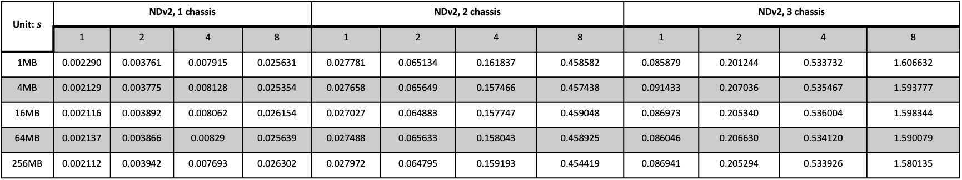
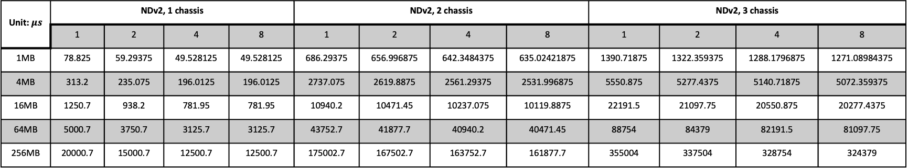
Allgather, one datacenter, different sub chunk number
Unit: $μs$ | NDv2, 1 chassis |  |  |  | NDv2, 2 chassis |  |  |  | NDv2, 3 chassis
 | 1 | 2 | 4 | 8 | 1 | 2 | 4 | 8 | 1 | 2 | 4 | 8
1MB | 78.825 | 59.29375 | 49.528125 | 49.528125 | 686.29375 | 656.996875 | 642.3484375 | 635.02421875 | 1390.71875 | 1322.359375 | 1288.1796875 | 1271.08984375
4MB | 313.2 | 235.075 | 196.0125 | 196.0125 | 2737.075 | 2619.8875 | 2561.29375 | 2531.996875 | 5550.875 | 5277.4375 | 5140.71875 | 5072.359375
16MB | 1250.7 | 938.2 | 781.95 | 781.95 | 10940.2 | 10471.45 | 10237.075 | 10119.8875 | 22191.5 | 21097.75 | 20550.875 | 20277.4375
64MB | 5000.7 | 3750.7 | 3125.7 | 3125.7 | 43752.7 | 41877.7 | 40940.2 | 40471.45 | 88754 | 84379 | 82191.5 | 81097.75
256MB | 20000.7 | 15000.7 | 12500.7 | 12500.7 | 175002.7 | 167502.7 | 163752.7 | 161877.7 | 355004 | 337504 | 328754 | 324379
Collective time
Unit: $s$ | NDv2, 1 chassis |  |  |  | NDv2, 2 chassis |  |  |  | NDv2, 3 chassis
 | 1 | 2 | 4 | 8 | 1 | 2 | 4 | 8 | 1 | 2 | 4 | 8
1MB | 0.002290 | 0.003761 | 0.007915 | 0.025631 | 0.027781 | 0.065134 | 0.161837 | 0.458582 | 0.085879 | 0.201244 | 0.533732 | 1.606632
4MB | 0.002129 | 0.003775 | 0.008128 | 0.025354 | 0.027658 | 0.065649 | 0.157466 | 0.457438 | 0.091433 | 0.207036 | 0.535467 | 1.593777
16MB | 0.002116 | 0.003892 | 0.008062 | 0.026154 | 0.027027 | 0.064883 | 0.157747 | 0.459048 | 0.086973 | 0.205340 | 0.536004 | 1.598344
64MB | 0.002137 | 0.003866 | 0.00829 | 0.025639 | 0.027488 | 0.065633 | 0.158043 | 0.458925 | 0.086046 | 0.206630 | 0.534120 | 1.590079
256MB | 0.002112 | 0.003942 | 0.007693 | 0.026302 | 0.027972 | 0.064795 | 0.159193 | 0.454419 | 0.086941 | 0.205294 | 0.533926 | 1.580135
Execution time
As the number of chunks increases, the collective time decreases, while the execution time increases.

Slide 16
Thank you!

