Slide 1

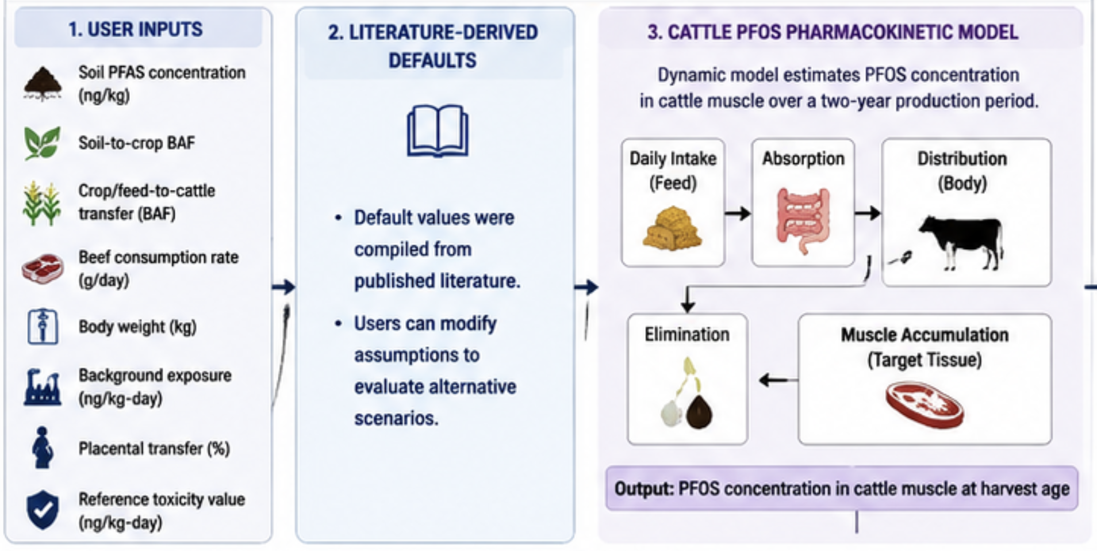
Interactive Web-Based Framework for Estimating PFAS Screening Values and Dietary Exposure Through the Soil–Crop–Cattle Pathway
Disclosure
Funding Sources
Potential Conflicts of Interest
Jiahe Tian,¹ Courtney Carignan^{1,2}
¹Department of Food Science and Nutrition, Michigan State University; ²Department of Pharmacology and Toxicology, Michigan State University
OBJECTIVE:
To develop an interactive web-based decision-support framework that estimates PFAS transfer through the soil–crop–cattle pathway and translates agricultural contamination scenarios into human dietary exposure and screening values.
Headline in Common Language
RESULTS:
Summarize findings as bullets
Figure 1. Dynamic PFOS Accumulation in Cattle
BACKGROUND:
PFAS are persistent contaminants that may enter agricultural systems through land-applied biosolids.
PFAS can transfer from amended soils into crops and livestock tissues.
Existing exposure assessment approaches are often difficult to adapt for scenario-based screening and risk communication.
Few accessible tools allow users to evaluate how assumptions about transfer factors, consumption rates, and toxicity values influence estimated exposure and screening values.
Figure 2. Child vs Adult Exposure
METHODS:
Module 1: User Inputs
Module 2: Literature-Derived Defaults
Default values were compiled from published literature.
Users can modify assumptions to evaluate alternative exposure scenarios.
Module 3: Cattle PFOS Pharmacokinetic Model
Module 4: Human Exposure and Screening Values
Figure 4. Web Tool Interface
Figure 3. Scenario Sensitivity
Cattle Feed rate
Summarize main finding
Acknowledgements & Funding:
We thank …. CC is supported in part by the National Institute of Environmental Health Sciences (R01ES028311), USEPA National Priorities Program (R839482), and USDA Hatch Program. This poster has not been formally reviewed by the funding agencies. The views expressed are solely from the authors and do not necessarily reflect those from the funding agencies. The agencies do not endorse any products or commercial services
References:
Sunderland, E. M., Hu, X. C., Dassuncao, C., Tokranov, A. K., Wagner, C. C., & Allen, J. G. (2019). A review of the pathways of human exposure to poly- and perfluoroalkyl substances (PFASs) and present understanding of health effects. J Expo Sci Environ Epidemiol, 29(2), 131-147. https://doi.org/10.1038/s41370-018-0094-1
etc
Daily intake → Absorption → Distribution → Muscle accumulation → Elimination

