Slide 1

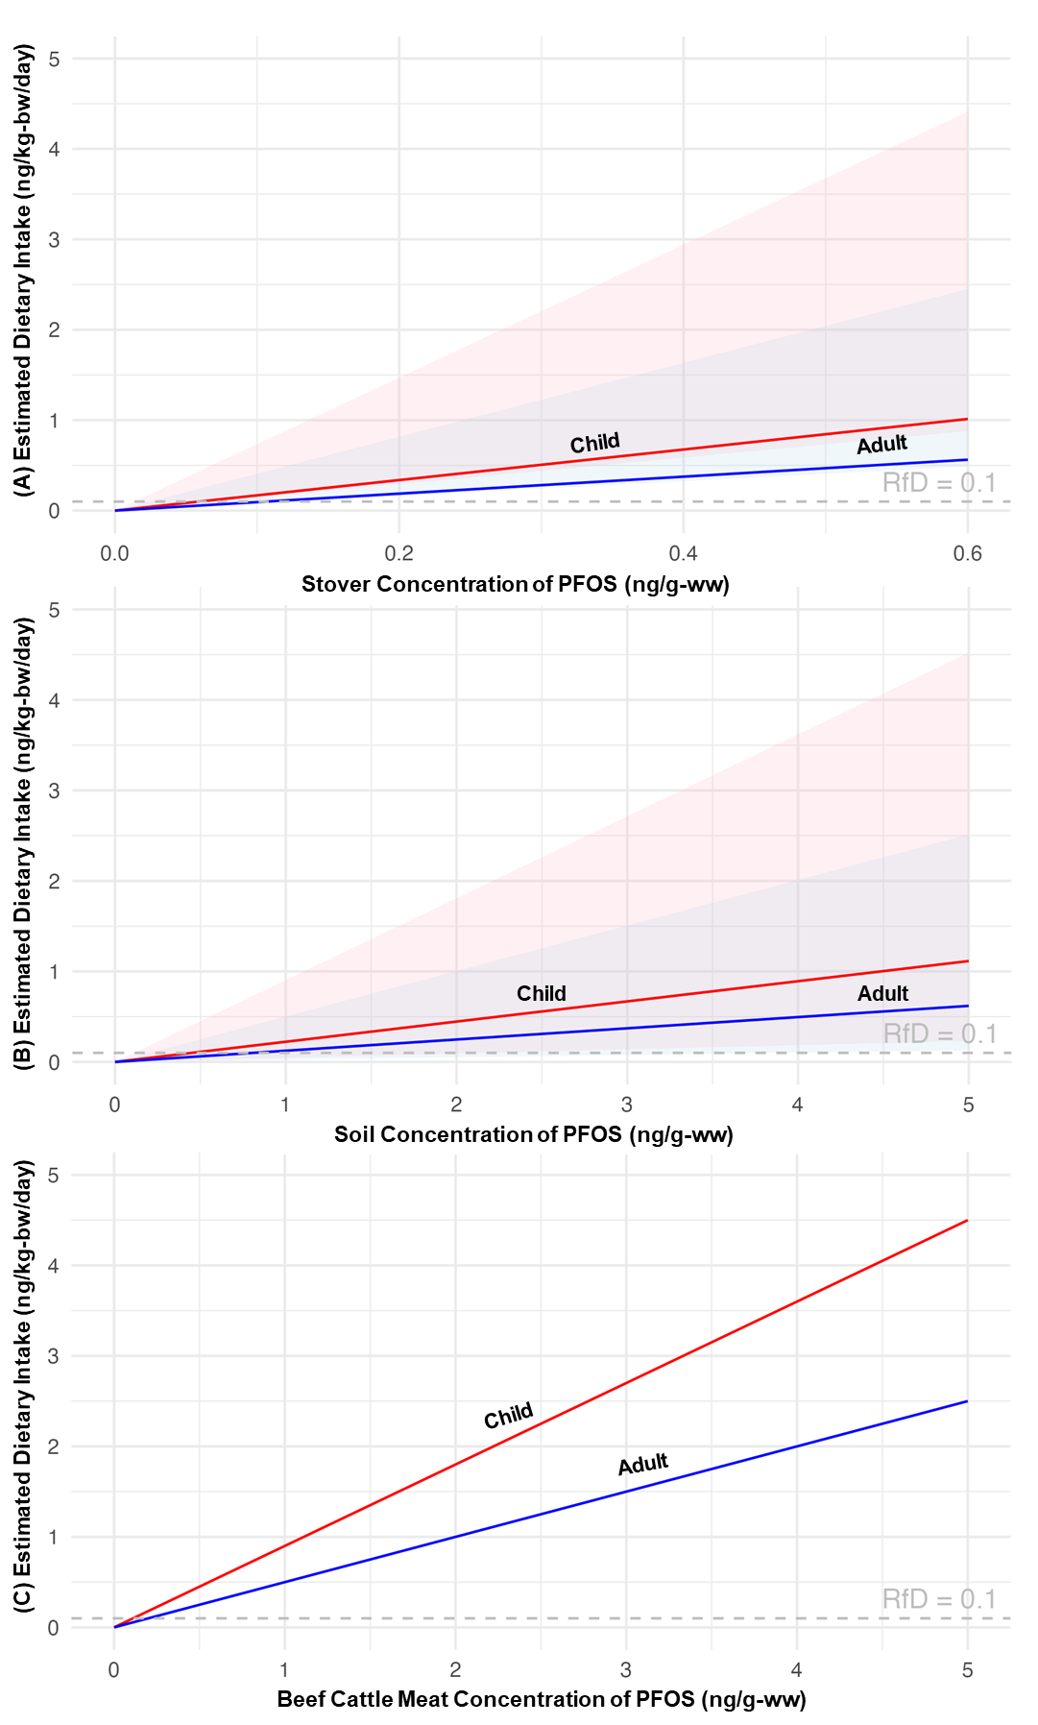
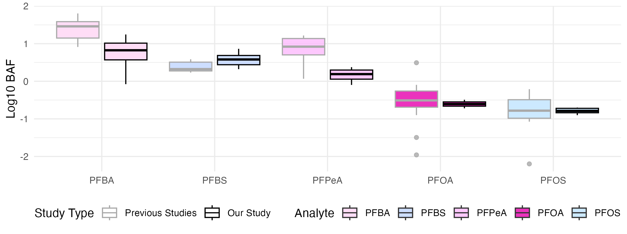
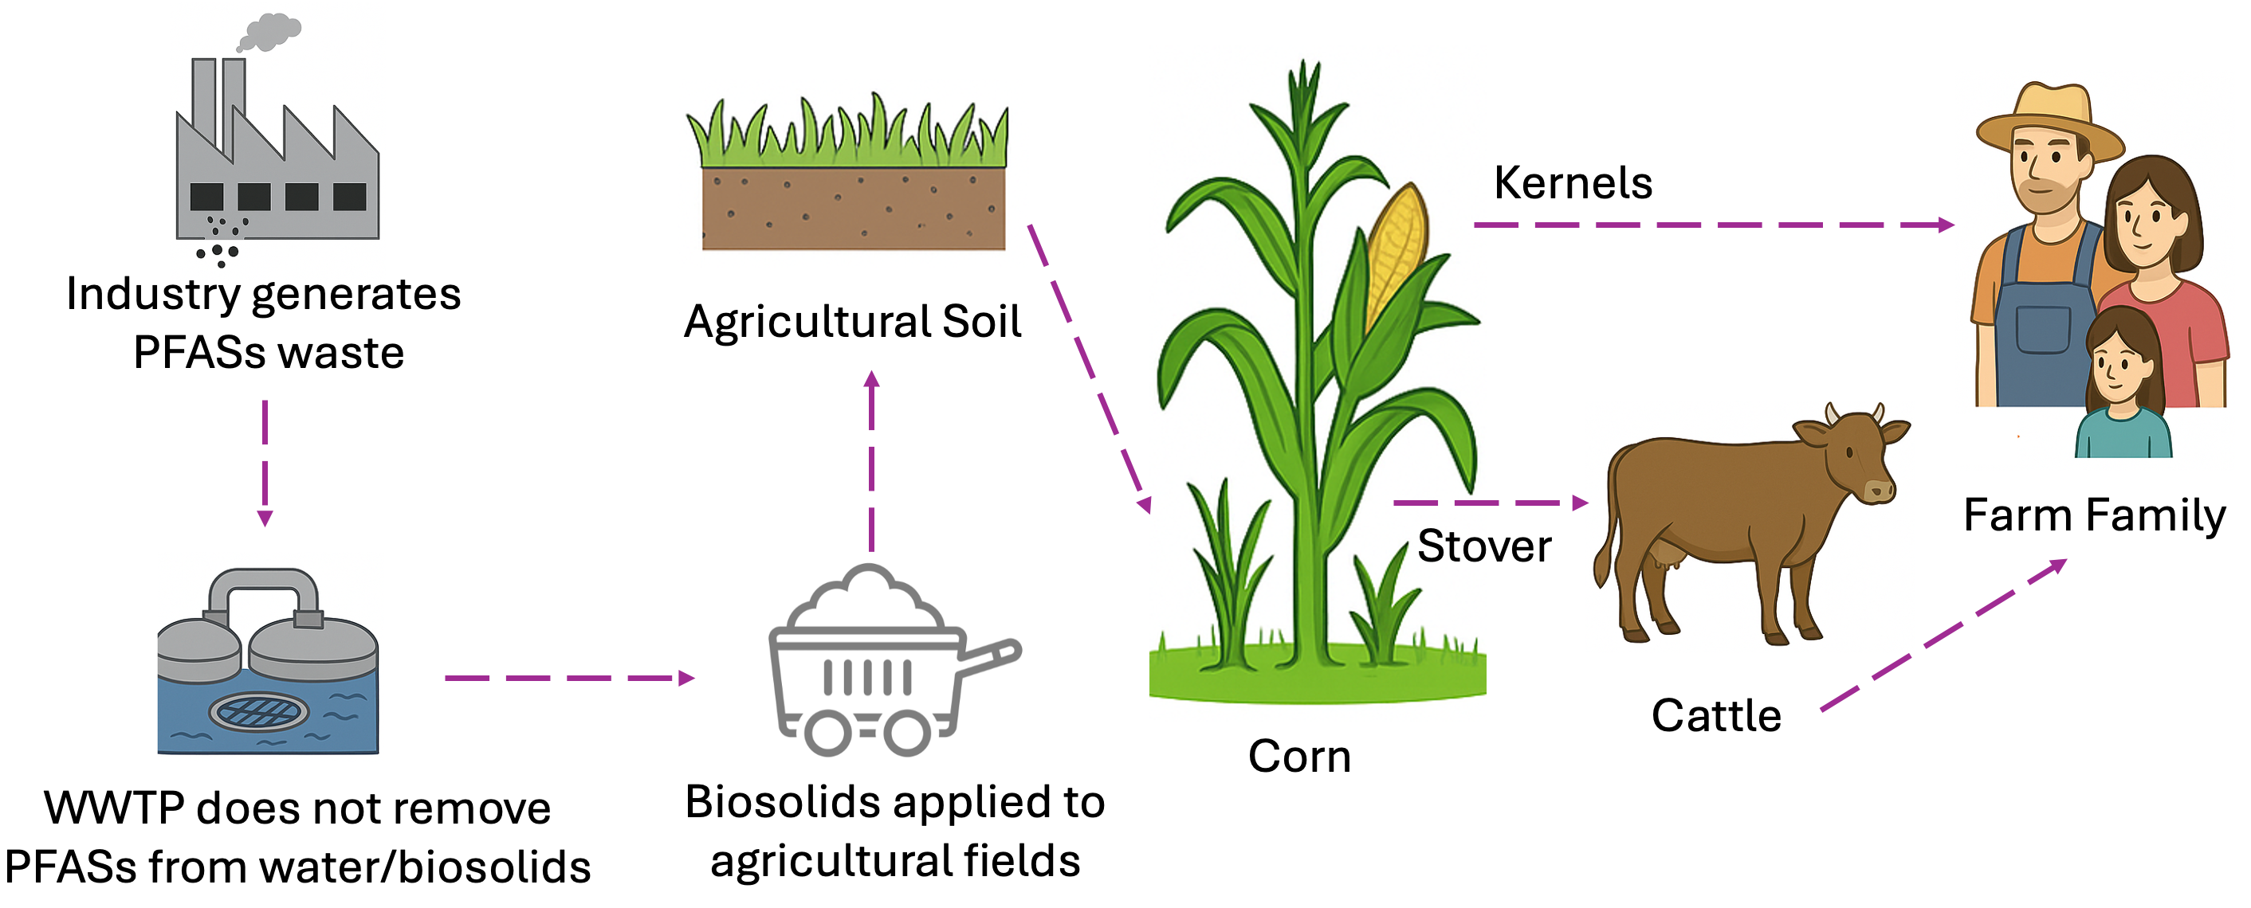

Modeling PFOS in Corn Stover and Beef to Assess Human Dietary Exposure
Jiahe Tian,¹ Ankita Bhattacharya,¹ Courtney C. Carignan¹
¹Department Food Science and Human Nutrition, Michigan State University, East Lansing, Michigan, USA
RESULTS
Median estimated PFOS exposure via beef consumption was notably higher for children compared to adults due to higher BW-CR.
PFOS concentrations were estimated for beef, stover and soil that result in exposures of 0.1 ng/kg-bw/day (U.S. EPA reference dose).
Exposure estimates increase with incorporation of upper bound BAF and BW-CR, cattle placental transfer, background PFOS exposure and mixtures of PFASs.
Figure 3. Estimated dietary intakes (EDI, ng/kg-bw/day) of PFOS
for children (ages 1 to 2, the red line is median EDI) and adults (ages 20 to 49, the blue line is median EDI) from our model for the soil-stover-meat pathway across concentrations of PFOS in A) soil, B) stover and C) beef cattle meat. Shading indicates upper-bound EDIs for children (red) and adults (blue). The dashed gray line at 0.01 ng/kg-bw/day indicates U.S. EPA’s reference dose (RfD) for PFOS.
Table 1. Concentrations below these values are safe for exposure from soil, stover and beef cattle grown or raised on this impacted farm
OBJECTIVES
Develop and apply modeling frameworks to quantify perfluorooctane sulfonic acid (PFOS) in crops and cattle from soil and estimate human dietary intake from beef consumption.
BACKGROUND
Per- and polyfluoroalkyl substances (PFAS) present in biosolid-amended soils can transfer and accumulate in crops, livestock, and, ultimately, humans through dietary intake.
Given the persistence of PFAS, there is a critical need for modeling tools to estimate PFAS transfer to crops and livestock and associated human dietary exposures.
METHODS
A literature review was conducted to compile bioaccumulation factors (BAFs) from soil to corn stover.
Figure 1. Comparison of soil to corn stover BAFs derived from previous studies (A) and calculated from our study samples (B).
Median and maximum BAFs and PFOS concentrations from biosolid-amended soils were used to estimate PFOS in stover.
A dynamic pharmacokinetic model was applied to predict PFOS in cattle muscle over two years.
The predicted PFOS concentrations in cattle muscle were multiplied by body weight-adjusted consumption rates (BW-CR) for beef to estimate daily exposure for both children and adults.
$\text{EDI}\text{ (}\text{ng}\text{/}\text{kg}\text{−}\text{bw}\text{/}\text{day}\text{)}\text{ =}\frac{C×\left(BW−CR\right)×( ED × EF)}{AT}$
EDI = Estimated Dietary Intake (dose; ng/kg-bw/day)
C = Concentration of PFAS in corn or cattle tissue (ng/g-ww)
BW-CR = Body weight adjusted consumption rate (g-ww/kg-day-1, (US EPA 2018)
EF = Exposure Frequency (days/years); assumed to be 365 days/year for daily exposure
ED = Exposure Duration (years); a duration of 1 year was used
AT = Averaging Time (days ); 365 days to estimate annual exposure
Figure 2. Pathway of PFAS Transfer from Industry to Farm Family via Agricultural Production
MUSCLE
PFOS
BLOOD
LIVER
KIDNEY
 | Soil conc. (ng/g) |  | Stover conc. (ng/g) |  | Muscle conc. (ng/g)
Percentile for BAF | Age 1 to 2 | Age 20 to 49 | Age 1 to 2 | Age 20 to 49 | Age 1 to 2 | Age 20 to 49
Min | 2.158 | 3.885 | 0.014 | 0.024 | 0.111 | 0.200
Median | 0.448 | 0.807 | 0.059 | 0.107
Max | 0.111 | 0.199 | 0.068 | 0.123
REFERENCE
xxxx
CONCLUSIONS
This study presents a quantitative approach for estimating PFOS accumulation from crops to livestock along with human dietary exposure to inform intervention strategies.
Future work will expand this approach to include additional staple crops used in cattle feed and a broader range of PFAS compounds.
Notes:
farm family: adults children, genders, age period
x human , should be farm family
make clear it’s not diary cow,
make the arrows clear
WWTP biosolids

