Slide 1
Bits, Bytes and Integers – Part 1 15-213/14-513/15-513: Introduction to Computer Systems 2nd Lecture, January 20, 2022

Slide 2
Announcements
Recitations begin next Monday January 24
Zoom links on Piazza
Linux Boot Camp Sunday January 23
More info on Piazza
Autolab, Piazza, Canvas rosters update once a day
Please be patient if you just enrolled
You can start labs 0 and 1 without Autolab access
We will give extensions for anything you couldn’t turn in because you weren’t on the roster

Slide 3
Announcements
Lab 0 is now available via schedule page and Autolab.
Due Tuesday January 25, 11:59pm ET
No grace days, no late submissions
Should take you less than five hours
Links on schedule page no longer go to Autolab
Lab 1 will become available at 3pm today
Due February 3, 11:59pm ET
One grace day
If you’re done with lab 0, now is a good time to start
Links will be added to schedule page

Slide 4
Timing of lecture slide distribution
Historically we post lecture slides after each lecture
We are frequently asked to post them before each lecture
Typical request: “It would help me follow along, and I could look over the slides beforehand and come prepared with questions”
Educational research suggests this is a good idea
Raver and Maydosz, “Impact of the provision and timing of instructor-provided notes on university students’ learning,” Active Learning in Higher Education 11(3) 189–200, 2010
Mooney and Bergin, “An analysis of alternative approaches for the distribution of lecture notes with the aid of a virtual learning environment to promote class engagement,” All Ireland Journal of Higher Education 6(2), 2014
Faculty will discuss this and decide by next week

Slide 5
How to download labs directly to sharks
On a shark machine:
cd private/15213 autolab download 15213-f21:labname cd labname tar -x --strip=1 -f labname-handout.tar
labname is the name from the website, but…
all lowercase letters
all spaces removed
for example: “C Programming Lab” → “cprogramminglab”
You may need to run autolab setup first
Only once ever
You need to do that anyway, so make submit works
Note: procedure will change starting with cache lab

Slide 6
Today: Bits, Bytes, and Integers
Representing information as bits
Bit-level manipulations
Integers
Representation: unsigned and signed
Conversion, casting
Expanding, truncating
Addition, negation, multiplication, shifting
Summary
Representations in memory, pointers, strings
today
next lecture

Slide 7
Everything is bits
Each bit is 0 or 1
By encoding/interpreting sets of bits in various ways
Computers determine what to do (instructions)
… and represent and manipulate numbers, sets, strings, etc…
Why bits? Electronic Implementation
Easy to store with bistable elements
Reliably transmitted on noisy and inaccurate wires
An Amazing & Successful Abstraction.
0
1
0
1.1V
0.9V
0.2V
0.0V
(which we won’t dig into in 213)

Slide 8
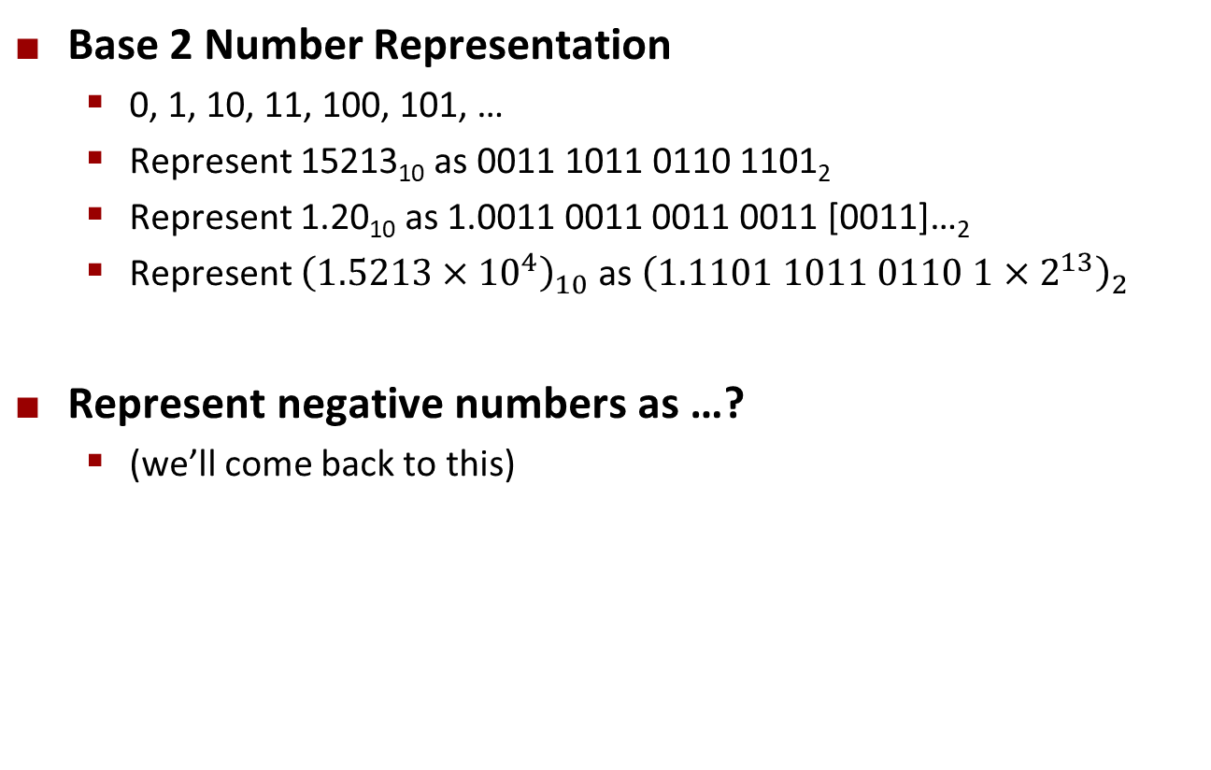
For example, can count in binary
Base 2 Number Representation
0, 1, 10, 11, 100, 101, …
Represent 15213₁₀ as 0011 1011 0110 1101₂
Represent 1.20₁₀ as 1.0011 0011 0011 0011 [0011]…₂
Represent ${\left(1.5213×{10}^{4}\right)}_{10}$ as ${\left(1.1101 1011 0110 1×2^{13}\right)}_{2}$
Represent negative numbers as …?
(we’ll come back to this)

Slide 9
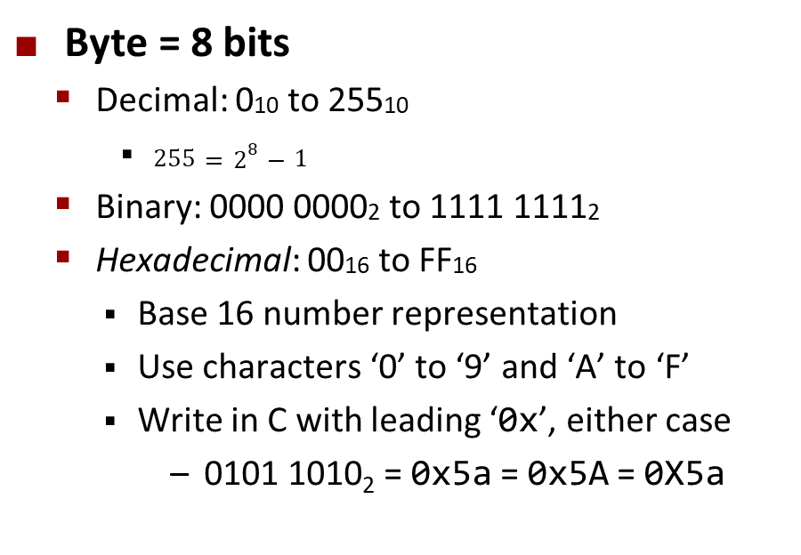
Encoding Byte Values
Decimal
Hex
Binary
Byte = 8 bits
Decimal: 010 to 25510
$255=2^{8}−1$
Binary: 0000 00002 to 1111 11112
Hexadecimal: 0016 to FF16
Base 16 number representation
Use characters ‘0’ to ‘9’ and ‘A’ to ‘F’
Write in C with leading ‘0x’, either case
0101 1010₂ = 0x5a = 0x5A = 0X5a
0
0
0000
1
1
0001
2
2
0010
3
3
0011
4
4
0100
5
5
0101
6
6
0110
7
7
0111
8
8
1000
9
9
1001
A
10
1010
B
11
1011
C
12
1100
D
13
1101
E
14
1110
F
15
1111
15213: 0011 1011 0110 1101
3
B
6
D

Slide 10
Combine bytes to make scalar data types
Size (# of bytes)
C Data Type | Typical 32-bit | Typical 64-bit
char | 1 | 1
short | 2 | 2
int | 4 | 4
long | 4 | 8
float | 4 | 4
double | 8 | 8
pointer | 4 | 8
“ILP32” | “LP64”

Slide 11
Today: Bits, Bytes, and Integers
Representing information as bits
Bit-level manipulations
Integers
Representation: unsigned and signed
Conversion, casting
Expanding, truncating
Addition, negation, multiplication, shifting
Summary
Representations in memory, pointers, strings
today
next lecture

Slide 12
Boolean Algebra
Developed by George Boole in 19th Century
Algebraic representation of logic
Encode “True” as 1 and “False” as 0
And
A&B = 1 when both A=1 and B=1
Or
A|B = 1 when either A=1 or B=1 or both
& | 0 | 1
0 | 0 | 0
1 | 0 | 1
| | 0 | 1
0 | 0 | 1
1 | 1 | 1
Not
~A = 1 when A=0
Exclusive-Or (Xor)
A^B = 1 when A=1 or B=1, but not both
~ | 0 | 1
 | 1 | 0
^ | 0 | 1
0 | 0 | 1
1 | 1 | 0

Slide 13
General Boolean Algebras
Operate on Bit Vectors
Operations applied bitwise
All of the Properties of Boolean Algebra Apply
01101001
& 01010101
01000001
01101001
| 01010101
01111101
01101001
^ 01010101
00111100
~ 01010101
10101010
01000001
01111101
00111100
10101010

Slide 14
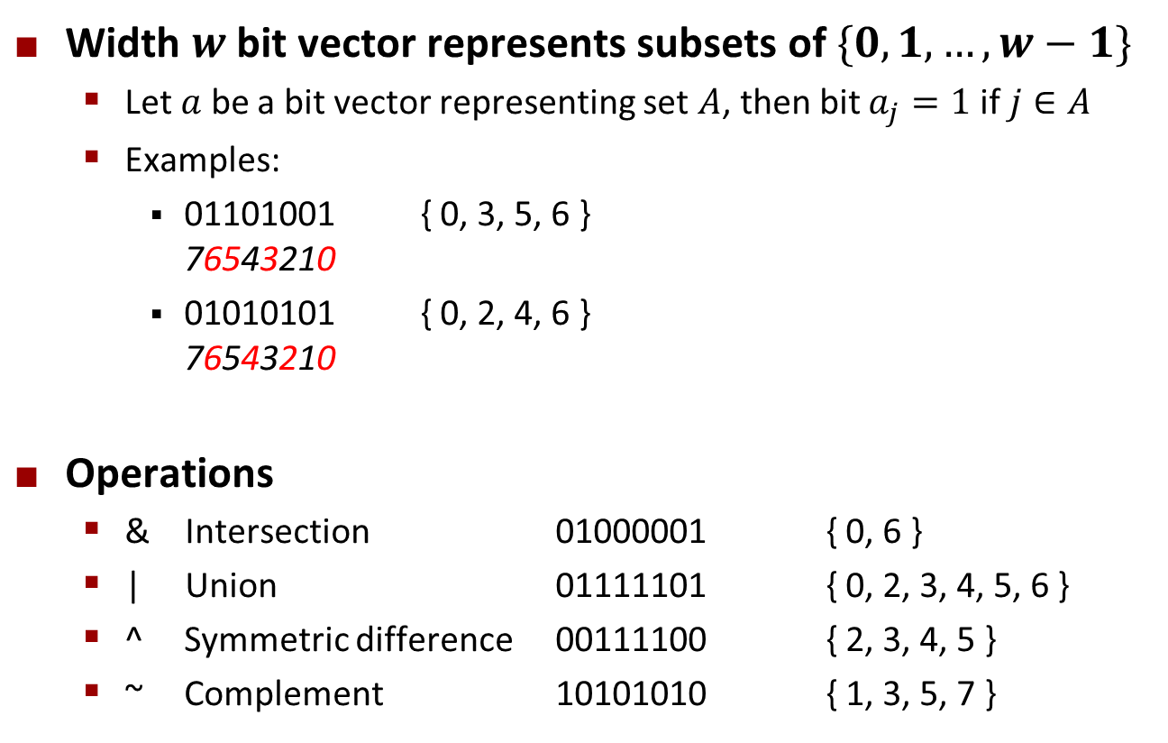
Example: Sets of Small Integers
Width $w$ bit vector represents subsets of $\{0, 1,…, w−1\}$
Let $a$ be a bit vector representing set $A$, then bit $a_{j}=1$ if $j∈A$
Examples:
01101001 { 0, 3, 5, 6 } 76543210
01010101 { 0, 2, 4, 6 } 76543210
Operations
& Intersection 01000001 { 0, 6 }
| Union 01111101 { 0, 2, 3, 4, 5, 6 }
^ Symmetric difference 00111100 { 2, 3, 4, 5 }
~ Complement 10101010 { 1, 3, 5, 7 }

Slide 15
Bit-Level Operations in C
Decimal
Hex
Binary
Operations &, |, ~, ^ Available in C
Apply to any “integral” data type
long, int, short, char, unsigned
View arguments as bit vectors
Arguments applied bit-wise
Examples (Char data type)
~0x41 → 0xBE
~010000012 → 101111102
~0x00 → 0xFF
~000000002 → 111111112
0x69 & 0x55 → 0x41
011010012 & 010101012 → 010000012
0x69 | 0x55 → 0x7D
011010012 | 010101012 → 011111012
0
0
0000
1
1
0001
2
2
0010
3
3
0011
4
4
0100
5
5
0101
6
6
0110
7
7
0111
8
8
1000
9
9
1001
A
10
1010
B
11
1011
C
12
1100
D
13
1101
E
14
1110
F
15
1111

Slide 16
Bit-Level Operations in C
Decimal
Hex
Binary
Operations &, |, ~, ^ Available in C
Apply to any “integral” data type
long, int, short, char, unsigned
View arguments as bit vectors
Arguments applied bit-wise
Examples (Char data type)
~0x41 → 0xBE
~010000012 → 101111102
~0x00 → 0xFF
~000000002 → 111111112
0x69 & 0x55 → 0x41
011010012 & 010101012 → 010000012
0x69 | 0x55 → 0x7D
011010012 | 010101012 → 011111012
Operations &, |, ~, ^ Available in C
Apply to any “integral” data type
long, int, short, char, unsigned
View arguments as bit vectors
Arguments applied bit-wise
Examples (Char data type)
~0x41 → 0xBE
~0100 00012 → 1011 11102
~0x00 → 0xFF
~0000 00002 → 1111 11112
0x69 & 0x55 → 0x41
0110 10012 & 0101 01012 → 0100 00012
0x69 | 0x55 → 0x7D
0110 10012 | 0101 01012 → 0111 11012
0
0
0000
1
1
0001
2
2
0010
3
3
0011
4
4
0100
5
5
0101
6
6
0110
7
7
0111
8
8
1000
9
9
1001
A
10
1010
B
11
1011
C
12
1100
D
13
1101
E
14
1110
F
15
1111

Slide 17
Contrast: Logic Operations in C
Contrast to Bit-Level Operators
Logic Operations: &&, ||, !
View 0 as “False”
Anything nonzero as “True”
Always return 0 or 1
Early termination
Examples (char data type)
!0x41 → 0x00
!0x00 → 0x01
!!0x41→ 0x01
0x69 && 0x55 → 0x01
0x69 || 0x55 → 0x01
p && *p (avoids null pointer access)
Watch out for && vs. & (and || vs. |)…
Super common C programming pitfall!

Slide 18
Shift Operations
Left Shift: x << y
Shift bit-vector x left y positions
Throw away extra bits on left
Fill with 0’s on right
Right Shift: x >> y
Shift bit-vector x right y positions
Throw away extra bits on right
Logical shift
Fill with 0’s on left
Arithmetic shift
Replicate most significant bit on left
Undefined Behavior
Shift amount < 0 or ≥ word size
Argument x
01100010
<< 3
00010000
00010000
00010000
Log. >> 2
00011000
00011000
00011000
Arith. >> 2
00011000
00011000
00011000
Argument x
10100010
<< 3
00010000
00010000
00010000
Log. >> 2
00101000
00101000
00101000
Arith. >> 2
11101000
11101000
11101000

Slide 19
Today: Bits, Bytes, and Integers
Representing information as bits
Bit-level manipulations
Integers
Representation: unsigned and signed
Conversion, casting
Expanding, truncating
Addition, negation, multiplication, shifting
Summary
Representations in memory, pointers, strings
Summary
today
next lecture

Slide 20
Encoding Integers
Unsigned
Two’s Complement
short int x = 15213;
short int y = -15213;
Sign Bit
C does not mandate using two’s complement
But, most machines do, and we will assume so
C short 2 bytes long
Sign Bit
For 2’s complement, most significant bit indicates sign
0 for nonnegative
1 for negative

Slide 21
Two-complement: Simple Example
-16 | 8 | 4 | 2 | 1
0 | 1 | 0 | 1 | 0
10 =
8+2 = 10
-16 | 8 | 4 | 2 | 1
1 | 0 | 1 | 1 | 0
-10 =
-16+4+2 = -10

Slide 22
Two-complement Encoding Example (Cont.)
x = 15213: 00111011 01101101
y = -15213: 11000100 10010011

Slide 23
Numeric Ranges
Unsigned Values
UMin = 0
000…0
UMax = 2^{w} – 1
111…1
Two’s Complement Values
TMin = –2^{w–1}
100…0
TMax = 2^{w–1} – 1
011…1
Minus 1
111…1
Values for W = 16

Slide 24
Values for Different Word Sizes
Observations
|TMin | = TMax + 1
Asymmetric range
UMax = 2 * TMax + 1
Question: abs(TMin)?
C Programming
#include <limits.h>
Declares constants, e.g.,
ULONG_MAX
LONG_MAX
LONG_MIN
Values platform specific

Slide 25
Unsigned & Signed Numeric Values
Equivalence
Same encodings for nonnegative values
Uniqueness
Every bit pattern represents unique integer value
Each representable integer has unique bit encoding
⇒ Can Invert Mappings
U2B(x) = B2U⁻¹(x)
Bit pattern for unsigned integer
T2B(x) = B2T⁻¹(x)
Bit pattern for two’s comp integer
X
B2U(X)
B2T(X)
0000
0
0
0001
1
1
0010
2
2
0011
3
3
0100
4
4
0101
5
5
0110
6
6
0111
7
7
1000
8
–8
1001
9
–7
1010
10
–6
1011
11
–5
1100
12
–4
1101
13
–3
1110
14
–2
1111
15
–1

Slide 26
Quiz Time!
Check out:
https://canvas.cmu.edu/courses/28101/quizzes/77043

Slide 27
Today: Bits, Bytes, and Integers
Representing information as bits
Bit-level manipulations
Integers
Representation: unsigned and signed
Conversion, casting
Expanding, truncating
Addition, negation, multiplication, shifting
Summary
Representations in memory, pointers, strings
today
next lecture

Slide 28
Mapping Between Signed & Unsigned
Two’s Complement
Unsigned
T2U
x
T2B
B2U
ux
X
Maintain Same Bit Pattern
Unsigned
U2T
Two’s Complement
ux
U2B
B2T
x
X
Maintain Same Bit Pattern
Mappings between unsigned and two’s complement numbers: Keep bit representations and reinterpret

Slide 29
Mapping Signed ↔ Unsigned
Bits
0000
0001
0010
0011
0100
0101
0110
0111
1000
1001
1010
1011
1100
1101
1110
1111
Signed
0
1
2
3
4
5
6
7
-8
-7
-6
-5
-4
-3
-2
-1
Unsigned
0
1
2
3
4
5
6
7
8
9
10
11
12
13
14
15
T2U
U2T

Slide 30
Mapping Signed ↔ Unsigned
Bits
0000
0001
0010
0011
0100
0101
0110
0111
1000
1001
1010
1011
1100
1101
1110
1111
Signed
0
1
2
3
4
5
6
7
-8
-7
-6
-5
-4
-3
-2
-1
Unsigned
0
1
2
3
4
5
6
7
8
9
10
11
12
13
14
15
=
+/- 16

Slide 31
Relation between Signed & Unsigned
Two’s Complement
Unsigned
T2U
x
T2B
B2U
ux
X
Maintain Same Bit Pattern
w–1
0
ux
+
+
+
• • •
+
+
+
x
-
+
+
• • •
+
+
+
Large negative weight
becomes
Large positive weight

Slide 32
Conversion Visualized
2’s Comp. → Unsigned
Ordering Inversion
Negative → Big Positive
UMax
UMax – 1
TMax + 1
Unsigned
Range
TMax
TMax
2’s Complement Range
0
0
–1
–2
TMin

Slide 33
Signed vs. Unsigned in C
Constants
By default are considered to be signed integers
Unsigned if have “U” as suffix
0U, 4294967259U
Casting
Explicit casting between signed & unsigned same as U2T and T2U
int tx, ty;
unsigned ux, uy;
tx = (int) ux;
uy = (unsigned) ty;
Implicit casting also occurs via assignments and procedure calls
tx = ux; int fun(unsigned u);
uy = ty; uy = fun(tx);

Slide 34
Casting Surprises
Expression Evaluation
If there is a mix of unsigned and signed in single expression, signed values implicitly cast to unsigned
Including comparison operations <, >, ==, <=, >=
Examples for W = 32: TMIN = -2,147,483,648 , TMAX = 2,147,483,647
Constant₁ Constant₂ Relation Evaluation
0 0U
-1 0
-1 0U
2147483647 -2147483647-1
2147483647U -2147483647-1
-1 -2
(unsigned)-1 -2
2147483647 2147483648U
2147483647 (int) 2147483648U
0 0U == unsigned
-1 0 < signed
-1 0U > unsigned
2147483647 -2147483648 > signed
2147483647U -2147483648 < unsigned
-1 -2 > signed
(unsigned) -1 -2 > unsigned
2147483647 2147483648U < unsigned
2147483647 (int) 2147483648U > signed

Slide 35
Unsigned vs. Signed: Easy to Make Mistakes
unsigned i;
for (i = cnt-2; i >= 0; i--)
a[i] += a[i+1];
Can be very subtle
#define DELTA sizeof(int)
int i;
for (i = CNT; i-DELTA >= 0; i-= DELTA)
. . .

Slide 36
Summary Casting Signed ↔ Unsigned: Basic Rules
Bit pattern is maintained
But reinterpreted
Can have unexpected effects: adding or subtracting 2^{w}
Expression containing signed and unsigned int
int is cast to unsigned!!

Slide 37
Today: Bits, Bytes, and Integers
Representing information as bits
Bit-level manipulations
Integers
Representation: unsigned and signed
Conversion, casting
Expanding, truncating
Addition, negation, multiplication, shifting
Summary
Representations in memory, pointers, strings
today
next lecture

Slide 38
Sign Extension
Task:
Given w-bit signed integer x
Convert it to w+k-bit integer with same value
Rule:
Make k copies of sign bit:
X ′ = x_{w–1} ,…, x_{w–1} , x_{w–1} , x_{w–2} ,…, x₀
k copies of MSB
w
X
• • •
• • •
X ′
• • •
• • •
k
w

Slide 39
Sign Extension: Simple Example
Positive number
Negative number
-16 | 8 | 4 | 2 | 1
0 | 1 | 0 | 1 | 0
-16 | 8 | 4 | 2 | 1
1 | 0 | 1 | 1 | 0
10 =
-10 =
-32 | 16 | 8 | 4 | 2 | 1
0 | 0 | 1 | 0 | 1 | 0
-32 | 16 | 8 | 4 | 2 | 1
1 | 1 | 0 | 1 | 1 | 0
10 =
-10 =

Slide 40
Larger Sign Extension Example
short int x = 15213;
int ix = (int) x;
short int y = -15213;
int iy = (int) y;
Decimal
Hex
Binary
x
15213
3B 6D
00111011 01101101
ix
15213
00 00 3B 6D
00000000 00000000 00111011 01101101
y
-15213
C4 93
11000100 10010011
iy
-15213
FF FF C4 93
11111111 11111111 11000100 10010011
Converting from smaller to larger integer data type
C automatically performs sign extension

Slide 41
Truncation
Task:
Given k+w-bit signed or unsigned integer X
Convert it to w-bit integer X’ with same value for “small enough” X
Rule:
Drop top k bits:
X ′ = x_{w–1} , x_{w–2} ,…, x₀
k
w
X
• • •
• • •
• • •
X ′
• • •
w

Slide 42
Truncation: Simple Example
No sign change
Sign change
-16 | 8 | 4 | 2 | 1
0 | 0 | 0 | 1 | 0
-16 | 8 | 4 | 2 | 1
0 | 1 | 0 | 1 | 0
2 =
10 =
 | -8 | 4 | 2 | 1
 | 0 | 0 | 1 | 0
 | -8 | 4 | 2 | 1
 | 1 | 0 | 1 | 0
2 =
-6 =
2 mod 16 = 2
10 mod 16 = 10U mod 16 = 10U = -6
-16 | 8 | 4 | 2 | 1
1 | 1 | 0 | 1 | 0
-16 | 8 | 4 | 2 | 1
1 | 0 | 1 | 1 | 0
-6 =
-10 =
 | -8 | 4 | 2 | 1
 | 1 | 0 | 1 | 0
 | -8 | 4 | 2 | 1
 | 0 | 1 | 1 | 0
-6 =
6 =
-6 mod 16 = 26U mod 16 = 10U = -6
-10 mod 16 = 22U mod 16 = 6U = 6

Slide 43
Summary: Expanding, Truncating: Basic Rules
Expanding (e.g., short int to int)
Unsigned: zeros added
Signed: sign extension
Both yield expected result
Truncating (e.g., unsigned to unsigned short)
Unsigned/signed: bits are truncated
Result reinterpreted
Unsigned: mod operation
Signed: similar to mod
For small (in magnitude) numbers yields expected behavior

Slide 44
Summary of Today: Bits, Bytes, and Integers
Representing information as bits
Bit-level manipulations
Integers
Representation: unsigned and signed
Conversion, casting
Expanding, truncating
Addition, negation, multiplication, shifting
Representations in memory, pointers, strings
Summary
today
next lecture

