Slide 1
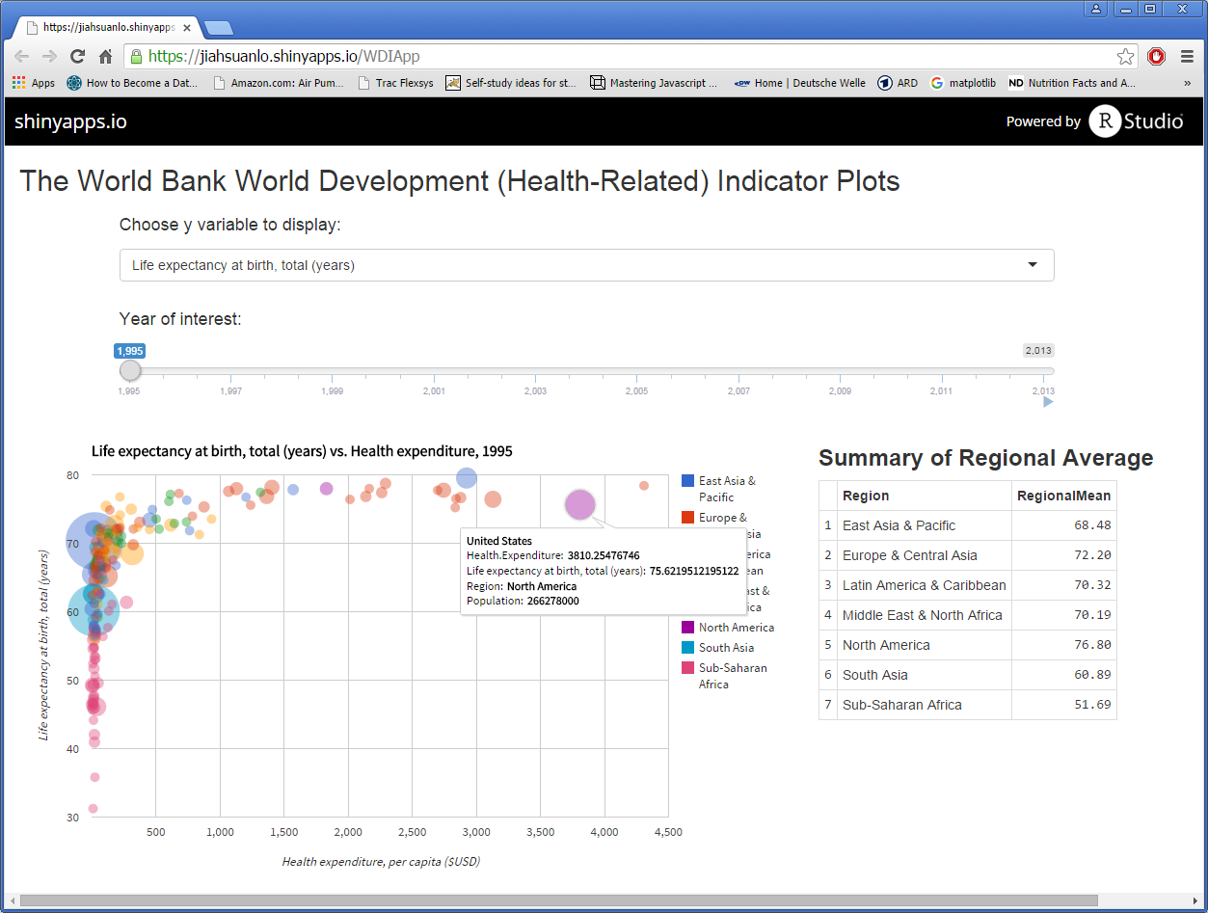
Various health related indicators can be selected here
Specific year can be selected here using slider
Year-by-year trend can be animated here
Bubble Chart (googleChart)
Regional summary table

