Slide 1
Store Sales in Ecuador
Kaggle Competition
26/9/2022

Slide 2
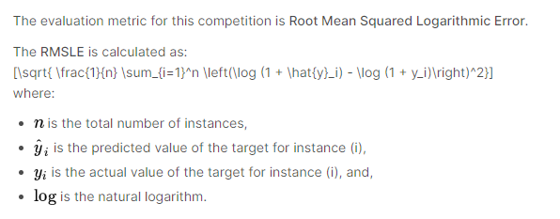
KPI
https://www.kaggle.com/competitions/store-sales-time-series-forecasting/data
Predict sales for each of the thousands of product families sold at Favorita stores in Ecuador across time
Accuracy measurement:

Slide 3
About the data
Holidays_events.csv → holidays and events
350 rows, 6 cols
Transferred column means that the holiday is celebrated on another date (moved by the govt)
Oil.csv → daily oil prices (Ecuador is oil-dependent country and economical health is vulnerable to shocks in oil prices)
1218 rows, 2 cols
Stores.csv → store metadata of city, state, type, and cluster (grouping of similar stores)
54 rows, 5 cols
Transactions.csv → all transactions across date per store
83488 rows, 3 cols
Train.csv
3000888 rows, 6 cols
Test.csv
28512 rows, 5 cols

Slide 4
Data Format (Merging all data) Matching of holiday date and celebrated location to store location
id | date
Store_nbr | family | onpromotion | Store_state | Store_city | Store_type | Store_cluster
#transactions
(date, store_nbr)
Oil_price
(date)
sales
(y_val)
Hol_type | Celebrate_type | Celebrate_location | transferred
(date) | National, local etc | (store_location)

Slide 5
Data exploration, EDA
In overall, which stores has the most sales?
Split by family category, location, holiday
Across time, analyse sales by:
Store
Location
Store_type, cluster
Compare sales with number of transactions

Slide 6
Data cleaning and manipulation
Change data type?
Change all words to lowercase
Fill NAs

Slide 7
Feature engineering
Encoding using LabelEncoder()
Feature selection by correlation, variance, regularization or feature importance
Cross-featuring:
Is holiday celebrated on that day/location? (Transferred, workday etc)
#transactions is total per store – what about per family category? By proportion?
Analyzing trends of oil price – bucketizing?
Extracting dates information – year, month, day
Including extra information:
Wages are paid every 2 weeks on 15th and last day of month – sales could be affected by this
7.8 magnitude earthquake struck Ecuador on 16 Apr 2016 – people rallied efforts in donating water and other products which affect sales for several weeks after

Slide 8
Modelling Preparation
Test-train set
Creating x_values for predictions

Slide 9
Model Design (Time-series)
Baseline Model: Regression
Statistical: ARIMA, Holt-Winter’s
Ensembled: Random Forest, XGBoost?
Deep-learning: LSTM

Slide 10
Hyperparameter tuning
Tree models
LSTM

Slide 11
Evaluation
Cross validation

