Slide 1
Store Sales in Ecuador
Kaggle Competition
26/9/2022

Slide 2
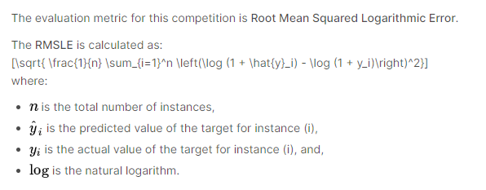
KPI
https://www.kaggle.com/competitions/store-sales-time-series-forecasting/data
Predict sales for each of the thousands of product families sold at Favorita stores in Ecuador across time
Accuracy measurement:

Slide 3
About the data
Holidays_events.csv → holidays and events
350 rows, 6 cols
Transferred column means that the holiday is celebrated on another date (moved by the govt)
Oil.csv → daily oil prices (Ecuador is oil-dependent country and economical health is vulnerable to shocks in oil prices)
1218 rows, 2 cols
Stores.csv → store metadata of city, state, type, and cluster (grouping of similar stores)
54 rows, 5 cols
Transactions.csv → all transactions across date per store
83488 rows, 3 cols
Train.csv
3000888 rows, 6 cols
Test.csv
28512 rows, 5 cols

Slide 4
Data Format
id | date
Store_nbr | family | onpromotion | Store_state | Store_city | Store_type | Store_cluster
#transactions
(date, store_nbr)
Oil_price
(date)
sales
(y_val)
Hol_type | Celebrate_type | Celebrate_location | transferred
(date) | National, local etc | (store_location)

Slide 5
Data exploration
Check for duplicates, typos, NULL values, distributions…

Slide 6
Data cleaning and manipulation
Change data type?
Change all words to lowercase
Fill in NULL?
Remove duplicates (not necessary anymore, checked that each article_id is indeed a different item although described similarly to others)
Check if the naming have any typo and not picked up from duplicated() method
Same product code/product categories but product name is slightly different?
Same address = same customer?
Same product code = same item?

Slide 7
Merging all into one dataframe

Slide 8
Feature engineering
Encoding
Selection?
Cross-featuring
Extracting dates

Slide 9
Modelling Preparation
Test-train set
Creating x_values for predictions

Slide 10
Model Design (Time-series)
Baseline Model: Regression
Statistical: ARIMA, Holt-Winter’s
Ensembled: Random Forest, XGBoost?
Deep-learning: LSTM

Slide 11
Hyperparameter tuning

Slide 12
Evaluation

Slide 13
Additional Considerations
Perform more detailed EDA:
E.g. sales performance, customer preferences, locations

