Slide 1
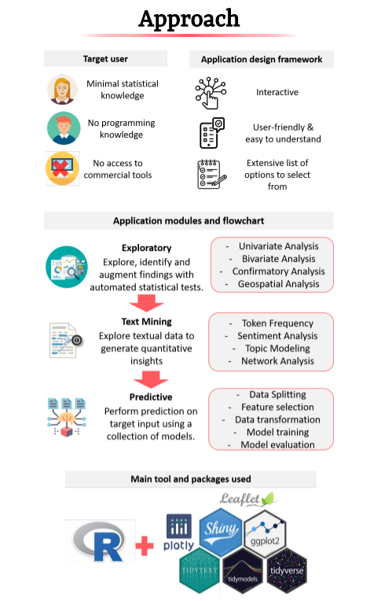

Slide 2



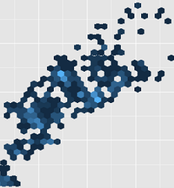

Analysis Flow
Text Pre-processing
Geospatial Visualization
Explore location-stamped media posting based on hexagon binning distribution map
Exploratory Data Analysis
Explore and identify temporal pattern, text features of frequency and cooccurrence
Social Media Text Mining
Generate quantitative insights based on topic modelling and tweet network techniques
This Photo by Unknown Author is licensed under CC BY-SA

Slide 3









Main Tool and Packages Applied
This Photo by Unknown Author is licensed under CC BY-NC

Slide 4
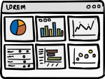
Design Concept
Analytical Dashboard
-Provide a comprehensive analysis of social media posts trends with respect to time
Ensure Simplicity
-Allow users to consume all the important information in the first glance
User Interactivity
-Customize selections and inputs for users to explore various setarious
Application Scenario
-Applicable to the public and government to understand the abnormal and risky event in the community
This Photo by Unknown Author is licensed under CC BY-NC

