Slide 1
Chapter-I and II
Introduction to OS
Abhijit A. M.
abhijit.comp@coep.ac.in

Slide 2
OS or kernel?
Debate on terminology
What you use in daily life is not kernel, but
  GUI, Shell, Applications, ...
  One view: OS = kernel + (GUI, Shell, Libraries, System programs, Minimum Applications,...)
  Correct, IMO!
What we study in this course is kernel
  Not how is “Ubuntu” built!

Slide 3
Building an “OS”
E.g. Debian
  A collection of thousands of applications, libraries, system programs, ... and Linux kernel !
  Linux kernel is at the heart, but heart is not a human without the body !
  Job of “Debian Developers”
    Collect the source code of all things you want
    Create an “Environment” for compiling things : bootstrap challenge
    Compile everything
    Ensure that things work “with each other”
      Very difficult! Versions, dependencies !
    “Package” things (e.g. make .deb files )

Slide 4

Components of a computer system
Abstract view

Slide 5
Today, different type of kernels to serve different needs
Each “Computing Environment” has a different requirement of managing resources, processes, etc
  Desktop / Laptop
  Thin Clients
  Workstations
  Handheld
  “Servers”
  Distributed systems
  Peer to peer systems
  Virtualization
  Cloud
  Real time

Slide 6

Von Neumann architecture
A von Neumann architecture

Slide 7
A key to “understanding”
Everything happens on processor
Processor is always running some instruction
We should be able to tell possible execution sequences on processor

Slide 8
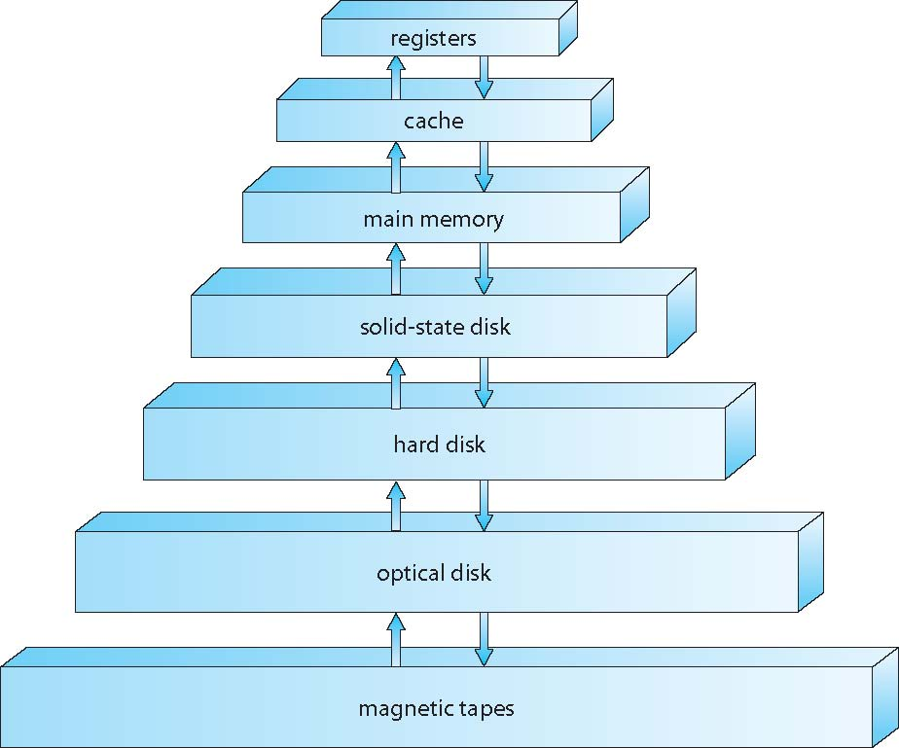
Memory hierarchy

Slide 9
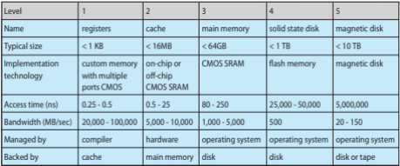
Memory hierarchy

Slide 10
System calls
We have seen
  Fork(), exec(): system calls to create processes
  Open(), read(), write() : system calls to play with files
System call: A service given by kernel

Slide 11
System calls: the problem
On a time shared system
  Applications and kernel run on the CPU taking turns
  Kernel allocates time to application , by setting a value in timer register, and then makes application run
    Timer ticks down every clock cycle
  Timer hardware interrupt occurs when timer = 0 , that is time of application is over
  Kernel runs again

Slide 12
System calls: the problem
Kernel must provide “services” to applications
  Create processes
  Grant access to resources to processes
  Etc
Process should be able to “call” kernel’s service
But everything runs on processor!
  That is both processes and kernel
Kernel should be able to run particular instructions which processes should not be able to !

Slide 13
System calls: the problem
Privileged Instructions
  Set the timer register
  Set a value in registers of I/O devices
  Set the MMU
  Etc
How to ensure that only kernel code can run privilged instructions?
  Not possible without hardware support in CPU!

Slide 14
System calls: the problem
CPU: 2 modes
  User mode and kernel mode
  All instructions can be executed in kernel mode
  Non-privileged instructions can be executed in User mode
  How to ensure this?
Special instruction: software interrupt instruction
  Changes the mode from User Mode to Kernel mode and changes the CS+IP (or PC) to a pre-defined address (where the kernel already exists)
  Two things at a time – that’s the key

Slide 15
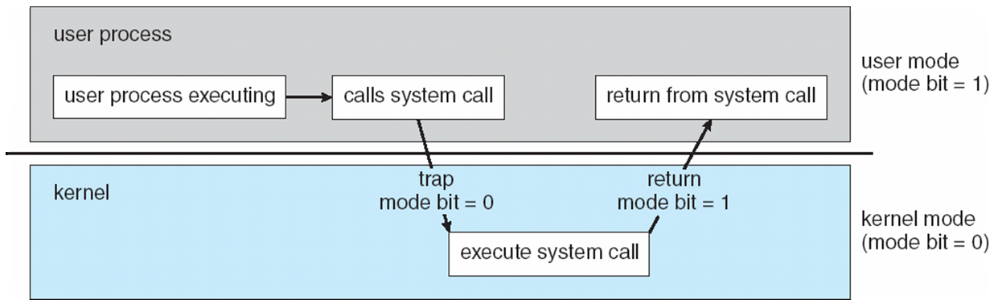
2 modes of operation of CPU needed for multi-tasking system

Slide 16
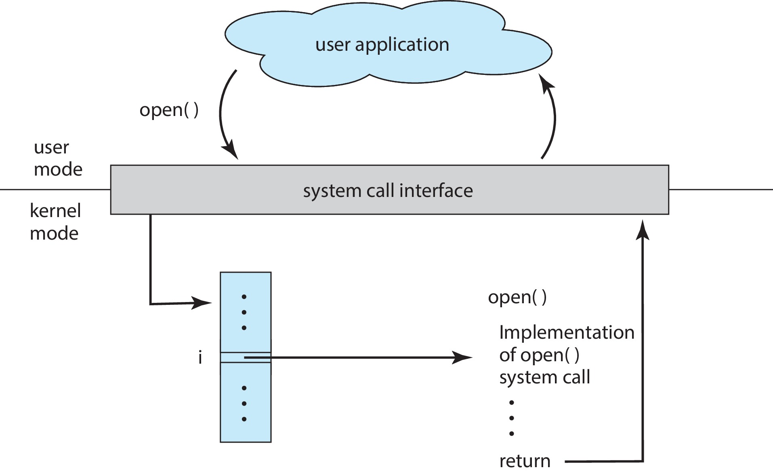
Application – kernel interaction in system calls

Slide 17
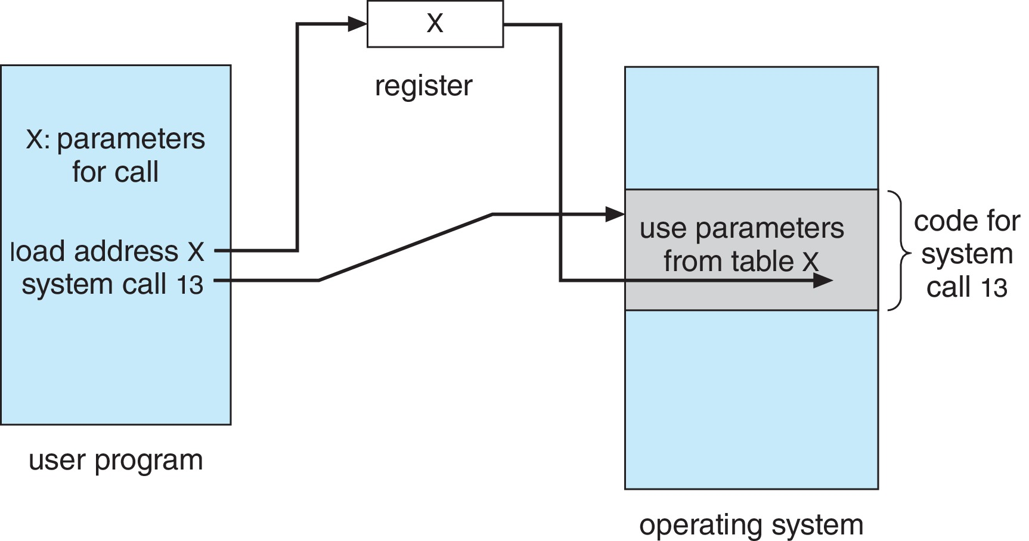
System call – parameter passing
Sharing of data between “user mode” and “kernel mode” code !

Slide 18
What a modern multi-processor, multi-tasking kernel does
Process Management
  Create an environment (fork, exec, exit, etc) so that processes can be created, exited, ...
Resource management
  Processes can access “resources” only through kernel
  System calls like: open(), brk(), ...
  Includes storage management – enable a “tree” type view of files and folders
  Manage memory for itself and all processes
  I/O Management – make I/o devices accessible to processes and itself
  Manage users (uid, gid, setuid(), seteuid(), .. )
Protection and Security
  Limit what a process can do
  Prevent “attacks” by internal and external agents

Slide 19
System calls exist for ...
Process control
  create process (fork), terminate process (exit)
  end, abort (kill)
  load, execute (exec)
  get process attributes (getpid, ..), set process attributes (setrlimit, ...)
  wait for time (sleep, ...)
  wait event (wait, ...), signal event (signal, kill, ... )
  allocate and free memory (brk, ... )
  Dump memory if error
  Debugger for determining bugs, single step execution
  Locks for managing access to shared data between processes

Slide 20
System calls exist for ...
File management
  create file (open, create), delete file (unlink)
  open, close (close()) file
  read, write, reposition (read, write, lseek, ...)
  get and set file attributes (chown, chmod, stat, ... )
Device management
    request device, release device
    read, write, reposition
    get device attributes, set device attributes
    logically attach or detach devices
  On Linux: mostly done using file systecalls, but special calls are also there: mknod, mkfifo, ...

Slide 21
System calls exist for ...
Information maintenance
    get time or date, set time or date
    get system data, set system data
    get and set process, file, or device attributes
  time, fcntl, ...
Communications
    create, delete communication connection
    send, receive messages if message passing model to host name or process name
    From client to server
    Shared-memory model create and gain access to memory regions
    transfer status information
    attach and detach remote devices
  Examples: socket, bind, listen, shmget, send, recv,

Slide 22
System calls exist for ...
Protection
    Control access to resources
    Get and set permissions
    Allow and deny user access
More
  On LinuxL “man syscalls”
  POSIX: Portable Operating System Interface
  See output of strace

Slide 23
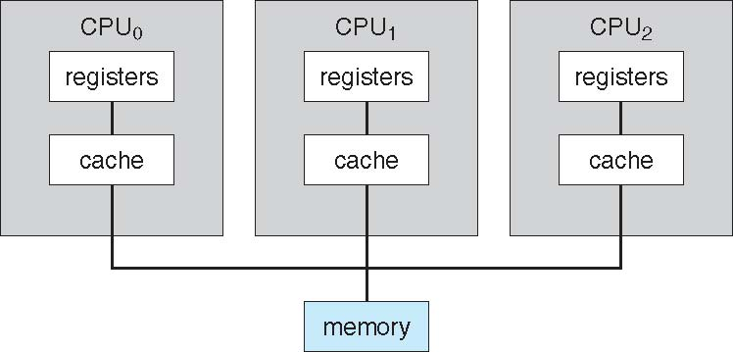
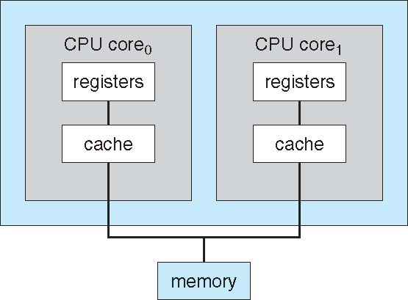
SMP, multi-core

Slide 24
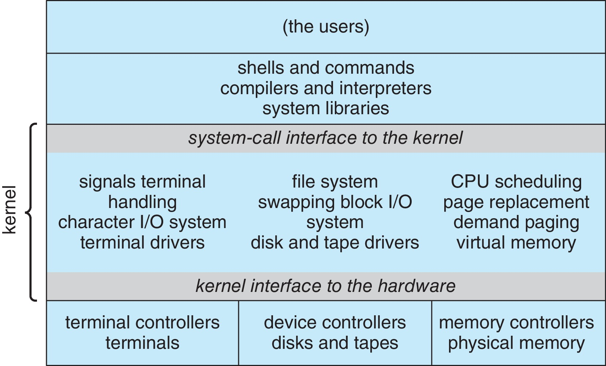
Traditional Unix system structure

Slide 25
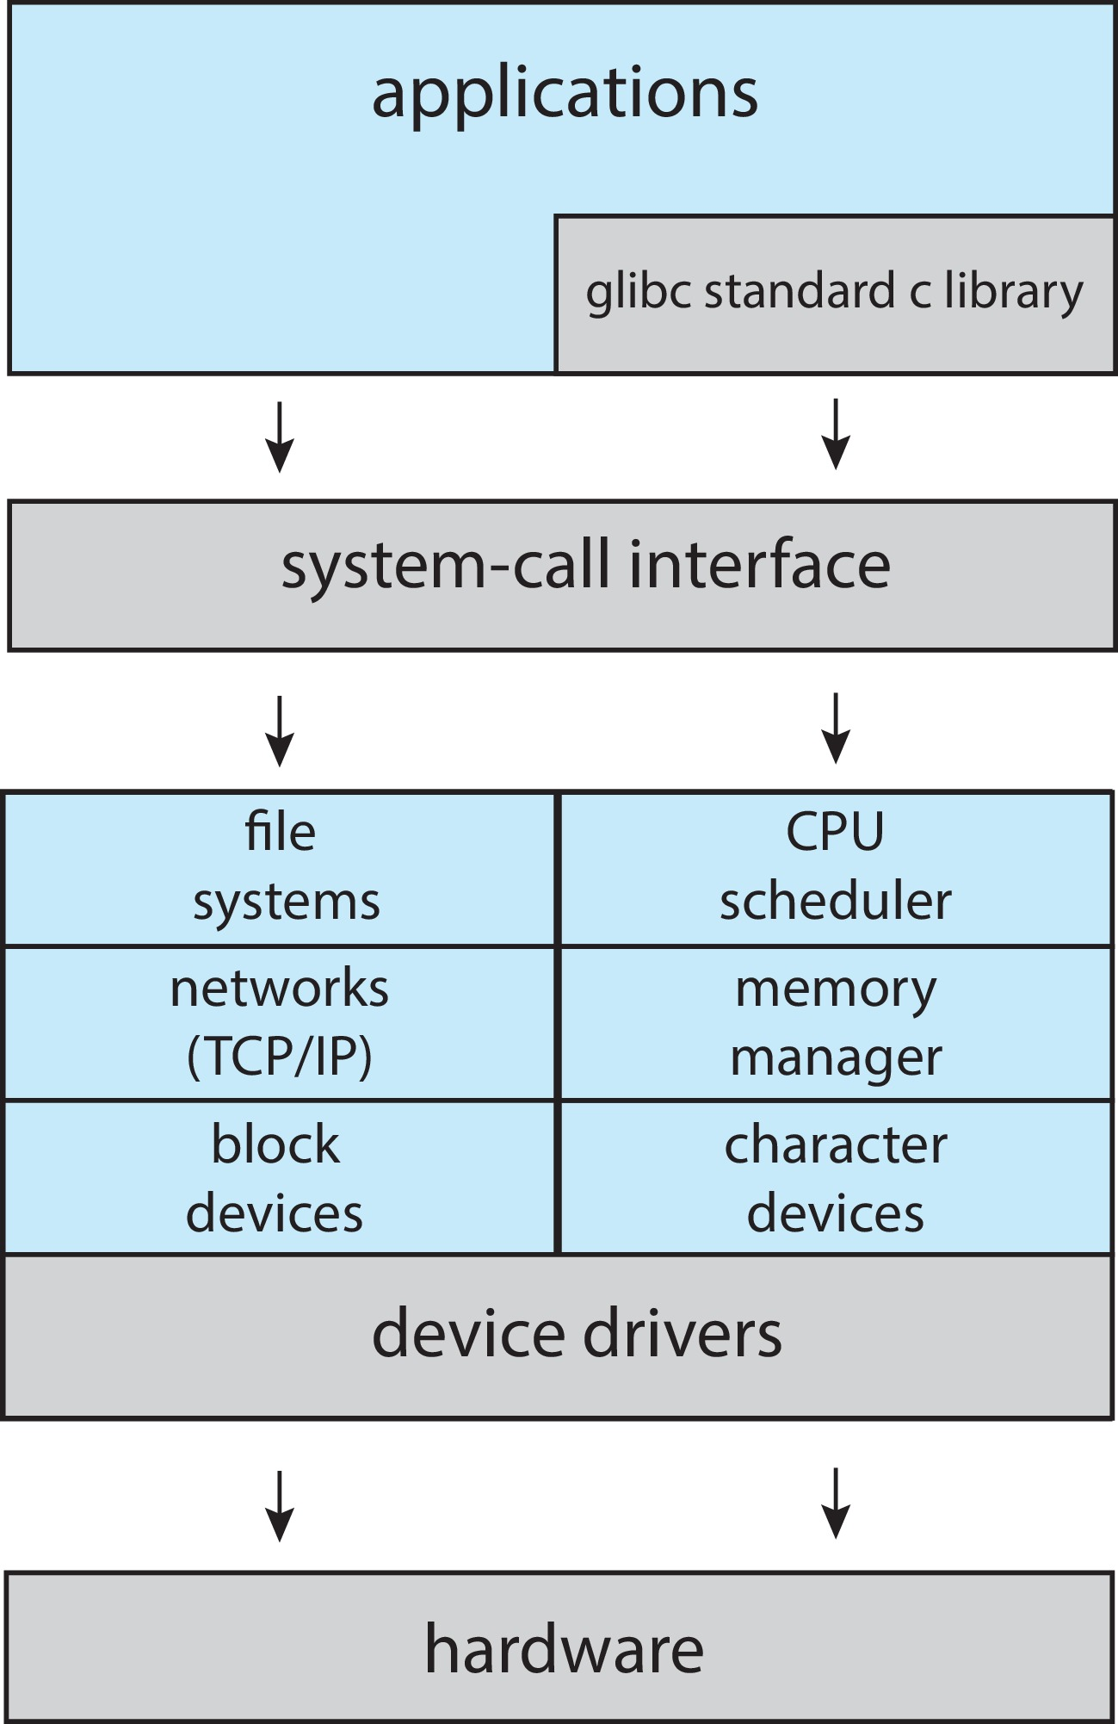
Linux system structure
Linux kernel is extendible
  Kernel modules
  lsmod, insmod, ..

Slide 26
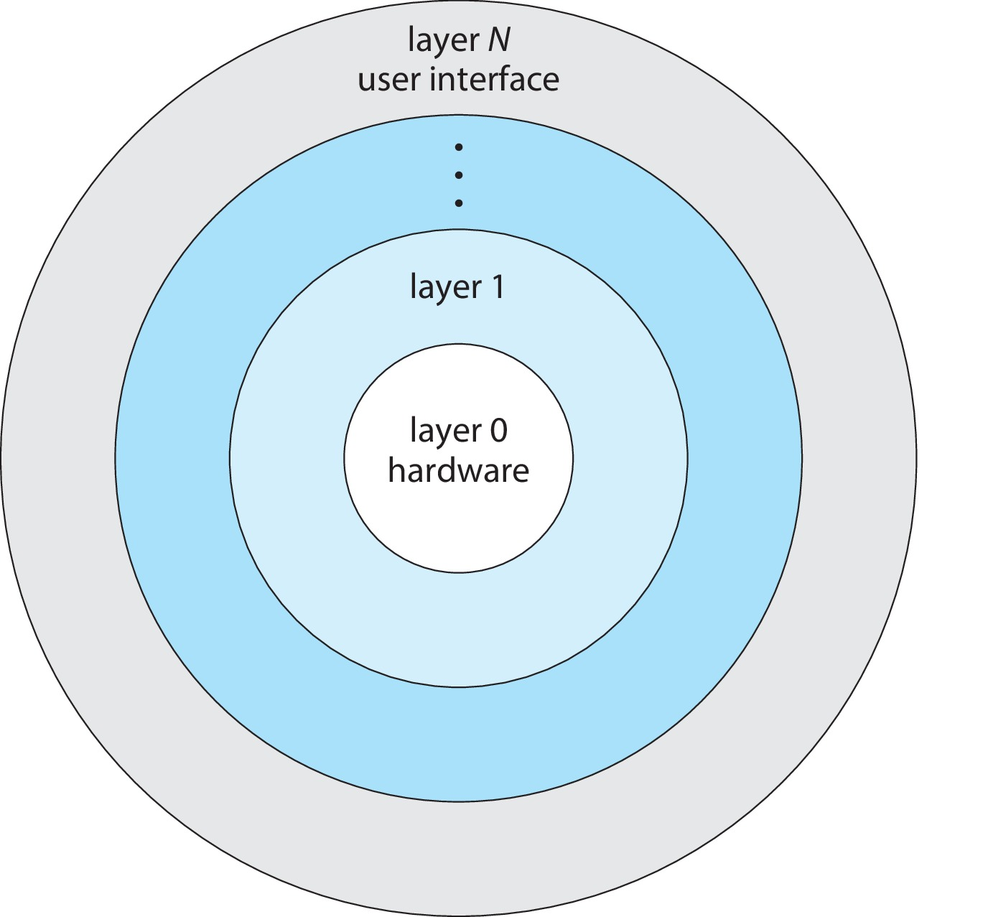
Layered approach
xv6

Slide 27
Microkernel approach
Mach, Mac OS X (based on Mach)
GNU herd
Against “monolithic” approach (Linux kerenel)

Slide 28
Skipped
IOS, Android structure

Slide 29
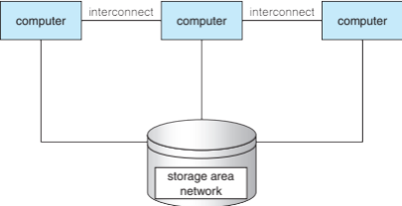
Clustered sytem

Slide 30
Free Software / Open Source kernels
Linux
BSD Unix
GNU Herd
xv6
Minix
FreeRTOS
OpenSolaris
Many others
https://en.wikipedia.org/wiki/Comparison_of_open-source_operating_systems

Slide 31
Virtualization
A general concept!
Create a “virtual reality” out of “reality”
  Black boxes that do something
  End users need not know “how”, but only “what”
Following all are “virtualizations”
  Function
  Class
  An application
  Debian GNU/Linux (or any OS)

Slide 32
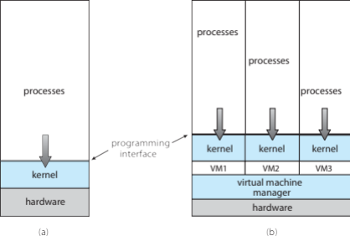
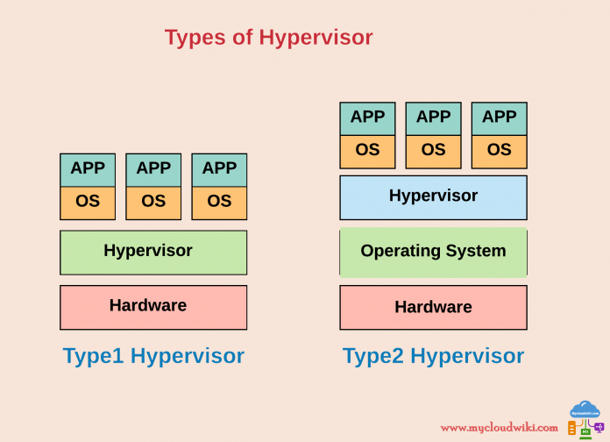
Virtual Machines, an example

