Slide 1
Understanding Boot Process
BIOS, UEFI, etc.
Abhijit A. M.
abhijit.comp@coep.ac.in
All credits: “Hands on Booting” by Yogesh Babar

Slide 2
What do we already know about “boot sequence”?
When POWERed-ON
  The CPU’s IP (or CS+IR, etc) has manufacturer defined value
    The Motherboard manufacturer has ensured that a code called “Basic Input Output System(BIOS)” is at this location
  CPU starts doing fetch-decode-execute-repeat
    So CPU is running BIOS
  BIOS
    code does a Power On Self Test (POST)
    Initializes hardware by writing to control ports, etc.
    Reads list of boot-devices, and finds the first available device

Slide 3
What do we already know about “boot sequence”?
  BIOS (contd)
    Reads “Sector-0” of the “Boot-device”, and loads it in RAM
      Sector-0 is “boot-loader’ (at least that’s what we said!)
    Jumps to it. Now boot-loader is running
  Boot-loader
    Loads the OS kernel (boot-loader somehow knows where kernel is!) in RAM
    Jumps to kernel code
    Now kernel is running
  Kernel
    Creates first process... and then fork-exec will create other processes

Slide 4
Legacy boot
The world of BIOS + MBR

Slide 5
Primary and Logical Partitions
Max 4 primary partitions
Want more?
  2nd or 3rd or 4th partition can be made “extended”
  Within extended partition create logical partitions

Slide 6
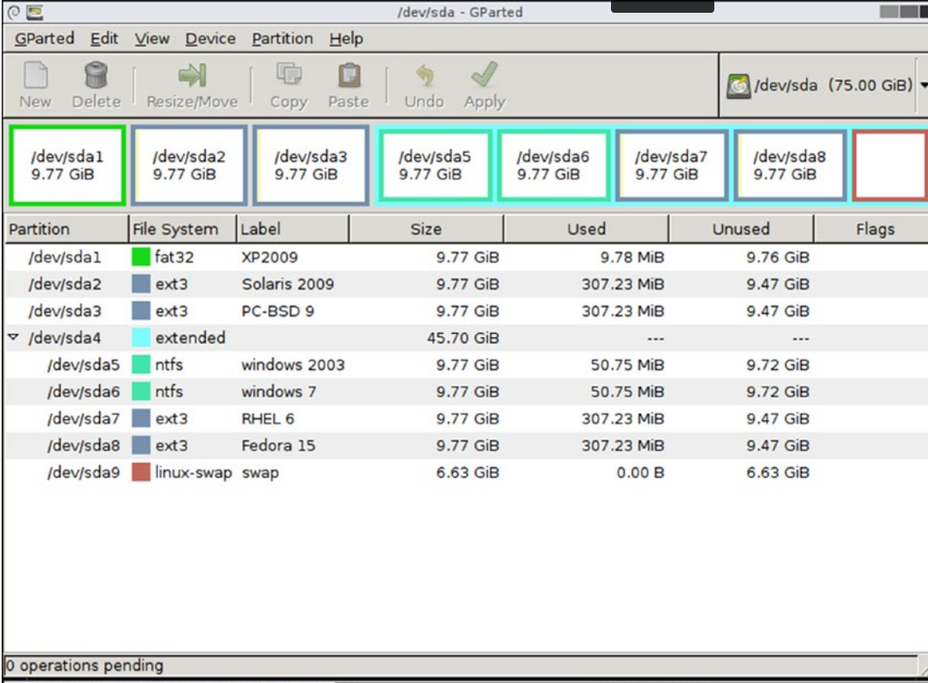
Primary and Logical Partitions

Slide 7
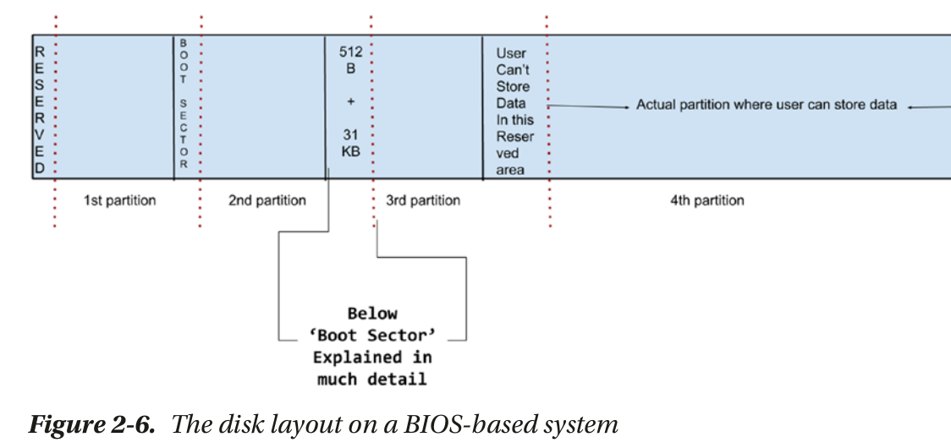
Primary and Logical Partitions

Slide 8
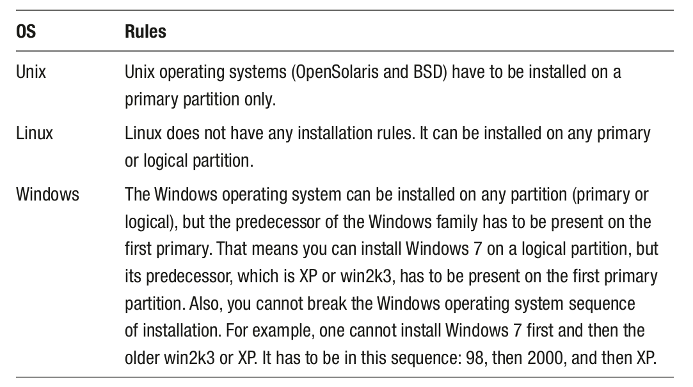

Slide 9
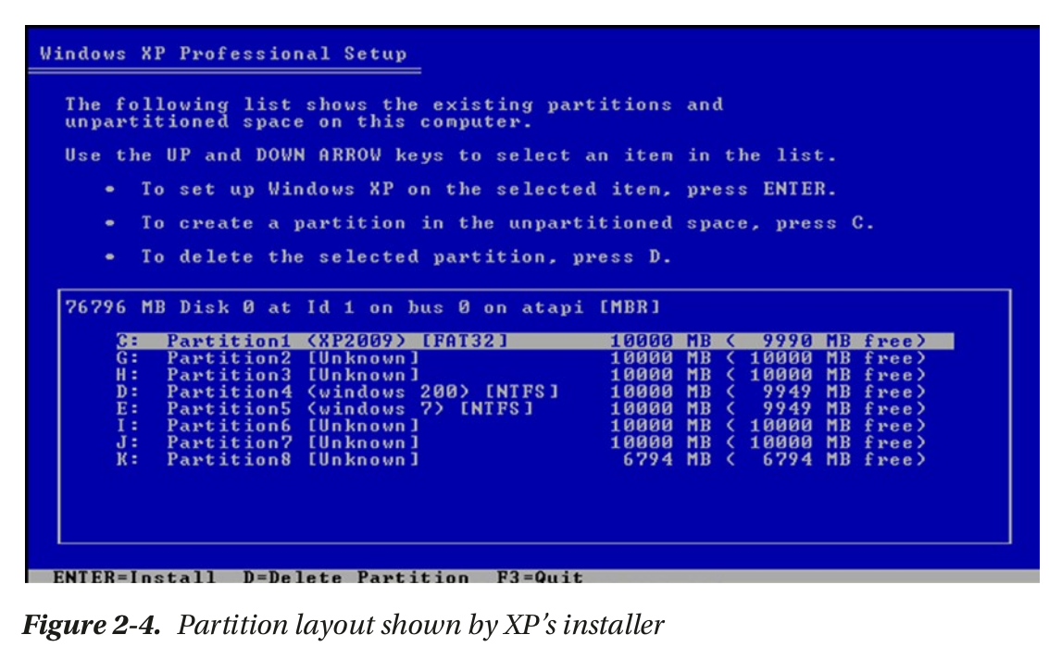
Windows XP installer

Slide 10
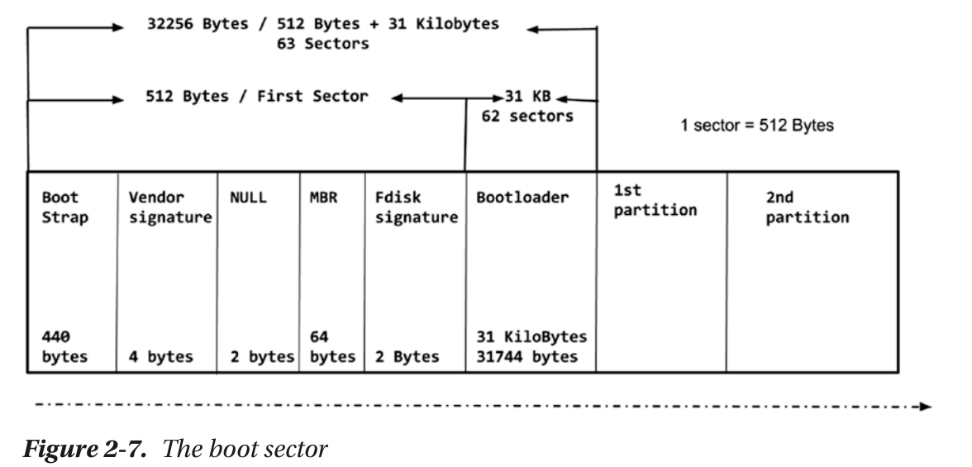
“Boot sector” is a misnomer here! it’s more than a sector!

Slide 11
Bootloader code is in three parts!

Slide 12
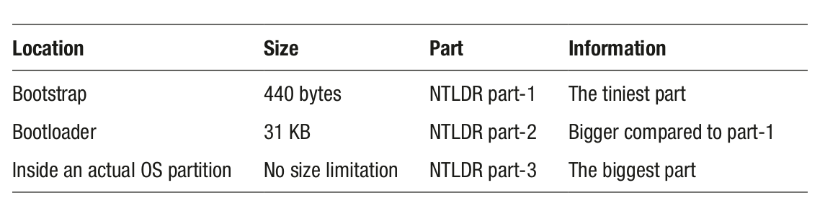
Bootloader code is in three parts!
See C:\NTLDR (NTLDR-3 file) file on Windows XP
Try deleting this file and booting
C:\Windows\winload.exe is Windows kernel

Slide 13
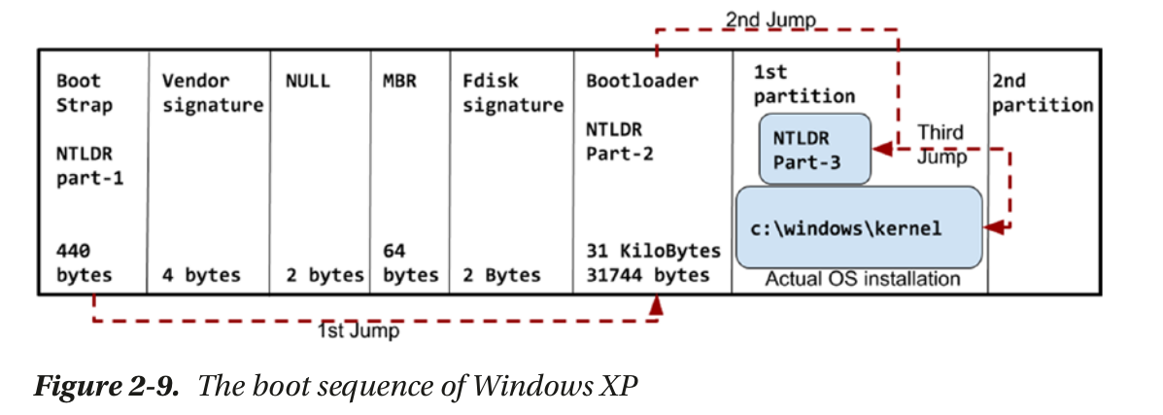
Boot sequence of Win-Xp
Note: The diagram is “conceptual”. In reality, each stage loads the next stage in RAM and “jumps” (that is calls “jump” instruction) to the location of the next stage in RAM. NO jumps happen on disk!

Slide 14
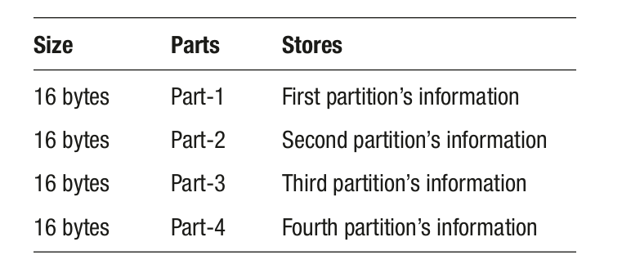
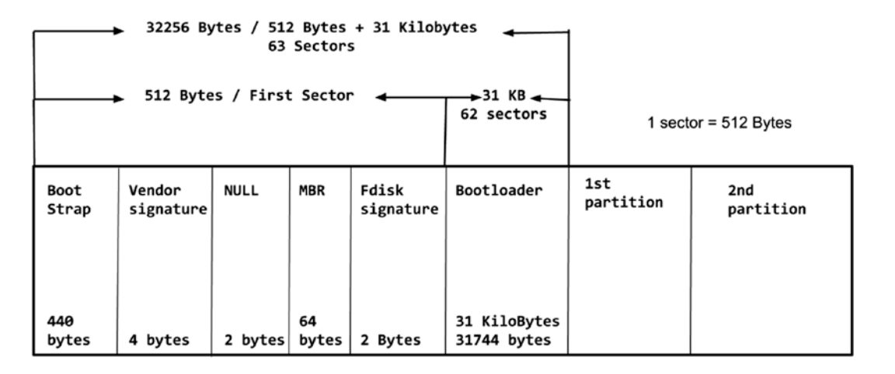
More on boot region
Vendor signature: Seagate, WD, etc.
NULL (is 0, else disk is bad)
MBR: reason why only 4 primary partitions!

Slide 15
More on boot region
Fdisk signature
  Can be “*” or something else
  When *, called boot flag, or active/inactive flag

Slide 16
More on boot region
Fdisk signature
  Can be “*” or something else
  When , called boot flag, or active/inactive flag, OS kernel is supposed to be loaded from partition with “*” flag
    Makes sense only when you have multi-boot system
  BIOS -> Bootstrap code (440 bytes) -> Bootloader (31 kB) of first partition -> where – partition which has “*” on it

Slide 17
Flowchart
Run: BIOS
Run: Partition-1, Bootloader part-1: Sector-0 , 440 bytes
Run: Partition-1, Bootlaoder part-2: 31k
  Checks where is the “*” mark, that is the active flag
    If on partition-1
      Run Partition-1, Bootlaoder part-3
    Else
      Run, Partition-x, Bootloader, part-0
The Bootloader-3 part of whichever partition in the end
  should be able to recognize the other operating systems
  Linux recognizes all, windows recognizes only itself, for other OS: depends

Slide 18
UEFI
Unified Extended Firmware Interface

Slide 19
BIOS Limitations
BIOS will only be able to jump to the first sector, which is 512 bytes.
BIOS cannot generate good graphics/GUIs.
You cannot use a mouse in the BIOS.
The maximum partition size is 2.2 TB.
The BIOS is dumb because it does not understand the bootloader or the OS.
It struggles to initialize the new-generation hardware devices.

Slide 20
UEFI advantages
UEFI can use the full CPU. Unlike the BIOS (which is stuck with 16 bits of processor), UEFI can access up to 64 bits.
UEFI can use a full RAM module. Unlike 1 MB of address space of the BIOS, UEFI can support and use terabytes of RAM.
Instead of 64 bytes of a tiny MBR, UEFI uses the GPT (GUID) partition table, which will provide an infinite number of partitions, and all will be primary partitions. In fact, there is no concept of primary and logical partitions.
A maximum partition size is 8 zettabytes.
UEFI has enterprise management tools.
  Boot remotely
  Browse internet
  Change firmware remotely

Slide 21
UEFI advantages
It’s a small OS
  a) You will have full access to audio and video devices.
  b) You will be able to connect to WiFi.
  c) You will be able to use the mouse.
  d) In terms of the GUI, UEFI will provide a rich graphics interface.
  e) UEFI will have its own app store like we have for Android and Apple phones.
  f) You will be able to download and use the applications from the UEFI app store, just like with Android and Apple phones. Hundreds of apps are available such as calendars, email clients, browser, games, shells, etc.
  g) UEFI is able to run any binary that has an EFI executable format.
  h) It boots operating systems securely with the help of the Secure Boot feature. We will discuss the Secure Boot feature in depth later in this book.
  i) UEFI is backward compatible, meaning it will support the “BIOS way” of booting. In other words, operating systems that do not have UEFI support will also be able to boot with UEFI.

Slide 22
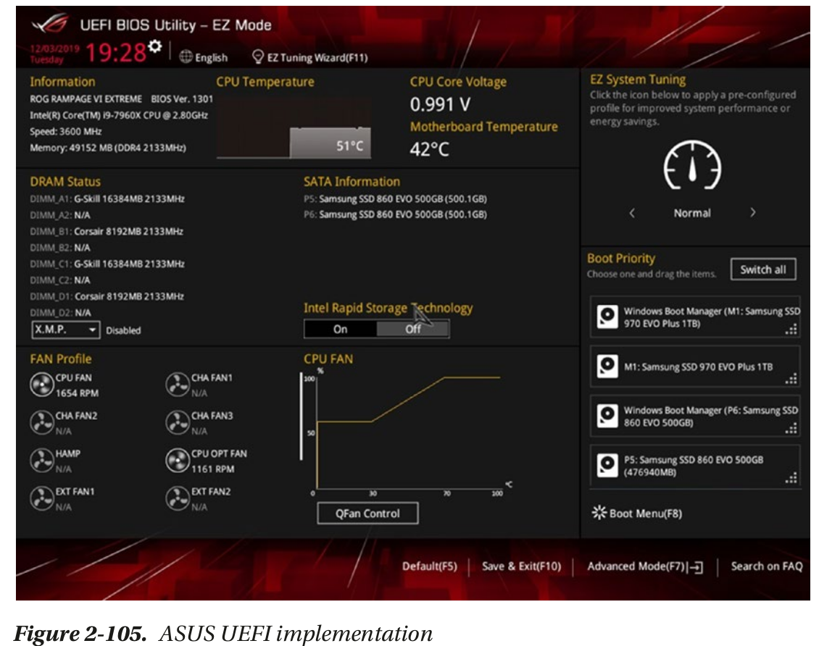

Slide 23
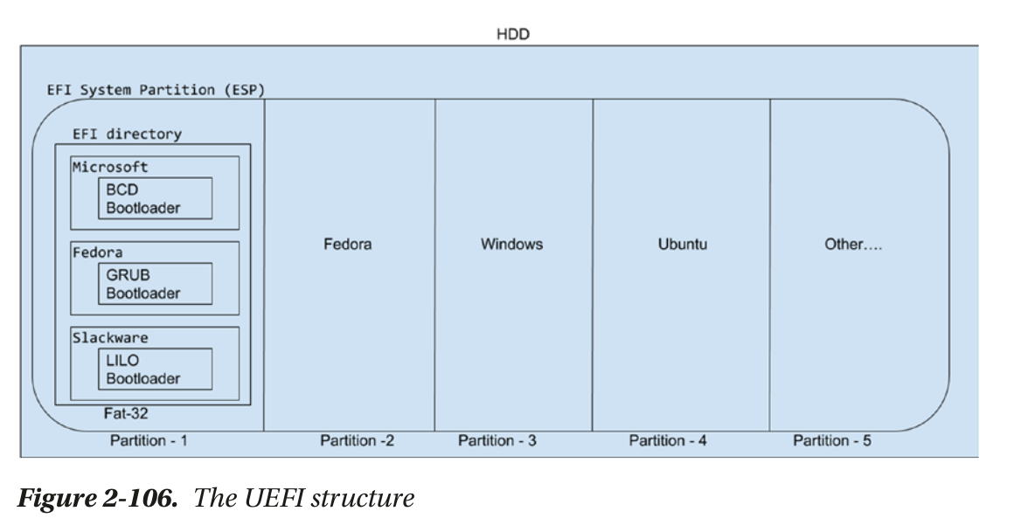

Slide 24
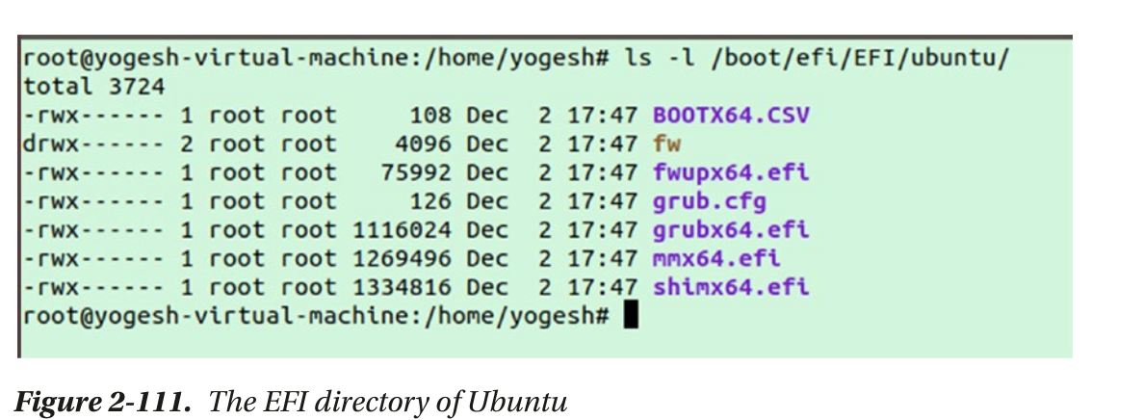

Slide 25
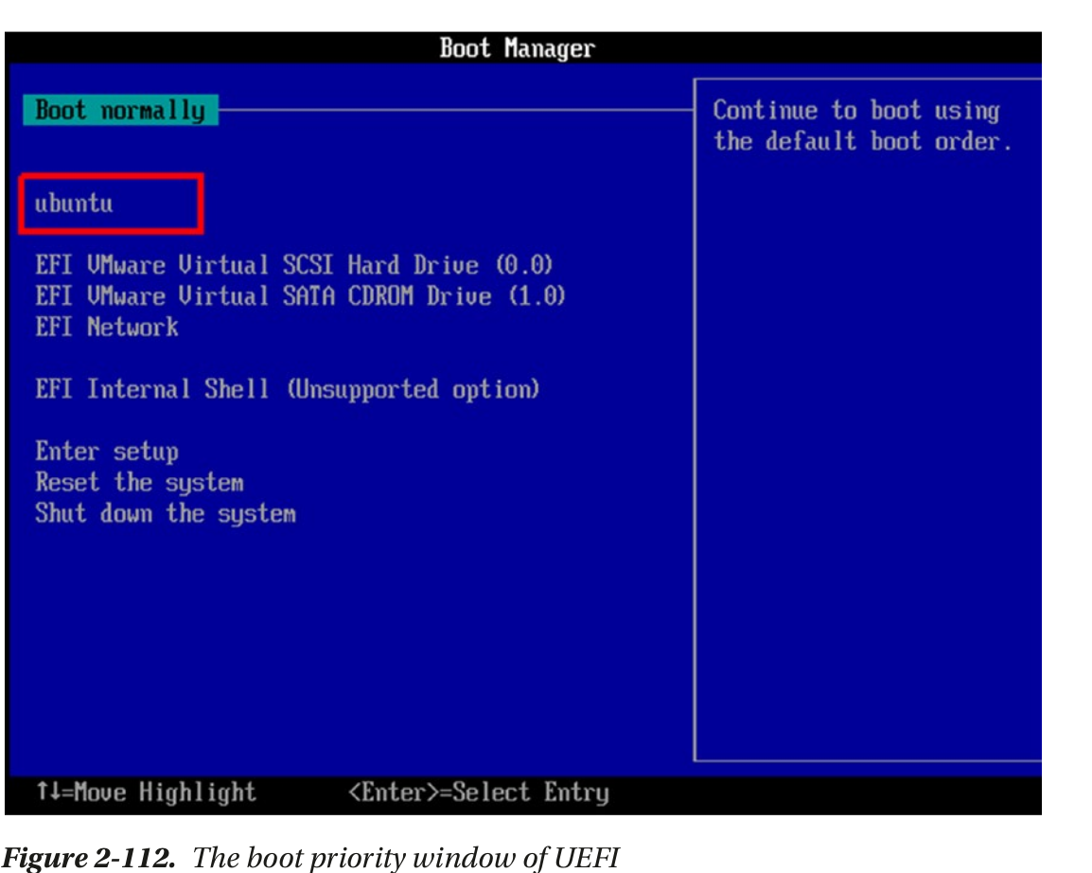

Slide 26
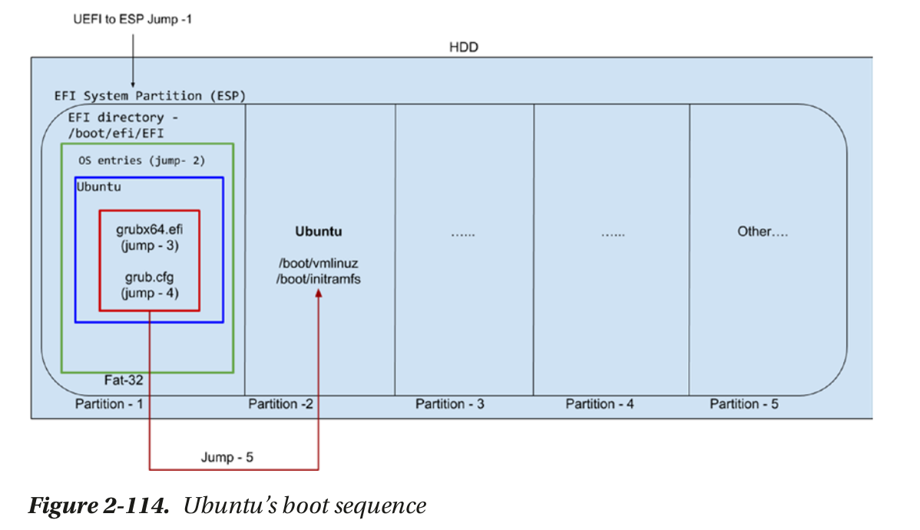

Slide 27
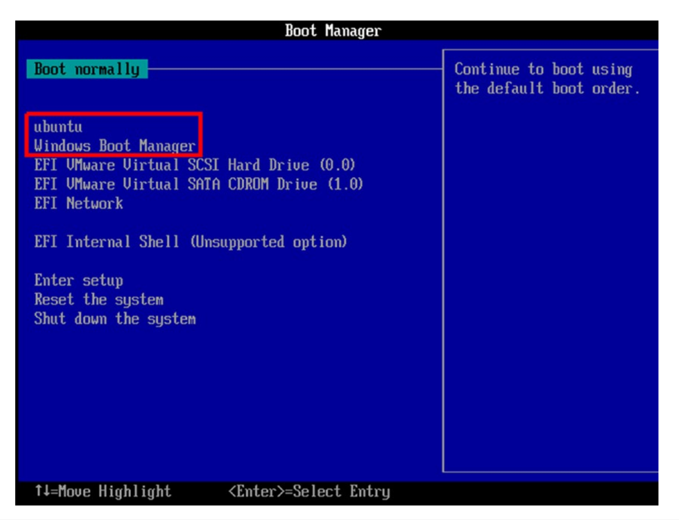

Slide 28
