Slide 1
Compilation, Linking, Loading
Abhijit A M

Slide 2
Review of last few lectures
Boot sequence: BIOS, boot-loader, kernel
Boot sequence: Process world
  kernel->init -> many forks+execs() -> ....
Hardware interrupts, system calls, exceptions
Event driven kernel
System calls
  Fork, exec, ... open, read, ...

Slide 3
What are compiler, assembler, linker and loader, and C library
System Programs/Utilities
Most essential to make a kernel really usable

Slide 4
Standard C Library
A collection of some of the most frequently needed functions for C programs
  scanf, printf, getchar, system-call wrappers (open, read, fork, exec, etc.), ...
An machine/object code file containing the machine code of all these functions
  Not a source code! Neither a header file. More later.
Where is the C library on your computer?
  /usr/lib/x86_64-linux-gnu/libc-2.31.so

Slide 5
Compiler
application program, which converts one (programming) language to another
  Most typically compilers convert a high level language like C, C++, etc. to Machine code language
E.g. GCC /usr/bin/gcc
  Usage: e.g.
  $ gcc main.c -o main
  Here main.c is the C code, and "main" is the object/machine code file generated
Input is a file and output is also a file.
Other examples: g++ (for C++), javac (for java)
main.c
gcc
main
Source code file
Machine code file

Slide 6
Assembler
application program, converts assembly code into machine code
What is assembly language?
  Human readable machine code language.
E.g. x86 assembly code
  mov 50, r1
  add 10, r1
  mov r1, 500
Usage. eg..
  $ as something.s -o something
main.s
as
main
assembly code file
Machine code file

Slide 7
Compilation Process
preprocessor
compiler + assembler
linking
m/c Code
try.o
Exectable
m/c Code
try
C Code
try.c
Handles all # directives in the input C code
Checks syntax errors, grammatical errors, missing declarations,e tc. And converts the input code to machine code
Combines machine code of input file(S) and library files
gcc

Slide 8
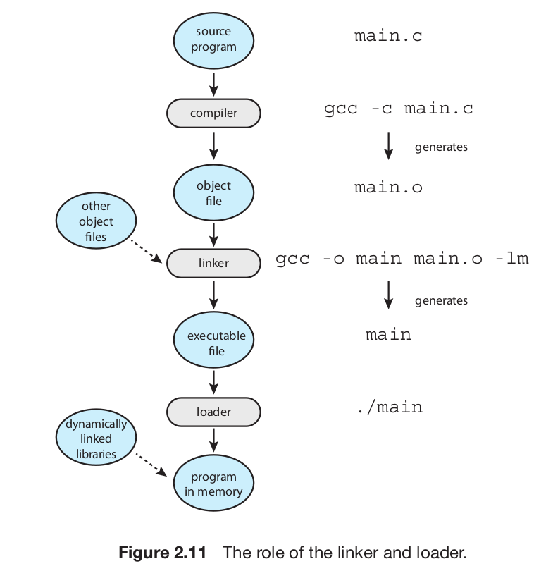
From the textbook

Slide 9
Example
try.c
#include <stdio.h>
#define MAX 30
int f(int, int);
int main() {
int i, j, k;
scanf("%d%d", &i, &j);
k = f(i, j) + MAX;
printf("%d\n", k);
return 0;
}
f.c
int g(int);
#define ADD(a, b) (a + b)
int f(int m, int n) {
return ADD(m,n) + g(10);
}
g.c
int g(int x) {
return x + 10;
}
Try these commands, observe the output/errors/warnings, and try to understand what is happening
$ gcc try.c
$ gcc -c try.c
$ gcc -c f.c
$ gcc -c g.c
$ gcc try.o f.o g.o -o try
$ gcc -E try.c
$ gcc -E f.c

Slide 10
More about the steps
Pre-processor
  #define ABC XYZ
    cut ABC and paste XYZ
  # include <stdio.h>
    copy-paste the file stdio.h
    There is no CODE in stdio.h, only typedefs, #includes, #define, #ifdef, etc.
Linking
  Normally links with the standard C-library by default
  To link with other libraries, use the -l option of gcc
    cc main.c -lm -lncurses -o main # links with libm.so and libncurses.so

Slide 11
Using gcc itself to understand the process
Run only the preprocessor
  cc -E test.c
  Shows the output on the screen
Run only till compilation (no linking)
  cc -c test.c
  Generates the “test.o” file , runs compilation + assembler
  gcc -S main.c
  One step before machine code generation, stops at assembly code
Combine multiple .o files (only linking part)
  cc test.o main.o try.o -o something

Slide 12
Linking process
Linker is an application program
  On linux, it's the "ld" program
  E.g. you can run commands like $ ld a.o b.o -o c.o
  Normally you have to specify some options to ld to get a proper executable file.
When you run gcc
  $ cc main.o f.o g.o -o try
  the CC will internally invoke "ld" . ld does the job of linking

Slide 13
Linking process
The resultatnt file "try" here, will contain the codes of all the functions and linkages also.
What is linking?
  "connecting" the call of a function with the code of the function.
What happens with the code of printf()?
  The linker or CC will automatically pick up code from the libc.so.6 file for the functions.

Slide 14
Executable file format
An executable file needs to execute in an environment created by OS and on a particular processor
  Contains machine code + other information for OS
  Need for a structured-way of storing machine code in it
Different OS demand different formats
  Windows: PE, Linux: ELF, Old Unixes: a.out, etc.
ELF : The format on Linux.
Try this
  $ file /bin/ls
  $ file /usr/lib/x86_64-linux-gnu/libc-2.31.so

Slide 15
Exec() and ELF
When you run a program
  $ ./try
  Essentially there willl be a fork() and exec("./try", ...")
  So the kernel has to read the file "./try" and understand it.
  So each kernel will demand it's own object code file format.
  Hence ELF, EXE, etc. Formats
ELF is used not only for executable (complete machine code) programs, but also for partially compiled files e.g. main.o and library files like libc.so.6
What is a.out?
  "a.out" was the name of a format used on earleir Unixes.
  It so happened that the early compiler writers, also created executable with default name 'a.out'

Slide 16
Utilities to play with object code files
objdump
  $ objdump -D -x /bin/ls
  Shows all disassembled machine instructions and “headers”
hexdump
  $ hexdump /bin/ls
  Just shows the file in hexadecimal
readelf
  Alternative to objdump
ar
  To create a “statically linked” library file
  $ ar -crs libmine.a one.o two.o
Gcc to create shared library
  $ gcc hello.o -shared -o libhello.so
To see how gcc invokes as, ld, etc; do this
  $ gcc -v hello.c -o hello
  /* https://stackoverflow.com/questions/1170809/how-to-get-gcc-linker-command */

Slide 17
Linker, Loader, Link-Loader
Linker or linkage-editor or link-editor
  The “ld” program. Does linking.
Loader
  The exec(). It loads an executable in the memory.
Link-Loader
  Often the linker is called link-loader in literature. Because where were days when the linker and loader’s jobs were quite over-lapping.

Slide 18
Static, dynamic / linking, loading
Both linking and loading can be
  Static or dynamic
  More about this when we learn memory management
An important fundamental:
  memory management features of processor, memory management architecture of kernel, executable/object-code file format, output of linker and job of loader, are all interdependent and in-separable.
  They all should fit into each other to make a system work
  That’s why the phrase “system programs”

Slide 19
Cross-compiler
Compiler on system-A, but generate object-code file for system-B (target system)
  E.g. compile on Ubuntu, but create an EXE for windows
Normally used when there is no compiler available on target system
  see gcc -m option
See https://wiki.osdev.org/GCC_Cross-Compiler

