Slide 1
Memory Management Basics

Slide 2
Summary
Understanding how the processor architecture drives the memory management features of OS and system programs (compilers, linkers)
Understanding how different hardware designs lead to different memory management schemes by operating systems

Slide 3
Addresses issued by CPU
During the entire ‘on’ time of the CPU
  Addresses are “issued” by the CPU on address bus
  One address to fetch instruction from location specified by PC
  Zero or more addresses depending on instruction
    e.g. mov $0x300, r1 # move contents of address 0x300 to r1 --> one extra address issued on address bus

Slide 4
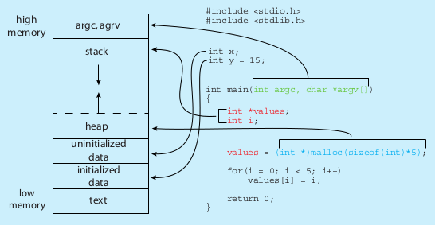
Memory layout of a C program
This “layout” shows
(a) which parts of a C program occupy memory, when the program is running
(b) A typical conceptual layout assumed by many compilers for calculating addresses in the generated machine code. This does not mean that other layouts are not possible
$ size /bin/ls
text data bss dec hex filename
128069 4688 4824 137581 2196d /bin/ls

Slide 5
Terminology
Text
  The machine code of the program : machine code for functions
Data
  Initiazlied global variables
  Do not get confused with the generic word “data” in English
BSS
  Uninitialized global variables
Heap
  Region from where malloc() gets memory
Stack
  Region from where the local variables and formal paramters are allocated space

Slide 6
Desired from a multi-tasking system
Multiple processes in RAM at the same time (multi-programming)
Processes should not be able to see/touch each other’s code, data (globals), stack, heap, etc.
Further advanced requirements
  Process could reside anywhere in RAM
  Process need not be continuous in RAM
  Parts of process could be moved anywhere in RAM

Slide 7
Different ‘times’
Different actions related to memory management for a program are taken at different times. So let’s know the different ‘times’
Compile time
  When compiler is compiling your C code
Load time
  When you execute “./myprogram” and it’s getting loaded in RAM by loader i.e. exec()
Run time
  When the process is alive, and getting scheduled by the OS

Slide 8
The sequence
Do not forget this
  Machine code is typically generated by compiler
  This machine code is put in RAM by the Loader (part of kernel) , that is exec() , when it’s requested to run that program
  The CPU’s PIPELINE will issue addresses on address bus as seen in the executable file
So question arises
  How does compiler put in addresses (for code, data, bss, local-variables, etc) in the executable file ?

Slide 9
Different types of Address binding
Which binding is actually used, is mandated by processor features + OS
Compile time address binding
  Address of code/variables is fixed by compiler
  Very rigid scheme
  Location of process in RAM can not be changed ! Non-relocatable code.
Load time address binding
  Address of code/variables is fixed by loader
  Location of process in RAM is decided at load time, but can’t be changed later
  Flexible scheme, relocatable code
Run time address binding
  Address of code/variables is fixed at the time of executing the code
  Very flexible scheme , highly relocatable code
  Location of process in RAM is decided at load time, but CAN be changed later also

Slide 10
Simplest case
RAM
Suppose the address issued by CPU reaches the RAM controller directly
CPU
address

Slide 11
Simplest case
How does this impact the compiler and OS ?
When a process is running the addresses issued by it, will reach the RAM directly
So exact addresses of globals, addresses in “jmp” and “call” must be part the machine instructions generated by compiler
  How will the compiler know the addresses, at “compile time” ?
RAM
CPU
address
Example
address: instruction
1000: mov $0x300, r1
1004: add r1, -3
1008: jnz 1000
Sequence of addressed sent by CPU: 1000, 0x300, 1004, 1008, 1000, 0x300, ...

Slide 12
Simplest case
Solution: compiler assumes some fixed addresses for globals, code, etc.
OS loads the program exactly at the same addresses specified in the executable file. Non-relocatable code.
Now program can execute properly.
RAM
CPU
address
Example
1000: mov $0x300, r1
1004: add r1, -3
1008: jnz 1000

Slide 13
Simplest case
Problem with this solution
  Programs once loaded in RAM must stay there, can’t be moved
  What about 2 programs?
    Compilers being “programs”, will make same assumptions and are likely to generate same/overlapping addresses for two different programs
    Hence only one program can be in memory at a time !
    No need to check for any memory boundary violations – all memory belongs to one process
Example: DOS
RAM
CPU
address
Example
1000: mov $0x300, r1
1004: add r1, -3
1008: jnz 1000

Slide 14

Base/Relocation + Limit scheme
base/relocation address
Base and Limit are two registers inside CPU’s Memory Management Unit
‘base’ is added to the address generated by CPU
The result is compared with base+limit and if less passed to memory, else hardware interrupt is raised
Process
In
RAM

Slide 15
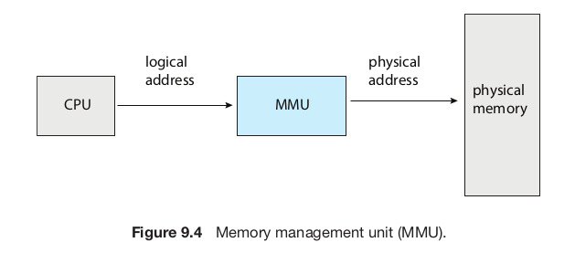
Memory Management Unit (MMU)
Is part of the CPU chip, acts on every memory address issue by execution unit of the CPU
In the scheme just discussed, the base, limit calculation parts are part of MMU

Slide 16
Base/Relocation + Limit scheme
Compiler’s work
  Assume that the process is one continous chunk in memory, with a size limit
  Assume that the process starts at address zero (!) and calculate addresses for globals, code, etc. And accordingly generate machine code
base
Compiler’s
view
Process
In
RAM
Base =0
Limit
Code
--
data
--
Bss
--
heap
--
stack
Limit
RAM

Slide 17
Base/Relocation + Limit scheme
base/relocation address
Loader’s job
  While loading the process in memory – must load as one continous segment
    Find an empty slot for this!
  Remember the ‘base’ and ‘limit’ values in the struct proc (memory management info in PCB)
    Setup the limit to be the size of the process as set by compiler in the executable file.
  Call the scheduler()
Scheduler()
  Will replace the base-limit registers with values obtained from PCB before scheduling the process
Process
In
RAM

Slide 18
Base/Relocation + Limit scheme
base/relocation address
Combined effect
  “Relocatable code” – the process can go anywhere in RAM at the time of loading
  Some memory violations can be detected – a memory access beyond base+limit will raise interrupt, thus running OS in turn, which may take action against the process
Process
In
RAM

Slide 19
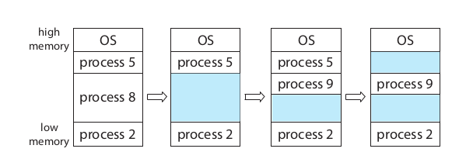
Example scenario of memory in base+limit scheme
Process 8 called exit()
Process 9 forked
Process 5 terminated

Slide 20
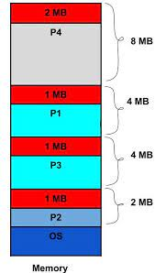
Continuous memory management and external fragmentation problem
Free chunks: 2 MB, 1MB, 1MB, 1MB
Total 5 MB is available!
Can we create a process of size 3MB?
No! - 3 MB not continous!

Slide 21
External Fragmentation
OS needs to find a continuous free chunk of memory that fits the size of the “segment”
  If not available, your exec() can fail due to lack of memory
Suppose 50k is needed
  Possible that mong 3 free chunks total 100K may be available, but no single chunk of 50k!
  External fragmentation
Solution to external fragmentation: compaction – move the chunks around and make a continous big chunk available. Time consuming, tricky.

Slide 22
It should be possible to have relocatable code even with “simplest case”
By doing extra work during “loading”.
How?
(Ans: loader replaces all addresses in the code! That is quite a lot of work, and challenging too)

Slide 23
Next scheme:
Multiple base +limit pairs
Limit:text
Base: text
Limit:data
Base: data
Limit: heap
Base: heap
P1: text
Limit: stack
Base: stack
Segment selector
P1: data
P1: heap
>
+
Logical address
Physical address
P1: stack
trap

Slide 24
Specifying “selector”
Explicitely
  Mov ES: 300, $30
  Here selector is Extra Segment Register and Logical address (or offset) is 300
Implicitely, like in x86
  Mov 300, $30
  Here Data Segment register is “implicit” selector

Slide 25
Next scheme: Segmentation
Multiple base +limit pairs
Multiple sets of base + limit registers
Whenever an address is issued by execution unit of CPU, it will also include reference to some base register
  And hence limit register paired to that base register will be used for error checking
Compiler: can assume a separate chunk of memory for code, data, stack, heap, etc. And accordingly calculate addresses . Each “segment” starting at address 0.
OS (Loader): will load the different ‘sections’ in different memory regions and accordingly set different ‘base’ registers

Slide 26
Next scheme:
Multiple base +limit pairs, with further indirection
Base + limit pairs can also be stored in some memory location (not in registers). Then it’s called Segment Table.
  Question: how will the cpu know where it’s in memory?
  One CPU register to point to the location of table in memory . Segment Table Base Register (STBR)
    X86 has two tables. Local Descriptor Table and Global Descriptor Table. Both are segment tables.
    Accordingly it has LDTR and GDTR.
Segment registers still in use, they give an index in this table
This is x86 segmentation
  Flexibility to have lot more “base+limits” in the array/table in memory

Slide 27
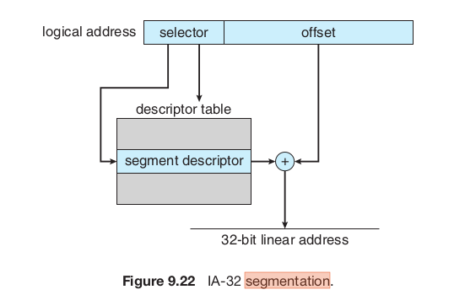
Next scheme:
Multiple base +limit pairs, with further indirection
Note:
”Selector” here is normally a segment register, like CS, DS
The machine code only has offset in it
The “Descriptor table” is a segmentation table

Slide 28
Segmentation and External fragmentation
Does segmentation also suffer from external fragmentation?
  Yes!

Slide 29
How many segment tables?
One per process
One for the kernel!
  Remember: kernel code also undergoes translation in MMU!

Slide 30
A point of confusion on “root” user
“root” user has privileges in accessing files
When “root” user runs an application, it runs in process-mode, not in kernel-mode!
  That process can do “more” but , it’s not kernel mode code!
Kernel is not run by “root” user!
  Kernel is not run by any user

Slide 31
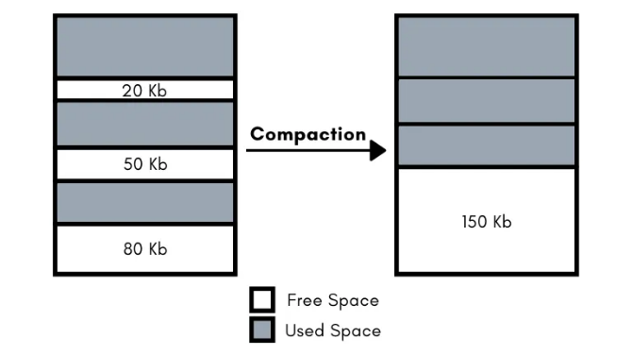
Solution to external fragmentation
Compaction !
OS moves the process chunks in memory to make available continous memory region
  Then it must update the memory management information in PCB (e.g. base of the process) of each process
Time consuming
Possible only if the relocation+limit scheme of MMU is available
P1
P1
P2
P2
P3
P3

Slide 32
Another solution to external fragmentation: Fixed size partitions
Fixed partition scheme
Memory is divided by OS into chunks of equal size: e.g., say, 50k
  If total 1M memory, then 20 such chunks
Allocate one or more chunks to a process, such that the total size is >= the size of the process
  E.g.if request is 50k, allocate 1 chunk
  If request is 40k, still allocate 1 chunk
  If request is 60k, then allocate 2 chunks
Leads to internal fragmentation
  space wasted in the case of 40k or 60k requests above
50K
Kernel
50K
Kernel
50K
Free
50K
P1 (50 KB)
50K
P2 (80 KB)
50K
Unused (20 KB)
50K
Free
50K
P3 (120 KB)
50K
50K
Unused (30 KB)
50K
Free
50K
Free

Slide 33
Solving external fragmentation problem
Process should not be continous in memory!
  The trouble is finding a big continous chunk!
Divide the continuous process image in smaller chunks (let’s say 4k each) and locate the chunks anywhere in the physical memory
  Need a way to map the logical memory addresses into actual physical memory addresses

Slide 34


Slide 35


Slide 36

Paging scheme
PTBR

Slide 37
Paging
Process is assumed to be composed of equally sized “pages” (e.g. 4k page)
Actual memory is considered to be divided into page “frames”.
CPU generated logical address is split into a page number and offset
A Page Table Base Register (PTBR) inside CPU will give location of an in memory table called page table
Page number used as offset in a table called page table, which gives the physical page frame number
Frame number + offset are combined to get physical memory address

Slide 38
Paging
Compiler: assume the process to be one continous chunk of memory (!) . Generate addresses accordingly . Compiler still treats text,data,bss,.. to be separate chunks, but in multiples of page-sizes.
OS: at exec() time – allocate different frames to process, allocate a page table(!), setup the page table to map page numbers with frame numbers, setup the page table base register, start the process
Now hardware will take care of all translations of logical addresses to physical addresses

Slide 39
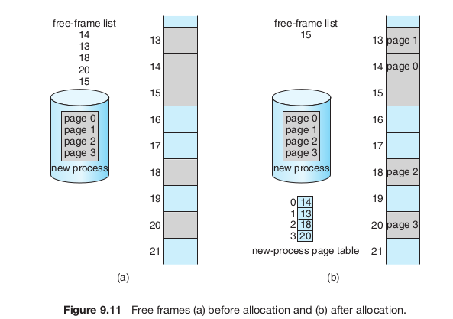

Slide 40
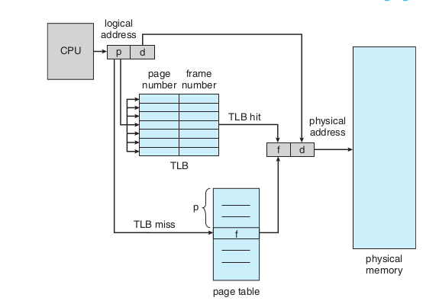
Speeding up paging
Translation Lookaside Buffer (TLB)
Part of CPU hardware
A cache of Page table entries
Searched in parallel for a page number

Slide 41
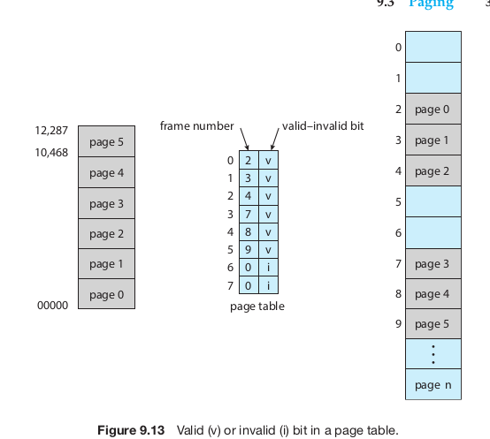
Memory protection with paging

Slide 42
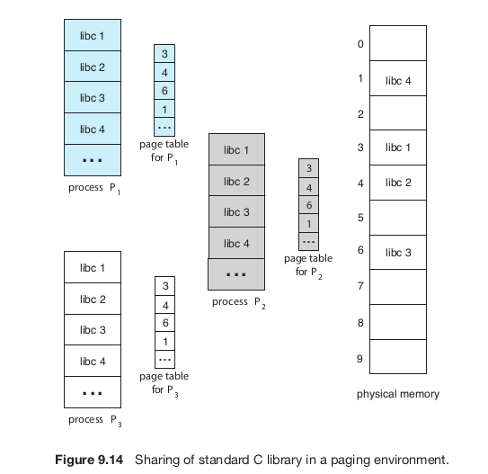
Shared pages (e.g. library) with paging

Slide 43
Paging: problem of large PT
64 bit address
Suppose 20 bit offset
  That means 2^20 = 1 MB pages
  44 bit page number: 2^44 that is trillion sized page table!
  Can’t have that big continuous page table!

Slide 44
Paging: problem of large PT
32 bit address
Suppose 12 bit offset
  That means 2^12 = 4 KB pages
  20 bit page number: 2^20 that is a million entries
  Can’t always have that big continuous page table as well, for each process!

Slide 45
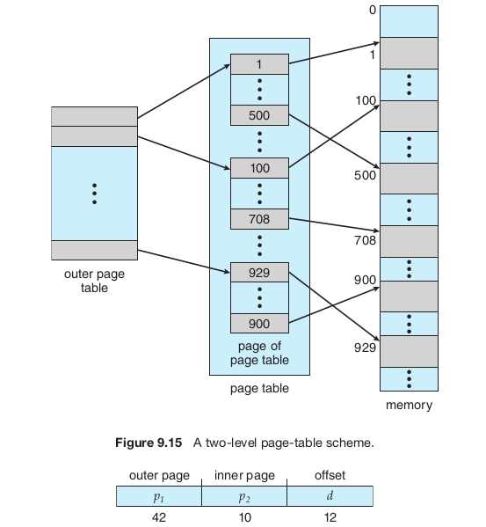
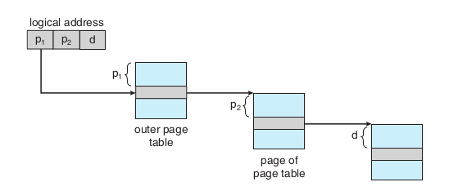
Hierarchical paging

Slide 46
X86 memory management

Slide 47
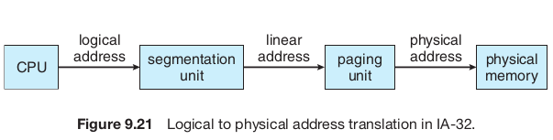

Slide 48
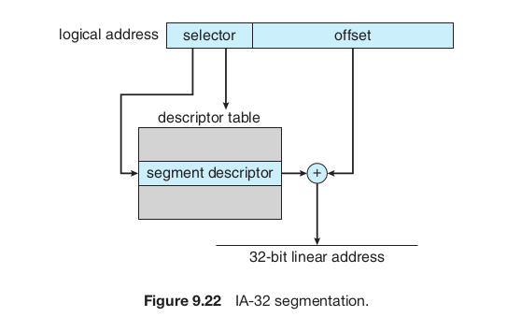
Segmentation in x86
The selector is automatically chosen using Code Segment (CS) register, or Data Segment (DS) register depending on which type of memory address is being fetched
Descriptor table (that is a segmentation table) is in memory
The location of Descriptor table (Global DT- GDT or Local DT – LDT) is given by a GDT-register i.e. GDTR or LDT-register i.e. LDTR

Slide 49
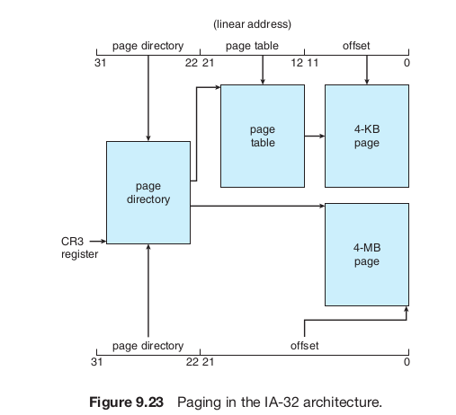
Paging in x86
Depending on a flag setup in CR3 register, either 4 MB or 4 KB pages can be enabled
Page directory, page table are both in memory

Slide 50

X86 Segmentation + Paging
GDTR
Selector value is implicit based on address being accessed.
Instruction: CS
Stack Variable: SS
Data: DS
etc.

Slide 51
X86 Segmentation + Paging
Paging is optional, segmentation compulsory
  Setting flags in Control Registers (CR) enables this
Page Table, Page Directory, page - are all size=4k, if 2-level paging is used
  Makes life simpler for the kernel

