Slide 1
VFS

Slide 2
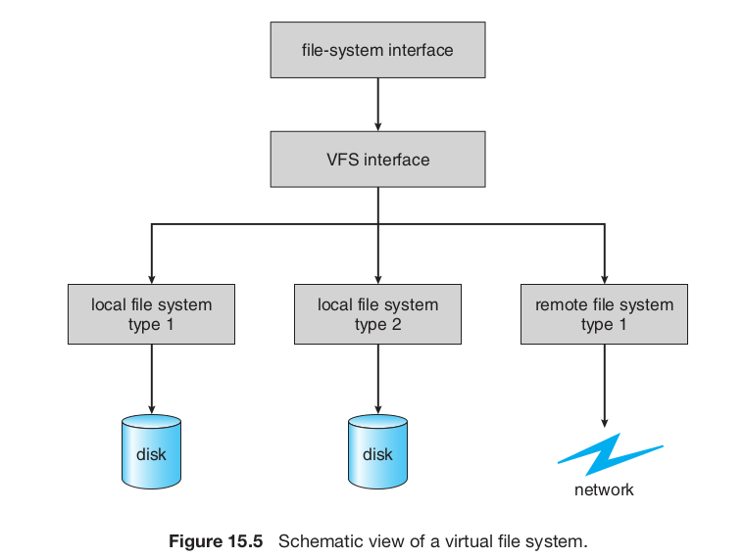

Slide 3
Illustrative example of VFS implementation

Slide 4
File System Code
open,read, write, close, pipe, fstat, chdir, dup, mknod, link, unlink, mkdir,
Files, Inodes, Buffers

Slide 5
What we already know
File system related system calls
  deal with ‘fd’ arrays (ofile in xv6). open() returns first empty index. open should ideallly locate the inode on disk and initialize some data structures
  maintain ‘offsets’ within a ‘file’ to support sequential read/write
  dup() like system calls duplicate pointers in fd-array
  read/write like system calls, going through ‘ofile’ array, should locate data of file on disk
  We need functions to read/write from disk – that is disk driver
  cache data of files in OS data structures for performance : buffering
  Need to handle on disk data structures as well
Faster recovery (like journaling in ext3) is desired

Slide 6
xv6 file handling code
Is a very good example in ‘design’ of a layered and modular architecture
Splits the entire work into different modules, and modules into functions properly
The task of each function is neatly defined and compartamentalized

Slide 7
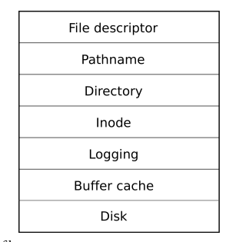
Layers of xv6 file system code
System Calls | open, read, write, close, link, pipe, mknod, unlink, fstat, mkdir, chdir, dup,
file.c fileinit, filealloc, filedup, fileclose, filestat, fileread, filewrite,
fs.c namex, namei, nameiparent, skipelem
fs.c dirlookup, dirlink
fs.c iiinit, ialloc, iupdate,iget, idup, ilock, iunlock, iput, iunlockput, itrunc, stati, readi, writei, bmap,
Block allocation on disk: balloc, bfree log.c : begin_op, end_op, initlog, commit,
bio.c binit, bget, bread, bwrite, brelse
ide.c: idewait, ideinit, idestart, ideintr, iderw
Normally, any upper layer can call any lower layer below
Abhijit: Block allocator should be considered as another Layer!

Slide 8
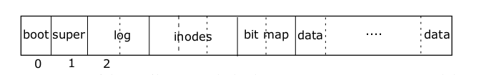
Layout of xv6 file system
Pointer shown are conceptual
May see the code of mkfs.c to get insight into the layout
struct superblock {
uint size; // Size of file system image (blocks)
uint nblocks; // Number of data blocks
uint ninodes; // Number of inodes.
uint nlog; // Number of log blocks
uint logstart; // Block number of first log block
uint inodestart; // Block number of first inode block
uint bmapstart; // Block number of first free map block
};
#define ROOTINO 1 // root i-number
#define BSIZE 512 // block size

Slide 9
Layout of xv6 file system
#define NDIRECT 12
#define NINDIRECT (BSIZE / sizeof(uint))
#define MAXFILE (NDIRECT + NINDIRECT)
// On-disk inode structure
struct dinode {
short type; // File type
short major; // Major device number (T_DEV only)
short minor; // Minor device number (T_DEV only)
short nlink; // Number of links to inode in file system
uint size; // Size of file (bytes)
uint addrs[NDIRECT+1]; // Data block addresses
};
#define DIRSIZ 14
struct dirent {
ushort inum;
char name[DIRSIZ];
};

Slide 10
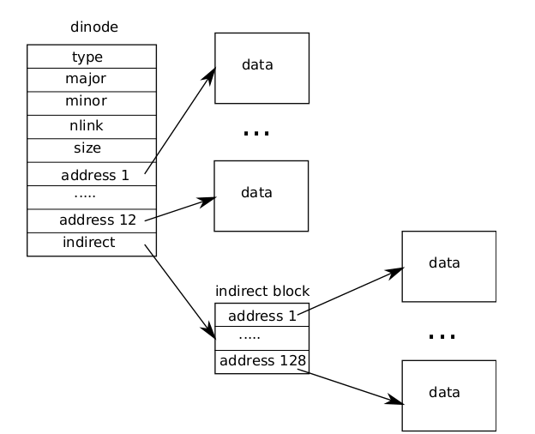
File on disk

Slide 11
Let’s discuss lowest layer first
System Calls | open, read, write, close, link, pipe, mknod, unlink, fstat, mkdir, chdir, dup,
file.c fileinit, filealloc, filedup, fileclose, filestat, fileread, filewrite,
fs.c namex, namei, nameiparent, skipelem
fs.c dirlookup, dirlink
fs.c iiinit, ialloc, iupdate,iget, idup, ilock, iunlock, iput, iunlockput, itrunc, stati, readi, writei, bmap,
Block allocation on disk: balloc, bfree log.c : begin_op, end_op, initlog, commit,
bio.c binit, bget, bread, bwrite, brelse
ide.c: idewait, ideinit, idestart, ideintr, iderw
Normally, any upper layer can call any lower layer below

Slide 12
ide.c: idewait, ideinit, idestart, ideintr, iderw
static struct spinlock idelock;
static struct buf *idequeue;
static int havedisk1;
ideinit
  was called from main.c: main()
  Initialized IDE controller by writing to certain ports
  havedisk=1 setup
  Initialize idelock
idewait
  BUSY loop waiting for IDE to be ready

Slide 13
ide.c: idewait, ideinit, idestart, ideintr, iderw
void idestart(buf *b)
  static void idestart(struct buf *b)
  Calculate sector number on disk using b->blockno
  Issue a read/write command to IDE controller.
  (This is the first buf on idequeue)
ideintr
  Take idelock. Called on IDE interrupt (through alltraps()->trap())
  Wakeup the process waiting on first buffer in buffer *idequeue;
  call idestart(). Release idelock.
iderw(buf *b)
  Move buf b to end of idequeue
  Call idestart() if not running, sleep on idelock

Slide 14
Let’s see buffer cache layer
System Calls | open, read, write, close, link, pipe, mknod, unlink, fstat, mkdir, chdir, dup,
file.c fileinit, filealloc, filedup, fileclose, filestat, fileread, filewrite,
fs.c namex, namei, nameiparent, skipelem
fs.c dirlookup, dirlink
fs.c iiinit, ialloc, iupdate,iget, idup, ilock, iunlock, iput, iunlockput, itrunc, stati, readi, writei, bmap,
Block allocation on disk: balloc, bfree log.c : begin_op, end_op, initlog, commit,
bio.c binit, bget, bread, bwrite, brelse
ide.c: idewait, ideinit, idestart, ideintr, iderw
Normally, any upper layer can call any lower layer below

Slide 15
Reminder: After main()->binit()
head
Conceptually Linked liks this
Buffers keep moving on list, as LRU
n
p
^{n}
^{p}
n
p
n
p
n
p
n
p
n
p
n
p
n
p
lock
buf[0]
buf[1]
buf[2]
...
head
struct bcache

Slide 16
struct buf
struct buf {
int flags; // 0 or B_VALID or B_DIRTY
uint dev; // device number
uint blockno; // seq block number on device
struct sleeplock lock; // Lock to be held by process using it
uint refcnt; // Number of live accesses to the buf
struct buf *prev; // cache list
struct buf *next; // cache list
struct buf *qnext; // disk queue
uchar data[BSIZE]; // data 512 bytes
};
#define B_VALID 0x2 // buffer has been read from disk
#define B_DIRTY 0x4 // buffer needs to be written to disk

Slide 17
buffer cache: static struct buf* bget(uint dev, uint blockno)
The bcache.head list is maintained on Most Recently Used (MRU) basis
  head.next is the Most Recently Used (MRU) buffer
  hence head.prev is the Least Recently Used (LRU)
Look for a buffer with b->blockno = blockno and b->dev = dev
  Search the head.next list for existing buffer (MRU order)
  Else search the head.prev list for empty buffer
  panic() if found in-use or empty buffer
Increment b->refcnt ; Returns buffer locked
Does not change the list structure, just returns a buf in use

Slide 18
buffer cache: struct buf* bread(uint dev, uint blockno)
struct buf*
bread(uint dev, uint blockno)
{
struct buf *b;
b = bget(dev, blockno);
if((b->flags & B_VALID) == 0) {
iderw(b);
}
return b; // locked buffer
}
void
bwrite(struct buf *b)
{
if(!holdingsleep(&b->lock))
panic("bwrite");
b->flags |= B_DIRTY;
iderw(b);
}
Recollect: iderw moves buf to tail of idequeue, calls idestart() and sleep()

Slide 19
buffer cache: void brelse(struct buf *b)
release lock on buffer
b->refcnt = 0
If b->refcnt = 0
  Means buffer will no longer be used
  Move it to front of the front of bcache.head

Slide 20
Overall in this diagram
head
p
n
^{p}
^{n}
p
n
p
n
p
n
p
n
p
n
p
n
p
n
Buffers keep moving to the front of the list and around
The list always contains NBUF=30 buffers
head.next is always the MRU and head.prev is always LRU buffer

Slide 21
File descriptor layer code
System Calls | open, read, write, close, link, pipe, mknod, unlink, fstat, mkdir, chdir, dup,
file.c fileinit, filealloc, filedup, fileclose, filestat, fileread, filewrite,
fs.c namex, namei, nameiparent, skipelem
fs.c dirlookup, dirlink
fs.c iiinit, ialloc, iupdate,iget, idup, ilock, iunlock, iput, iunlockput, itrunc, stati, readi, writei, bmap,
Block allocation on disk: balloc, bfree log.c : begin_op, end_op, initlog, commit,
bio.c binit, bget, bread, bwrite, brelse
ide.c: idewait, ideinit, idestart, ideintr, iderw

Slide 22
data structures related to “file” layer
struct file {
enum { FD_NONE, FD_PIPE, FD_INODE } type;
int ref; // reference count
char readable;
char writable;
struct pipe *pipe; // used only if it works as a pipe
struct inode *ip;
uint off;
};
// interesting no lock in struct file !
struct proc {
...
struct file *ofile[NOFILE]; // Open files per process
...
}
struct {
struct spinlock lock;
struct file file[NFILE];
} ftable; //global table from which ‘file’ is allocated to every process
Lock is used to protect updates to every entry in the array

Slide 23
Multiple processes accessing same file.
Each will get a different ‘struct file’
  but share the inode !
  different offset in struct file, for each process
  Also true, if same process opens file many times
File can be a PIPE (more later)
  what about STDIN, STDOUT, STDERR files ?
  Figure out!
ref
  used if the file was ‘duped’ or process forked . in that case the ‘struct file’ is shared

Slide 24
file layer functions
filealloc
  find an empty struct file in ‘ftable’ and return it
  set ref = 1
filedup(file *)
  simply ref++
fileclose
  --ref
  if ref = 0
    free struct file
    iput() / pipeclose()
    note – transaction if iput() called
filestat
  simply return fields from inode, after holding lock. on inodes for files only.

Slide 25
file layer functions
fileread
  call readi() or piperead()
  readi() later calls device-read or inode read (using bread())
filewrite
  call pipewrite() or writei()
  writei() is called in a loop, within a transaction
Why does readi() call read on the device , why not fileread() itself call device read ?

Slide 26
Reading Directory Layer
System Calls | open, read, write, close, link, pipe, mknod, unlink, fstat, mkdir, chdir, dup,
file.c fileinit, filealloc, filedup, fileclose, filestat, fileread, filewrite,
fs.c namex, namei, nameiparent, skipelem
fs.c dirlookup, dirlink
fs.c iiinit, ialloc, iupdate,iget, idup, ilock, iunlock, iput, iunlockput, itrunc, stati, readi, writei, bmap,
Block allocation on disk: balloc, bfree log.c : begin_op, end_op, initlog, commit,
bio.c binit, bget, bread, bwrite, brelse
ide.c: idewait, ideinit, idestart, ideintr, iderw

Slide 27
directory entry
#define DIRSIZ 14
struct dirent {
ushort inum;
char name[DIRSIZ];
};
Data of a directory file is a sequence of such entries. To find a name, just get all the data blocks and search the name
How to get the data for a directory? We already know the ans!

Slide 28
struct inode* dirlookup(struct inode *dp, char *name, uint *poff)
Given a pointer to directory inode (dp), name of file to be searched
  return the pointer to inode of that file (NULL if not found)
  set the ‘offset’ of the entry found, inside directories data blocks, in poff
How was ‘dp’ obtained? Who should be calling dirlookup? Why is poff returned?
  During resolution of pathnames?
Code: call readi() to get data of dp, search name in it, name comes with inode-num, iget() that inode-num

Slide 29
int dirlink(struct inode *dp, char *name, uint inum)
Create a new entry for ‘name’_’inum’ in directory given by ‘dp’
  inode number must have been obtained before calling this. How to do that?
Use dirlookup() to verify entry does not exist!
Get empty slot in directory’s data block
Make directory entry
Update directory inode! writei()

Slide 30
namex
Called by namei(), or nameiparent()
Just iteratively split a path using “/” separator and get inode for last component
iget() root inode, then
Repeatedly calls
  split on “/”, dirlookup() for next component

Slide 31
races in namex()
Crucial. Called so many times!
one kernel thread is looking up a pathname another kernel thread may be changing the directory by calling unlink
  when executing dirlookup in namex, the lookup thread holds the lock on the directory and dirlookup() returns an inode that was obtained using iget.
Deadlock? next points to the same inode as ip when looking up ".". Locking next before releasing the lock on ip would result in a deadlock.
  namex unlocks the directory before obtaining a lock on next.

Slide 32
Let’s see Inode Layer
System Calls | open, read, write, close, link, pipe, mknod, unlink, fstat, mkdir, chdir, dup,
file.c fileinit, filealloc, filedup, fileclose, filestat, fileread, filewrite,
fs.c namex, namei, nameiparent, skipelem
fs.c dirlookup, dirlink
fs.c iinit, ialloc, iupdate,iget, idup, ilock, iunlock, iput, iunlockput, itrunc, stati, readi, writei, bmap,
Block allocation on disk: balloc, bfree log.c : begin_op, end_op, initlog, commit,
bio.c binit, bget, bread, bwrite, brelse
ide.c: idewait, ideinit, idestart, ideintr, iderw

Slide 33
On disk & in memory inodes
struct {
struct spinlock lock;
struct inode inode[NINODE];
} icache;
// On-disk inode structure
struct dinode {
short type; // File type
short major; // T_DEV Major device number
short minor; // Minor device number
short nlink; // Number of links
uint size; // Size of file (bytes)
uint addrs[NDIRECT+1]; /
};
// in-memory copy of an inode
struct inode {
uint dev; // Device number
uint inum; // Inode number
int ref; // Reference count
struct sleeplock lock; // protects everything below here
int valid; // been read from disk?
short type; // copy of disk inode
short major;
short minor;
short nlink;
uint size;
uint addrs[NDIRECT+1];
};

Slide 34
In memory inodes
Kernel keeps a subset of on disk inodes, those in use, in memory
  as long as ‘ref’ is >0
The iget and iput functions acquire and release pointers to an inode, modifying the ref count.
See the caller graph of iget()
  all those who call iget()
Sleep lock in ‘inode’ protects
  fields in inode
  data blocks of inode

Slide 35
iget and iupdate
iget
  searches for an existing/free inode in icache and returns pointer to one
  if found, increments ref and returns pointer to inode
  else gets empty inode , initializes, ref=1 and return
  No lock held after iget()
  Code must call ilock() after iget() to get lock
  During lookup (later), many processes can iget() an inode, but only one holds the lock
iupdate(inode *ip)
  read on disk block of inode
  get on disk inode
  modify it as specified in ‘ip’
  modify disk block of inode
  log_write(disk block of inode)

Slide 36
itrunc , iput
iput(ip)
  if ref is 1
    itrunc(ip)
    type = 0
    iupdate(ip)
    i->valid = 0 // free in memory
  else
    ref--
itrunc(ip)
  write all data blocks of inode to disk
    using bfree()
  ip->size = 0
    Inode is freed from use
  iupdate(ip)
  called from iput() only when ‘ref’ becomes zero

Slide 37
race in iput ?
A concurrent thread might be waiting in ilock to use this inode
  and won’t be prepared to find the in ode is not longer allocated
This is not possible. Why?
  no way for a syscall to get a ref to a inode with ip->ref = 1
void
iput(struct inode *ip)
{
acquiresleep(&ip->lock);
if(ip->valid && ip->nlink == 0){
acquire(&icache.lock);
int r = ip->ref;
release(&icache.lock);
if(r == 1){
// inode has no links and no other references: truncate and free.
itrunc(ip);

Slide 38
buffer and inode cache
to read an inode, it’s block must be read in a buffer
So the buffer always contains a copy of the on-disk dinode
  duplicate copy in in-memory inode
The inode cache is write-through,
  code that modifies a cached inode must immediately write it to disk with iupdate
Inode may still exist in the buffer cache

Slide 39
allocating inode
ialloc(dev, type)
  Loop over all disk inodes
  read inode (from it’s block)
  if it’s free (note inum)
  zero on disk inode
  write on disk inode (as zeroes)
  return iget(dev, inum)
panic if no free inodes
ilock
  code must acquire ilock before using inode’s data/fields
  Ilock reads inode if it’s already not in memory

Slide 40
Trouble with iput() and crashes
iput() doesn’t truncate a file immediately when the link count for the file drops to zero, because
  some process might still hold a reference to the inode in memory: a process might still be reading and writing to the file, because it successfully opened it.
if a crash happens before the last process closes the file descriptor for the file,
  then the file will be marked allocated on disk but no directory entry points to it
Unsolved problem.
How to solve it?

Slide 41
Get Inode data: bmap(ip, bn)
Allocate ‘bn’th block for the file given by inode ‘ip’
Allocate block on disk and store it in either direct entries or block of indirect entries
  allocate block of indirect entries if needed using balloc()

Slide 42
writing/reading data at a given offset in file
readi(struct inode *ip, char *dst, uint off, uint n)
writei(struct inode *ip, char *src, uint off, uint n)
Calculate the block number in file where ‘off’ belongs
Read sufficient blocks to read ‘n’ bytes
using bread(), brelse()
Call devsw.read if inode is a device Inode.
Writei() also updates size if required

Slide 43
Let’s see block allocation layer
System Calls | open, read, write, close, link, pipe, mknod, unlink, fstat, mkdir, chdir, dup,
file.c fileinit, filealloc, filedup, fileclose, filestat, fileread, filewrite,
fs.c namex, namei, nameiparent, skipelem
fs.c dirlookup, dirlink
fs.c iinit, ialloc, iupdate,iget, idup, ilock, iunlock, iput, iunlockput, itrunc, stati, readi, writei, bmap,
Block allocation on disk: balloc, bfree log.c : begin_op, end_op, initlog, commit,
bio.c binit, bget, bread, bwrite, brelse
ide.c: idewait, ideinit, idestart, ideintr, iderw
Normally, any upper layer can call any lower layer below
Abhijit: Block allocator should be considered as another Layer!

Slide 44
allocating & deallocating blocks on DISK
balloc(devno)
  looks for a block whose bitmap bit is zero, indicating that it is free.
  On finding updates the bitmap and returns the block.
  balloc() calls bread()->bget to get a block from disk in a buffer.
    Race prevented by the fact that the buffer cache only lets one process use any one bitmap block at a time.
  Calls log_write(bp);
    Thus writes to bitmap blocks are also logged
bfree(devno, blockno)
  finds the right bitmap block and clears the right bit.
  Also calls log_write()

Slide 45
Let’s see logging layer
System Calls | open, read, write, close, link, pipe, mknod, unlink, fstat, mkdir, chdir, dup,
file.c fileinit, filealloc, filedup, fileclose, filestat, fileread, filewrite,
fs.c namex, namei, nameiparent, skipelem
fs.c dirlookup, dirlink
fs.c iiinit, ialloc, iupdate,iget, idup, ilock, iunlock, iput, iunlockput, itrunc, stati, readi, writei, bmap,
Block allocation on disk: balloc, bfree log.c : begin_op, end_op, initlog, commit,
bio.c binit, bget, bread, bwrite, brelse
ide.c: idewait, ideinit, idestart, ideintr, iderw
Normally, any upper layer can call any lower layer below

Slide 46
Recovery
Problem. Consider creating a file on ext2 file system.
  Following on disk data structures will/may get modified
  Directory data block, new directory data block, block bitmap, inode table, inode table bitmap, group descriptor, super block, data blocks for new file, more data block bitmaps, ...
  All cached in memory by OS
Delayed write – OS writes changes in its in-memory data structures, and schedules writes to disk when convenient
  Possible that some of the above changes are written, but some are not
  Inconsistent data structure! --> Example: inode table written, inode bitmap written, but directory data block not written

Slide 47
Recovery
Consistency checking (e.f. fsck command) – compares data in directory structure with data blocks on disk, and tries to fix inconsistencies
  Can be slow and sometimes fails
Use system programs to back up data from disk to another storage device (magnetic tape, other magnetic disk, optical)
Recover lost file or disk by restoring data from backup

Slide 48
Recovery
Is a critical problem!
Downtime is un-desired!
A attempt at the solution: log structured / journaling file systems, e.g. ext3

Slide 49
Log structured file systems
Log structured (or journaling) file systems record each metadata update to the file system as a transaction
All transactions are written to a log
  A transaction is considered committed once it is written to the log (sequentially)
  Sometimes to a separate device or section of disk
  However, the file system may not yet be updated
The transactions in the log are asynchronously written to the file system structures
  When the file system structures are modified, the transaction is removed from the log
If the file system crashes, all remaining transactions in the log must still be performed
Faster recovery from crash, removes chance of inconsistency of metadata

Slide 50
Journaling file systems
Veritas FS
Ext3, Ext4
Xv6 file system!

Slide 51
log in xv6
a mechanism of recovery from disk
Concept: multiple write operations needed for system calls (e.g. ‘open’ system call to create a file in a directory)
  some writes succed and some don’t
  leading to inconsistencies on disk
In the log, all changes for a ‘transaction’ (an operation) are either written completely or not at all
During recovery, completed operations can be “rerun” and incomplete operations neglected

Slide 52
log in xv6
xv6 system call does not directly write the on-disk file system data structures.
A system call calls begin_op() at begining and end_op() at end
  begin_op() increments log.outstanding
  end_op() decrements log.outstanding, and if it’s 0, then calls commit()
During the code of system call, whenever a buffer is modified, (and done with)
  log_write() is called
  This copies the block in an array of blocks inside log, the block is not written in it’s actual place in FS as of now
when finally commit() is called, all modified blocks are copied to disk in the file system

Slide 53
log on disk
log.start
log.start + 1
log.start+30
boot
block
super
block
log
log
log
data
of 52nd
block
data
of 68nd
block
...
log
indoes | bitmap | data ....
block[30]
Start, size,
etc
n
=2
52 | 68
0 1 2 3 ..... 29
logheader

Slide 54
log
struct logheader { // ON DISK
int n; // number of entries in use in block[] below
int block[LOGSIZE]; // List of block numbers stored
};
struct log { // only in memory
struct spinlock lock;
int start; // first log block on disk (starts with logheader)
int size; // total number of log blocks (in use out of 30)
int outstanding; // how many FS sys calls are executing.
int committing; // in commit(), please wait.
int dev; // FS device
struct logheader lh; // copy of the on disk logheader
};
struct log log;

Slide 55
Typical use case of logging
/* In a system call code * /
begin_op();
...
bp = bread(...);
bp->data[...] = ...;
log_write(bp);
...
end_op();
prepare for logging. Wait if logging system is not ready or ‘committing’. ++outstanding
read and get access to a data block – as a buffer
modify buffer
note down this buffer for writing, in log. proxy for bwrite(). Mark B_DIRTY. Absorb multiple writes into one.
Syscall done. write log and all blocks. --outstanding.
If outstanding = 0, commit().
match colors in code and comments on right-side

Slide 56
Example of calls to logging
//file_write() code
begin_op();
ilock(f->ip);
/*loop */ r = writei(f->ip, ...);
iunlock(f->ip);
end_op();
each writei() in turn calls bread(), log_write() and brelse()
  also calles iupdate(ip) which also calls bread, log_write and brelse
Multiple writes are combined between begin_op() and end_op()

Slide 57
Logging functions
Initlog()
  Set fields in global log.xyz variables, using FS superblock
  Recovery if needed
  Called from first forkret()
Following three called by FS code
begin_op(void)
  Increment log.outstanding
end_op(void)
  Decrement log.oustanding and call commit() if it’s zero
log_write(buf *)
  Remember the specified block number in log.lh.block[] array
  Set the block to be dirty
write_log(void)
  Called only from commit()
  Use block numbers specified in log.lh.block and copy those blocks from memory to log-blocks
commit(void)
  Called only from end_op()
  write_log()
  Write header to disk log-header
  Copy from log blocks to actual FS blocks
  Reset and write log header again

Slide 58
pipes
struct pipe {
struct spinlock lock;
char data[PIPESIZE];
uint nread;
// number of bytes read
uint nwrite;
// number of bytes written
int readopen;
// read fd is still open
int writeopen;
// write fd is still open
};
functions
  pipealloc
  pipeclose
  pipread
  pipewrite

Slide 59
pipes
pipealloc
  allocate two struct file
  allocate pipe itself using kalloc (it’s a big structure with array)
  init lock
  initialize both struct file as 2 ends (r/w)
pipewrite
  wait if pipe full
  write to pipe
  wakeup processes waiting to read
piperead
  wait if no data
  read from pipe
  wakeup processes waiting to write
Good producer consumer code !

Slide 60
Further to reading system call code now
Now we are ready to read the code of system calls on file system
  sys_open, sys_write, sys_read , etc.
Advise: Before you read code of these, contemplate on what these functions should do using the functions we have studied so far.
Also think of locks that need to be held.

