Slide 1
Threads
Abhijit A M
abhijit.comp@coep.ac.in

Slide 2
Threads
thread — a fundamental unit of CPU utilization
  A separate control flow within a program
  set of instructions that execute “concurrently” with other parts of the code
  Note the difference: Concurrency: progress at the same time, Parallel: execution at the same time
Threads run within application
  An application can be divided into multiple parts
  Each part may be written to execute as a threads
Let’s see an example

Slide 3
Threads
Multiple tasks with the application can be implemented by separate threads
  Update display
  Fetch data
  Spell checking
  Answer a network request
Process creation is heavy-weight while thread creation is light-weight, due to the very nature of threads
Can simplify code, increase efficiency
Kernels are generally multithreaded

Slide 4
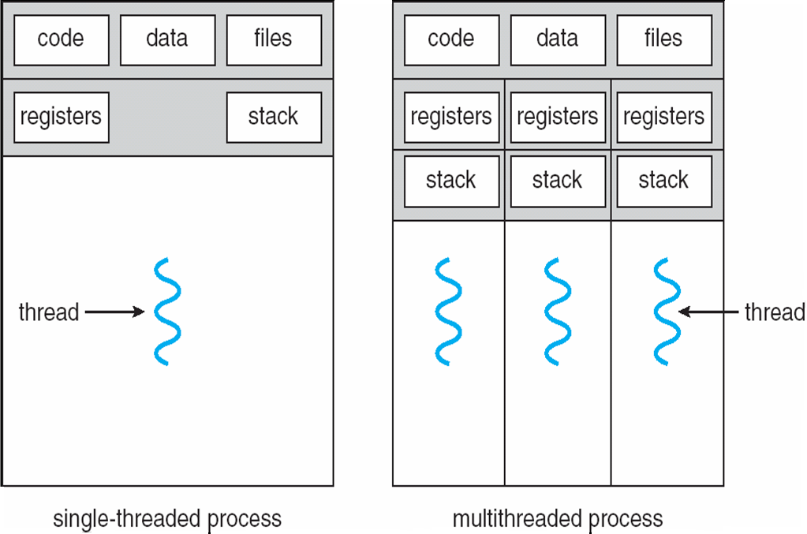
Single vs Mulththreaded process

Slide 5
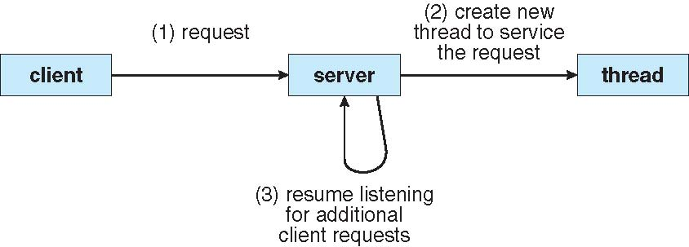
A mulththreaded server

Slide 6
Benefits of threads
Responsiveness:
Resource Sharing
Economy
Scalability

Slide 7
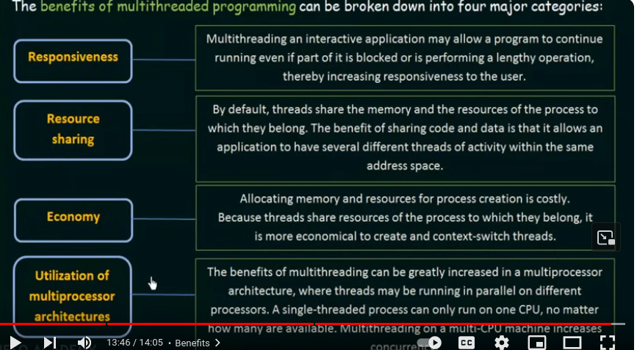

Slide 8
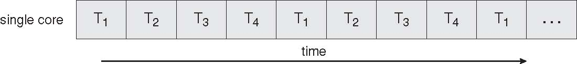
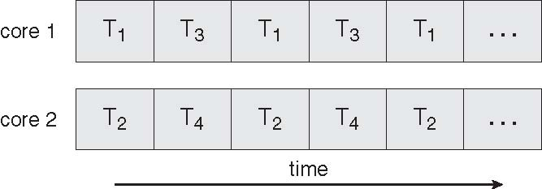
Single vs Multicore systems
Single core : Concurrency possible
Multicore : parallel execution possible

Slide 9
Multicore programming
Multicore systems putting pressure on programmers, challenges include:
  Dividing activities
  Balance
  Data splitting
  Data dependency
  Testing and debugging

Slide 10
User vs Kernel Threads
User Threads: Thread management done by user-level threads library
Three primary thread libraries:
  POSIX Pthreads
  Win32 threads
  Java threads
Kernel Threads: Supported by the Kernel
Examples
  Windows XP/2000
  Solaris
  Linux
  Tru64 UNIX
  Mac OS X

Slide 11
User threads vs Kernel Threads
User threads
  User level library provides a “typedef” called threads
  The scheduling of threads needs to be implemented in the user level library
  Need some type of timer handling functionality at user level execution of CPU
    OS needs to provide system calls for this
  Kernel does not know that there are threads!
Kernel Threads
  Kernel implements concept of threads
  Still, there may be a user level library, that maps kernel concept of threads to “user concept” since applications link with user level libraries
  Kernel does scheduling!

Slide 12
Mulththreading models
How to map user threads to kernel threads?
  Many-to-One
  One-to-One
  Many-to-Many
What if there are no kernel threads?
  Then only “one” process. Hence many-one mapping possible, to be done by user level thread library
  Is One-One possible?

Slide 13
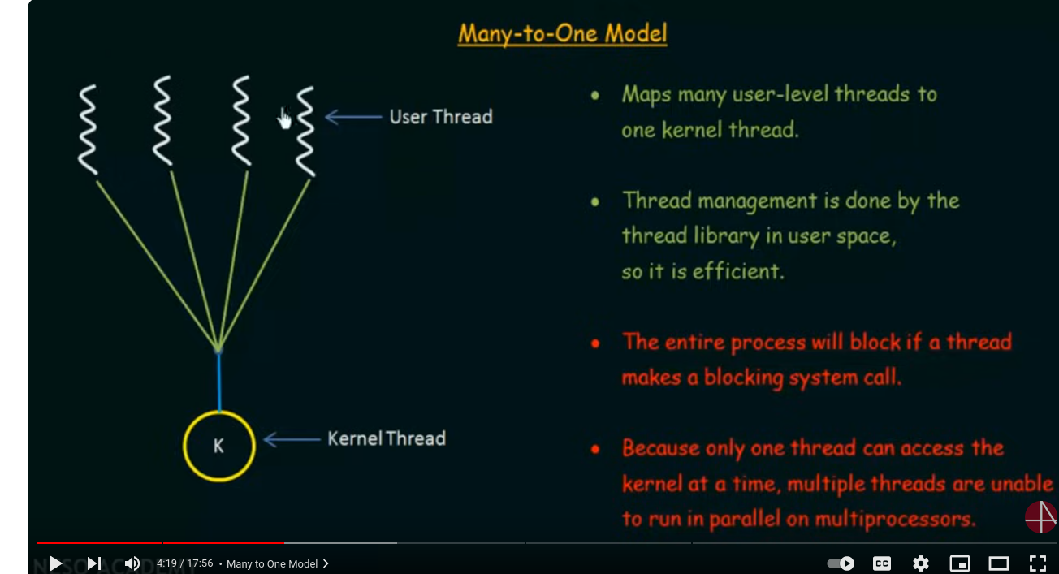

Slide 14
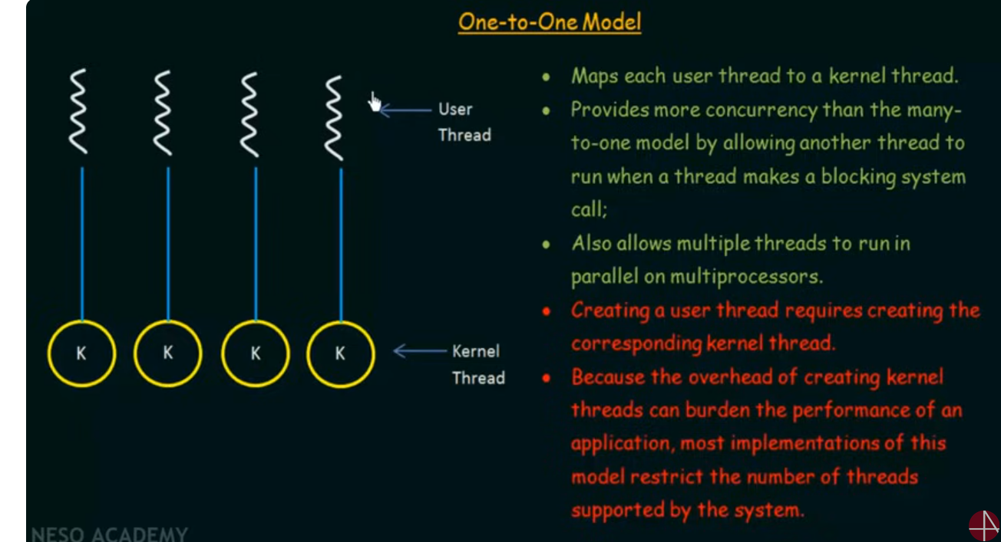

Slide 15
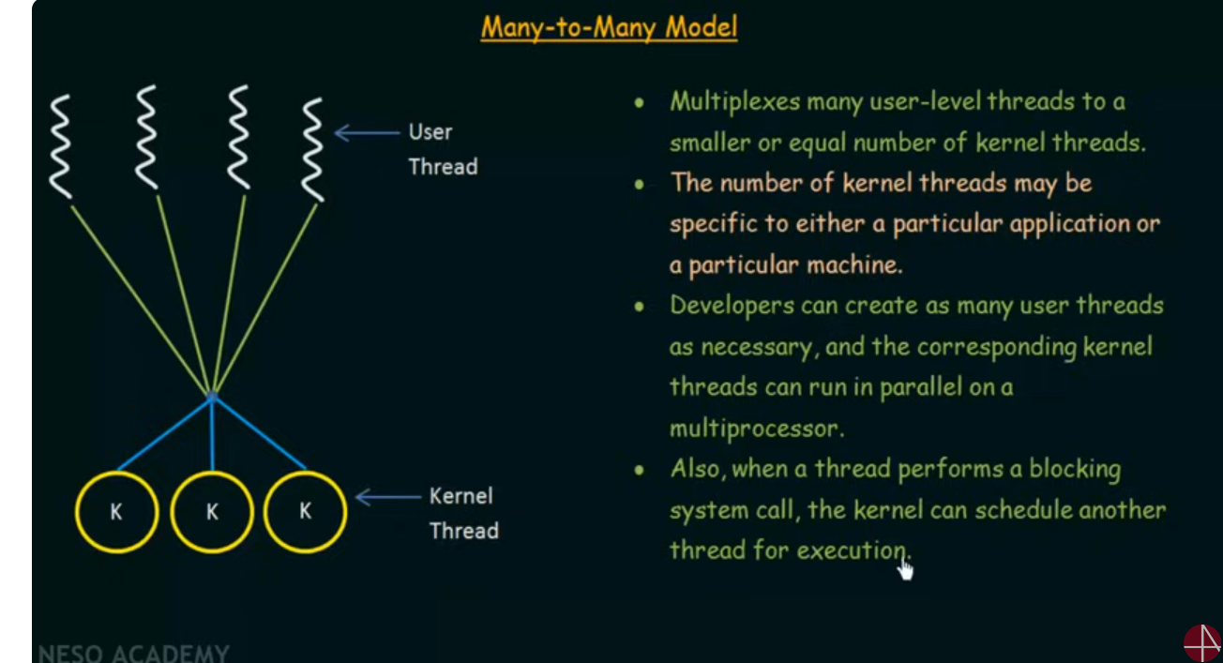

Slide 16
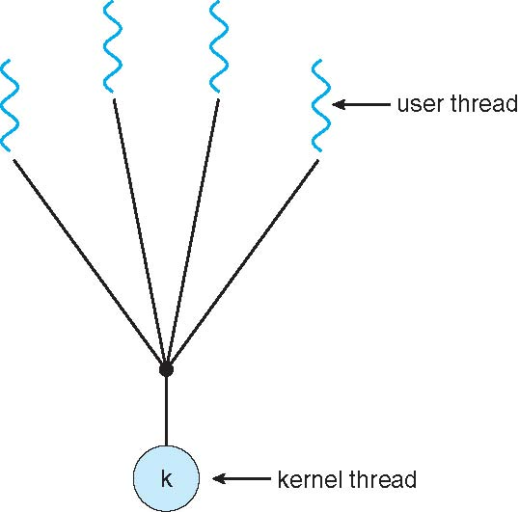
Many-One Model
Many user-level threads mapped to single kernel thread
Examples:
  Solaris Green Threads
  GNU Portable Threads

Slide 17
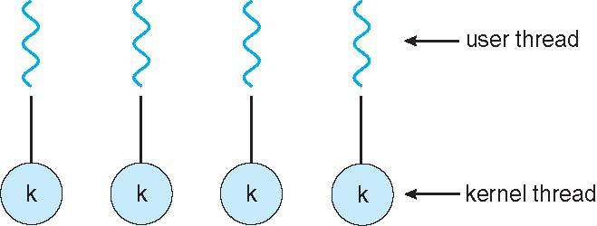
One-One Model
Each user-level thread maps to kernel thread
Examples
  Windows NT/XP/2000
  Linux
  Solaris 9 and later

Slide 18
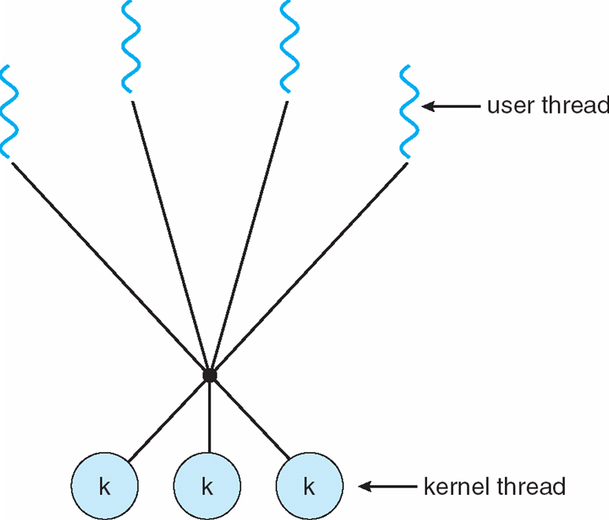
Many-Many Model
Allows many user level threads to be mapped to many kernel threads
Allows the operating system to create a sufficient number of kernel threads
Solaris prior to version 9
Windows NT/2000 with the ThreadFiber package

Slide 19
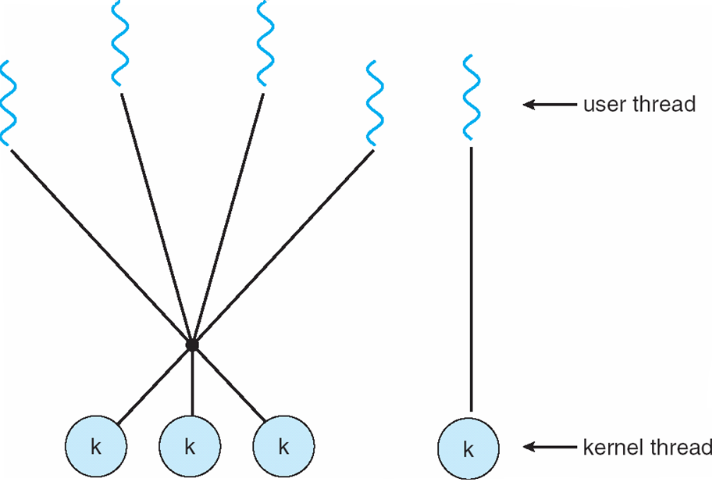
Two Level Model
Similar to M:M, except that it allows a user thread to be bound to kernel thread
Examples
  IRIX
  HP-UX
  Tru64 UNIX
  Solaris 8 and earlier

Slide 20
Thread Libraries

Slide 21
Thread libraries
Thread library provides programmer with API for creating and managing threads
Two primary ways of implementing
  Library entirely in user space
  Kernel-level library supported by the OS

Slide 22
pthreads
May be provided either as user-level or kernel-level
A POSIX standard (IEEE 1003.1c) API for thread creation and synchronization
API specifies behavior of the thread library, implementation is up to development of the library
Common in UNIX operating systems (Solaris, Linux, Mac OS X)

Slide 23
Demo of pthreads code
Demonstration on Linux – see the code, compile and execute it.

Slide 24
Other libraries
Windows threading API
  CreateThread(...)
  WaitForSingleObject(...)
  CloseHandle(...)
Java Threads
  The Threads class
  The Runnable Interface

Slide 25
Issues with threads
Semantics of fork() and exec() system calls
  Does fork() duplicate only the calling thread or all threads?
Thread cancellation of target thread
  Terminating a thread before it has finished
  Two general approaches:
    Asynchronous cancellation terminates the target thread immediately.
    Deferred cancellation allows the target thread to periodically check if it should be cancelled.

Slide 26
More on threads

Slide 27
Thread pools
Some kernels/libraries can provide system calls to : Create a number of threads in a pool where they await work, assign work/function to a waiting thread
Advantages:
  Usually slightly faster to service a request with an existing thread than create a new thread
  Allows the number of threads in the application(s) to be bound to the size of the pool

Slide 28
Thread Local Storage (TLS)
Thread-specific data, Thread Local Storage (TLS)
  Not local, but global kind of data for all functions of a thread, more like “static” data
  Create Facility needed for data private to thread
  Allows each thread to have its own copy of data
  Useful when you do not have control over the thread creation process (i.e., when using a thread pool)
  gcc compiler provides the storage class keyword thread for declaring TLS data
    static __thread int threadID;
int arr[16];
int f() {
a(); b(); c();
}
int g() {
x(); y();
}
int main() {
th_create(...,f,...);
th_create(...,g,...);
}
//arr is visible to all of them!
//need data for only f,a,b,c
//need data for only g,x,y

Slide 29
Thread Local Storage (TLS) in pthreads
Functions
  pthread_key_create
  pthread_key_delete
  pthread_setspecific
  pthread_getspecific
See
  thrd_specific.c file

Slide 30
Scheduler activations for threads
Library
--
th_setup(int n) {
max_threads = n;
curr_threads = 0;
}
th_create(...., fn,....) {
if(curr_threads < max_threads)
create kernel thread;
schedule fn on one of the kernel threads;
}
application
---
f() {
scanf();
}
g() {
recv();
}
h() {...}; i() {...}
main()
th_setup(2);
th_create(...,f,...);
th_create(...,g,...);
th_create(...,h,...);
th_create(...,i,...);
}

Slide 31
Scheduler activations for threads
Scheduler Activations
  Both M:M and Two-level models require communication to maintain the appropriate number of kernel threads allocated to the application
  Scheduler activations provide upcalls - a communication mechanism from the kernel to the thread library
  This communication allows an application to maintain the correct number kernel threads

Slide 32
Scheduler activations for threads
Library
--
upcall_handler() {
Create one more LWP and schedule threads on this;
}
th_setup(int n) {
max_LSW = n;
curr_LWP = 0;
register_upcall(upcall_handler);
}
th_create(...., fn,....) {
if(curr_LWP < max_LWP)
create LWP;
schedule fn on one of the LWP;
}
application
---
f() {
scanf();
}
g() {
recv();
}
h() {...}; i() {...}
main()
th_setup(2);
th_create(...,f,...);
th_create(...,g,...);
th_create(...,h,...);
th_create(...,i,...);
}
Kernel
---
register_upcall(function f) {
proc->upcall = f;
}
sys_write() {
// before calling sleep() going to block
myproc()->upcall(); // tricky!
}

Slide 33
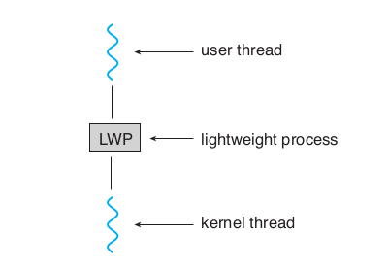
Issues with threads
Scheduler Activations: LWP approach
  An intermediate data structure LWP
  appears to be a virtual processor on which the application can schedule a user thread to run.
  Each LWP attached to a kernel thread
  Typically one LWP per blocking call, e.g. 5 file I/Os in one process, then 5 LWPs needed

Slide 34
Issues with threads
Scheduler Activations: LWP approach
  Kernel needs to inform application about events like: a thread is about to block, or wait is over : this is ‘upcall’
  This will help application relinquish the LWP or request a new LWP

Slide 35
Issues with threads
Example NetBSD
  “An Implementation of Scheduler Activations on the NetBSD Operating System”
    https://web.mit.edu/nathanw/www/usenix/freenix-sa/freenix-sa.html

Slide 36
Linux threads
Only threads (called task), no processes!
Process is a thread that shares many particular resources with the parent thread
Clone() system call to create a thread

Slide 37
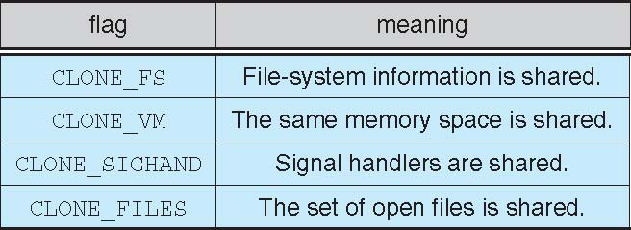
Linux threads
clone() takes options to determine sharing on process create
struct task_struct points to process data structures (shared or unique depending on clone options)
fork() is a wrapper on top of clone()
  Use ‘strace’ to see this.

Slide 38
Issues in implementing threads project
How to implement a user land library for threads?
How to handle 1-1, many-one, many-many implementations?
Identifying the support required from OS and hardware
Identifying the libraries that will help in implementation

Slide 39
Issues in implementing threads project
Understand the clone() system call completely
  Try out various possible ways of calling it
  Passing different options
  Passing a user-land buffer as stack
How to save and restore context?
  C: setjmp, longjmp
  Setcontext, getcontext(), makecontext(), swapcontext() functions
Sigaction is more powerful than signal
  Learn SIGALRM handling for timer and scheduler, timer_create() & timer_stop() system calls
Customized data structure to store threads, and manage thread-lists for scheduling

Slide 40
Signals

Slide 41
Signals
Signals are used in UNIX systems to notify a process that a particular event has occurred.
Signal handling
  Synchronous and asynchronous
A signal handler (a function) is used to process signals
  Signal is generated by particular event
  Signal is delivered to a process
  Then, signal is “handled” by the handler

Slide 42
Signals
More about signals
  Different signals are typically identified as different numbers
  Operating systems provide system calls like kill() and signal() to enable processes to deliver and receive signals
  Signal() - is used by a process to specify a “signal handler” – a code that should run on receiving a signal
  Kill() is used by a process to send another process a signal
  There are restrictions on which process can send which signal to other processes

Slide 43
Demo
Let’s see a demo of signals with respect to processes
Let’s see signal.h
  /usr/include/signal.h
  /usr/include/asm-generic/signal.h
  /usr/include/linux/signal.h
  /usr/include/sys/signal.h
  /usr/include/x86_64-linux-gnu/asm/signal.h
  /usr/include/x86_64-linux-gnu/sys/signal.h
man 7 signal
Important signals: SIGKILL, SIGUSR1, SIGSEGV, SIGALRM, SIGCLD, SIGINT, SIGPIPE, ...

Slide 44
Signal handling by OS
Process 12323 {
signal(19, abcd);
}
OS: sys_signal {
Note down that process 12323 wants to handle signal number 19 with function abcd
}
Process P1 {
kill (12323, 19) ;
}
OS: sys_kill {
Note down in PCB of process 12323 that signal number 19 is pending for you.
}
When process 12323 is scheduled, at that time the OS will check for pending signals, and invoke the appropriate signal handler for a pending signal.

Slide 45
Threads and Signals
Signal handling Options:
  Deliver the signal to the thread to which the signal applies
  Deliver the signal to every thread in the process
  Deliver the signal to certain threads in the process
  Assign a specific thread to receive all signals for the process

