Slide 1
RED BLACK TREES

Slide 2
Introduction
Red-Black tree is a self-balancing binary search tree in which each node contains an extra bit for denoting the color of the node, either red or black.
A red-black tree satisfies the following properties:
Red/Black Property: Every node is colored, either red or black.
Root Property: The root is black.
Leaf Property: Every leaf (NIL) is black.
Red Property: If a red node has children then, the children are always black.
Depth Property: For each node, any simple path from this node to any of its descendant leaf has the same black-depth (the number of black nodes).

Slide 3
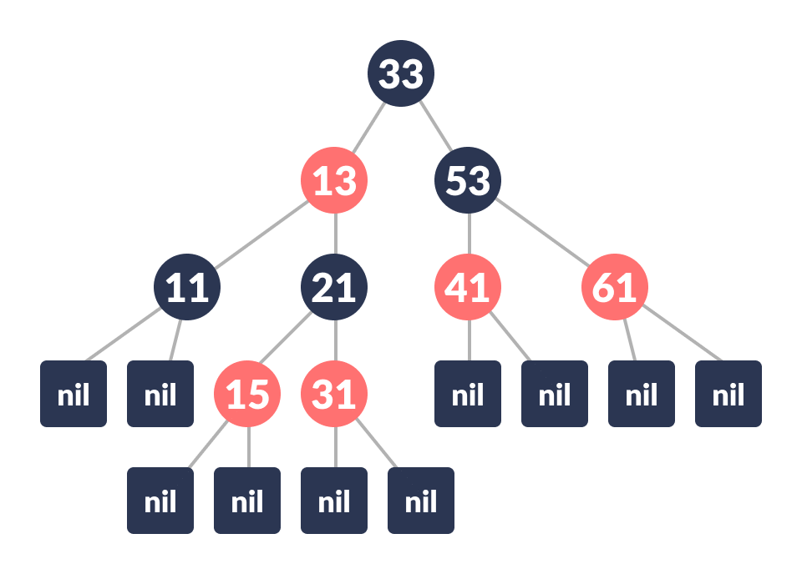
Example
Each node has the following attributes:
color
key
leftChild
rightChild
parent (except root node)

Slide 4
How the red-black tree maintains the property of self-balancing?
The red-black color is meant for balancing the tree.
The limitations put on the node colors ensure that any simple path from the root to a leaf is not more than twice as long as any other such path. It helps in maintaining the self-balancing property of the red-black tree.

Slide 5
Operations on a Red-Black Tree
Rotating the subtrees in a Red-Black Tree
In rotation operation, the positions of the nodes of a subtree are interchanged.
Rotation operation is used for maintaining the properties of a red-black tree when they are violated by other operations such as insertion and deletion.
There are four types of rotations:
Left Rotate
Right Rotate
Left-Right Rotate
Right Left Rotate
[Refer AVL tree ppt for more details on Rotations]

Slide 6
Inserting an element into a Red-Black Tree
While inserting a new node, the new node is always inserted as a RED node. After insertion of a new node, if the tree is violating the properties of the red-black tree then, we do the following operations.
Recolor
Rotation

Slide 7

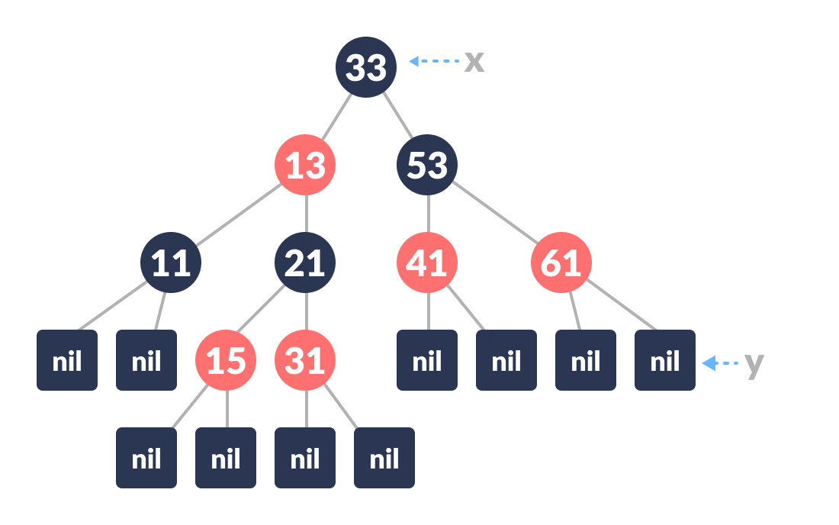
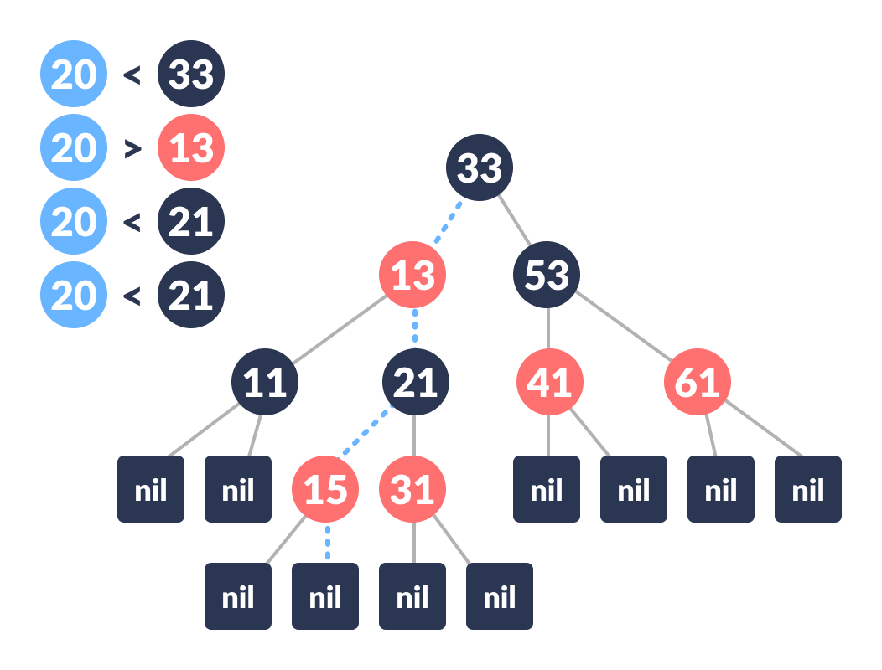
Algorithm to insert a node
Let new node to be inserted be
Let y be the leaf (ie. NIL) and x be the root of the tree.
Check if the tree is empty (ie. whether x is NIL). If yes, insert newNode as a root node and color it black.
Else, repeat steps following steps until leaf (NIL) is reached.
Compare newKey with rootKey.
If newKey is greater than rootKey, traverse through the right subtree.
Else traverse through the left subtree.

Slide 8
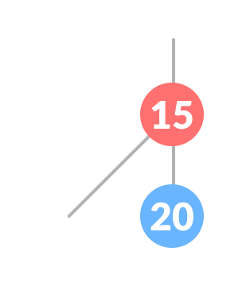
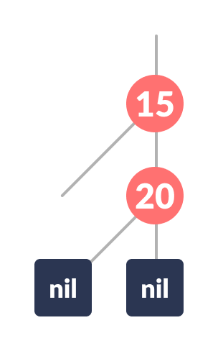
Algorithm to insert node
5. Assign the parent of the leaf as a parent of newNode.
6. If leafKey is greater than newKey, make newNode as rightChild.
7. Else, make newNode as leftChild.
8. Assign NULL to the left and rightChild of newNode.
9. Assign RED color to newNode.
10. Call InsertFix-algorithm to maintain the property of red-black tree if violated.

Slide 9
Why newly inserted nodes are always red in a red-black tree?
This is because inserting a red node does not violate the depth property of a red-black tree.
If you attach a red node to a red node, then the rule is violated but it is easier to fix this problem than the problem introduced by violating the depth property.

Slide 10
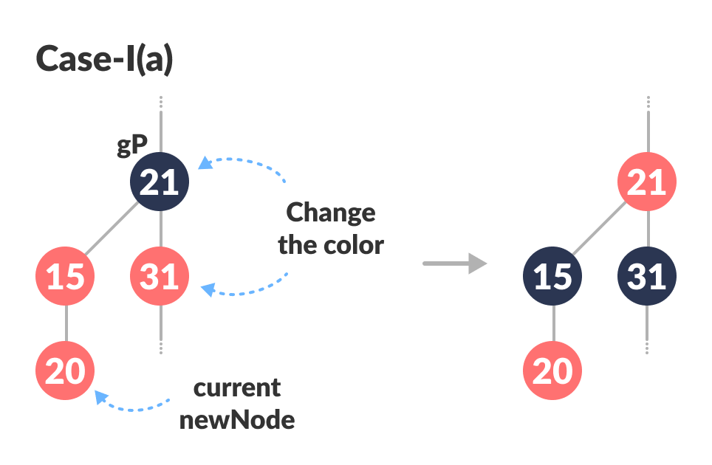
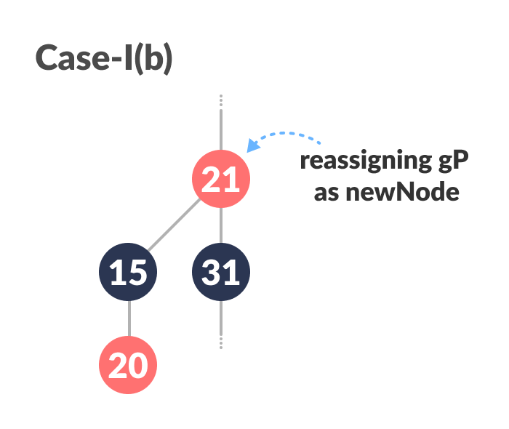
Algorithm to Maintain Red-Black Property After Insertion
This algorithm is used for maintaining the property of a red-black tree if insertion of a newNode violates this property.
Do the following until the parent of newNode p is RED.
If p is the left child of grandParent gP of newNode, do the following. Case-I:
If the color of the right child of gP of newNode is RED, set the color of both the children of gP as BLACK and the color of gP as RED.
3. Assign gP to newNode

Slide 11
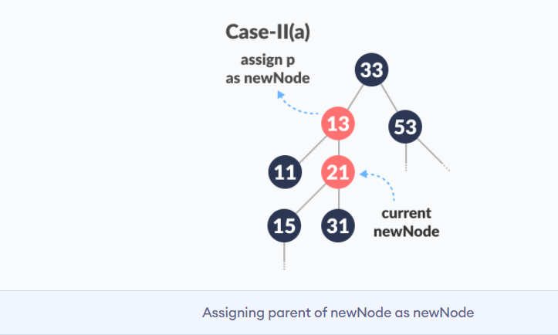
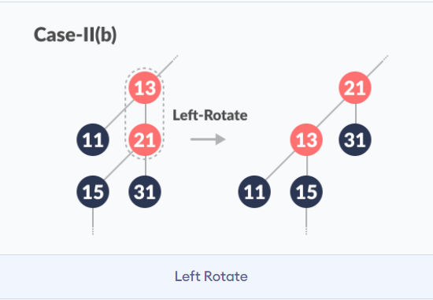
Algorithm to Maintain Red-Black Property After Insertion
Case II
(Before moving on to this step, while loop is checked. If conditions are not satisfied, it the loop is broken.) Else if newNode is the right child of p then, assign p to newNode.
Left-Rotate newNode

Slide 12
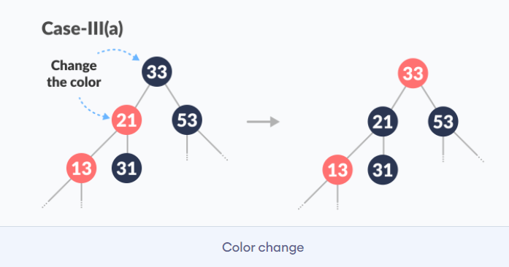
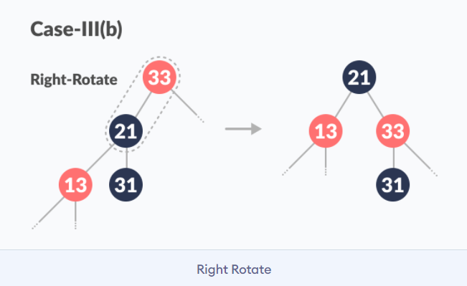
Algorithm to Maintain Red-Black Property After Insertion
Case III
(Before moving on to this step, while loop is checked. If conditions are not satisfied, it the loop is broken.) Set color of p as BLACK and color of gP as RED.
Right-Rotate gP.

Slide 13
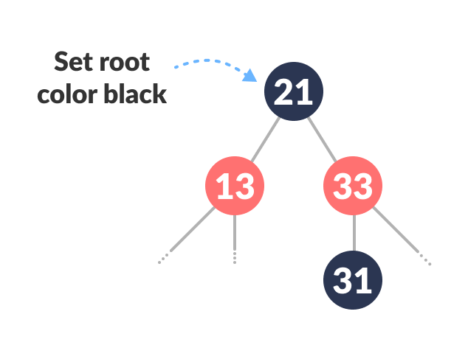
Algorithm to Maintain Red-Black Property After Insertion
3. Else, do the following.
If the color of the left child of gP of z is RED, set the color of both the children of gP as BLACK and the color of gP as RED.
Assign gP to newNode.
Else if newNode is the left child of p then, assign p to newNode and Right-Rotate newNode.
Set color of p as BLACK and color of gP as RED.
Left-Rotate gP.
4. (This step is performed after coming out of the while loop.) Set the root of the tree as BLACK.

Slide 14
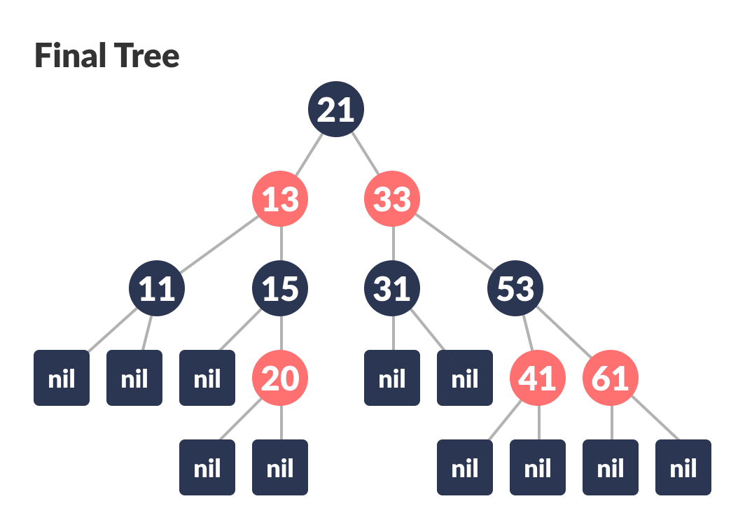
Final Tree

