Slide 2
task
functional
structure
Preprocessing
Realign
Slice Timing
Suit segmentation
Output :
c_<NAME>.nii
c_<NAME>_pcereb.nii
Coregister to structure
Suit normalize
Output :
wsuit_<NAME>.nii
1st level
Contrast map
Reslice to SUIT space
wsuit_con<NAME>.nii
Reslice to MNI space
wsuit_con<NAME>.nii
Smooth
Swsuit_<NAME>.nii
Smooth
Swsuit_<NAME>.nii
2nd level
Flexible anova
2nd level
Flexible anova

Slide 3
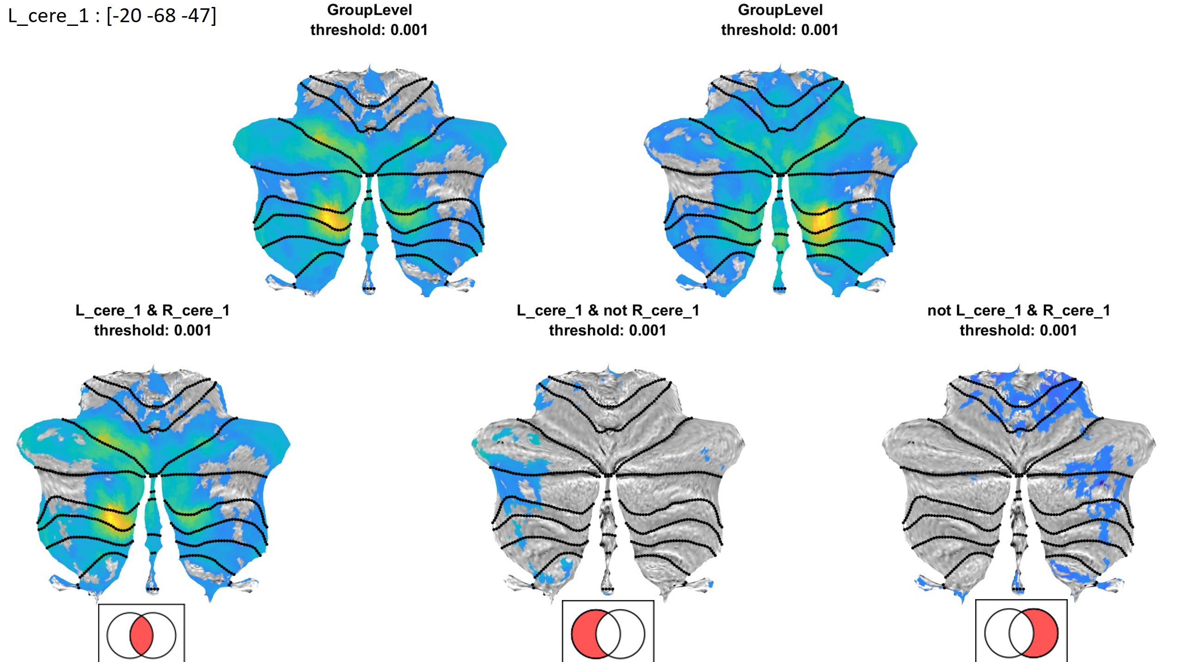
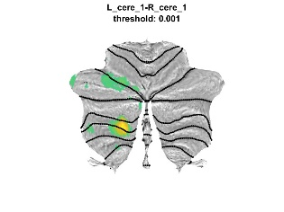
Rest
SPM
Conn (for all subject in one project)
Preprocessing
Structure : segmentation
Functional : realign, slice Timing, outlier detection, corigester to structure
Normalize to SUIT space
Normalize to MNI space
denoise
Smooth
Smooth
Create subject project from old subject
2nd level
One sample T and Pair T
(compare L and R)
2nd level
One sample T and Pair T
(compare L and R)
Get individual ROI coordinate
For one sample T
“AND”,”IMPLY”,”NIMPLY”
for Right and Left cerebellum
Mask out cerebellum
Maskfile : ./suit/templete/maskMNI.nii
1st level
connectivity
One sample T
Get beta value
From : ./result/firstlevel/SBC_01/
To : [sub.folder]/connREST_1stresult
Mask for L_cere_1
Pair T

