Slide 2
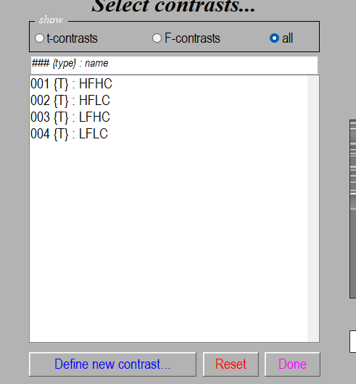


contrast_idx(int)
Mask(?? Not sure but none is empty ( [] ) )
Require Input : SPMfile
Optional Input : contrast_idx
mask
thresType
thres_value
thres_clusSize
thres_clusSize_ResTab
thresType(string)
thres_value(int)
thres_clusSize(int)
Load SPM.mat
(SPM)
thres_clusSize_ResTab(boolean)
Using this table to get voxel size threshold ?
Set input value
Template file
atlas.nii → label file
(same size to contrast name.nii)
atlas.txt → label name file)
if
thres_clusSize_ResTab
0
(SPM)
spm_getSPM
(xSPM)
1
voxels threshold = 0
SPM.k = 0
(xSPM)
spm_write_filtered
(output file)
Get brain area
Loop for all area
(SPM)
spm_getSPM
(xSPM)
Outputfile
./Clust_check/contrast name.nii
Label all cluster
Percentage in this area
sum(Outputmask & brain area)/sum(brain area)
(xSPM)
spm_list
(TabDat) → get FDRc
Save table
SPM.k = FDRc

Slide 3
Outputfile
./Clust_check/contrast name.nii
Label all cluster
Outputfile
./Clust_check/contrast name.nii
Label all cluster

