Slide 2
Step1_convert2nii.m
---------------------define subject
Get subject ID and age in wordname_list.xlsx
Choose subject with certain limit
-----------------------------------
Subject i
Find subject folder in NAS
-------------------------check Data
Check contain only one folder
Find the latest one folder
(…_2)
-----------------------------------
------------------------------Main
Get this folder from NAS
Rawdata
Convert .IMA file to .nii file
Upload to NAS
niiData
------------------------------END

Slide 3
Step1_convert2nii.m
Define
allsubName --> all subject name
ftp

Slide 4
step2_niiFile2local.m
Subject i
From Nas folder(niiData)
Find func --> [ *_4D.nii ]
Struct --> [*.nii]
DownLoad to pc folder

Slide 5
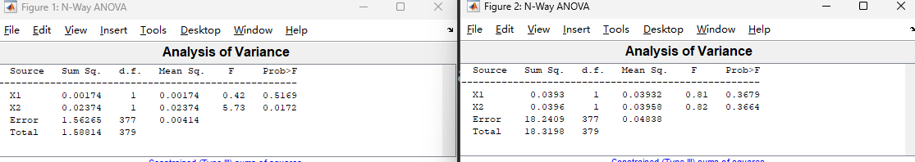
accuracy
RespTime
X1 : C
X2 : F

Slide 6
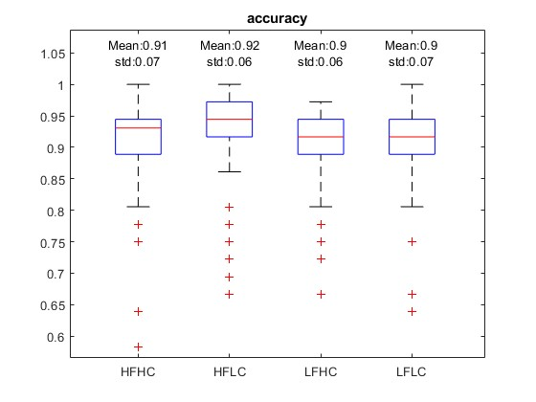
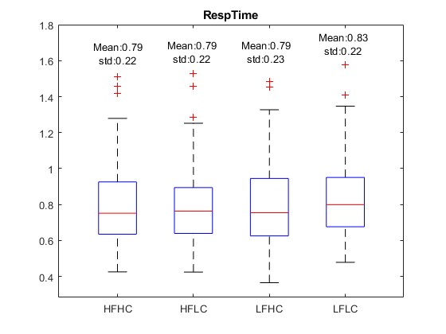

Slide 7
+
Story_1
…
STORY
Story_8
+
+
Sentence_1
oral
+
LOCALIZER
Sentence_2
Sign Lang.
…
+
Sentence_24
oral
+

