Slide 2
---------------------define subject
Step1_convert2nii.m
Get subject ID and age in wordname_list.xlsx
Choose subject with certain limit
-----------------------------------
Subject i
Find subject folder in NAS
-------------------------check Data
Check contain only one folder
Find the latest one folder
(…_2)
-----------------------------------
------------------------------Main
Get this folder from NAS
Rawdata
Convert .IMA file to .nii file
Get .nii info store in MRIinfo
Upload to NAS
niiData
Create MRIinfo.xlsx
------------------------------END

Slide 3
Step1_convert2nii.m
Define
allsubName --> all subject name
ftp

Slide 4
step2_niiFile2local.m
Subject i
From Nas folder(niiData)
Find func --> [ *_4D.nii ]
Struct --> [*.nii]
DownLoad to pc folder

Slide 5
+
Story_1
…
STORY
Story_8
+
+
Sentence_1
oral
+
LOCALIZER
Sentence_2
Sign Lang.
…
+
Sentence_24
oral
+

Slide 6
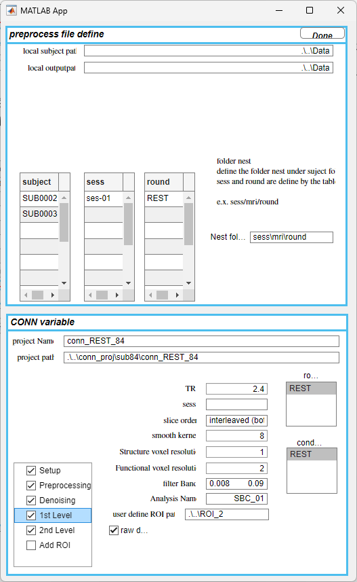
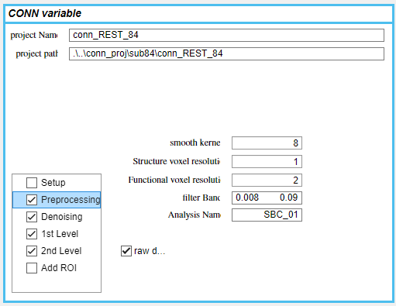
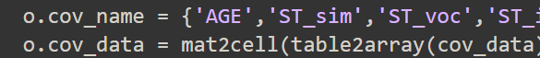
確認資料路徑對不對(rawdata .IMA file)第一層應該要是受試者編號
(niidata .nii file)
根據自己定義的sess跟round
根據路徑裡的名字，找到包含SUB名字
目前2nd level 的contrast沒有寫好，所以不會顯示在這，要從script確認，這兩個變數
格式:cell裡的cell是一組contrast
Ex: 有兩組contrast, Allsubject 以及 Allsubject , Age
sub_effect ={{‘AllSubjects’},{‘Allsubject’,’Age’}}
sub_con = {[1],[1,0]}
放project的路徑
以及project 的名字
確定流程 點下去會根據需要的參數去顯示需要檢查的參數
Setup 的 2nd level covariate define 也沒寫好，從這兩個變數確認

