Slide 1
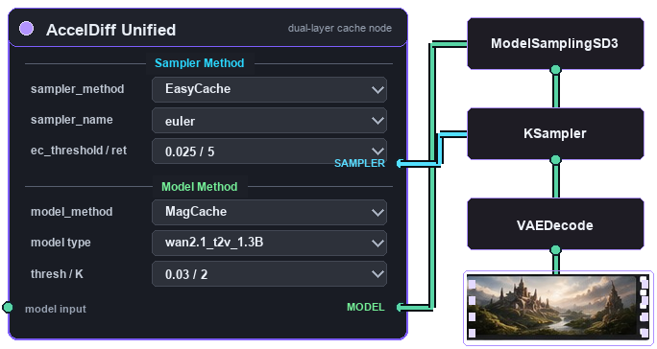
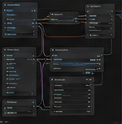
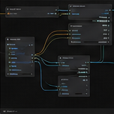
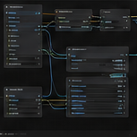
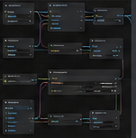
One Node, Two Layers
Sampler + model speedups
Unified ComfyUI acceleration stack
✓
Pick sampler + model
✓
Use one or both
✓
Keeps each method's logic
Today: separate plugins, separate wiring
Now: one dual-layer node
TeaCache
EasyCache
MagCache
AdaptiveDiff
Nodes from different authors
Separate wiring patterns
Separate logic paths
Skip steps, reuse residuals
Many nodes, scattered params
Rebuild to switch methods
Different rules
Easy to miswire
Unclear knobs
Hard to evaluate
Docs + trial/error
High overhead
😔 Too much wiring
😊 Stack both outputs.
Two acceleration layers
Model families (more coming)
TeaCache
EasyCache
MagCache
AdaptiveDiff
Wan
Hunyuan
Video
OpenSora
Flux
Stack Both
Layers
Model L1 cache
TeaCache logic
Sampler reuse
Original logic
Model cache
Original logic
Sampler skip
Original logic
Wan2.1
T2V / I2V
V1.0
T2V / I2V
V1.2
T2V
Schnell / Dev
Image / Video
🚀 Algorithm cores stay intact
Sampler + model stack
ComfyUI-AccelDiff

