Slide 1
Lab 2 Containers
CIS 4360 Microservices
Jackie Gan

Slide 2
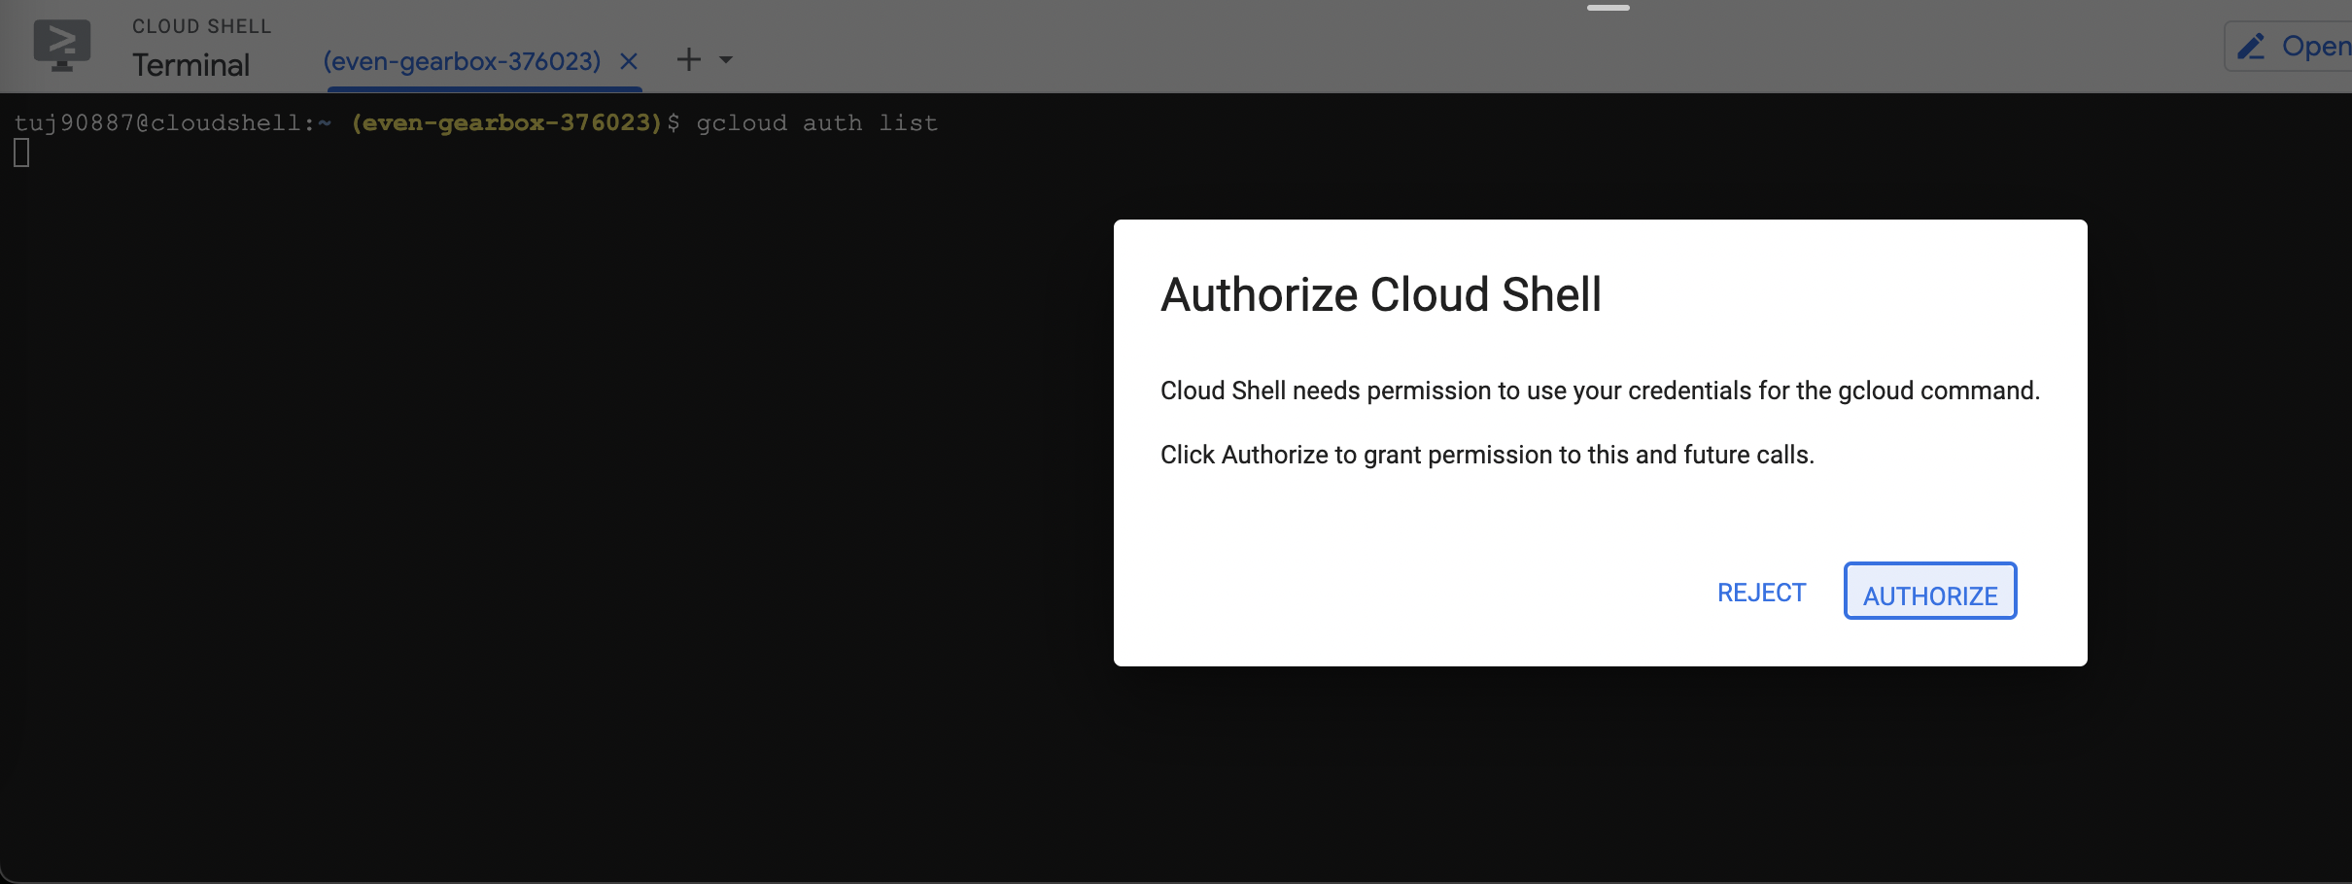
Step 1

