Slide 1


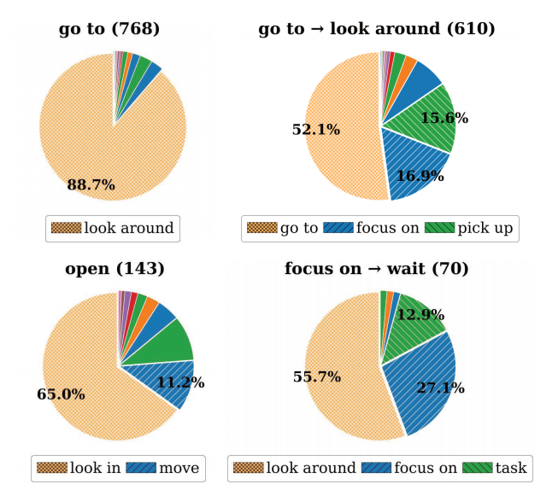
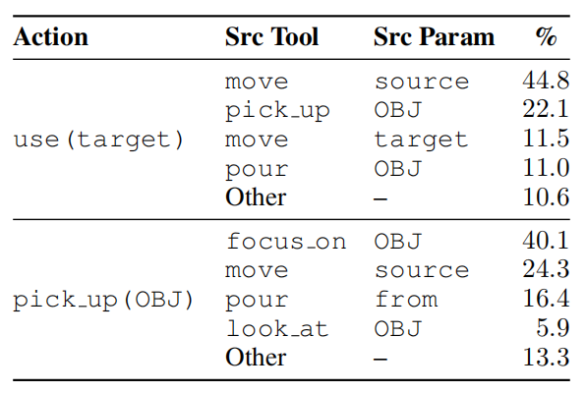
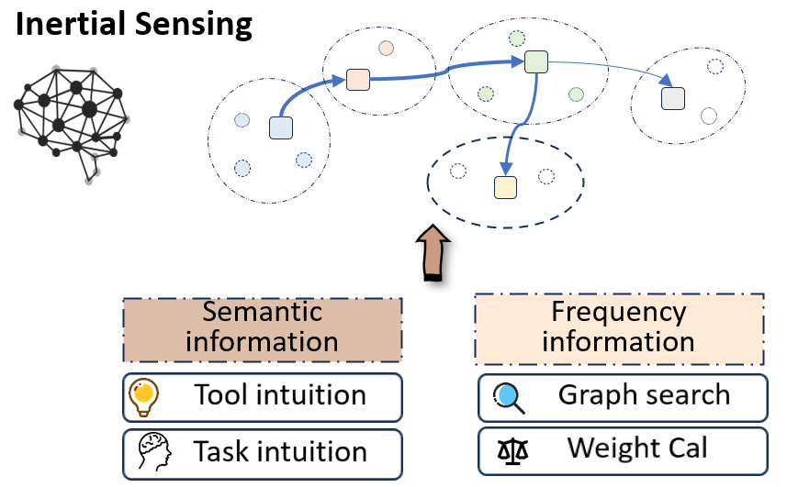


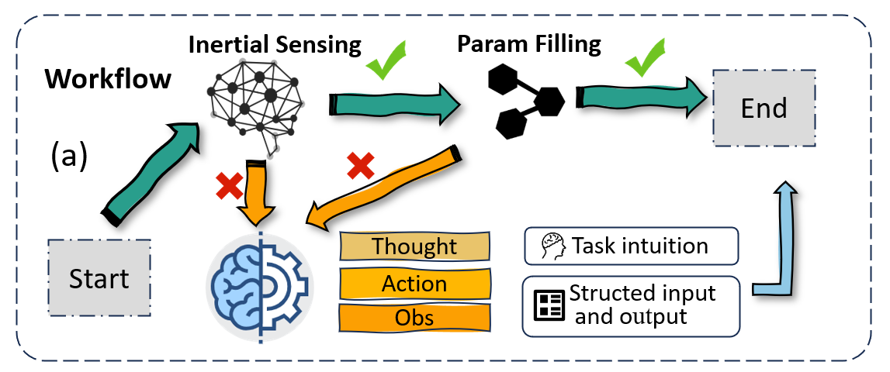
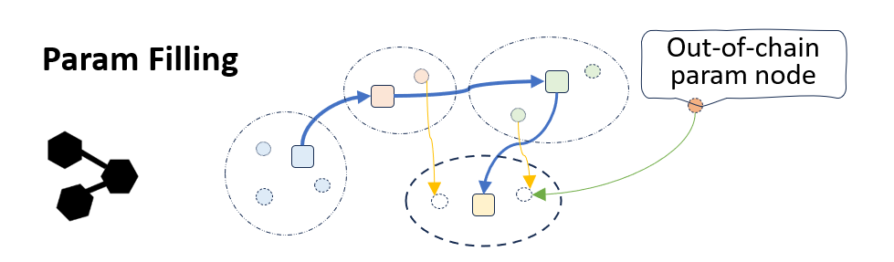
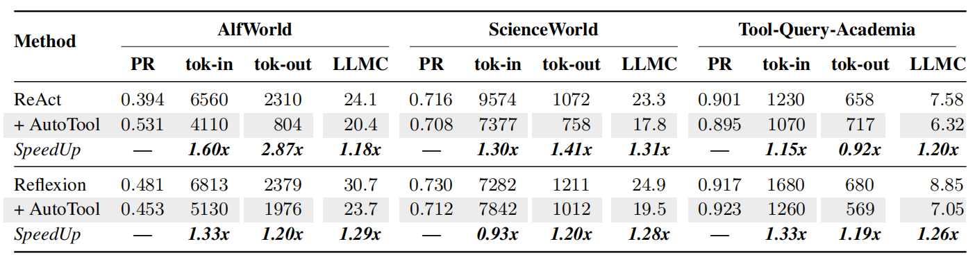
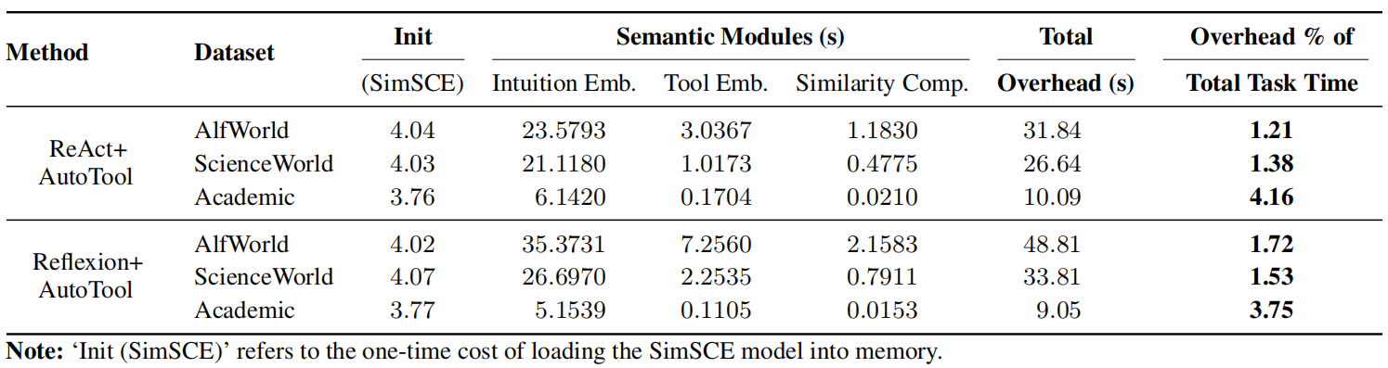
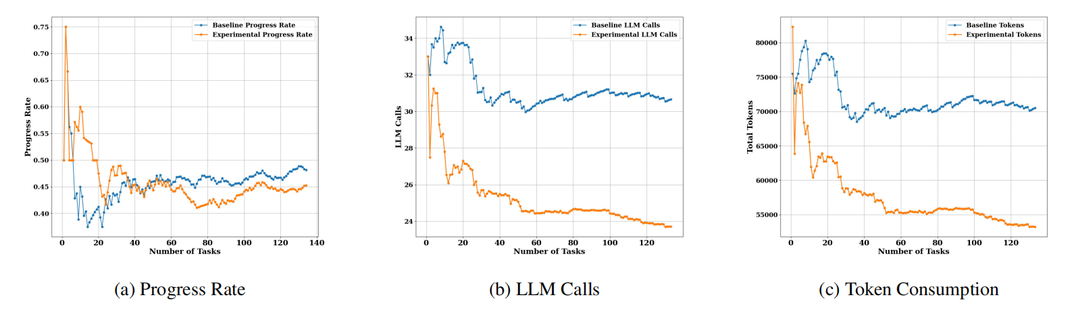
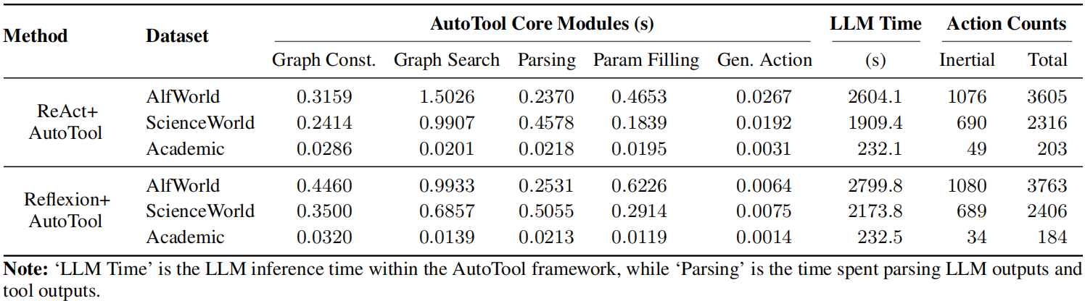

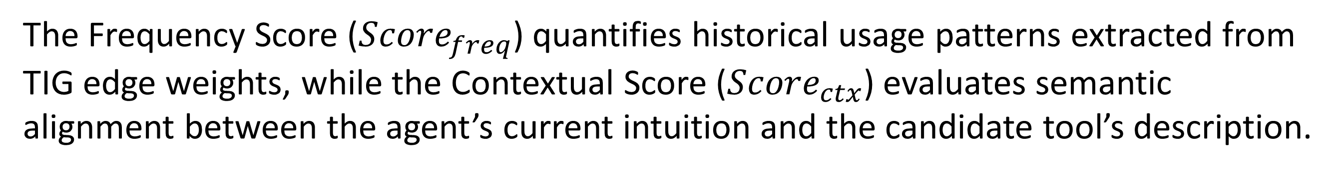
AutoTool: Efficient Tool Selection for Large Language Model Agents
Jingyi Jia, Qinbin Li*
School of Computer Science and Technology
Huazhong University of Science and Technology
Can we utilize statistical methods instead of relying heavily on LLM inference to select tools efficiently?
Motivation
(a) LLM Agents have high inference costs for tool selection
(b) Tool Invocation Exhibits Predictable, Low Entropy Inertia
Current agent frameworks lies in the high inference cost of tool selection, especially in approaches like ReAct that repeatedly invoke the LLM to determine which tool to use at each step. We argue that this universal reliance on the LLM is not only costly but also sub-optimal. The core issue is that not all decision steps in a task are of equal complexity or importance. Many tool invocations, both for selection and parameter filling, occur in highly patterned or repetitive contexts that do not require the LLM’s full, nuanced reasoning power. This universal application of a resource-intensive model for both complex and simple decisions constitutes an over-utilization of its powerful abilities, creating unnecessary computational overhead.
We model the sequence as a k-th order Markov chain: a 0-order model (assuming independence) yields a baseline entropy of 3.50 bits, this value decreases to 2.52 bits for a 1st-order model and drops further to 1.93 bits for a 2nd-order model.
Methodology
Tool Inertia Graph (TIG)
(b) Match based on frequency and the contextual relevance.
Tool Node:
Tool Sequence Edge:
AutoTool searches the TIG to identify candidate tools that have historically followed the sequence of the most recent k tools. For each candidate, we calculate a Comprehensive Inertia Potential Score (CIPS). We select the tool achieving the highest CIPS.
Primary node, representing an available tool.
Connect Tool Node to represent sequential dependencies
Parameter Node:
Param Dependency Edge:
Secondary node, representing a specific in/output parameter.
Connect Parameter Node to model the data flow between tools
In the DBLP citation network, which venue has the most publications by Andrea Omicini?
The Frequency Score (${Score}_{freq}$) quantifies historical usage patterns extracted from TIG edge weights, while the Contextual Score (${Score}_{ctx}$) evaluates semantic alignment between the agent’s current intuition and the candidate tool’s description.
(c) Param filling through backtracking param flow.
Traverses the parameter dependency edges in the TIG.
Environmental state matching, using key states maintained by the agent.
Heuristic filling based on the agent’s current state or task goal.
(a) Before each step, attempt inertial invocation. If both inertia detection and parameter filling succeed, invoke the tool; otherwise, defer to the LLM.
AutoTool attempts to populate its required parameters using a hierarchical, non-LLM strategy
Main Results
All experiments are conducted in a pure cold-start setting. The core graph is built online from scratch without any prior trajectories, ensuring fairness across comparisons. AutoTool’s optimization mechanism yields substantial efficiency gains across all datasets. On average, it reduces the LLM call count by 15% to 25% and the total token consumption by 10% to 40% without sacrificing too much performance.

