Slide 1
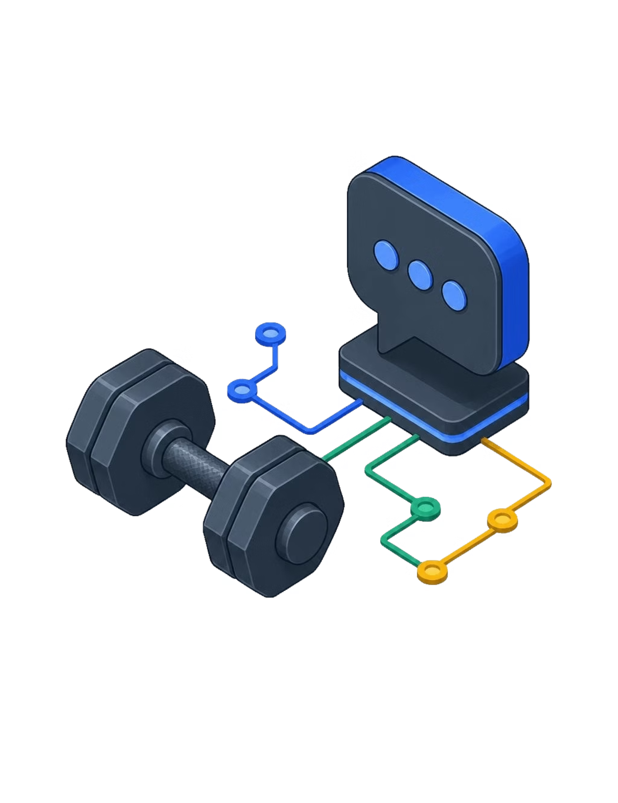
PROJECT PRE-PROPOSAL
Personal Fitness Chatbot
CS425 G1-T3
Members: Jia Kai, Michael, Jerome, Hsien Ray, Qi Xun
Notes:
Hi everyone. Our project is a Personal Fitness Chatbot.
The idea is to build a chatbot that can understand basic fitness questions and give users simple, personalised guidance.
We’ll focus on things like workout plans, exercise advice, nutrition, motivation, and safety.

Slide 2


Problem Statement
Generic fitness advice
Personal training is expensive
Online recommendations are often broad and one-size-fits-all. They do not account for a user's goals, experience level, available equipment, or schedule.
Professional one-to-one training can be unaffordable for many beginners and regular users.
There is a need for an affordable conversational system that can understand users’ fitness goals and provide basic personalised guidance.
Notes:
Many people get their fitness advice from the internet, but this advice is often quite general. It usually doesn’t consider someone’s goals, experience, equipment, or schedule.
Having a personal trainer would be more personalised, but it can be expensive, especially for beginners.
So, we want to explore whether an NLP chatbot can provide basic fitness support in a more affordable and accessible way.

Slide 3
User Scenarios
SAMPLE USER QUERY
Six Scenarios
“Create a 3-day beginner workout plan using dumbbells.”
Workout planning
Exercise recommendations
Exercise technique
Nutrition guidance
Progress logging
Motivation
EXTRACTED SLOT ENTITIES
intent: generate workout plan
duration: 3 days
experience: beginner
equipment: dumbbells
Notes:
These are some examples of what users might ask.
They could ask for a workout plan, exercise recommendations, form guidance, nutrition advice, progress logging, or motivation.
For example, if someone says, “Create a 3-day beginner workout plan using dumbbells,” the chatbot should understand that they want a workout plan.
It should also pick up the details: three days, beginner level, and dumbbells. These details can then be used to make the response more relevant.

Slide 4
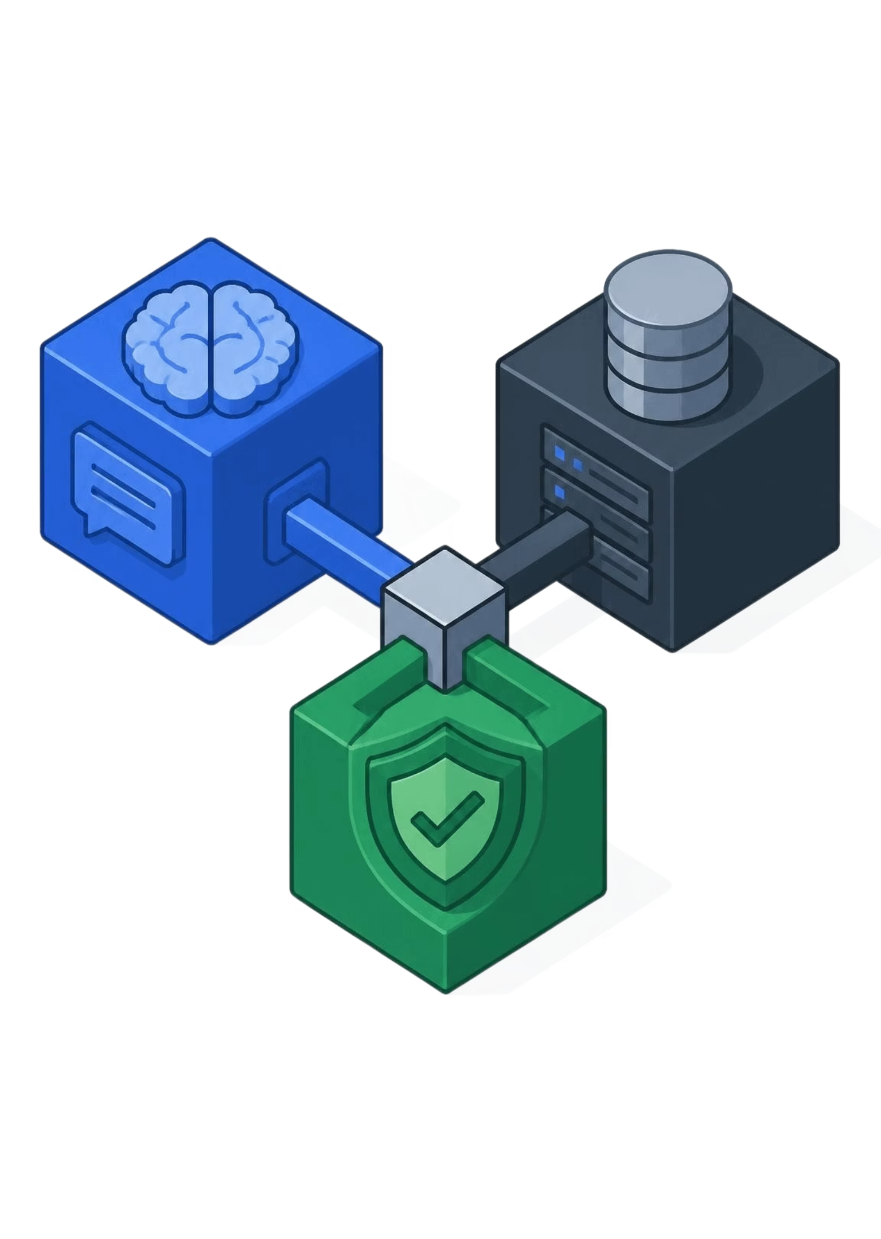
Aim & Objectives
NLP will interpret requests and provide basic personalised fitness guidance.
1
2
3
Fitness intents
User profile
Responses
Classify intents and extract exercise, equipment, goals, duration, and experience.
Maintain a user profile and retrieve from a structured exercise knowledge base.
Generate templated, safety-checked responses in a Streamlit prototype.
Notes:
Our main aim is to use NLP to understand fitness-related requests and provide basic personalised guidance.
We want the chatbot to identify what the user is asking and extract useful details from their message.
It should also remember basic information about the user and retrieve relevant exercise information.
Finally, we plan to use structured responses so the chatbot is more consistent and easier to control.

Slide 5
System Architecture
01
02
03
04
05
06
1. Input
2. Clean
3. Classify
4. Extract
5. State
6. Guard
Raw message
Preprocessing
Intent detection
Entity slots
User profile
Safety check
User text
Tokenise
DistilBERT
NER / regex
Context
Safety filter
Target latency: under 200 ms on a standard CPU.
Notes:
This is the general flow of our system.
The user first enters a message. The system then cleans the text and identifies the user’s intent.
After that, it extracts details such as the user’s goal, equipment, experience level, or workout duration.
The chatbot can then use this information, together with the user profile and exercise database, to create a response.
Before giving the response, the system will also check for safety-related queries.

Slide 6
NLP Techniques
LAYER 1: INTENT
LAYER 2: EXTRACTION
LAYER 3: GENERATION
DistilBERT Classifier
Entity Slot Fillers
Structured Templates
Fine-tuned transformer for 7-class intent detection: workouts, search, form, nutrition, logging, motivation, and unsafe queries.
Rule-based and spaCy matchers extract exercises, body parts, equipment, goals, duration, and injury flags.
Deterministic templates populate verified entries, preventing hallucination and enforcing disclaimers.
66M params · CPU-ready
Dictionary + spaCy NER
Grounded · Zero Drift
Separating language parsing from answer synthesis guarantees controllable, safe outputs.
Notes:
We are planning to use three main NLP components.
The first is intent classification. This helps the chatbot understand whether the user wants a workout plan, exercise recommendation, nutrition advice, or something else.
The second is entity extraction. This identifies useful details such as exercises, equipment, body parts, goals, and duration.
The final part is response generation. We plan to use templates and information from our knowledge base instead of generating completely unrestricted answers.
This should make the chatbot’s responses more consistent and reduce the chance of unsupported advice.

Slide 7
Dataset & Knowledge Base
NLU TRAINING CORPUS
GROUND-TRUTH STORE
Intent & Entity Data
Structured Knowledge Base
Curated intent examples split 70/15/15 across train, validation, and test.
Augmented with typos, slang, and varied phrasing to mirror beginner queries.
A curated JSON schema indexes vetted exercises by:
Exercise name, target muscle group & difficulty level
Required equipment & step-by-step movement cues
Common technical mistakes & injury contraindications
70/15/15 split
Data augmentation
JSON schema
Vetted exercise bank
A focused exercise domain limits unverified medical advice.
Notes:
For the training data, we plan to use fitness-related intent examples divided into training, validation, and test sets.
We will try to include different ways of asking similar questions, including informal wording and common beginner expressions.
We will also create a structured exercise knowledge base. This can include the exercise name, target body part, difficulty, equipment, instructions, and common mistakes.
At the beginning, we will keep the fitness domain focused so that the information is easier to manage and check.

Slide 8
Evaluation Plan
SUBSYSTEM | PROPOSED METRICS | SUCCESS CRITERIA
Intent Classification | Accuracy, Precision, Recall, Macro-F1 | Macro-F1 ≥ 0.90
Entity Extraction | Precision, Recall, slot-level F1 | Entity F1 ≥ 0.85
Knowledge Retrieval | Recall@3 and Recall@5 | Recall@3 ≥ 0.88
Safety & Experience | Out-of-scope rate; human clarity and safety ratings | 100% Medical Queries Flagged
Proposed evaluation targets ensure model robustness before user deployment.
Notes:
We will evaluate the chatbot in a few different ways.
For intent classification, we will use measures such as accuracy and macro-F1.
For entity extraction, we will check whether the system correctly identifies information like exercises, goals, and equipment.
For retrieval, we will check whether relevant exercises appear in the top results.
We also plan to conduct some human evaluation to see whether the responses are clear, relevant, and safe.
The scores shown here are our proposed targets, not results that we have achieved yet.

Slide 9
Project Roadmap
1
2
Plan and prepare
Build the NLP layer
Finalise intents, clean examples, and prepare the knowledge base.
Train intent classification, add entity extraction and safety detection.
3
4
Connect dialogue and responses
Interface and evaluate
Track profiles, retrieve exercises, create templates, and connect components.
Build Streamlit, test realistic conversations, and evaluate the system.
Expected deliverable: a working prototype for safe, personalised fitness guidance.
Notes:
We plan to complete the project in four stages.
First, we will prepare the intents, training examples, and exercise knowledge base.
Next, we will build the intent classification, entity extraction, and safety components.
After that, we will connect the dialogue system, user profile, retrieval, and response templates.
Finally, we will build the Streamlit interface and evaluate the chatbot using realistic examples.
The final goal is to produce a working prototype that gives simple and personalised fitness guidance.
To conclude, this project will explore how NLP can be used to create a more affordable and accessible fitness assistant.
Thank you.

