Slide 1
AirPick
An Exceptional Airport Pickup and Drop-off Platform

Slide 2
Table of contents
01
02
03
Overview
Demonstration
Management
Problem solved, prototype vs. final version, and development process.
Key features and demo/screenshots
Challenges faced and future development.

Slide 3
Our Team!
Ke Jia Yang Yang
RunZhou Zhu QingYun Wang

Slide 4
01
OverView
Problem solved, prototype vs. final version, and development process.

Slide 5
What have we accomplished?
We started from SCRATCH to create an EFFICIENT and user-friendly airport pickup and drop-off platform, designed to provide every user with a SEAMLESS travel experience !!!

Slide 6
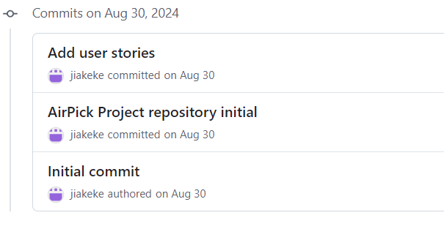
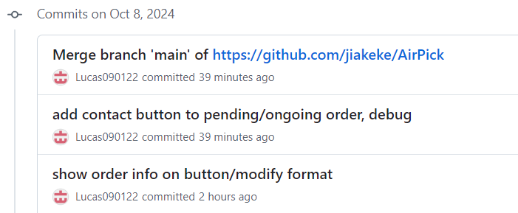


50
208
15
Development Days
Commits
Branchs

Slide 7
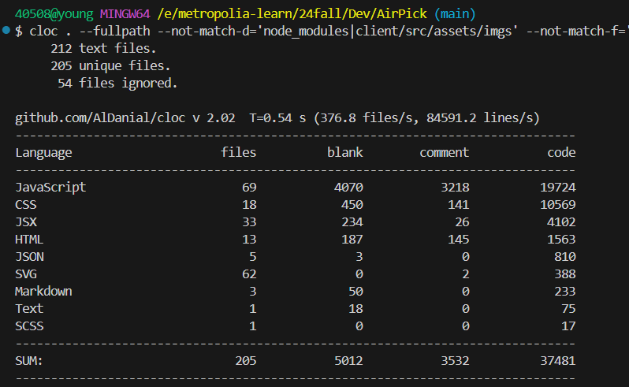
37481
The total code lines~~~

Slide 8
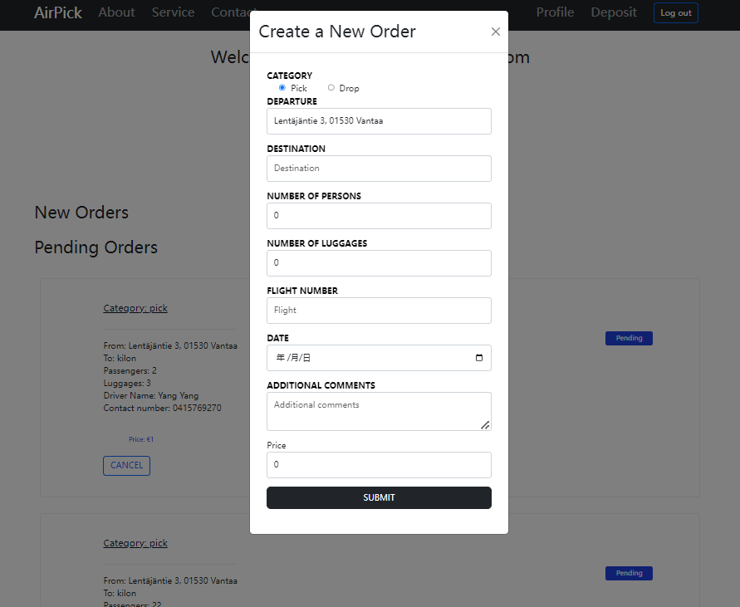
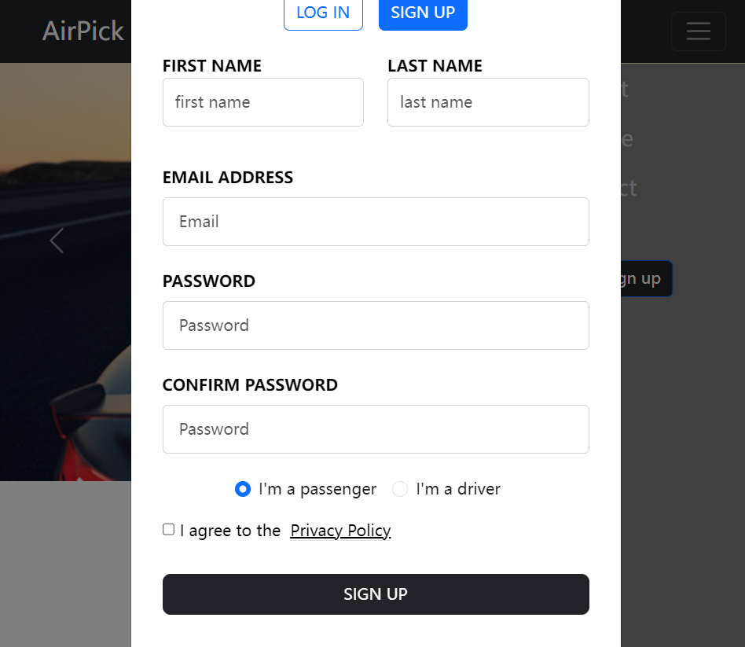
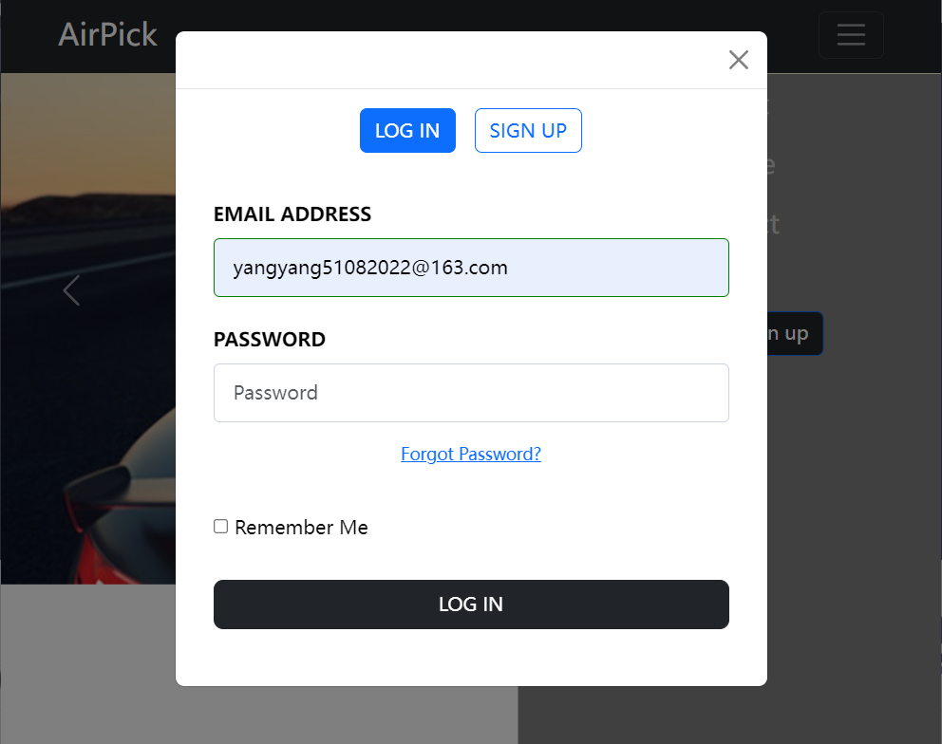
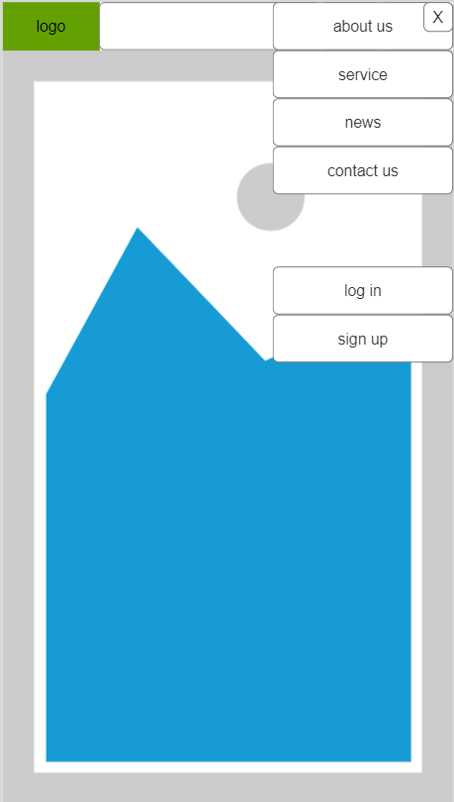
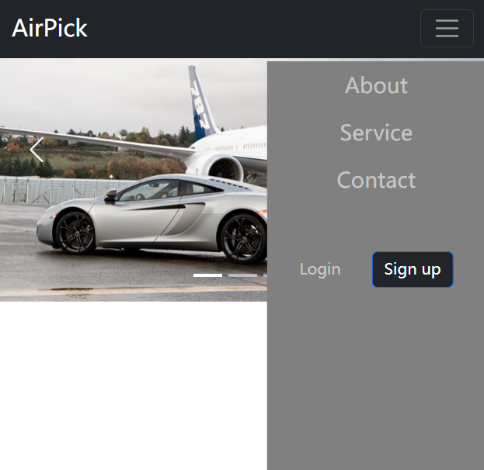
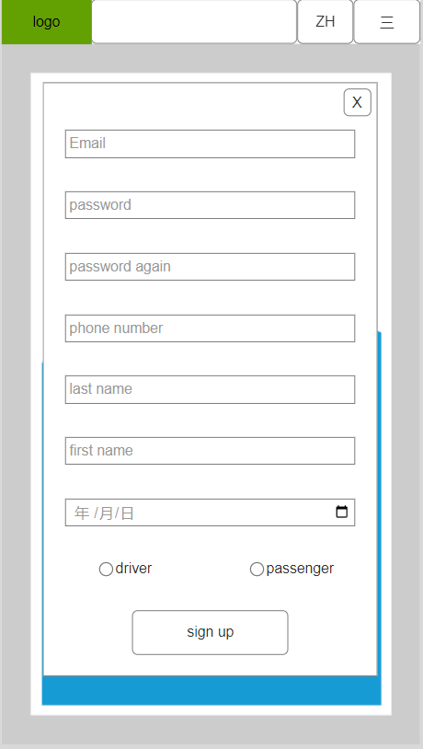
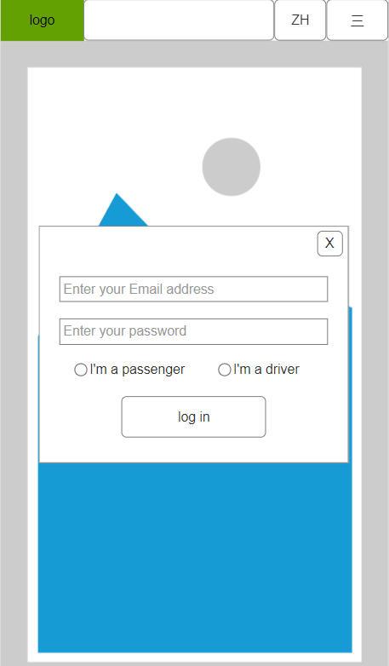
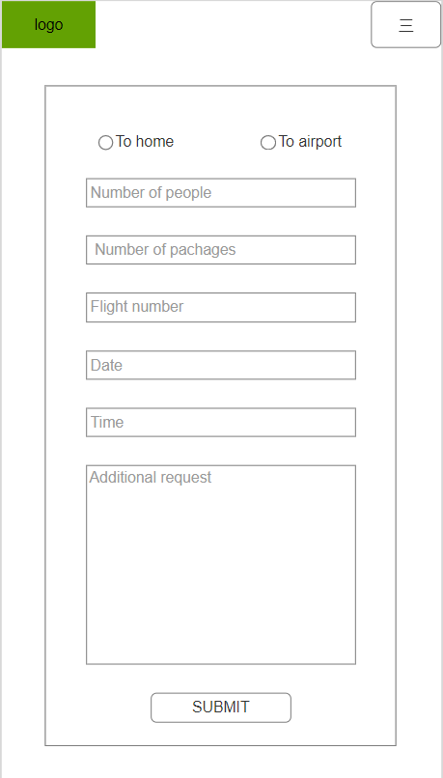
From prototype to product
prototype
product

Slide 9
02
Demonstration
Key features and demo/screenshots

Slide 10
Is everyone ready? Next up is our website presentation!

Slide 11

Code Detail
Good products start with good code~~~

Slide 12
03
Management
Challenges faced and future development.

Slide 13
Daily Scrum
1
What did you do yesterday?
2
What will you do today?
3
Are there any obstacles in your way?

Slide 14
Sprint Review
Connecting Front-End and Back-End
Implementing Authentication
Front-End Enhancements and Backend Testing
Documenting and Evaluating Project Alignment

Slide 15
Sprint Retrospective
49
208
2556
Scrum meetings
Commits
Backend Code
4971
43
Frontend Code
Completed Tickets

Slide 16
Thanks!
Do you have any questions?
yangyang51082022@gamil.com
https://airpick.onrender.com/

