Slide 1
GradeBook
Group 3 :Ke Jia , Qingyun Wang, Yang Yang

Slide 2
How We Organize Our Project
AI’s Role in Our Project
Bug Fixing: AI provided efficient suggestions for debugging, helping to identify and resolve issues faster.
Testing Assistance: AI contributed to optimizing test cases, improving overall efficiency.
GitHub link https://github.com/jiakeke/SEP1
Trello link https://trello.com/b/6O53FdZ7/product-backlog

Slide 3
Architectural Design
ER
Use case
Sequence Diagram
Activiti diagram
Class diagram
https://github.com/jiakeke/SEP1

Slide 4
What We Use
Programming Language: Java, SQL
Frameworks: JavaFX, JDBC
Database: MariaDB
Tools: IntelliJ IDEA, GitHub, Trello ,Jenkins , Docker
AI Assistance: Copilot, ChatGPT

Slide 5
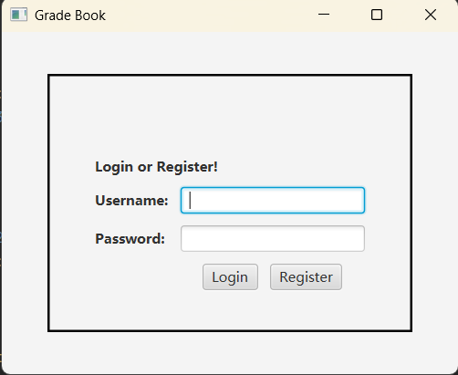
Our Project

Slide 6
Learning achievement
Technical Aspect:
We developed a desktop application using JavaFX again, reinforcing our previous knowledge and gaining deeper insights into UI design and data interaction.
Project Management:
We took turns as project managers, experiencing task allocation, progress tracking, and team coordination, which improved our organizational skills.
Team Collaboration:
Using GitHub for version control, we effectively managed code conflicts and optimized team collaboration, making development more efficient.
Testing & Deployment:
During testing and deployment, we encountered compatibility and environment issues. Through multiple attempts and adjustments, we successfully overcame technical challenges, ensuring system stability.

Slide 7
Thanks~~~

Slide 8
Plan for further development
Feedback to the course:
https://ojp.metropolia.fi/lomakkeet/1/lomake.html?code=VFgwMEVZMjctMzAwNg==
https://ojp.metropolia.fi/lomakkeet/1/lomake.html?code=VFgwMEVZMjctMzAwMw==

Slide 9
Product Backlog

Slide 10
Sprint 1
Sprint Master Ke Jia
Sprint Backlog 7
Done 7
Release 0
Postpone 0
Testing

Slide 11
Sprint 2
Sprint Master QingYun Wang
Sprint Backlog 27
Done 27
Release 0
Postpone 0
Testing

Slide 12
Sprint 3
Sprint Master Yang Yang
Sprint Backlog 23
Done 23
Release 0
Postpone 0
Testing

Slide 13
Sprint 4
Sprint Master
Sprint Backlog
Done
Release
Postpone
Testing

