Slide 1
GRPO Reward Ablation for Arithmetic LLM
Final Project
Which reward design improves arithmetic accuracy most reliably?
Primary metric: exact-match arithmetic accuracy.
Shared step-0 baseline across runs: 0.1406.
What We Compare
H1: binary only
H2: binary + process/format
H3: binary + distance reward
What Stays Fixed
Same SFT checkpoint
Same tokenizer + verifier
Same decode settings
Target Outcome
Faster early learning
Higher late-stage accuracy
No proxy-metric drift

Slide 2
Experiment Setup at a Glance
Setup
Controlled Comparison
Only the reward formula changes across H1/H2/H3. Architecture, data, and decoding remain fixed.
Start Point
Shared SFT checkpoint
Shared tokenizer and verifier
Prompt Pool
50,000 generated arithmetic prompts
Depth <= 5, numbers 1..20, invalid filtered
Decode + Evaluation
max length 256, temperature 1.0
top-k 50, top-p 0.95
Metric: exact-match arithmetic accuracy
Only Variable
H1: binary reward
H2: add process + format reward
H3: add distance reward

Slide 3
Why Reward Design Matters
Motivation
Binary Reward (H1)
+ Perfect alignment with correctness
- Sparse signal when output is wrong
- Can slow early learning
Auxiliary Rewards (H2/H3)
+ Denser feedback during training
+ Potentially faster optimization
- Risk: optimize proxy, not correctness
Ablation Question
Can denser rewards improve learning speed without sacrificing exact arithmetic accuracy?

Slide 4
How We Built the SFT Checkpoint
Data + Training
Dataset and Procedure
• Foundational pretraining data: 200,000 synthetic arithmetic samples.
• SFT data: 4,096 instruction samples in data/instruction_corpus_sft_4k.txt.
• SFT split: 3,686 train + 410 val (90/10 split from dataloader).
• SFT training config: 1 epoch, batch size 64, learning rate 5e-05, 58 optimizer steps.
• Training samples are generated from random +/- expression trees with parentheses; RL prompt pool filters invalid expressions.

Slide 5
Hypotheses and Reward Designs
Reward Definitions
Hypothesis | Reward Formula | Auxiliary Signal Meaning
H1: Binary-only | R = 1.0 * binary | No auxiliary term.
H2: Binary + Process + Format | R = 0.8 * binary + 0.15 * process + 0.05 * format | Process trace rewards structured steps; format rewards template compliance.
H3: Binary + Distance-Based Reward | R = 0.9 * binary + 0.1 * exp(-|err| / 10) | Distance reward = exp(-|err|/10); higher reward means closer answer.

Slide 6
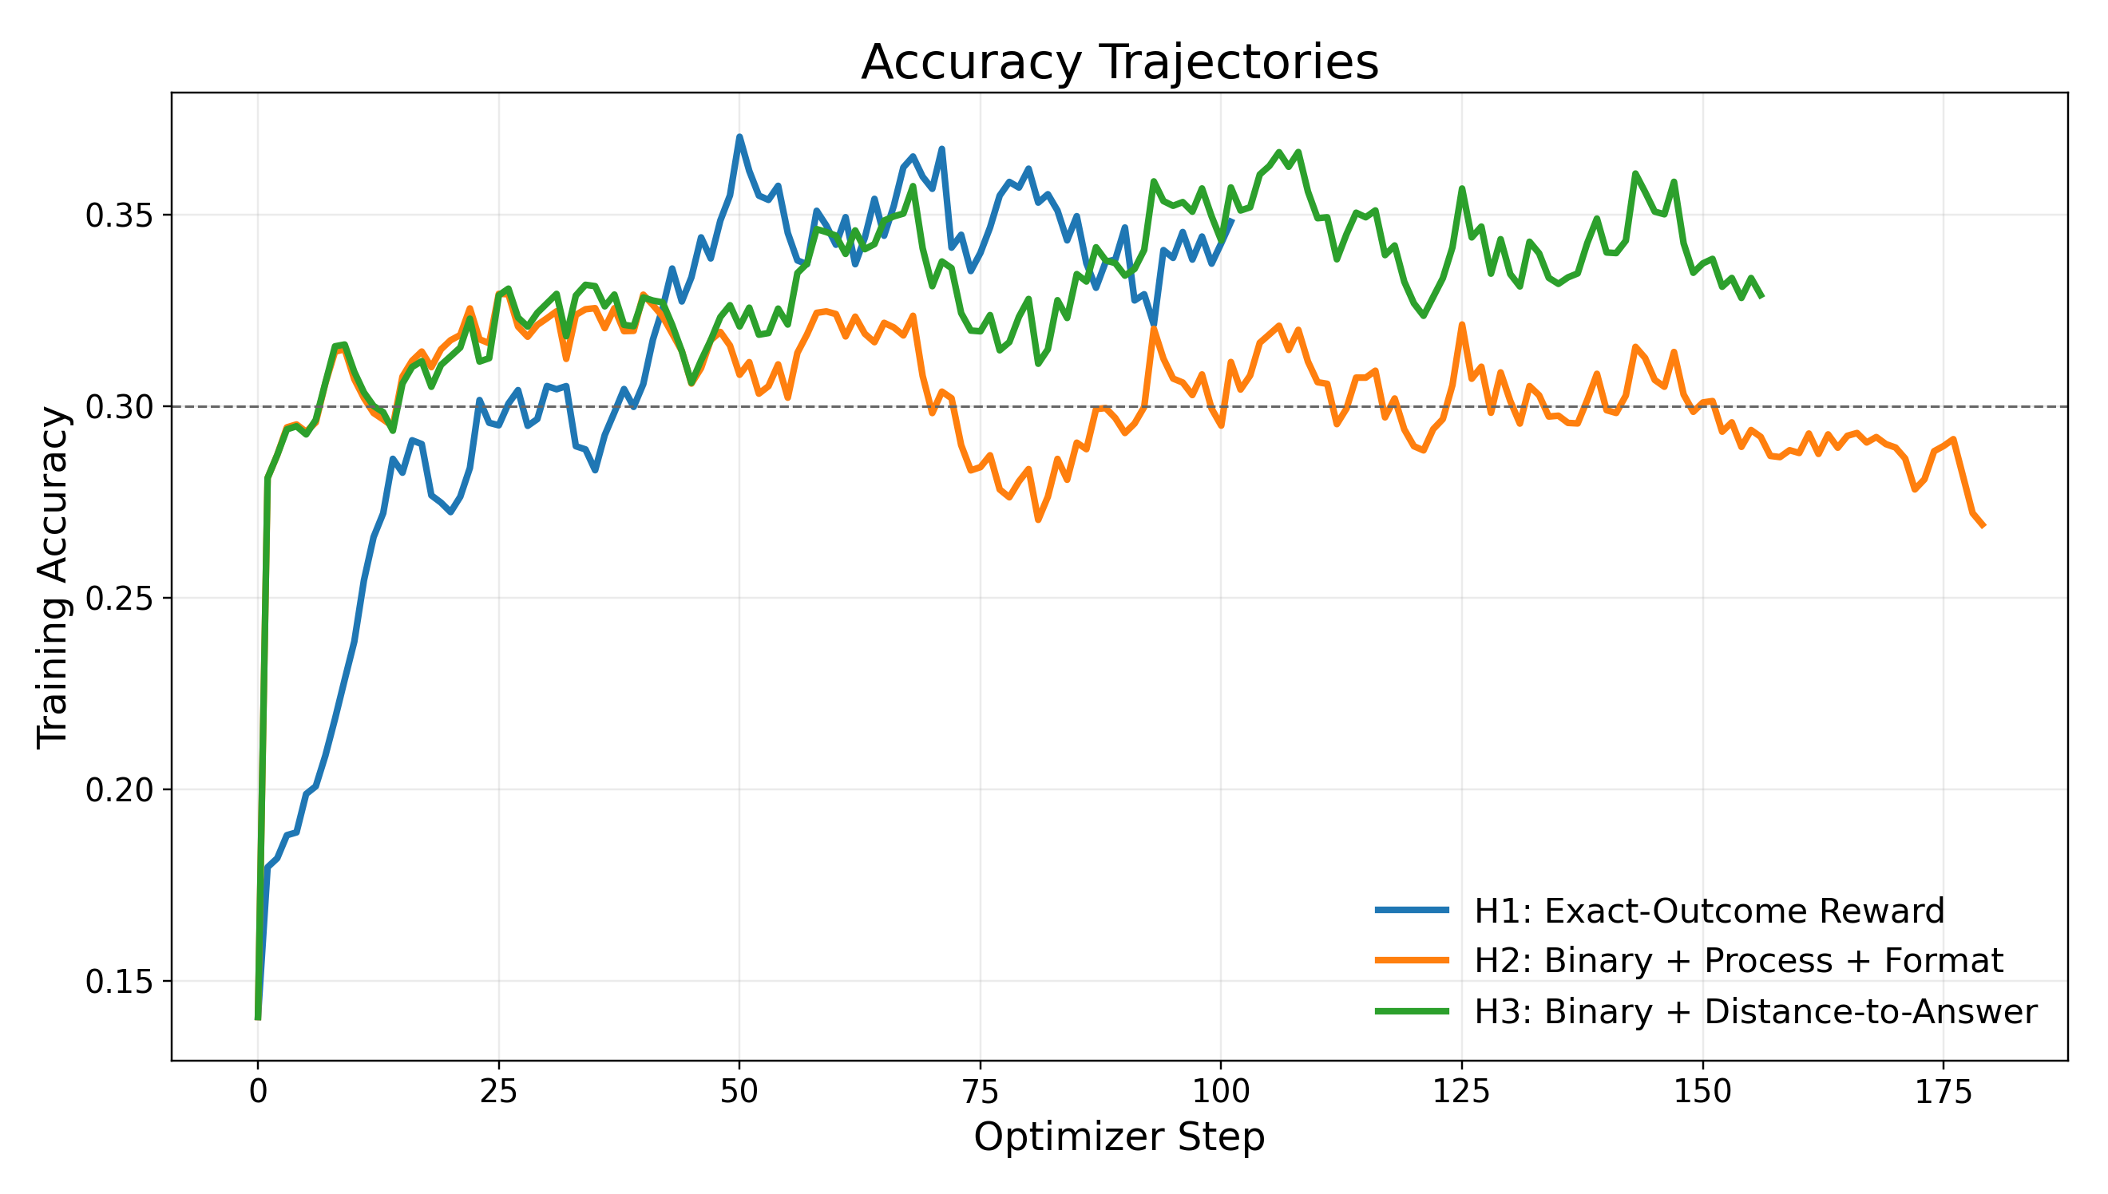
Accuracy Across Hypotheses
Main Result
• Reach 0.30 accuracy: H1=23, H2=7, H3=7. Later-stage mean: H3(0.342) ≈ H1(0.340) > H2(0.287).

Slide 7
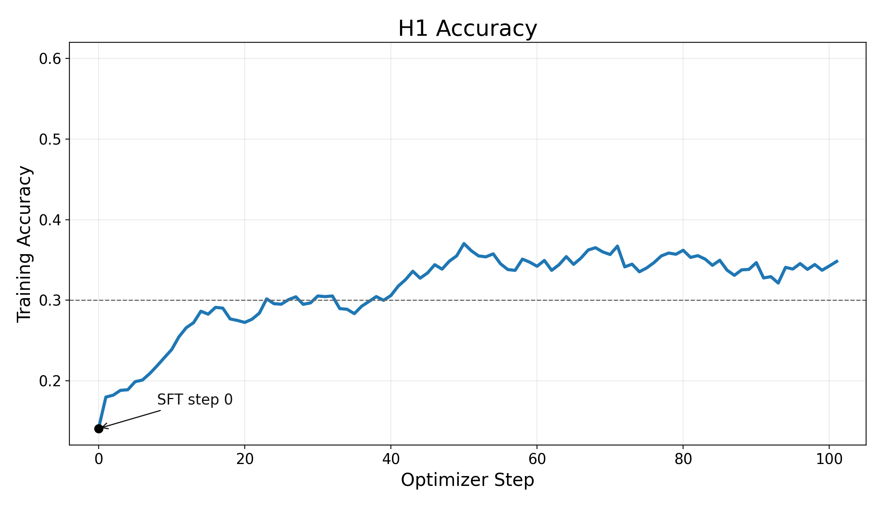
H1: Binary Exact Outcome
Hypothesis 1
Interpretation
• Reward: 1 if exact answer, else 0.
• Reached 0.30 accuracy at step 23.
• Sparse but fully aligned objective.
• Late-stage mean accuracy: 0.340.

Slide 8
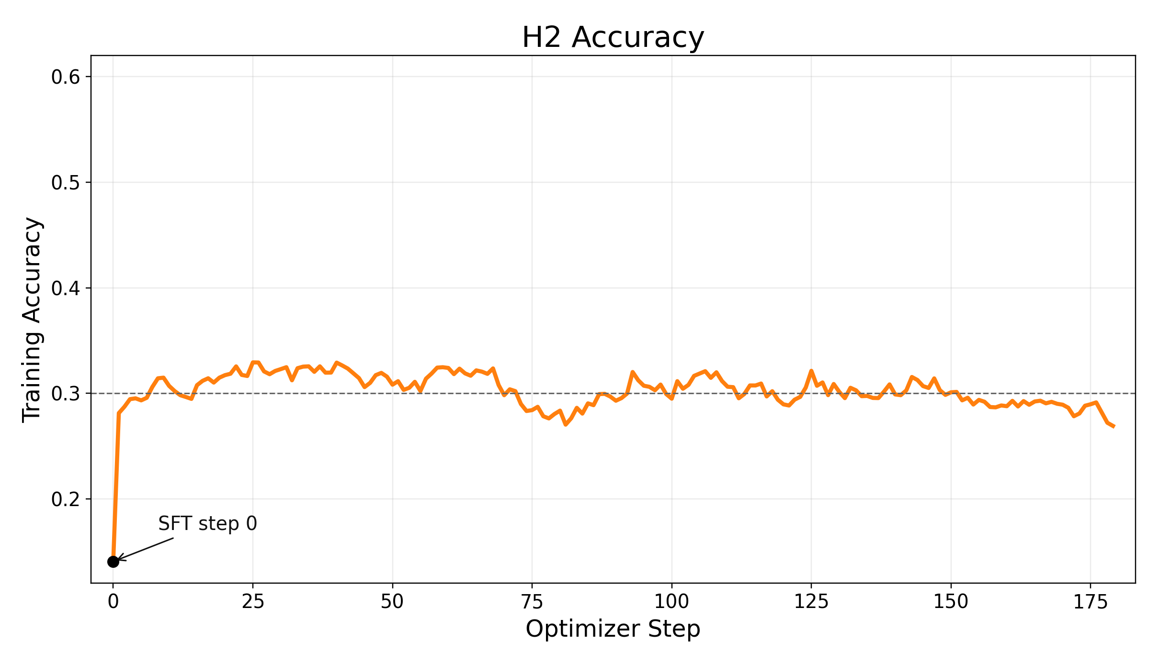
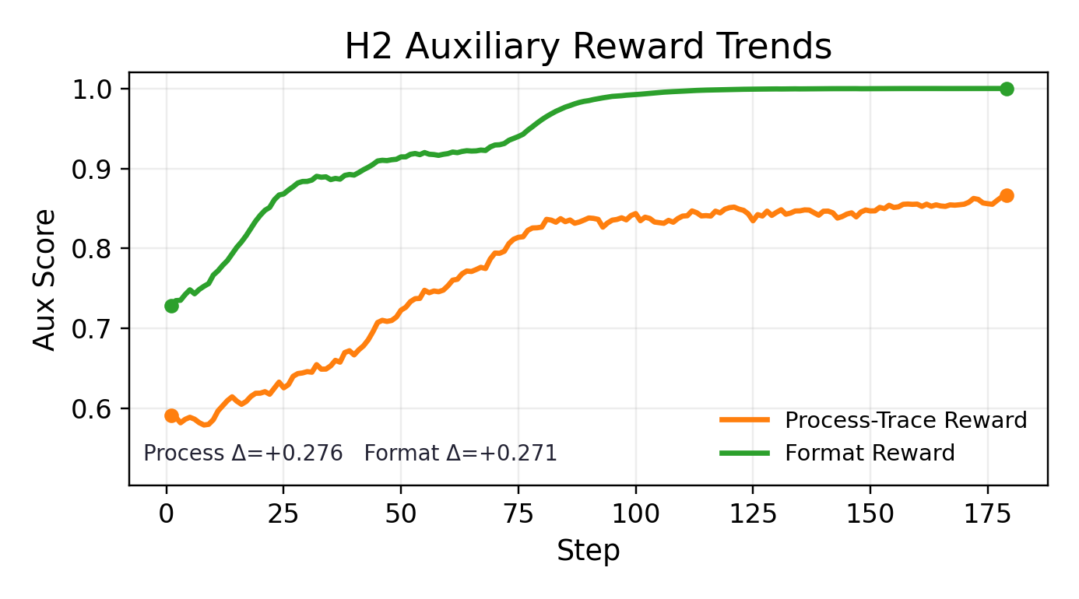
H2: Binary + Process + Format
Hypothesis 2
Aux Learning + Influence
• Reward mix: 0.8 binary + 0.15 process + 0.05 format.
• Right panel is an auxiliary reward trend, not optimization loss.
• Aux signals rise strongly: process 0.591 -> 0.890, format 0.729 -> 1.000.
• Accuracy outcome: late mean 0.287 < H1 0.340 and H3 0.342.

Slide 9
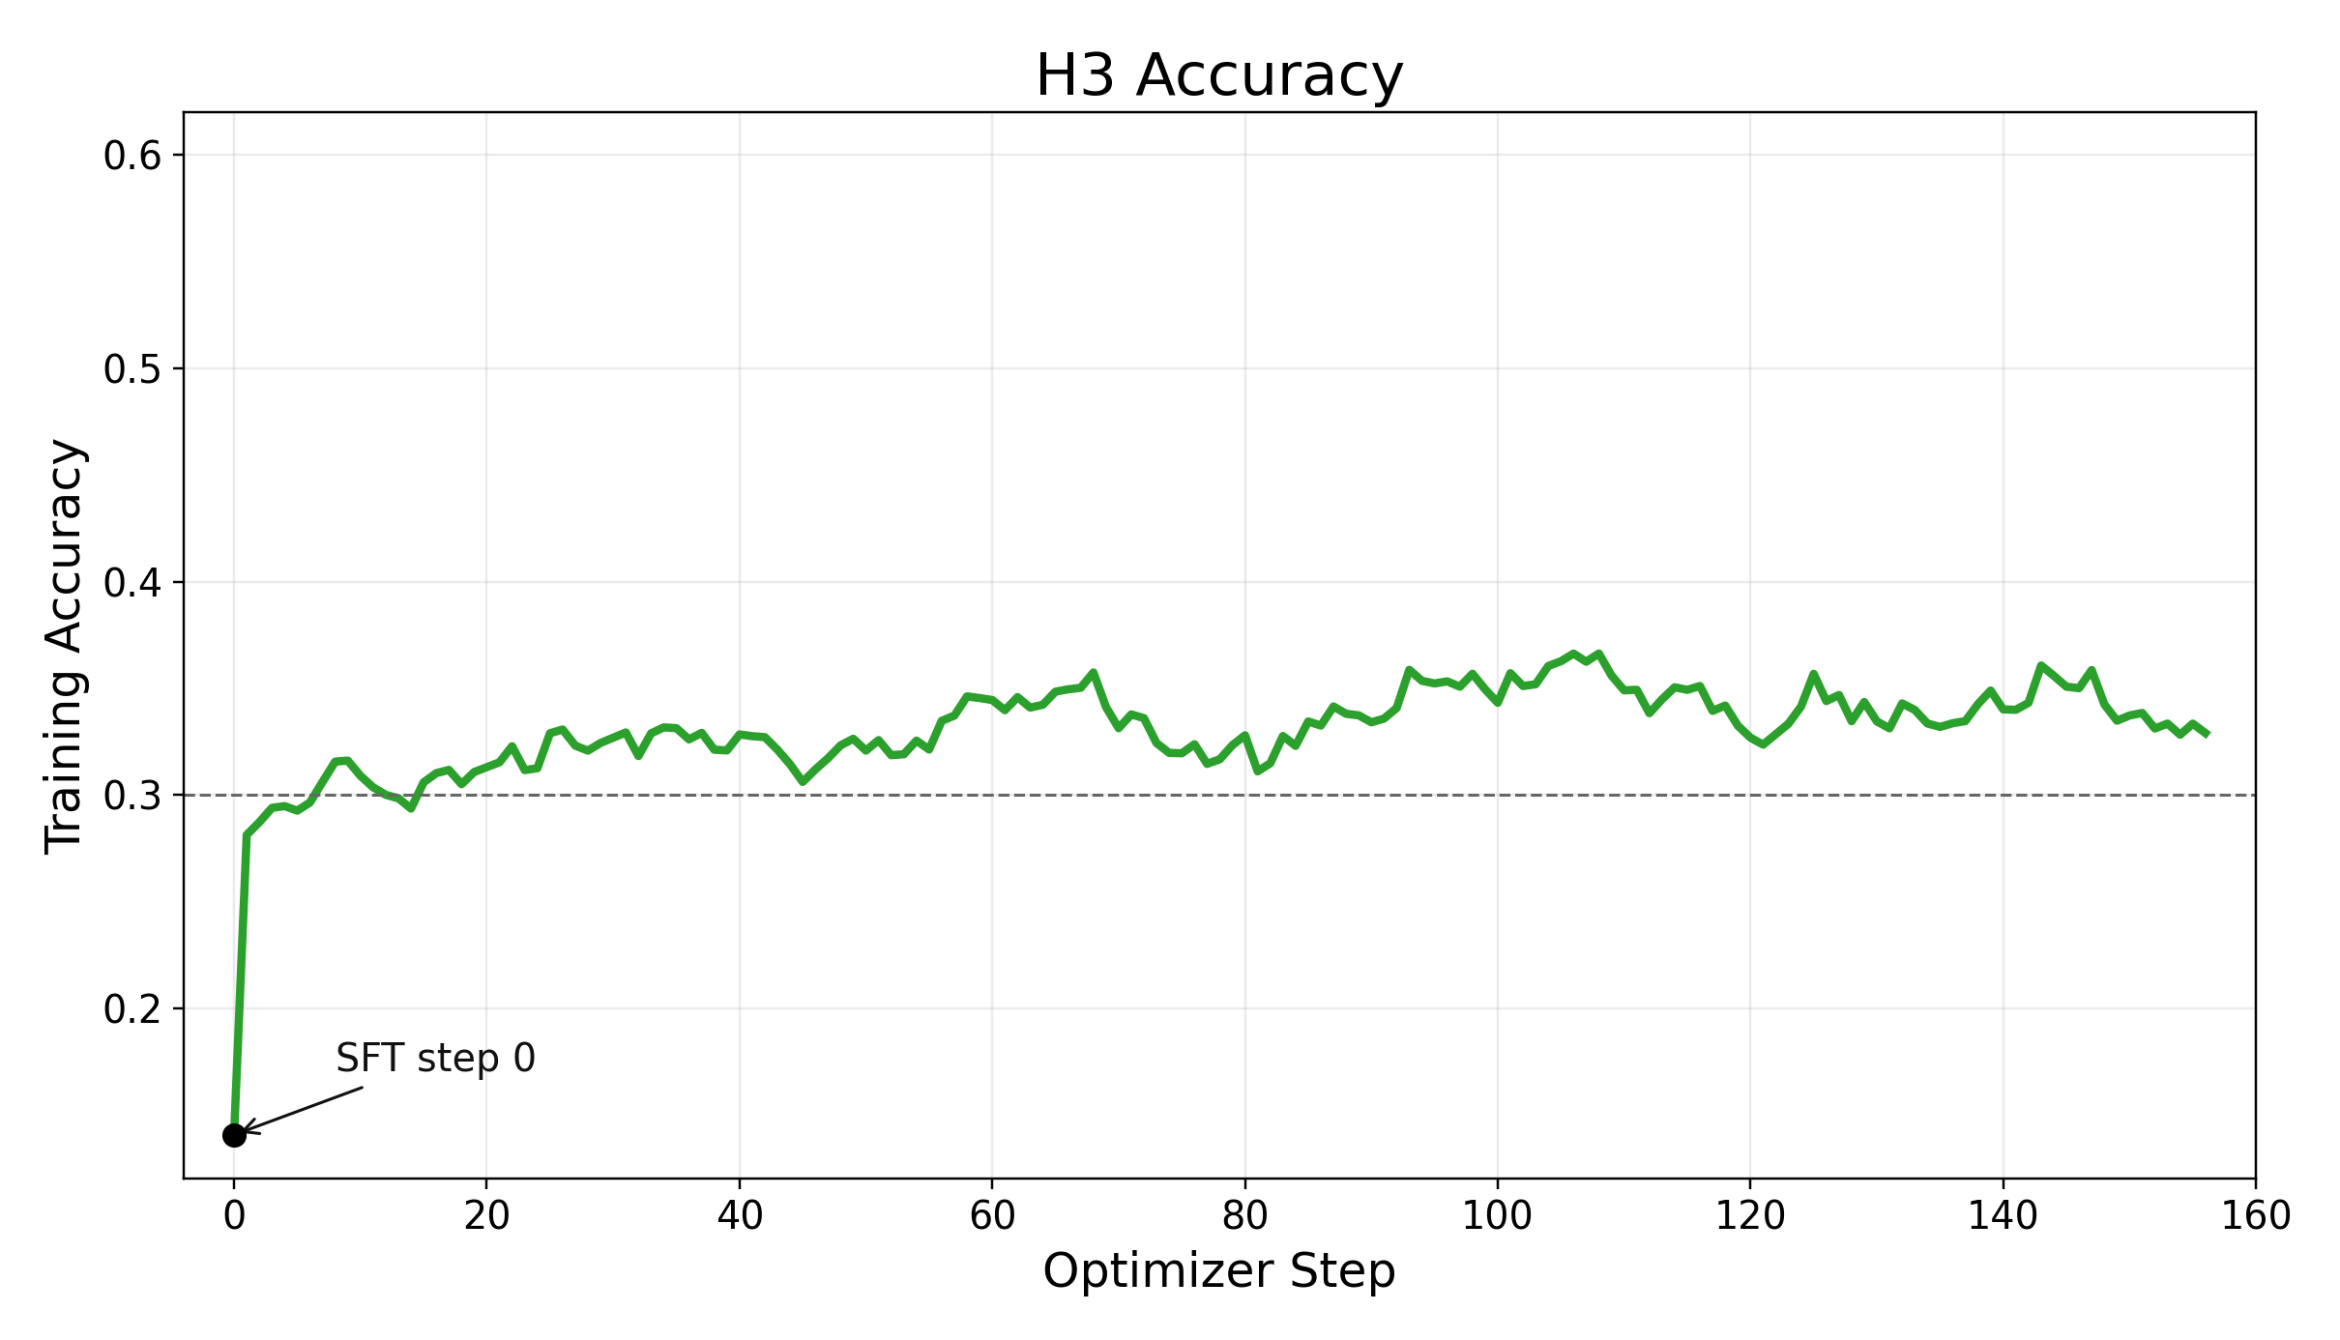
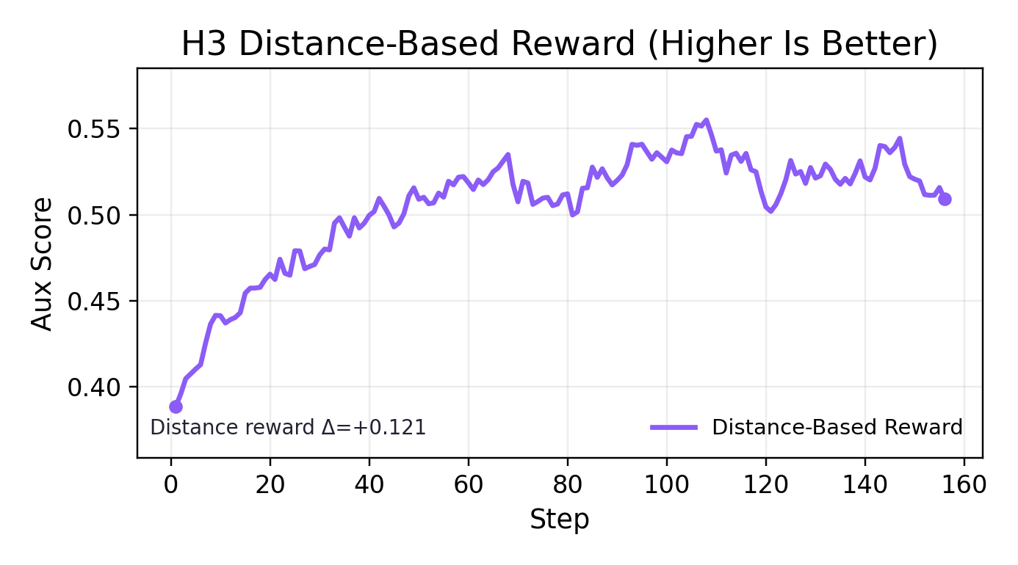
H3: Binary + Distance-Based Reward
Hypothesis 3
Core Definition
• Reward mix: 0.9 binary + 0.1 distance-based reward.
• Distance-based reward = exp(-|predicted final - true final| / 10): higher is better (closer answer).

Slide 10
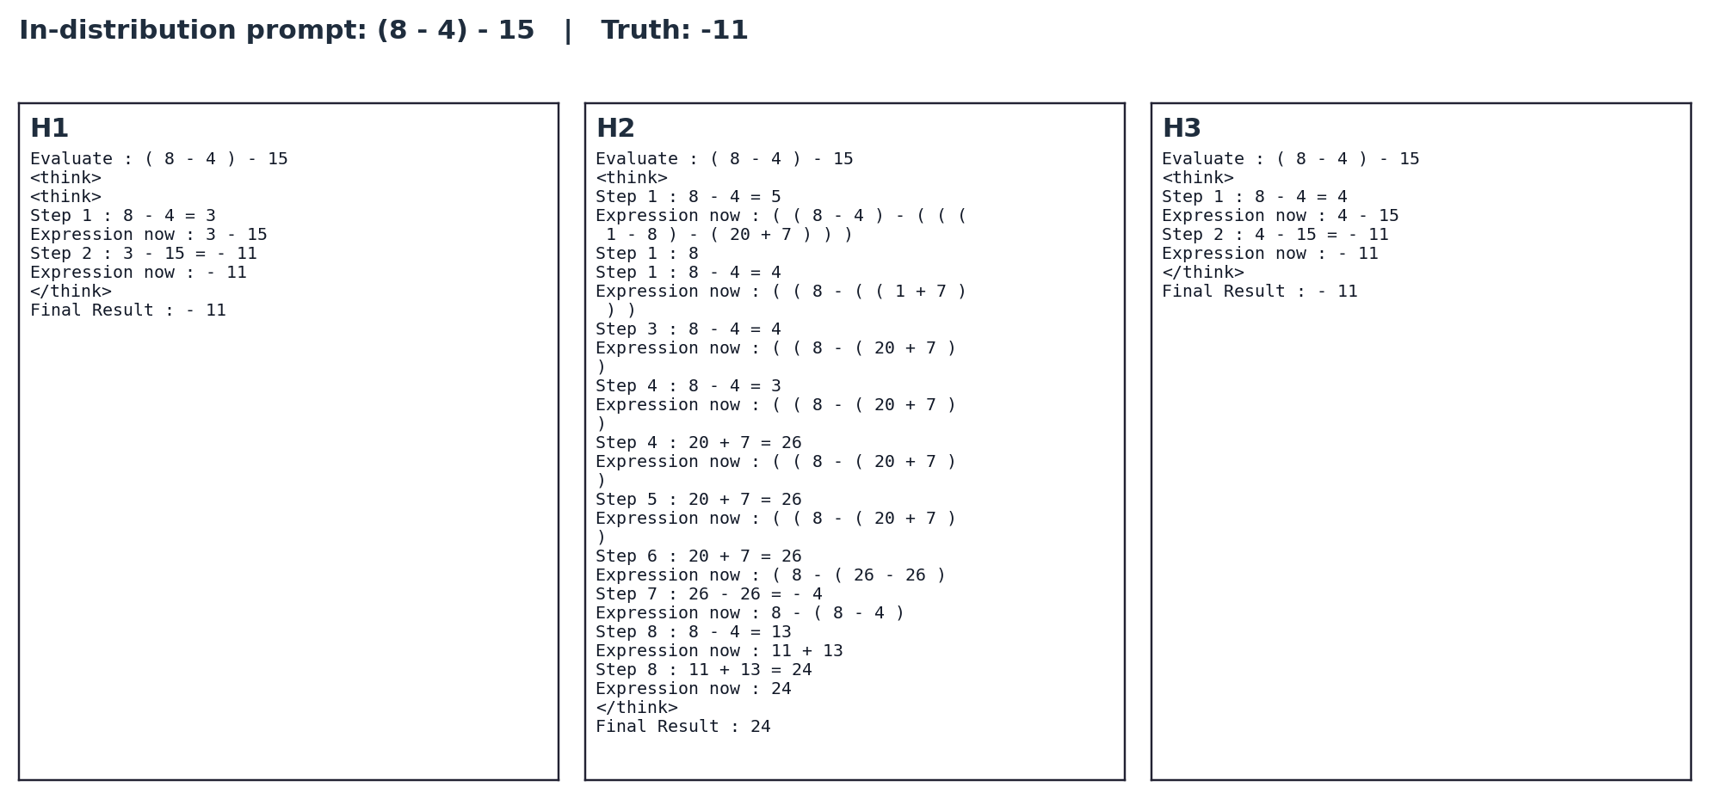
Prompt-Response Behavior Differences
H1 / H2 / H3

Slide 11
Final Interpretation
Conclusion
Takeaways
• H1: slow but cleanly aligned to final accuracy.
• H2: auxiliary rewards are learned, but final accuracy impact is negative in this setup.
• H3: distance-based reward is learned and gives a positive final-accuracy lift over H2.
• Convergence bands remain relatively close overall, suggesting model capacity remains a limiting factor.

