Slide 1
ANALOG IC DESIGN AUTOMATION
Jialin Lu
2020/09/18

Slide 2
0. Self-Introduction
Name
Jialin lu
University
Fudan University
Degree and major
Phd first year, ME
Research interests
Machine learning
Circuit optimization

Slide 3
1. Why We Talk About Analog Design Automation?
Analog V.S. Digital
More target to trade off
Complex behavior
Before V.S. Now
Machine learning
Significant increase in computing
Highly dependent on designer experience
Time and money consuming
EDA tools can only focus on simulation & verification
It’s time !

Slide 4
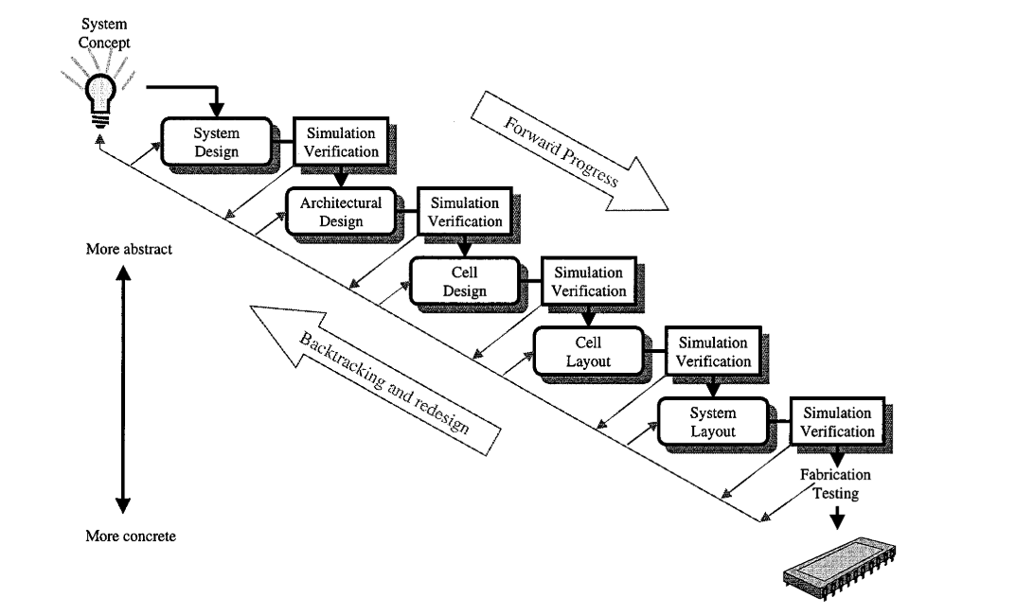
2. AMS Circuit Design and Automation
✘
Circuit modeling
Behavioral Modeling
Circuit synthesis
Topology synthesis
Circuit sizing
Layout generator
Commercial simulator:
time consuming, but reliable
？
Based library
Based optimization
✔
BAG
MAGICAL
…
High-level view of the analog or mixed-signal IC design process

Slide 5
3. Topology Synthesis
Based library:
Collect the predefined topology in the library
Choose through rules or calculations
But:
Difficult to collect the original circuit
Unable to create a new circuit structures
Based optimization:
Use optimization algorithms such as genetic evolution to modify existing circuits
Or set the target and search space to generate randomly
But:
low efficiency
Against experience

Slide 6
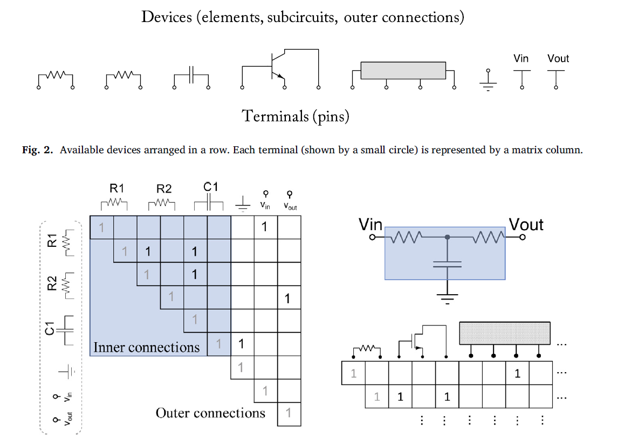
3. Topology Synthesis
Rojec, Ž., Bűrmen, Á. and Fajfar, I., 2019. Analog circuit topology synthesis by means of evolutionary computation. Engineering Applications of Artificial Intelligence, 80, pp.48-65.

Slide 7
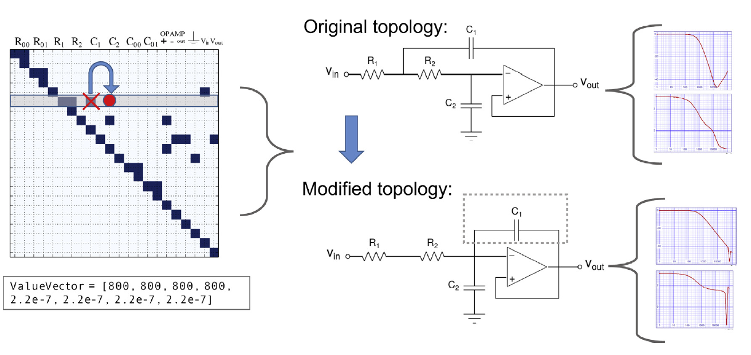
3. Topology Synthesis

Slide 8
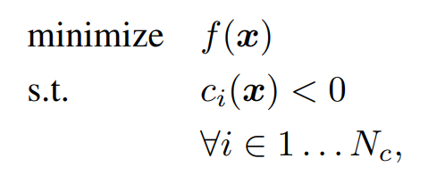
4. Circuit sizing
Model-based:
Manual or regression models
High efficiency but low accuracy
Simulation-based:
optimization is driven directly by the circuit simulations
Time consuming
Online optimization:
Bayesian optimization
Reinforcement learning
Black-box function:

Slide 9
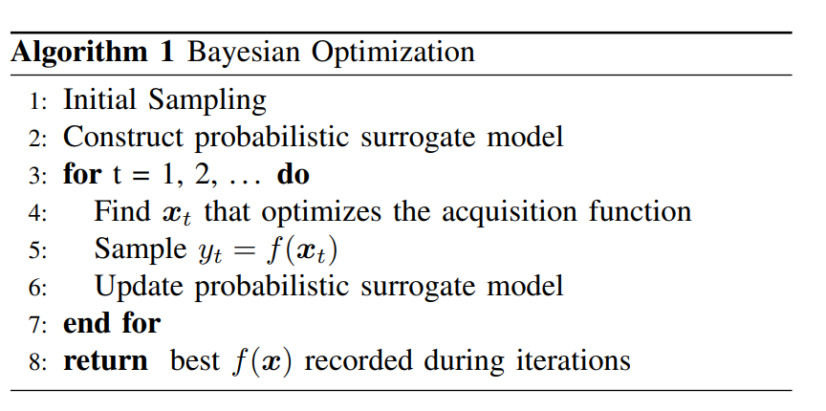
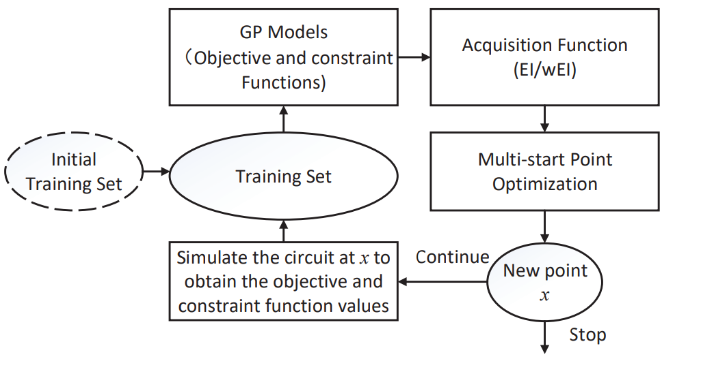
4. Circuit sizing
Lyu, W., Xue, P., Yang, F., Yan, C., Hong, Z., Zeng, X. and Zhou, D., 2017. An efficient Bayesian optimization approach for automated optimization of analog circuits. IEEE Transactions on Circuits and Systems I: Regular Papers, 65(6), pp.1954-1967.

Slide 10
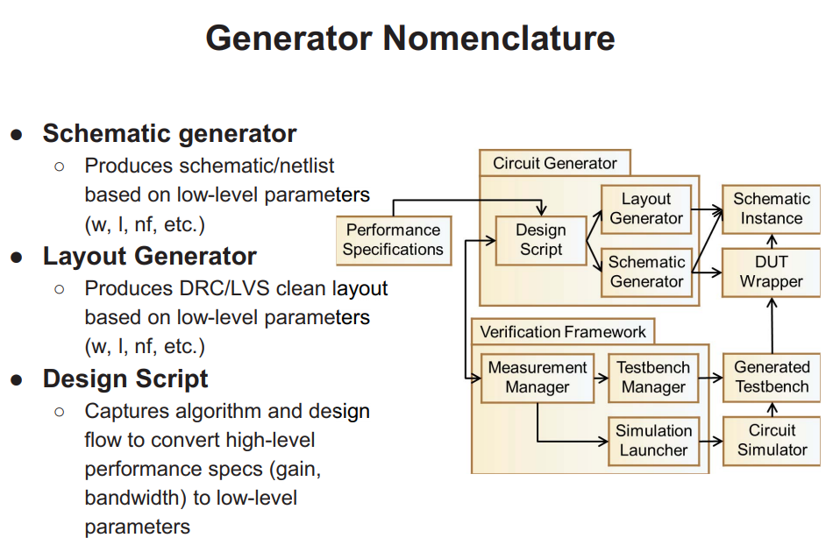
5. Automatic layout generation
Chang, E., Han, J., Bae, W., Wang, Z., Narevsky, N., NikoliC, B. and Alon, E., 2018, April. BAG2: A process-portable framework for generator-based AMS circuit design. In 2018 IEEE Custom Integrated Circuits Conference (CICC) (pp. 1-8). IEEE

Slide 11
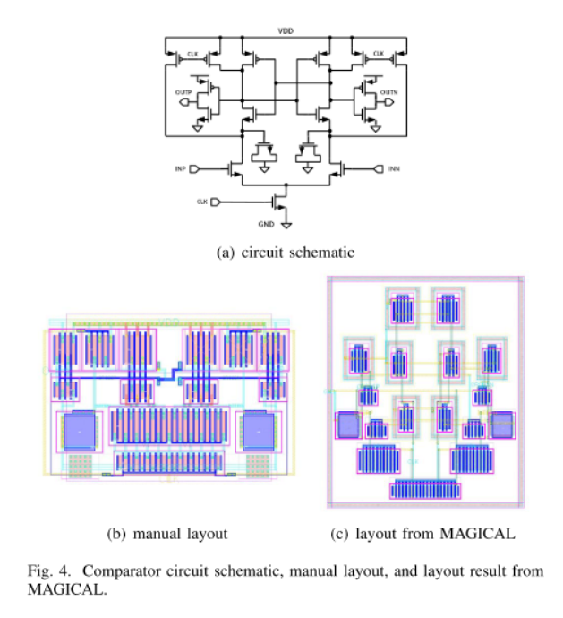
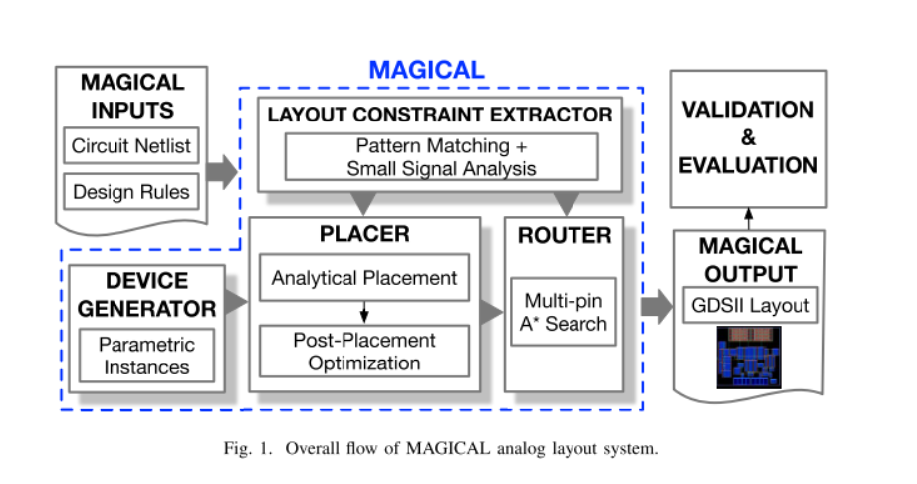
5. Automatic layout generation
Xu, Biying, et al. "MAGICAL: Toward Fully Automated Analog IC Layout Leveraging Human and Machine Intelligence." 2019 IEEE/ACM International Conference on Computer-Aided Design (ICCAD). IEEE, 2019.

