Slide 1




A Mixed-Variable Bayesian Optimization Approach for Analog Circuit Synthesis
Jialin Lu¹, Shuhan Zhang¹, Fan Yang^{1*}, Dian Zhou² and Xuan Zeng^{1∗}
¹State Key Lab of ASIC & System, School of Microelectronics, Fudan University, China
²Department of Electrical Engineering, University of Texas at Dallas, Richardson, TX, U.S.A
2020 IEEE International Symposium on Circuits and Systems
Virtual, October 10-21, 2020

Slide 2
0. Self-Introduction
Name
jialin Lu
University
fudan University
Degree and major
PhD first year
mE
interest
Machine learning
Analog IC design automation

Slide 3
1. Problem Formulation
circuit
performance
Min：
circuit design
Mathematical abstraction
s.t.：
circuit
constraints
which：
are discrete
design
parameters
are continuous

Slide 4
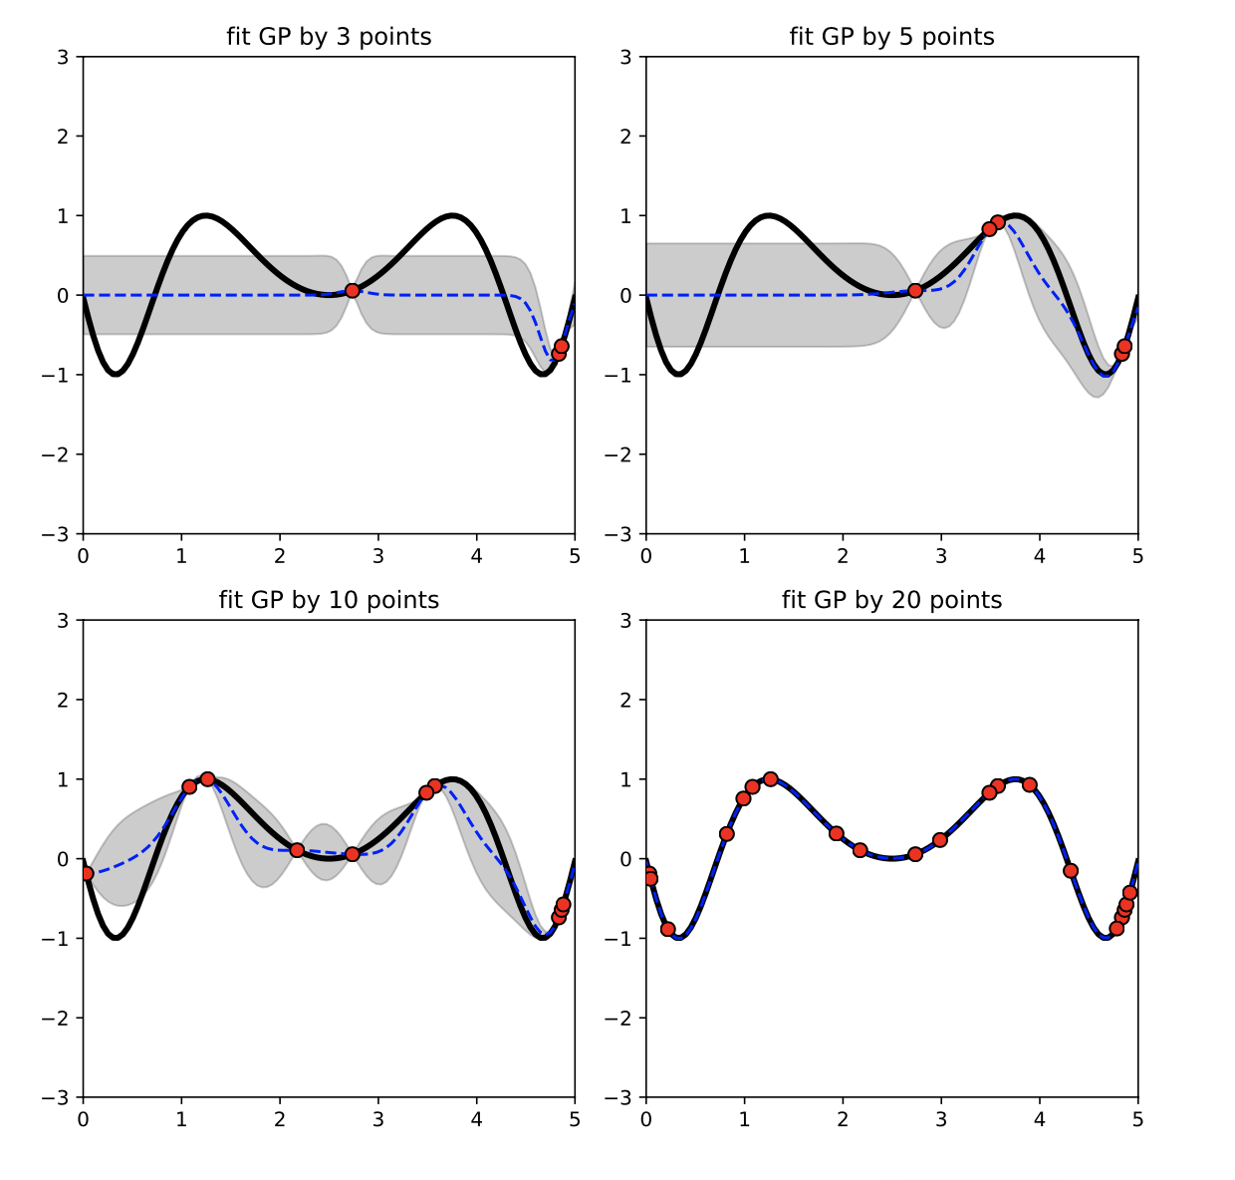
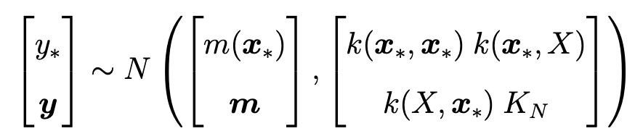
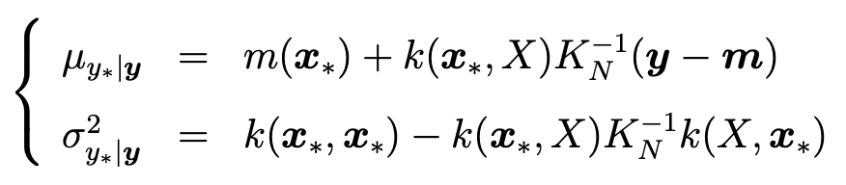
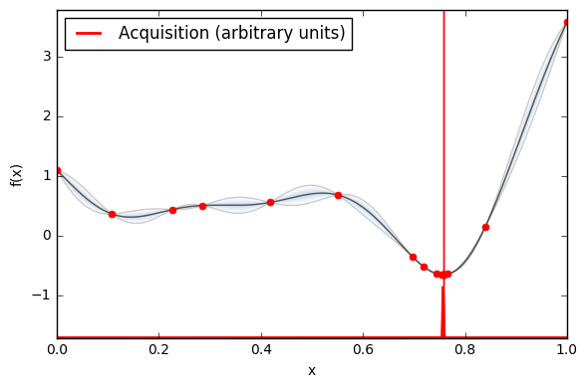
2. Background – Bayesian Optimization
Gaussian Process
Assume：
Drive：
Surrogate model
Standard BO
acquisition function

Slide 5
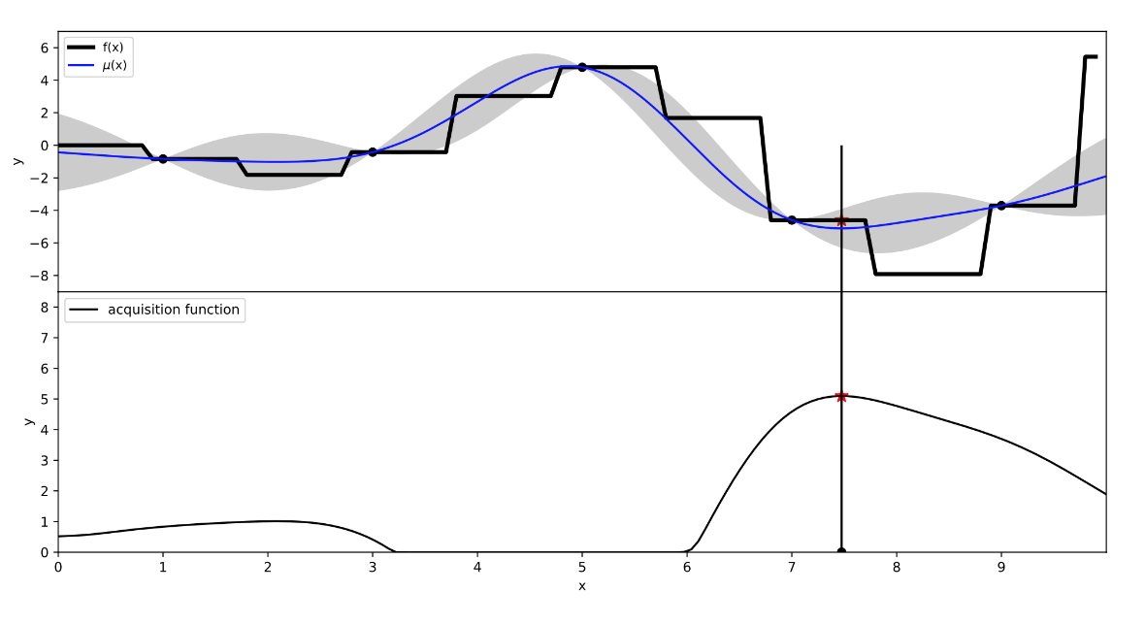
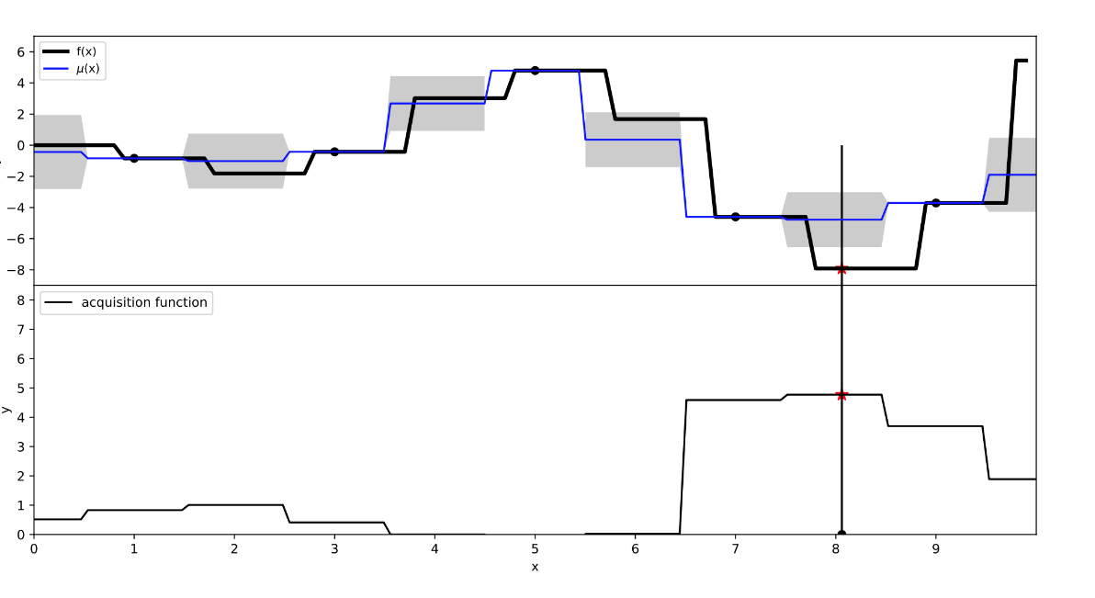
2. Background – Shortcomings of traditional BO
Comparison of the basic kernel and our improved kernel for Bayesian optimization.
The figure shows that either maximize the acquisition functions or the objective function f(x) (top, traditional BO) x that maximizes the acquisition function does not match the actual global optimum with the basic kernel.
While (bottom, our solution) x that maximizes the acquisition function matches the actual global optimum with our improved kernel.

Slide 6
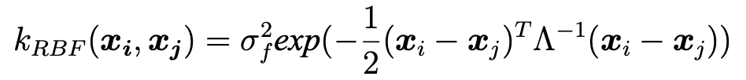
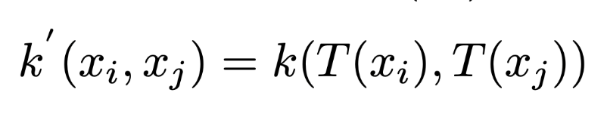
3. Our Solution
Modify the kernel function to make it suitable for discrete variables：
T(*) is the rounding operator, which means the conversion of rounding all integer variable parts in the input vector x to the nearest integer value.

Slide 7
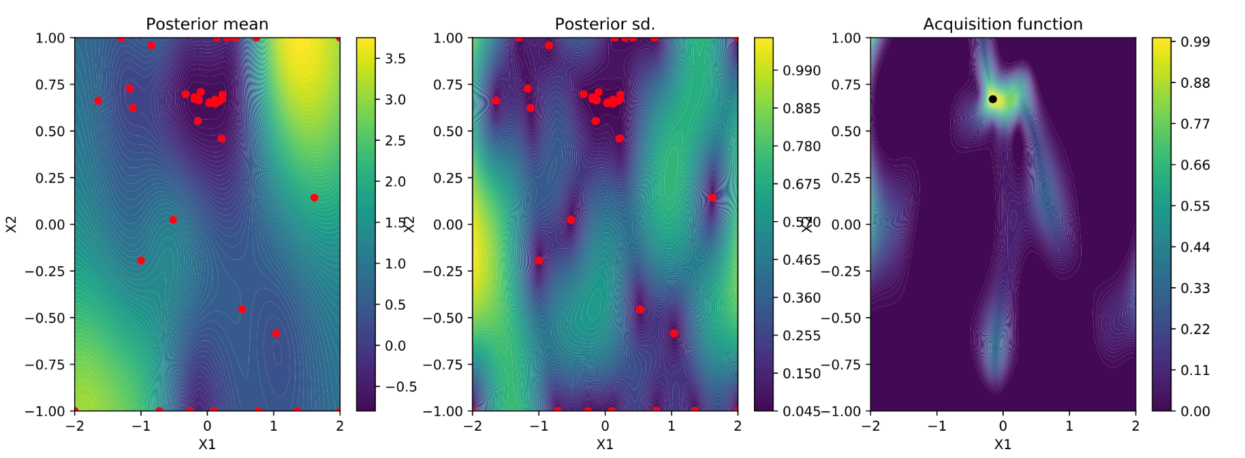
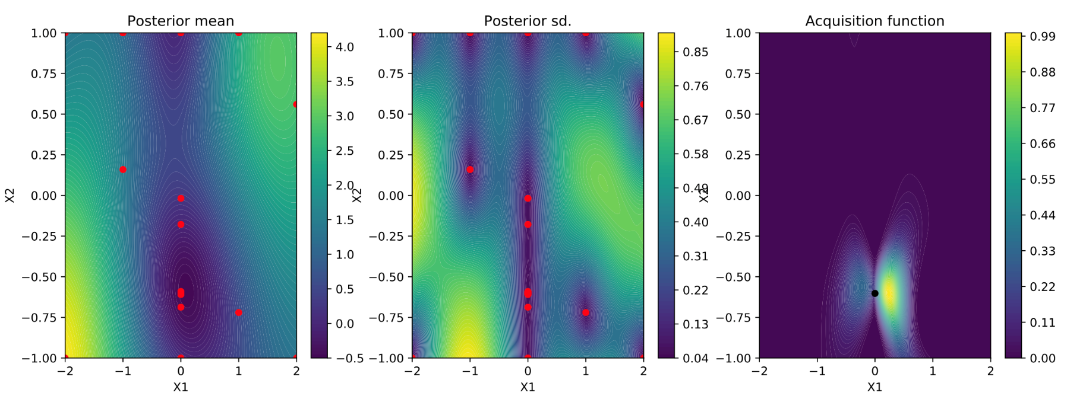
4. Results on mix-variable test function

Slide 8
5.Results on analog circuits
Comparison algorithm:
Standard BO, NSGA-II, and the discrete BO algorithm we proposed ；
Experimental setting:
Each algorithm runs 8 times independently
The upper limit of the number of circuit simulations in a single optimization is set to 600
Results and convergence times after the optimization are collected;
Experimental environment:
a server with 2 Intel Xeon CPU cores and 128GB memory;
Experimental circuits：
Low-Power Three-stage Amplifier
Charge Pump
Voltage Controlled Oscillator

Slide 9
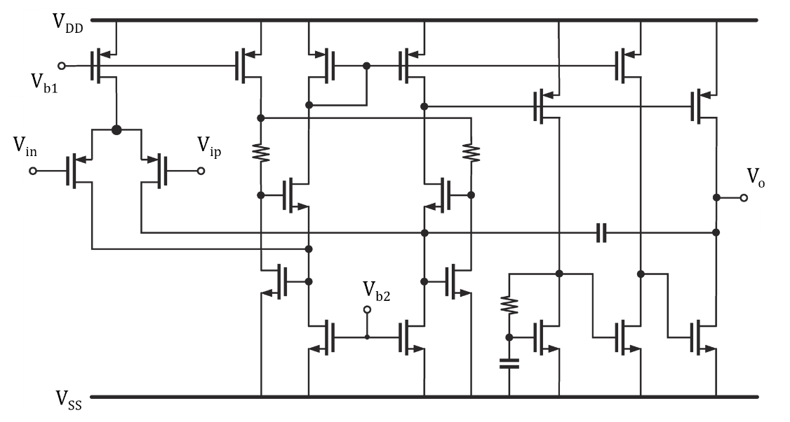
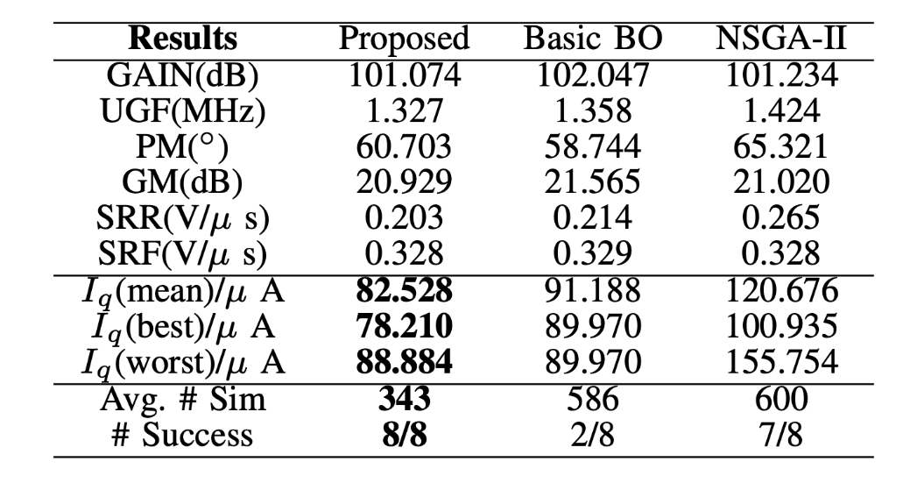
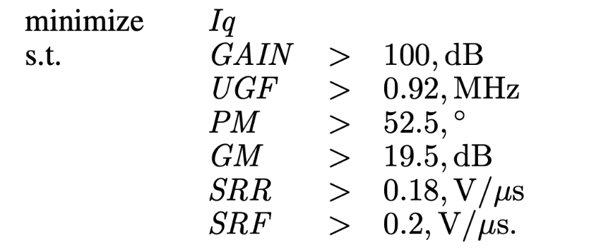
5.Results on analog circuits
Low-Power Three-stage Amplifier
9 design variables, 4 continuous & 5 discrete
Compared with traditional Bayesian optimization algorithm, it reduces the number of simulations (59%)
Compared with the NSGA-II algorithm, the optimization effect is improved (32%)

Slide 10
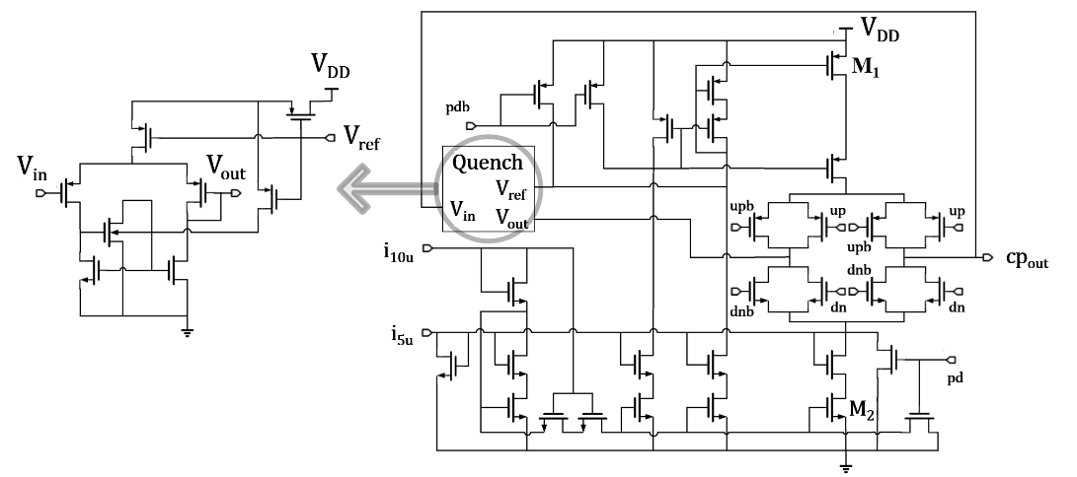
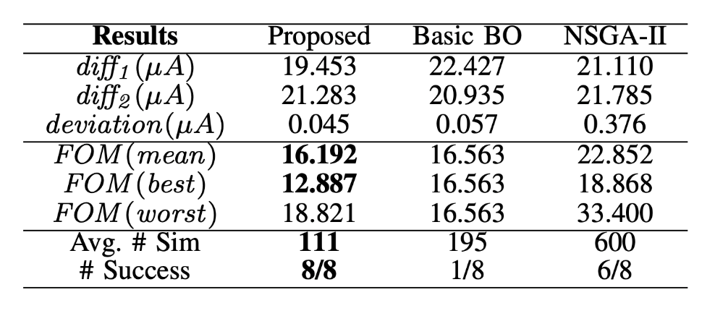
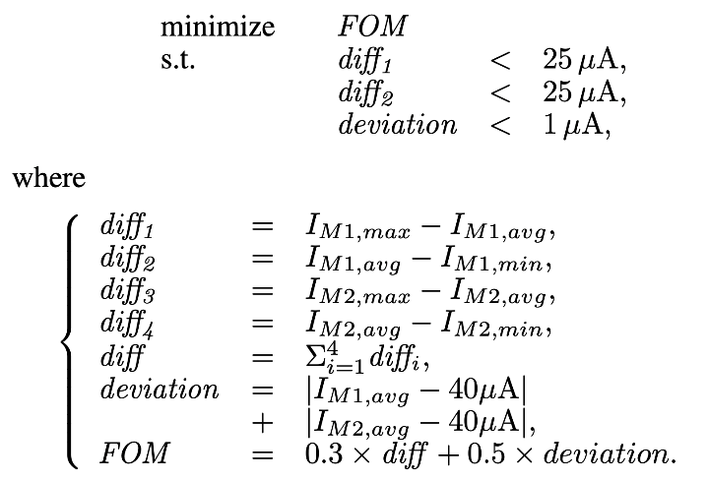
5.Results on analog circuits
Charge Pump
24 design variables, 18 continuous & 6 discrete
Compared with traditional Bayesian optimization algorithm, it reduces the number of simulations (57%)
Compared with the NSGA-II algorithm, the optimization effect is improved (29%)

Slide 11
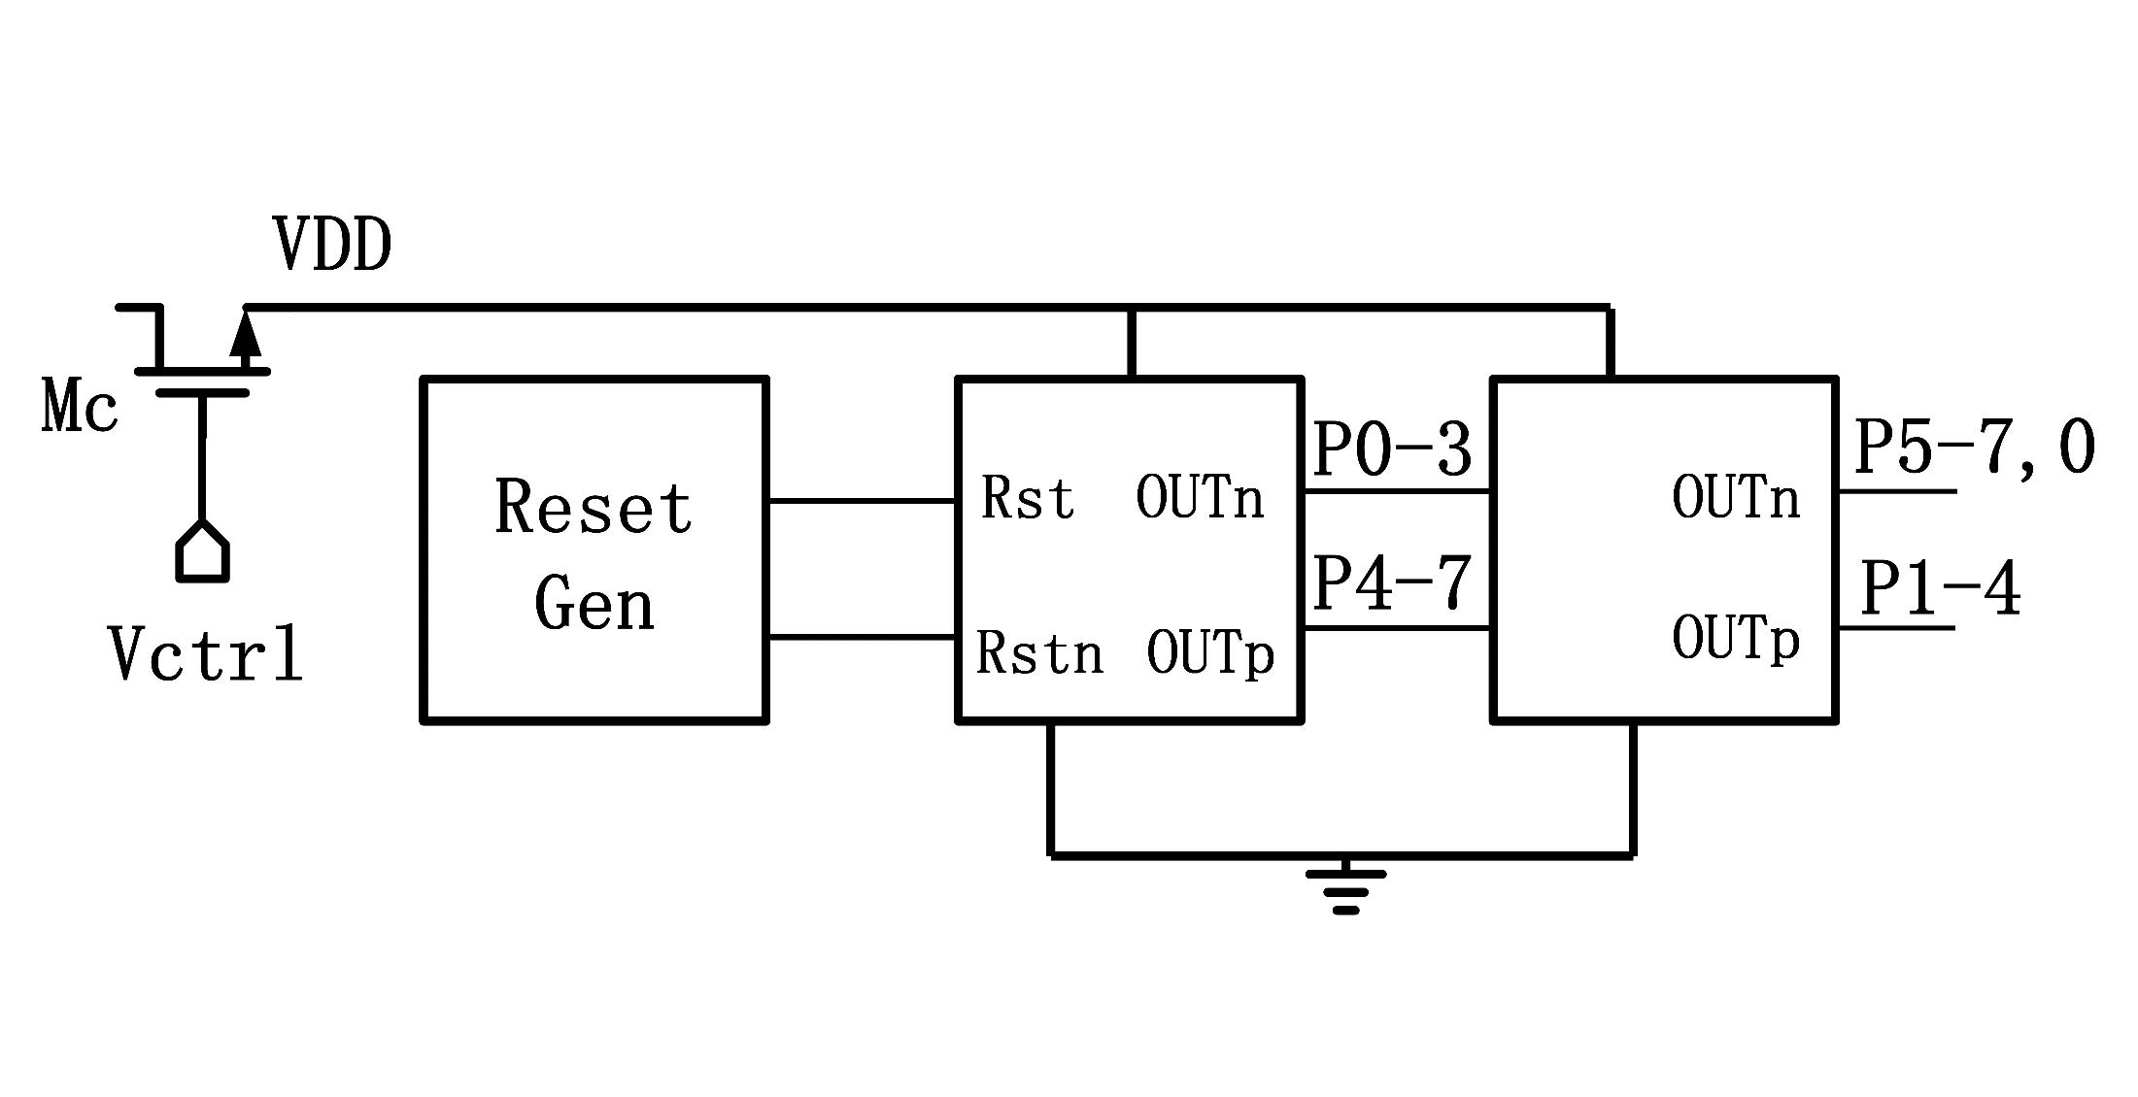
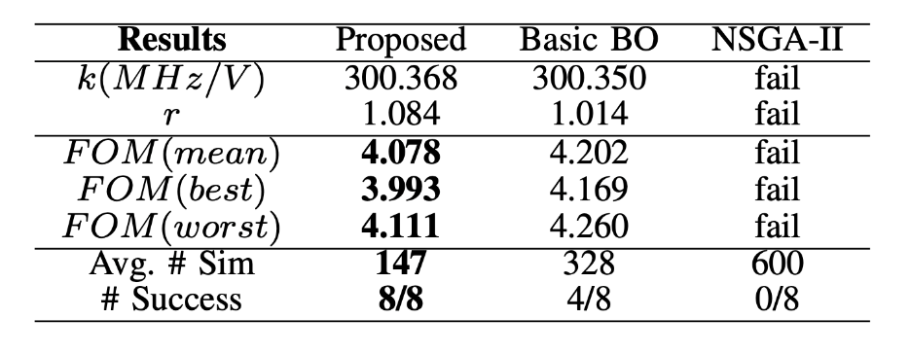
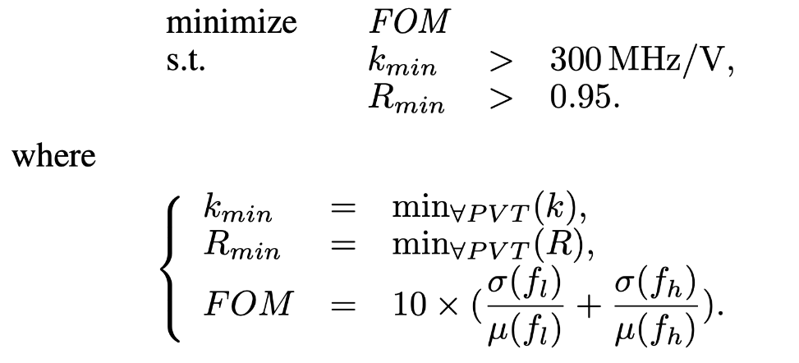
5.Results on analog circuits
Voltage Controlled Oscillator
20 design variables, 12 continuous & 8 discrete
Compared with traditional Bayesian optimization algorithm, it reduces the number of simulations (56%)
The NSGA-II algorithm cannot handle 14 constraints and fails in all experiments

Slide 12
Thank you！

