Slide 1
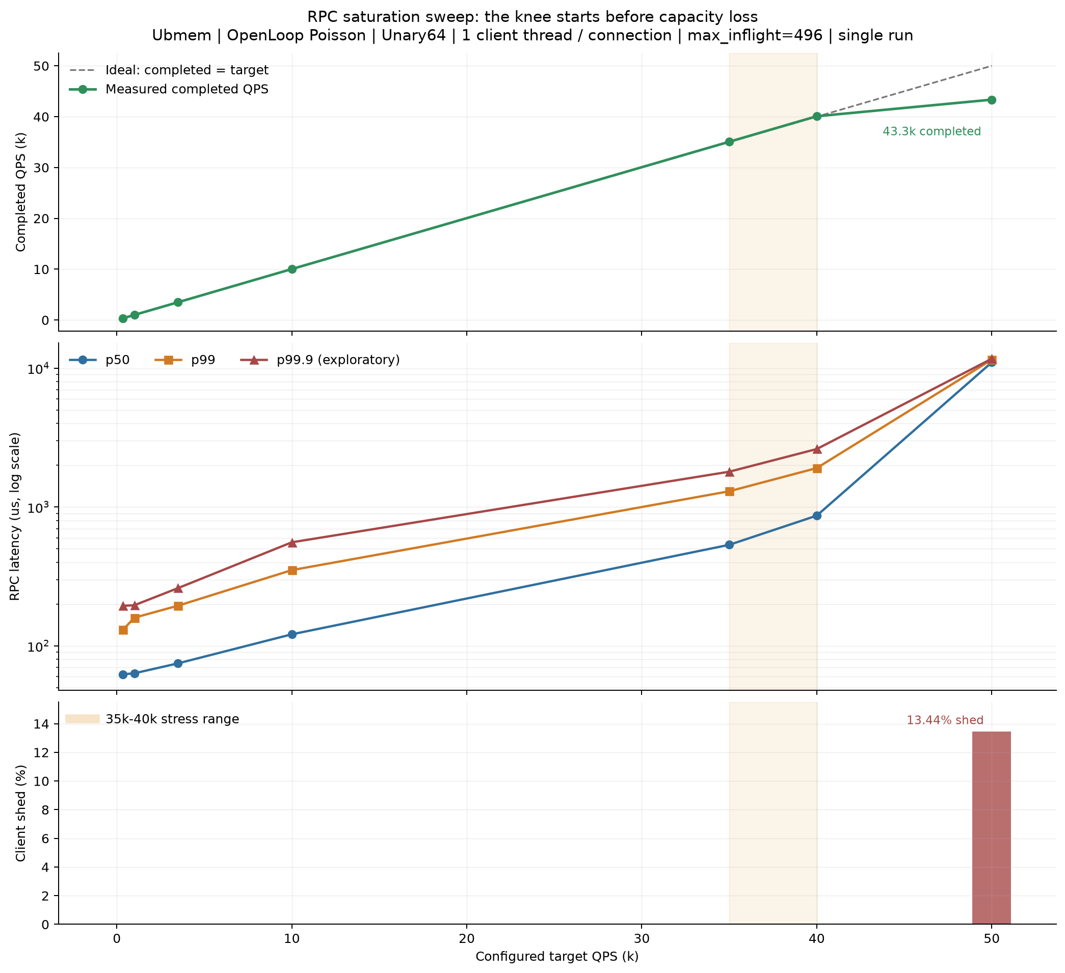
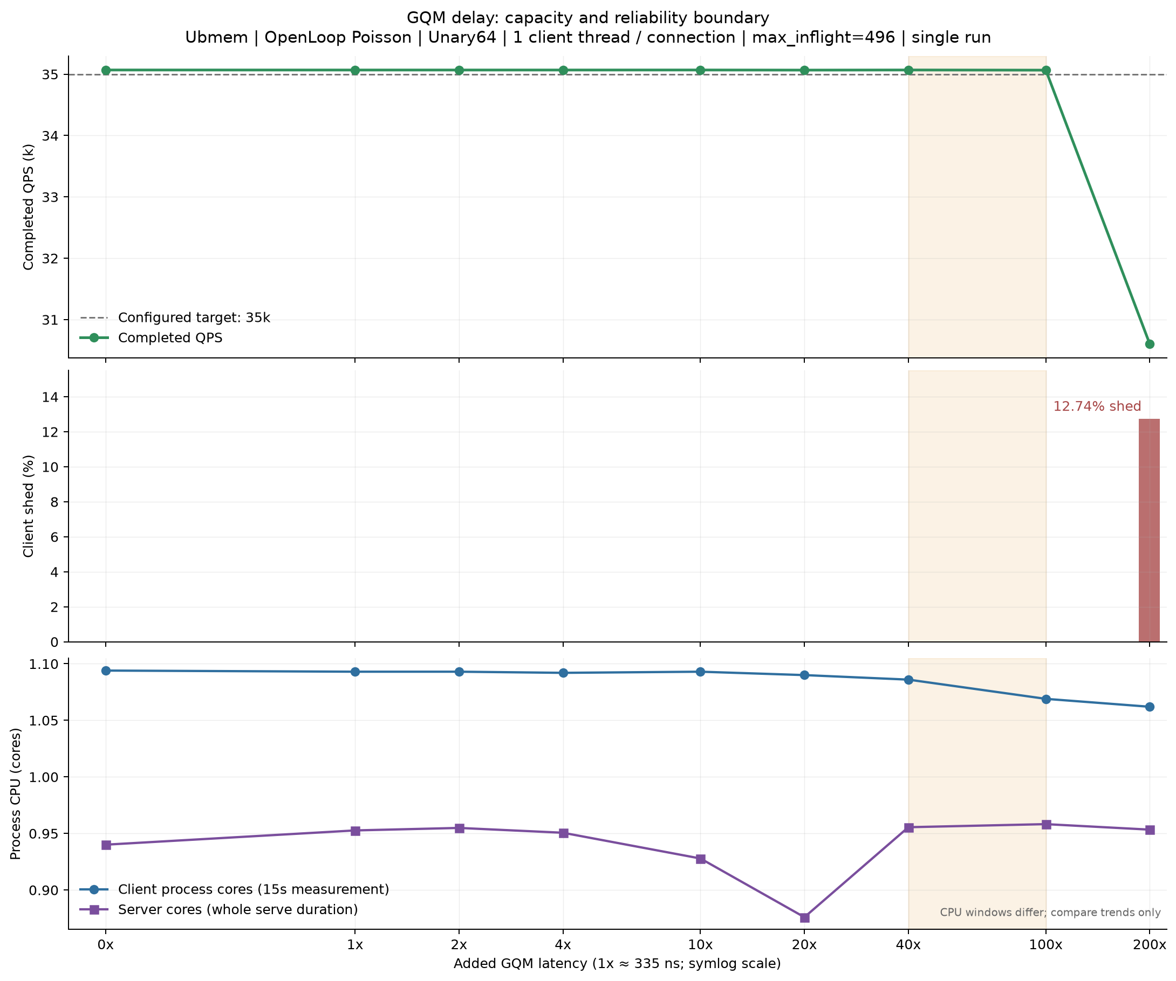
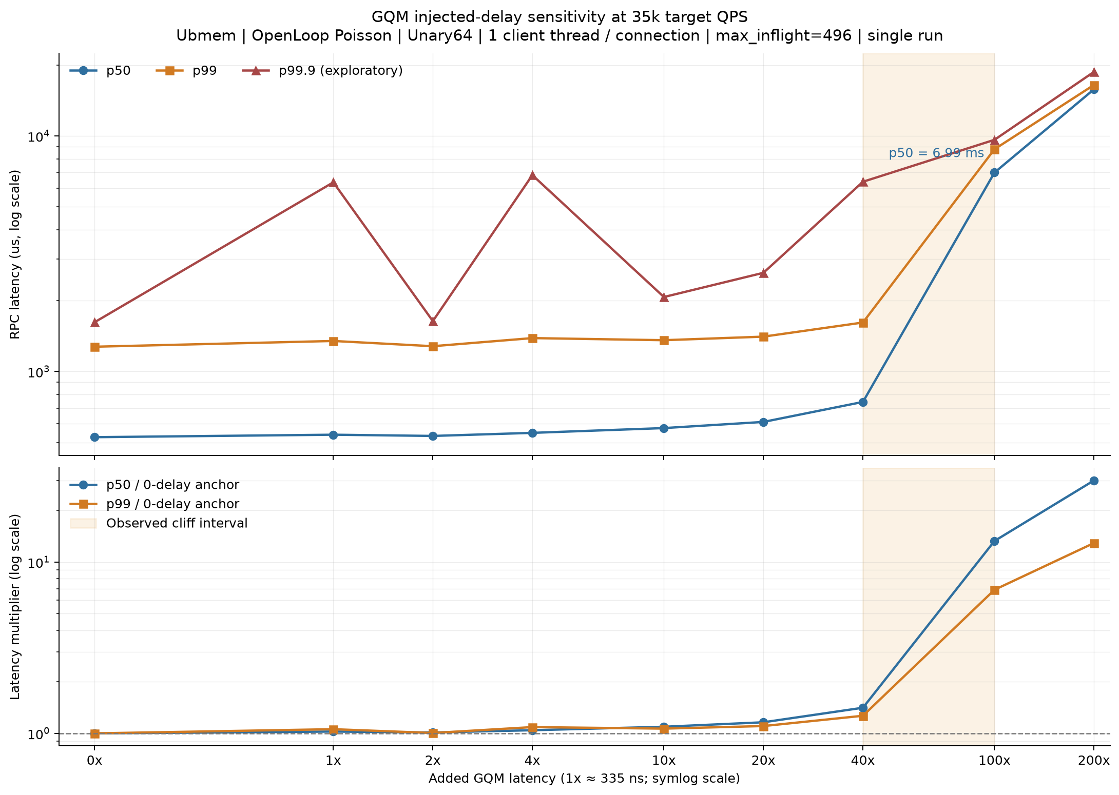
RPC Baseline QPS Sweep 与 35K Open-loop Delay Sweep
Unary64 · Poisson open loop · 35K target QPS · max_inflight=496 · server 1 IO + 1 CPU · single run / point
Sweep A · Baseline QPS
Sweep B · 35K Open-loop GQM delay
Latency
Capacity
Added
QPS
p50
p99
0x
35.07K
526 µs
1.274 ms
40x
35.07K
743 µs
1.615 ms
100x
35.07K
6.992 ms
8.784 ms
当前 35K envelope 中，100x 出现明显 latency 跳升；200x 同时出现 completed QPS 下降。
200x
30.60K
15.781 ms
16.473 ms
Source: gqm_injected_delay_sweep/README.md · EDR-0002
01

Slide 2
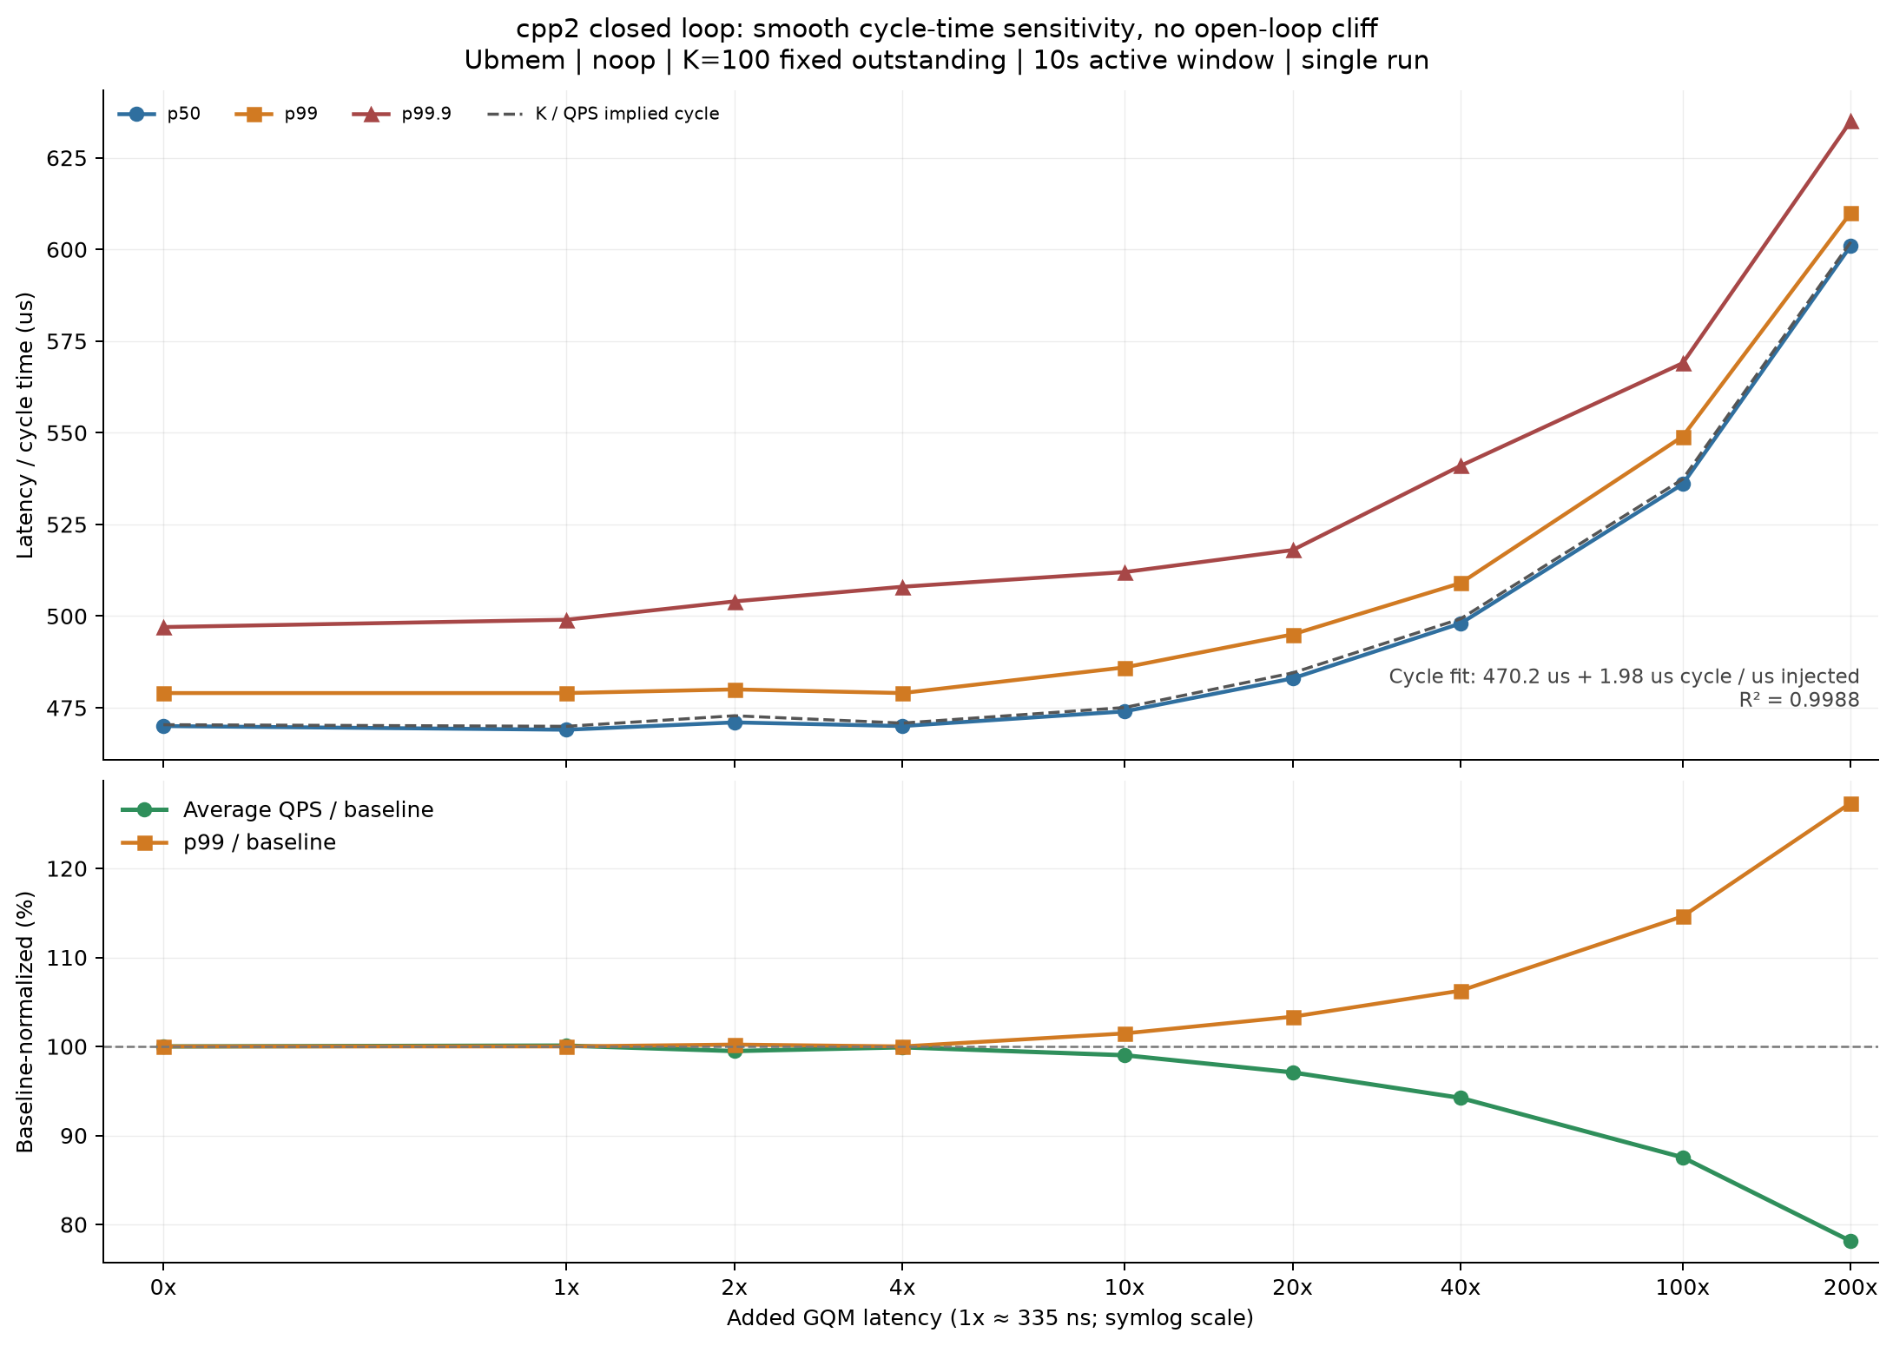
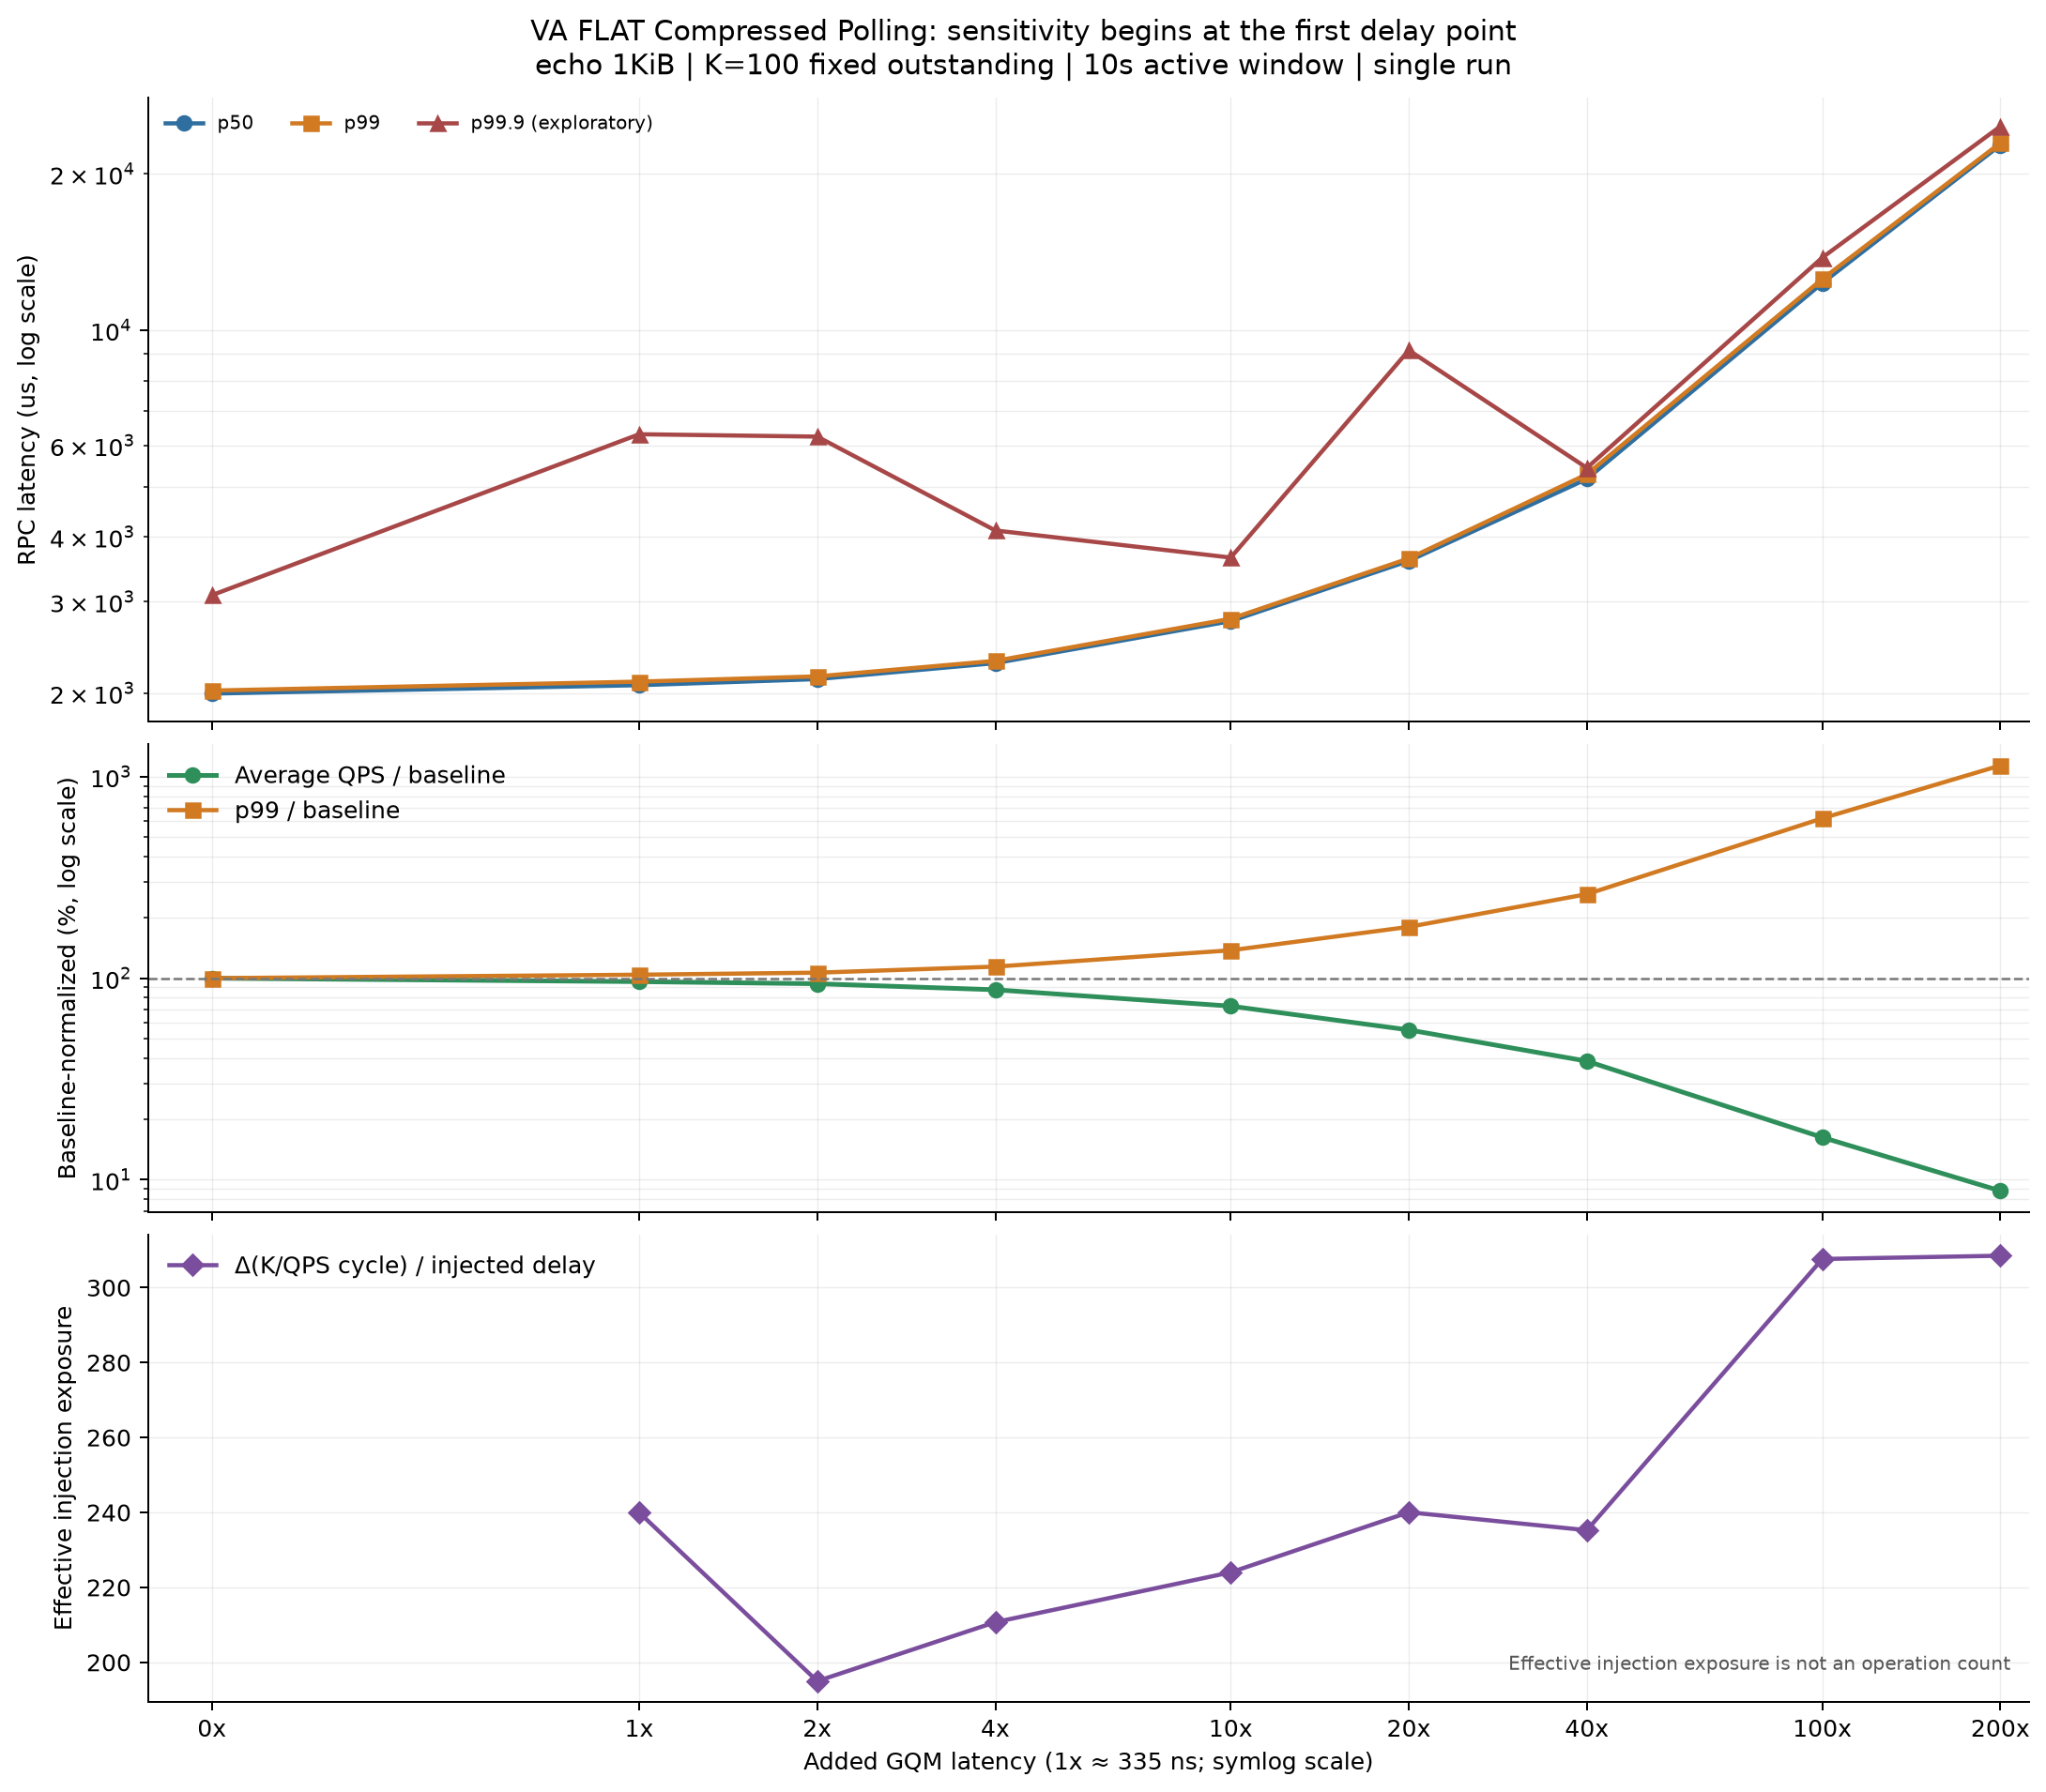
cpp2 与 VA FLAT Fixed-outstanding Delay Sweep
K=100 fixed outstanding · 0x–200x · 10 s active window · normalized within each path · single run / point
cpp2 noop · server 1 IO + 1 CPU
VA FLAT echo 1 KiB · server 1 IO + 0 CPU
Metric
0x
40x
100x
200x
Metric
0x
40x
100x
200x
QPS retained
100.00%
94.21%
87.54%
78.13%
QPS retained
100.00%
38.77%
16.23%
8.81%
p99 / base
1.000x
1.063x
1.146x
1.273x
p99 / base
1.000x
2.611x
6.208x
11.355x
两条路径对相同注入倍率呈现不同的 normalized QPS 与 p99 响应；workload 与 CPU 配置不同，不构成绝对性能 A/B。
Source: gqm_injected_delay_sweep/README.md · EDR-0003
02

Slide 3
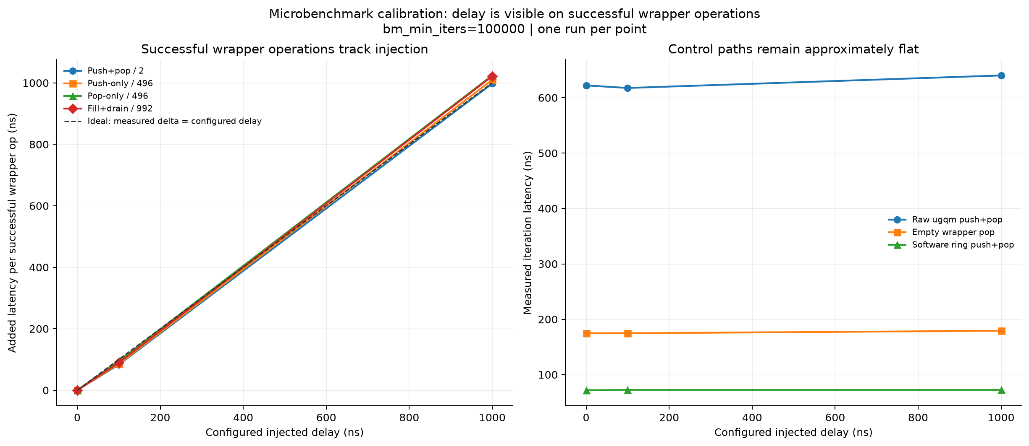
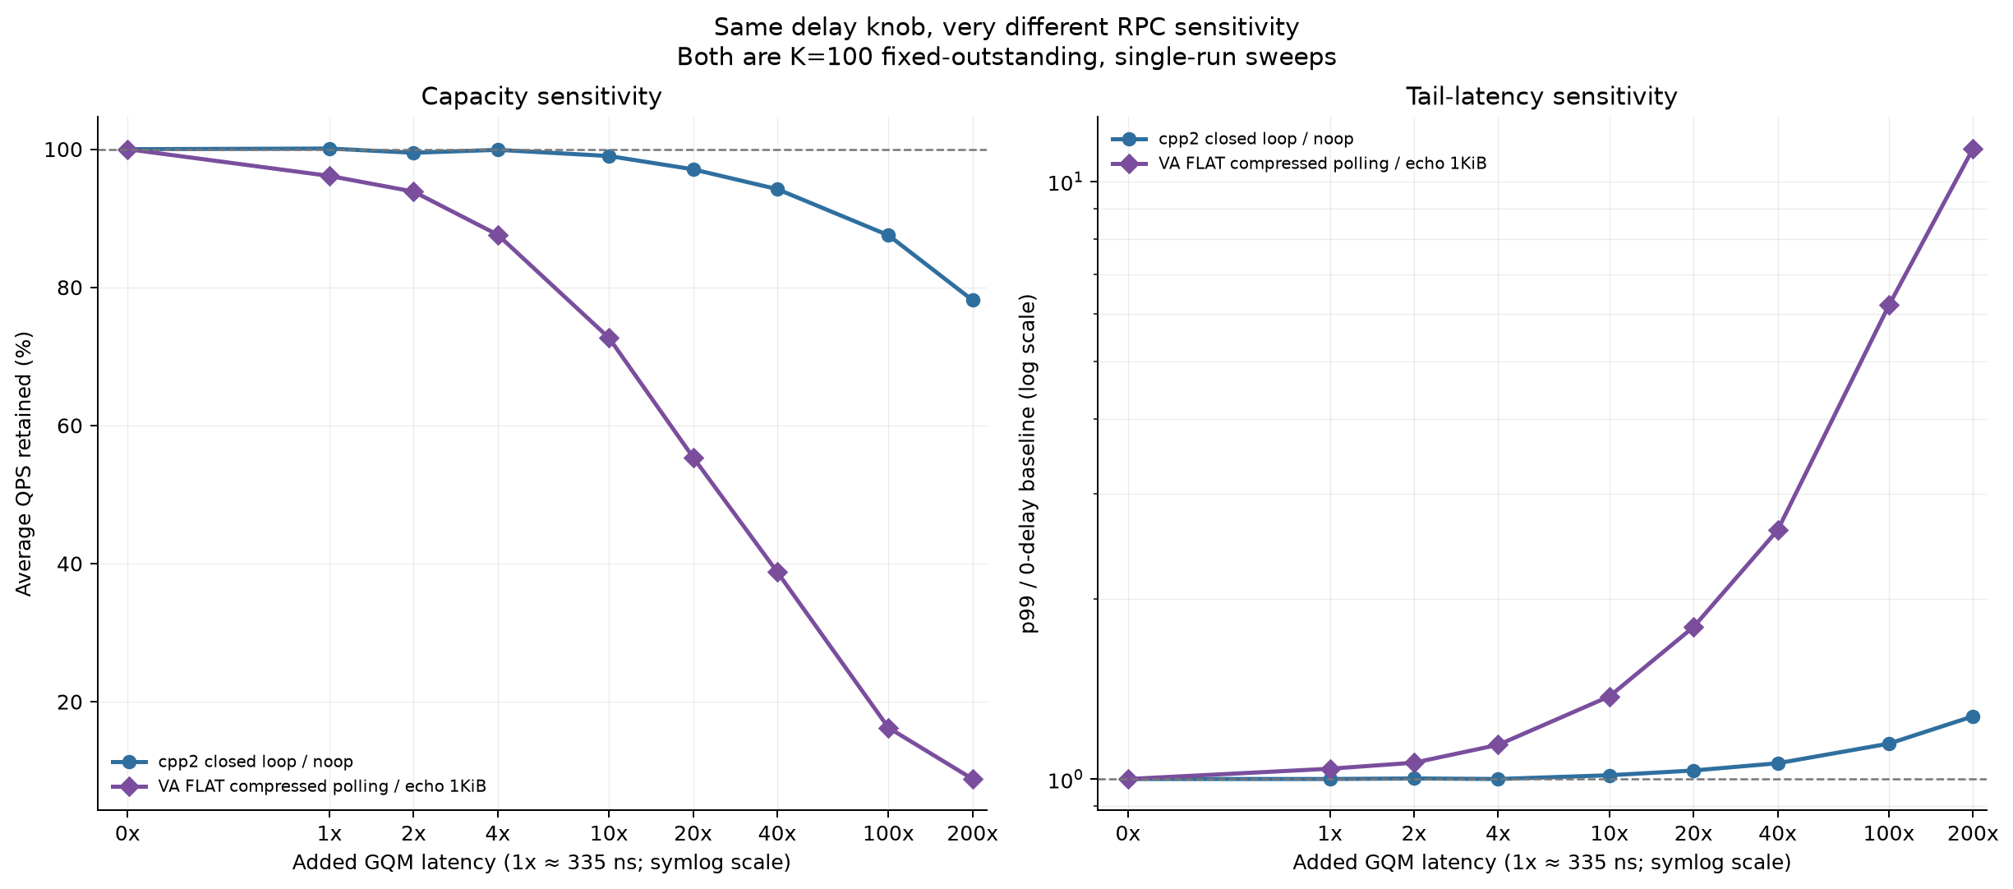
GQM Wrapper 注入校准
bm_min_iters=100000 · configured delay={0,100,1000} ns · successful wrapper operations normalized per operation
Microbenchmark calibration
Fixed-outstanding 结果对照
Benchmark
+100 ns
+1000 ns
push-only / 496
85.4 ns/op
1009.8 ns/op
pop-only / 496
95.0 ns/op
1024.1 ns/op
push+pop / 2
83.2 ns/op
997.7 ns/op
fill+drain / 992
89.5 ns/op
1021.8 ns/op
1 µs 配置约增加 1 µs / successful wrapper operation；effective exposure 是路径级敏感度指标，不是已测得的 operation count。
实验边界：每点单次运行；缺少 client/server 与 push/pop 分方向 counter。
Source: gqm_injected_delay_sweep/README.md · microbenchmark calibration
03

