Slide 1
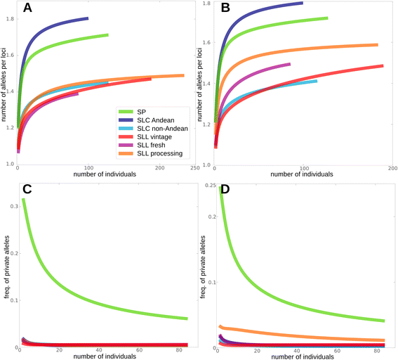
X-asis:
number of individuals/
Sample size/
g
Y-asis:
Number of alleles per loci/
Number of distinct alleles per loci/
R_output$column4
X-asis:
number of individuals/
Sample size/
g
Y-asis:
freq of private alleles/
Number of private alleles per loci/
C_output$column4

Slide 2
ADZE
Input
Paramfile
Datafile

Slide 3
Paramfile.txt
MAIN para
-g : max standard sample size
-Data_lines: # of rows of data in datafile (2N, N= # individual)
-Loci: # of loci
-NON_DATA_ROWS: # of rows should be ignored (1)
-NON_DATA_COLS:
-GROUP_BY_COL: <non_data_cols, the column which indicates the group
-DATA_FILE : name of the data file
-R_out
-P_out

Slide 4
Paramfile.txt
Combination para (for private allelic richness)
-COMB
-K_RANGE
-C_OUT

Slide 5
Paramfile.txt
Advanced para (for missing data)
-MISSING: how missing data represented
-TOLERANCE: largest allowed fraction of missing data at any given division for a locus, or be left out
-FULL_R
-FULL_P
-FULL_C
-PRINT_PROGRESS

Slide 6
Datafile
Structure format
1st line: non-data lines + locus names
2N lines:
Each individual is printed on two consecutive lines (diploid)

Slide 7
Structure

Slide 8
Genetic groups
SP
SLC Andean
SLC non Andean
SLL vintage
SLL fresh
SLL processing

