Slide 1
Backlink Explorer
Abdusamed Ahmed (Group 11)
Ming
Chi

Slide 2

Project Summary
To build an entire end to end point backlink explorer service with likes of commercial available solutions What is a backlink A URL pointing to another URL either INBOUND or OUTBOUND Existing solution are all pay-walled requiring month subscription

Slide 3
Milestone Status
Milestone | Description | Status
Milestone 1 | Build the web engine | REACHED
Milestone 2 | Efficient data structure for storage | REACHED
Milestone 3 | Port the data via API for Front-end | REACHED
Milestone 4 | Achieve High Concurrency via Akka | REACHED
Milestone 5 | Deploy on Cloud | -
Milestone 6 | Spam URL Detection | REACHED
Milestone 7 (Bonus) | Ranking Algorithm | -

Slide 4
Challenges Faced
Crawling million of URLs - concurrency
Processing the URLs data due to non uniform structures
Ideal data structure to use for storage, processing & retrieving
Acquiring data in real-time
User-Generated Content (UGC) proprietorship - Craiglit, GumTree
Detecting spam - URLs - Logistic Regression - body to auto generated URLs

Slide 5
High Level System Overview
User
Web Crawler
Spam Detection
Internet
Server
Database - Redis

Slide 6
Technology Stack
React
Front-end
Play Framework
REST-ful API + server
Back-end
Scala - crawler
Apache Spark
Spam detection
Redis
Database
Running all of them concurrently for a seamless, homogenous system

Slide 7
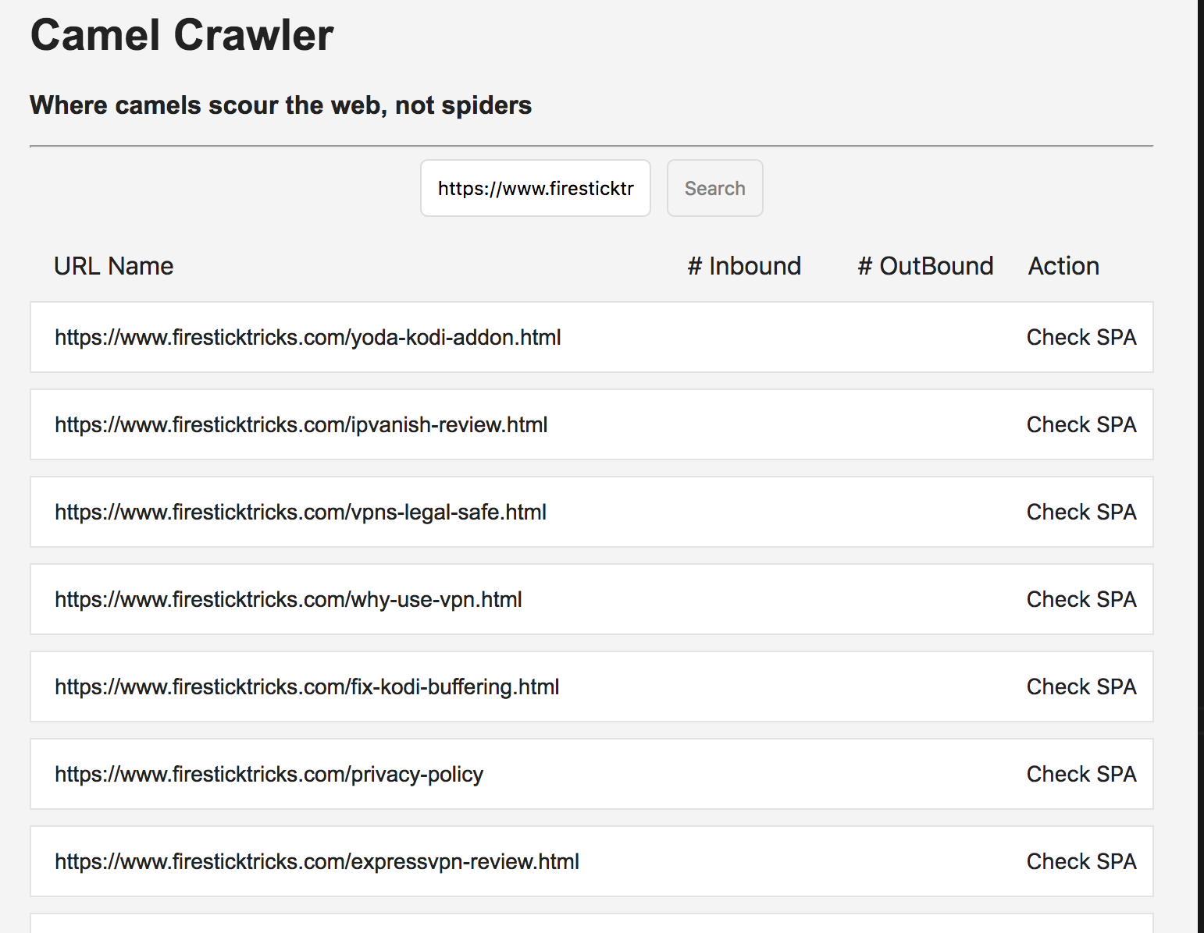
Front End (React)
Dynamically generated Table
User inputs URL to search -> searches through REDIS
Action allows to check if URL is Spam or not -> runs Spam detection
Interacts with back-end using REST-ful API

Slide 8
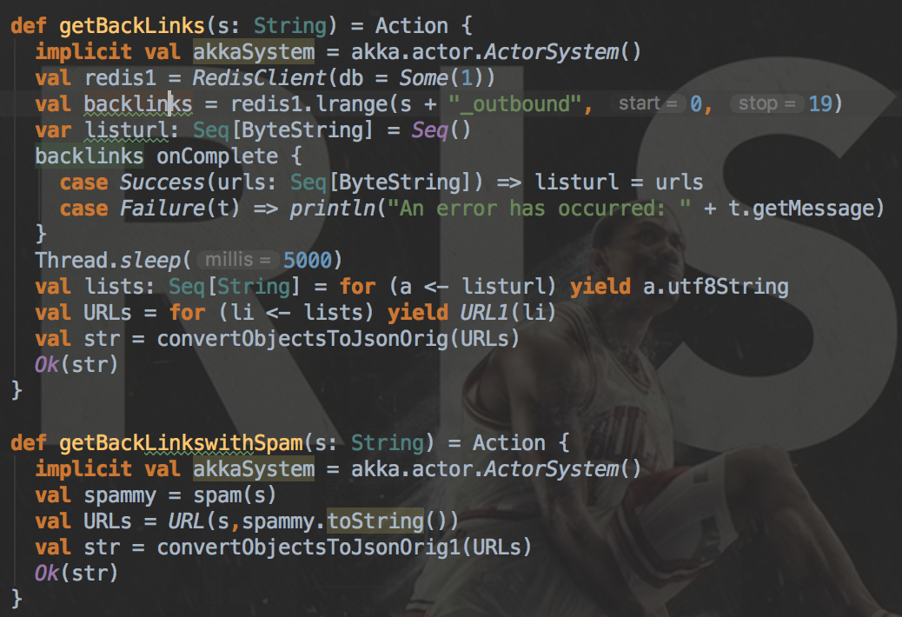
Play Framework
REST-ful Endpoints
Retrieve URLs for a query
Retrieve Spam score
Controller
Redis -> RESTful API -> REACT

Slide 9
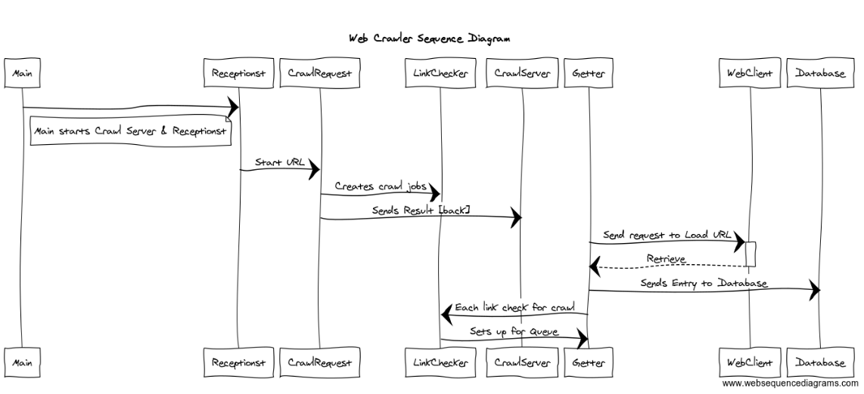
Back End

Slide 10

Redis
Redis-scala is a library build with AKKA for scala to connect to redis.
Redis is a non-relational database which takes fewer space than MYSQL and stores everything as string which is perfect for interacting front-end throw json.
Redis uses key-value pattern so we can retrieve the backlinks through it.
RedisGraph will be a better choice of dataset but it’s not supported on Scala.

Slide 11


Apache Spark (Spam URL Detection)
Machine learning method: LogisticRegression & Naive Bayes
Prediction
Training Data (30k URLs)
Test Data (18K URLs)
Model
Spam URL
Verified URL
Merge
LG & NB
User Input

Slide 12
Apache Spark (Spam URL Detection)
Accuracy
> target accuracy(70%)

Slide 13
Future Upgrades
REACT
DIsplay outbound & inbound links with animated charts
Visual upgrades such has Action Button changes to numerical values
User accounts to store user preferences e.g. ‘starred URLs” and much more
Crawler
Rotating proxies to avoid blacklist from CDNs e.g. DistilNetworks & Cloudfare
Implement headless browser Selenium to crawl JavaScript enabled websites
Tweaking crawler to avoid all footers links to avoid repetition
Back-end PlayFramework
More endpoints e.g. total inbound links, outbound links, ranking of URLs
Apache Spark
Use more metrics to improve the accuracy of the training model e.g. domain WHOIS info
REDIS
Implement Redis Sentinel for multiple instance of Redis cluster

Slide 14


