Slide 1
Sleep Hours and Melatonin
By J.Z

Slide 2
QUESTION: WHAT AFFECTS THE NUMBER OF HOURS I SLEEP
- Dependency on Melatonin
- Importance of understanding sleep patterns

Slide 3
Data Collection
- Utilizing Apple Health for tracking sleep hours (14 sample) (Nov.12-Nov.25)
- Incorporating regular melatonin supplementation
(Brand: Nature Made 10mg)
- Monitoring and recording sleep patterns

Slide 4

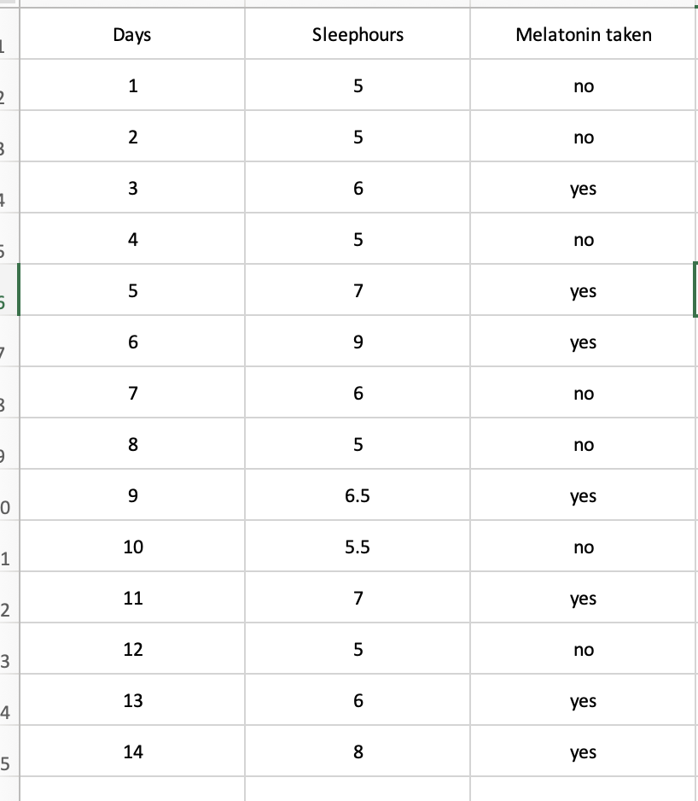
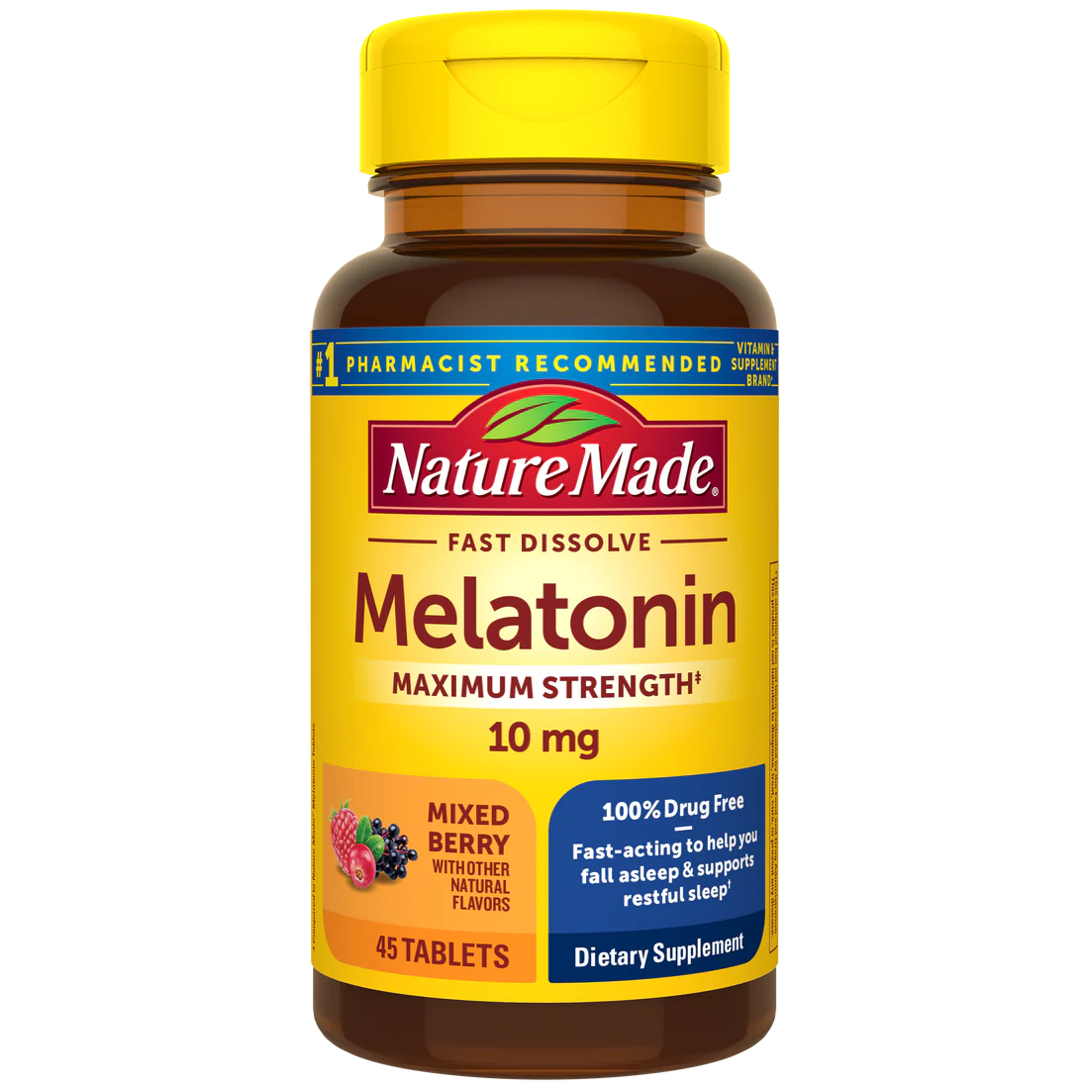
Data Collection
IV: Taken melatonin
(Yes/No)
DV: Hours of sleeping per day

Slide 5
T-test
- Establishing Null Hypothesis: No significant effect of melatonin on sleep hours
- Formulating Alternative Hypothesis: Melatonin significantly affects sleep hours
- Methodology for conducting: T-test

Slide 6
T-test Result
T = -4.2178
p-value = 0.003361
(Under 95% confidence interval)
Sample estimates:
Mean in group no mean in group yes
5.214286hrs 7.071429hrs

Slide 7
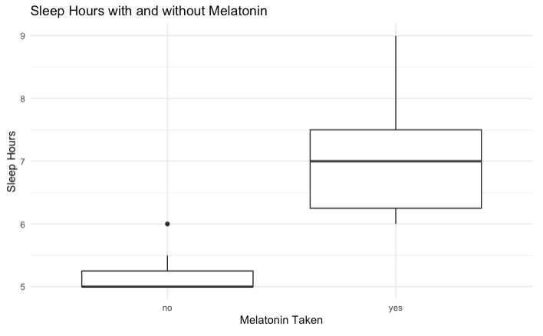
Conclusion
Since the P value is 0.003, which is less than 0.05, we are confident to say we reject the null hypothesis. It is clear to say that melatonin has an effect on the sleeping hours in a significant way.

Slide 8
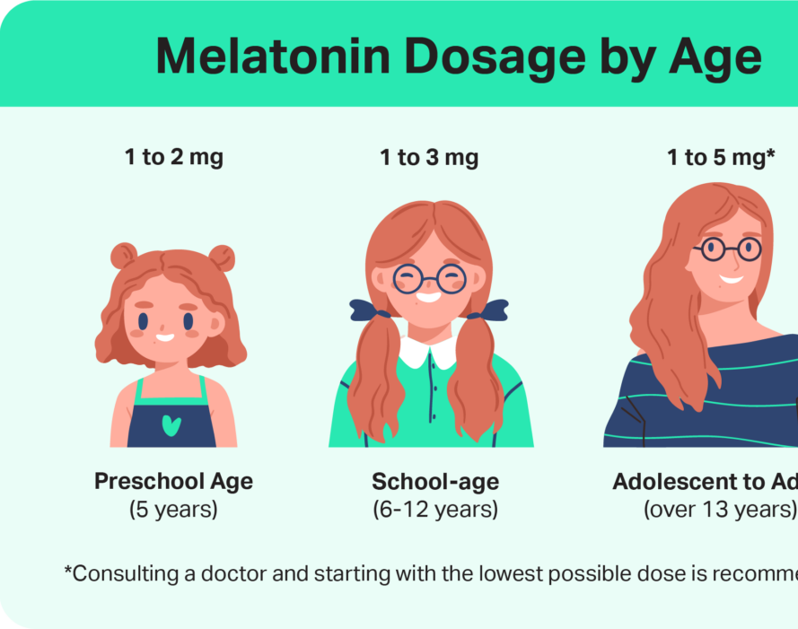
Caution: Side effect
Feeling sleepy or tired in the daytime
Headache.
Stomachache.
Feeling sick (nausea)
Feeling dizzy.
Feeling irritable or restless.
Dry mouth.
Dry or itchy skin.

Slide 9
Github link: https://github.com/jiamingz999/dataproject2023
Thanks for watching!
谢谢！

